Slide 1
The Database World of Azure
A Review of Azure’s Database Offerings
Steve Hughes, Director of Consulting
9/24/2019

Slide 2
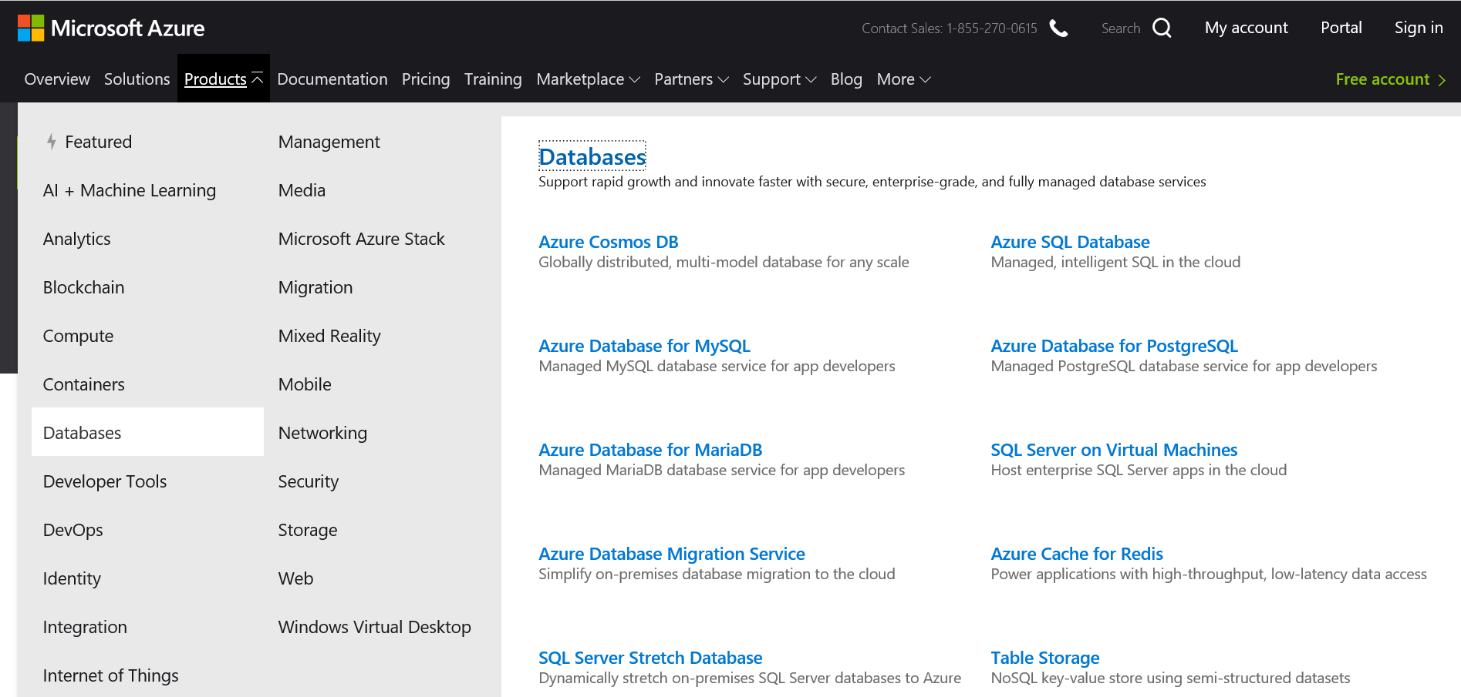
Origin of the Topic

Slide 3
Digging in to each offering
Purpose
Why would you choose to use this product?
What are common uses?
Platform
How is it delivered to you?
What are its strengths?
Pennies
How is it charged?
What does it cost

Slide 4
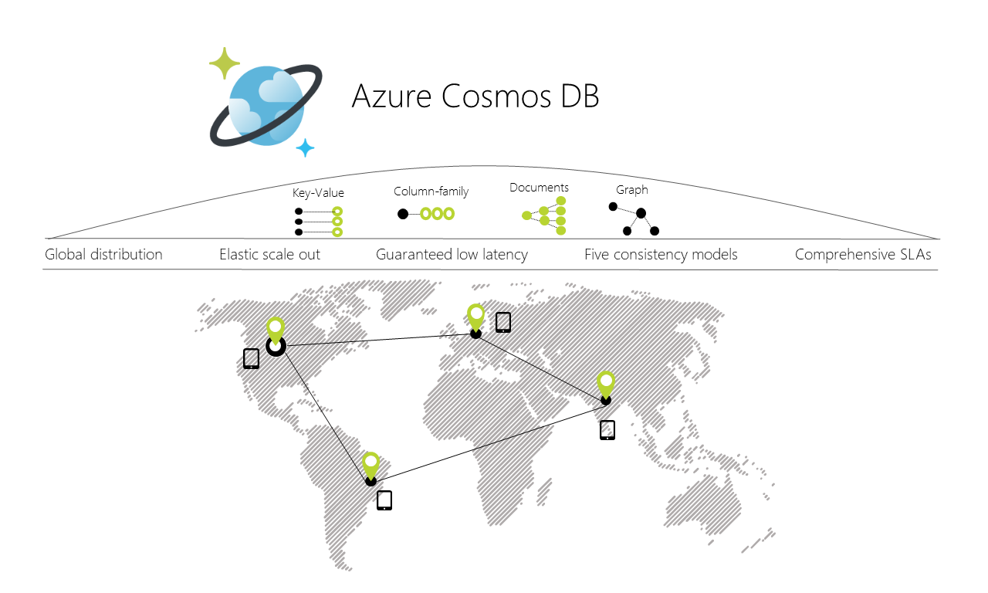
Azure Cosmos DB
Purpose | Platform | Pennies
Document database solution Low latency, globally scalable Supports Cassandra, MongoDB and similar solutions for migration NoSQL workloads Ideal for applications, gaming, and similar solutions Pragmatic Works has implemented this to support global logging in distributed data warehouse solutions | PaaS Significant Components Turnkey global distribution SLA backed low latency including up to 99.999% availability Scalability to meet demand with capacity – elastic and unlimited Multi-model support including Cassandra, MongoDB, SQL, Gremlin, Etcd, and Table | Throughput sold by RU/s – Request Units per second Provisioned Throughput - 100 RU/s Multiple region writes - $12/mo Single region writes - $6/mo Storage billed for each GB - $0.25/GB per month

Slide 5
Azure SQL Database
Purpose | Platform | Pennies
Great option for SQL Server database workloads Reduced learning curve for experienced SQL Server professionals Managed Instance is nearly 100% ready for any SQL Server on premises workload | PaaS Microsoft’s database platform including built in High Availability (HA) and backups Versionless solutions – never deal with upgrades again Elastic scalability Built in advanced security including online tools to track vulnerabilities Single database, elastic database and Managed Instance options | DTU (Data Transaction Units) Single and Elastic database options Merges costs of compute, memory and storage vCore Supports all options Choose cores and memory Add storage Additional costs to consider Backup storage Long term retention Active Geo-replication Advanced Threat Protection

Slide 6
Azure Database for MySQL
Purpose | Platform | Pennies
Migrate MySQL workloads to the cloud Support common open source solutions to the cloud including products such as Wordpress and Drupal One of the common database platforms used for open source and web based solutions | PaaS Managed community MySQL Database version (not a custom Azure version) Built on Microsoft’s relational database platform which has built in High Availability (HA) and backups Azure IP Advantage included to protect your solutions | 3 Pricing Tiers Basic General Memory optimized vCore pricing across all tiers with storage priced per tier Additional cost considerations Read replicas Backup storage Advanced Threat Protection

Slide 7
Azure Database for PostgreSQL
Purpose | Platform | Pennies
Migrate PostgreSQL and Oracle workloads to the cloud Commonly used with retail and eCommerce solutions | Community supported PostgreSQL distribution PaaS Built on Microsoft’s Database Platform which includes High Availability (HA) and backups Hyperscale performance with Citus Azure IP Advantage protection | Single Server Basic General Purpose Memory Optimized Hyperscale (PREVIEW) Per node pricing model Additional considerations Backup storage Read replicas Advanced Threat Protection

Slide 8
Azure Database for MariaDB
Purpose | Platform | Pennies
Migrate MariaDB solutions Ideal for eCommerce and retail solutions | PaaS Built on Microsoft’s Database Platform with built in High Availability (HA) and backups Community Edition supported (no custom Azure version) Support for elastic scaling as well | 3 Pricing Tiers Basic General Memory optimized vCore pricing across all tiers with storage priced per tier Additional cost considerations Read replicas Backup storage Advanced Threat Protection

Slide 9
SQL Server on Virtual Machines
Purpose | Platform | Pennies
Direct support for SQL Server in a model we use on premises today 100% compatibility with the on premises version Extended support for SQL Server 2008 on older Windows version | IaaS Premium Storage Build it out and manage it yourself – you are responsible to build out HA and backup solutions | Bring your own licenses Hybrid benefits Option to embed licensing into the VM – pay per use

Slide 10
Azure Database Migration Service
Purpose | Platform | Pennies
Simplify and accelerate your cloud data migration and planning Migrate from SQL Server on premises to SQL Server on Azure with an understanding of the best fit Online migration capabilities | Supports various migration plans from various sources to viable targets (e.g. Oracle to Azure Database for PostgreSQL) Sort of like a SaaS solution – you can start up a Service for free and use it for your migration Scenarios: SQL 2008 – Azure SQL MI Oracle – Azure PostgreSQL MySQL – Azure MySQL | $0 cost to use the service

Slide 11
Azure Cache for Redis
Purpose | Platform | Pennies
In-memory data store to improve the performance of applications Designed to support applications and database by providing a cost-effective in-memory caching solution Works with SignalR and similar frameworks | PaaS Backed by an open source Redis server, works with any Redis solution | 3 Tiers Basic Standard Premium Additional Consideration Geo-replication

Slide 12
SQL Server Stretch Database
Purpose | Platform | Pennies
Hybrid solution to stretch SQL Server to the cloud Use the cloud to manage data that may not be commonly used | PaaS + On Premises, truly Hybrid scenarios Works with SQL 2016 and above Seamless to users and easy to implement | Compute charged by DTU on Azure SQL DB Data storage priced separately

Slide 13
Table Storage
Purpose | Platform | Pennies
Key value pair store with high performance NoSQL solution | PaaS Supports OData-based queries Flexible schema Supports petabytes of data Part of the original set of storage options | Priced primarily by storage

Slide 14
Offering | Purpose | Platform | Pennies
Azure Cosmos DB | Document DB | PaaS/Global replication | RU/s + storage
Azure SQL Database | SQL Server on Azure | PaaS/Managed SQL Server | DTUs and vCore
Azure Database for MySQL | MySQL on Azure | PaaS/Managed MySQL Community Edition | vCore + storage
Azure Database for PostgreSQL | PostgreSQL on Azure | PaaS/Managed PostgreSQL Community Edition | vCore + storage
Azure Database for Maria DB | MariaDB on Azure | PaaS/Managed MariaDB Community Edition | vCore + storage
SQL Server on Virtual Machines | Like on premises | IaaS/Self-managed VM solutions including patching | VMs + licensing
Azure Database Migration Service | Migration optimization | SaaS/ “Wizard like functionality” | $0
Azure Cache for Redis | In-memory caching | PaaS | Capacity
SQL Server Stretch Database | Extend SQL to Azure | Hybrid/PaaS | DTU
Table Storage | Key Value Pair | PaaS | Storage

