Slide 1


Intro to Azure Data Factory
Data Flows

Slide 2
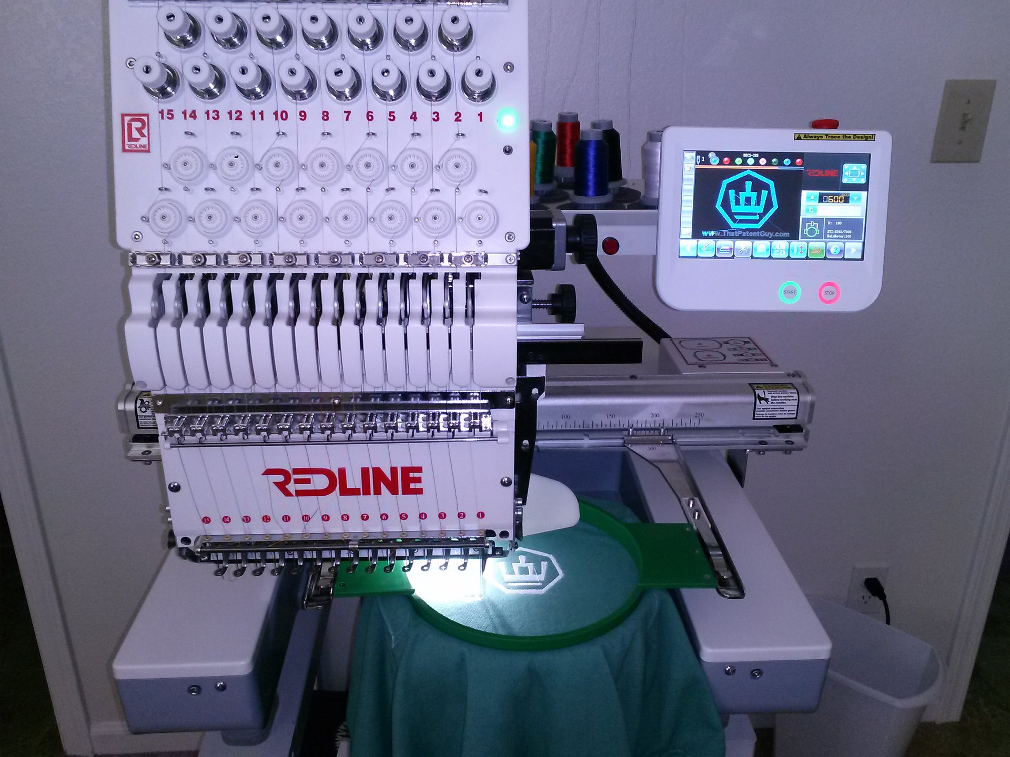


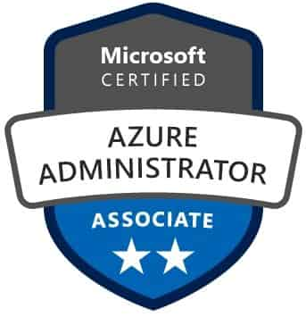
About Me
Senior BI Consultant with Pragmatic Works
Email: ALetourneau@PragmaticWorks.com
Twitter: @LadyRuna
20+ years focused on MSSQL Server as Developer/DBA
for financial and accounting software industries.
Microsoft Certified Azure Administrator Associate

Slide 3
Agenda
Data Flows vs Pipeline in ADF
What are Wrangling Data Flows
What are Mapping Data Flows
DEMO: Creating Data Flows
Which One Should I Use?

Slide 4
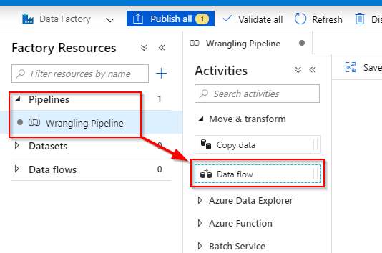
Data Flow vs Pipeline
Pipeline is a container for the Data Flow

Slide 5
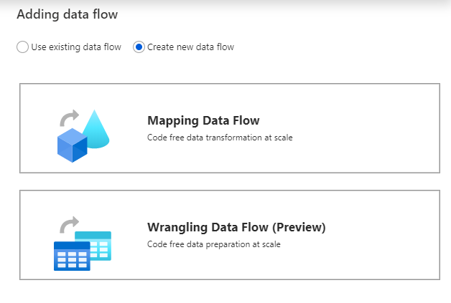
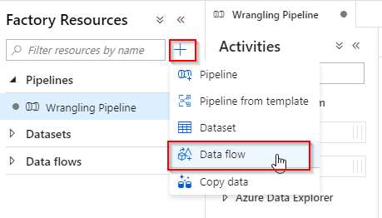
Creating Data Flow
Click on + next to Factory Resources and choose “Add Data Flow”
OR
Add Data Flow Activity to Pipeline

Slide 6

Mapping Data Flows

Slide 7
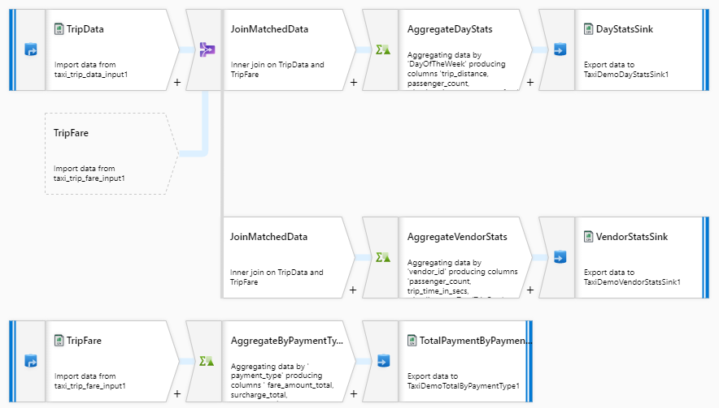
What is a Mapping Data Flow?

Slide 8
Mapping Data Flow Sources and Sinks
Source | Restrictions
Azure Blob Storage | JSON, Avro, Text, Parquet
Azure Data Lake Storage Gen1 | JSON, Avro, Text, Parquet
Azure Data Lake Storage Gen2 | JSON, Avro, Text, Parquet
Azure Synapse Analytics
Azure SQL Database
Azure CosmosDB

Slide 9
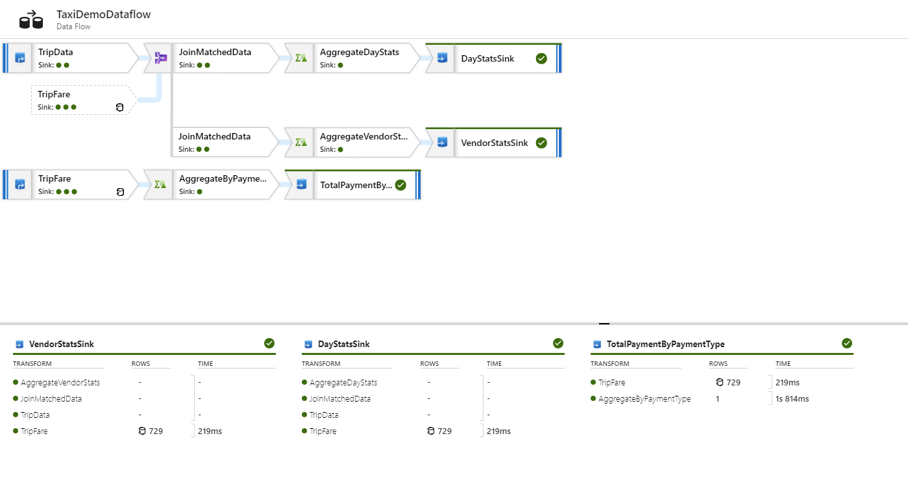
Mapping Data Flow – Feels like SSIS

Slide 10
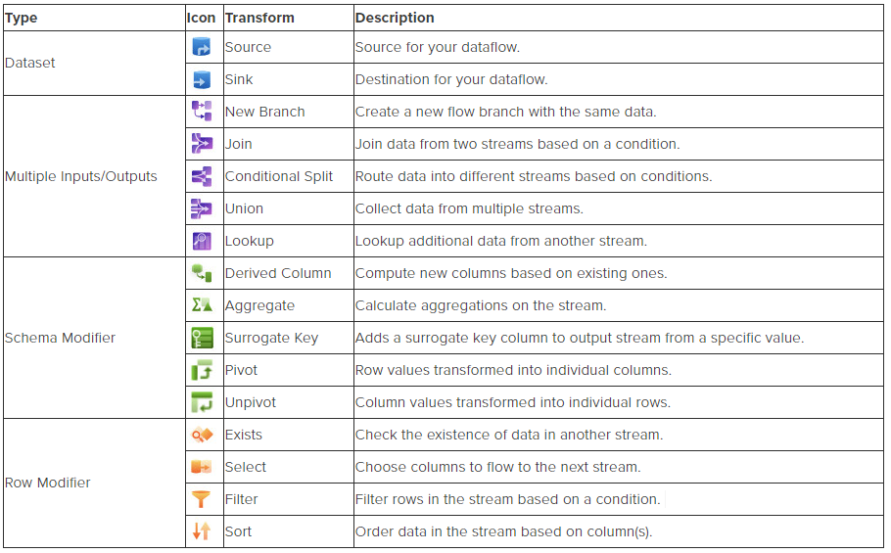
Mapping Data Flow Transformations

Slide 11

Wrangling Data Flows

Slide 12
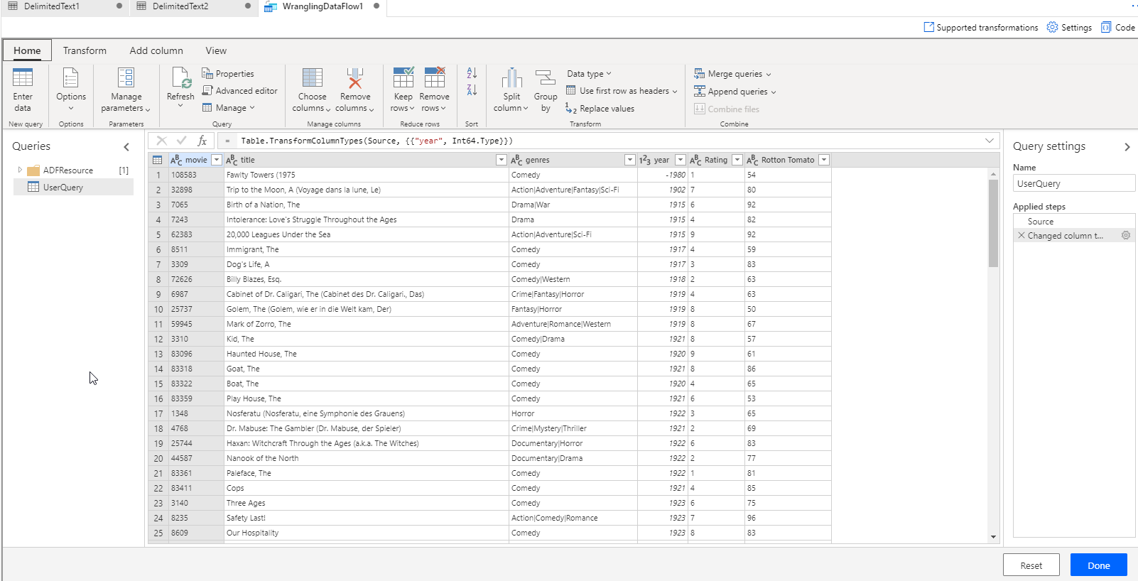
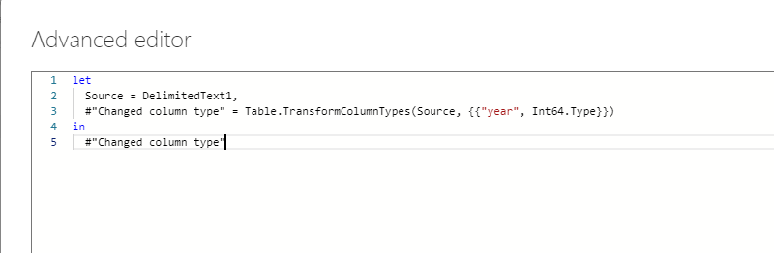
What is a Wrangling Data Flow?

Slide 13
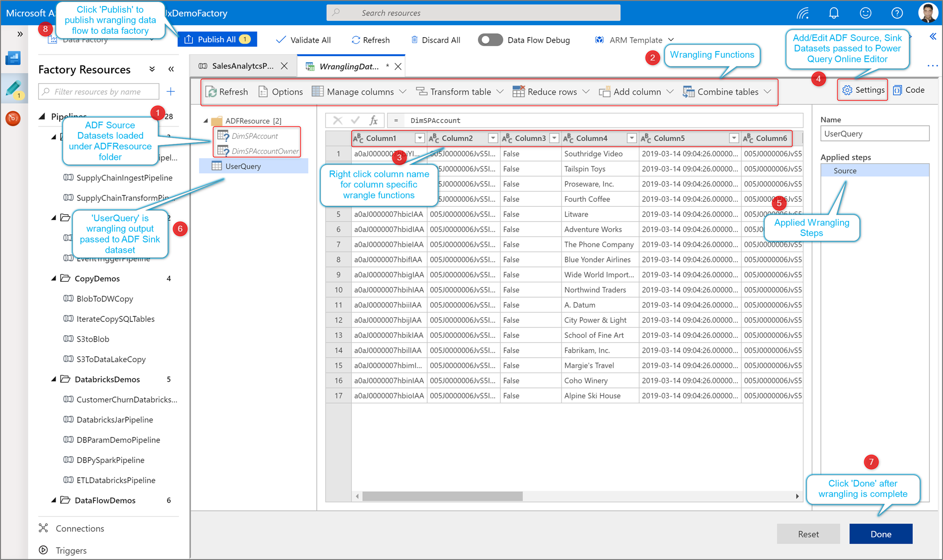
What is a Wrangling Data Flow?
From: https://docs.microsoft.com/en-us/azure/data-factory/wrangling-data-flow-tutorial

Slide 14
Wrangling Data Flow Sources and Sinks
Source | Restrictions | Authentication
Azure Blob Storage | CSV, Parquet | Account Key
Azure Data Lake Storage Gen1 | CSV | Service Principal
Azure Data Lake Storage Gen2 | CSV, Parquet | Account Key, Service Principal
Azure SQL Database |  | SQL Authentication
Azure CosmosDB |  | SQL Authentication

Slide 15
Wrangling Data Flow Restrictions
Availability limited to Data Factories in 14 regions
Perform all transformations on the UserQuery
Renaming, adding, and deleting queries is not supported
Can only write to ONE sink
Not all M Query functions are supported

Slide 16



DEMO TIME!

Slide 17

Wrangling or Mapping?
Notes:
It DEPENDS…..

Slide 18
Wrangling or Mapping?
Wrangling Data Flows
Prepare and Explore Data
Focused on the Data
Mapping Data Flows
Transform Data
Focused on Data Flow

Slide 19
Wrangling or Mapping?
Both have
  Similar sets of Sources & Sinks
  Similar sets of transformations
Combine for best of both worlds
  Clean & Prepare – Wrangling DF
  Load into Dimensional Model – Mapping DF

Slide 20
Wrangling Data Flow - Resources
https://docs.microsoft.com/en-us/azure/data-factory/wrangling-data-flow-overview
https://docs.microsoft.com/en-us/azure/data-factory/wrangling-data-flow-tutorial
https://docs.microsoft.com/en-us/azure/data-factory/wrangling-data-flow-functions
https://github.com/gauravmalhot/wranglingdataflow
Notes:
Last one includes FAQ listing supported regions – current list is limited (no Central US yet)

Slide 21
Mapping Data Flow - Resources
https://github.com/SQLPlayer/CheatSheets/blob/master/ADFDF-Cheat-Sheet-sqlplayer.pdf
https://github.com/kromerm/adfdataflowdocs/blob/master/patterns/adfdataflowlinks.md
https://kromerbigdata.com/
https://docs.microsoft.com/en-us/azure/data-factory/data-flow-transformation-overview
Notes:
The ADF Data Flow Cheat Sheet has excellent comparison between SSIS / SQL vs Mapping Data Flow.

Slide 22

HEY!
Did you turn off Data Flow Debug?!??
Remember:
Data Flow Debug is an active Spark cluster which incurs costs for use.
The debug session has a default minimum of 60 minutes of billing time, unless it is manually switched off.
Save money by always manually shutting down the Data Flow Debug when finished working.
Notes:
Nermal the Dragon Nerd is checking on me!

Slide 23
Questions?
Hope you enjoyed the Webinar!

