Slide 1
Power BI dataflows
Beginners Guide to dataflows in Power BI

Slide 2
Hello, my name is…
Erin Ostrowsky
BI Consultant & Technical Trainer
Writer/Creator/Traveler
LinkedIn: Erin Ostrowsky
eostrowsky@pragmaticworks.com
Blog: Data-radiant.com
Twitter: @RadiantData

Slide 3
AGENDA
BIG PICTURE:
What’s the problem in self-service BI? Why dataflows?
Who uses dataflows in Power BI?
FOCUS:
How can an analyst use dataflows?
How do I create a dataflow?
Notes:
First, we’re going to go over what a power bi dataflow is, who uses dataflows, and why you would use dataflows to begin with.
We’re going to cover creating and using dataflows as well as the extensibility of Azure products in combination with Dataflows.
We’ll also be going over some best practices, tips, and tricks when it comes to using Dataflows.

Slide 4
Who uses dataflows?
Citizen Developers
IT/Enterprise Developers
Creation vs. Consumption
Licensing & Strategy
Notes:
Licensing
1. Need a license bc it uses existing capacities, not for free/tral users
2. Licensing disparities bt Premium and Pro: Storage, Linked & Computed Entities, Incremental Refresh, Parallel Executions
**Note: we will be doing all Demos using a Premium license.**
3. Available for Pro → Explain Use Cases although limited may be valuable
Citizen Developers = Same target persona
Roles: Creation vs. Consumption
Data Wrangler vs. Analyst
IT/Developers

Slide 5
What’s the problem with self-service BI?
Gaps in data preparation process
Need for standardized ETL in self-service BI process
Need for Re-usable data
Need for greater extension of data capabilities – ML, AI, etc.
Notes:
Gaps in data preparation process
Need for standardized ETL
Need for Re-usable data
Need for greater extension of data capabilities

Slide 6
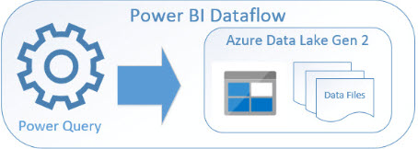
What are dataflows – and how do they solve our problem? Hint: Power Query for the Web
Reports & Dashboards – Vis.
Datasets – Data models
Dataflows – Self-service ETL
Storage – Data (ADLSv2)
Gateways and connectors
Dataflows bridge the data prep gap
Notes:
Dataflows bridge the data prep gap
Standardized ETL
Re-usable & Extensible
Power Query for the web
“Self-service data warehousing”
Leverages the cloud
Leverages ADLSv2 & CDM

Slide 7
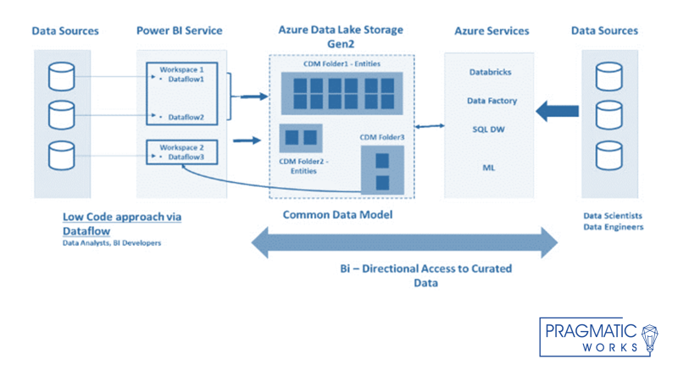
Notes:
How CDM and dataflows work together
Go over model left to right → process
Then explain “bi-direction access to curated data”
Third scenario: add your CDM-folders as a dataflow
Premium feature only
Add your own data lake

Slide 8
Dataflows Use Cases for the Analyst
Re-use: One Power Query table in multiple Power BI Reports
E.g. Date table, Product table
Benefit: Any additional transformations are consistent at the source, not made per .pbix file
Notes:
Licensing
1. Need a license bc it uses existing capacities, not for free/tral users
2. Licensing disparities bt Premium and Pro: Storage, Linked & Computed Entities, Incremental Refresh, Parallel Executions
**Note: we will be doing all Demos using a Premium license.**
3. Available for Pro → Explain Use Cases although limited may be valuable
Citizen Developers = Same target persona
Roles: Creation vs. Consumption
Data Wrangler vs. Analyst
IT/Developers

Slide 9
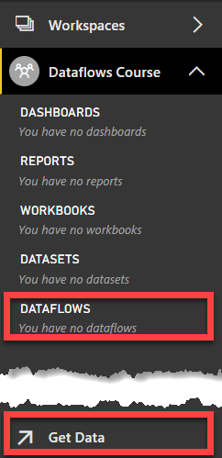
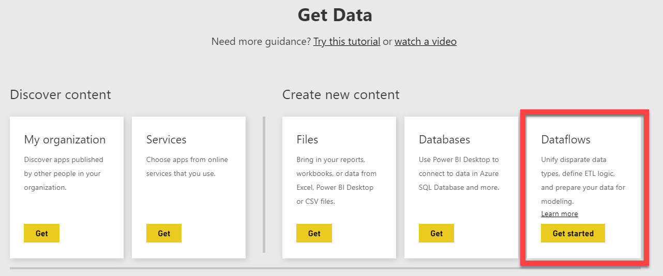
How to Create a Dataflow
Modle 1
Power BI Service = Cloud only
Workspace Dependent
My Workspace
Admin enabled
Online Power Query
Not all transforms available in GUI
Copy/paste M Code option
Notes:
Dataflows are cloud service only – currently not available for report server users.
You can create a dataflow inside of any workspace you have Edit access to within your organization, EXCEPT “My Workspace”.
To create a Dataflow, we utilize the “Get Data” button that is located within the workspace.
If you’re used to working within Power BI, Get Data has a very different functionality here.
In Get Data, you can discover and utilize apps published by other people in your organization, upload previously built Power BI Reports, load spreadsheets as workbooks, connect to certain databases like Azure SQL DB, but what we are focused on here is creating a Dataflow. Again, if you’re not seeing the Dataflow section, you must be in a Workspace other than “My Workspace”.

Slide 10
Module 1
Introducing Dataflows in the Power BI Service

Slide 11
What are entities?
PBI Desktop vs. PBI Service
Computed Reference & Enable Load to perform transforms on data residing in dataflow storage…. Think about branches of transformations, e.g. Data Call Center → Service Calls, Complaints, Leads, etc.
Linked – Reuse other entities without data maintenance (not a copy or duplicate); READ-ONLY; Auto refresh if in same workspace, but not different
Custom vs. Standard
Notes:
PBI Desktop vs. PBI Service
Entities are tables, essentially.
Desktop = all entities called the same even if Lists, Records, Tables, etc.
Service w dataflows, diff types of entities distinguished
Computed
Similar to a Reference table in PBI Desktop, except diff functionality loading data from sources
Computed entities are good for creating another branch of data transformation through another entity.
Used for aggregation like grouping → subset of data
The original query extracts data from the data source – applies data transformations, loads into ADLSv2. The second query – the computed entity – will NOT extract data from the data source. The computed entity will extract data from the result of the original table in the Azure data lake, and then apply transformations on it. ** The transformations of Computed Entity will apply on the data that seats in the dataflow section of azure data lake storage, not on the data source.**
B) The original source query MUST be set as Enable load or it’s not considered a computed entity (bc of how output is structure in ADLSv2)
C) Premium-only feature
Linked
Let’s say you do not want to do another set of transformations.
You want to just get a copy of the same entity that you have in another dataflow, in this dataflow as part of this data mart.
You may not want to make any data transformation at all, just a mere copy, or let’s say just a link. This type of entity is called a Linked Entity.
You cannot apply any data transformation on a Linked Entity. A Linked entity is just a link to the original entity, which is an entity in another dataflow. If you want to change the transformation, you have to go to the original query and change it.
Premium-only feature
Custom vs. Standard
Mapped to CDM = Standard
Non-mapped to CDM = Custom

Slide 12
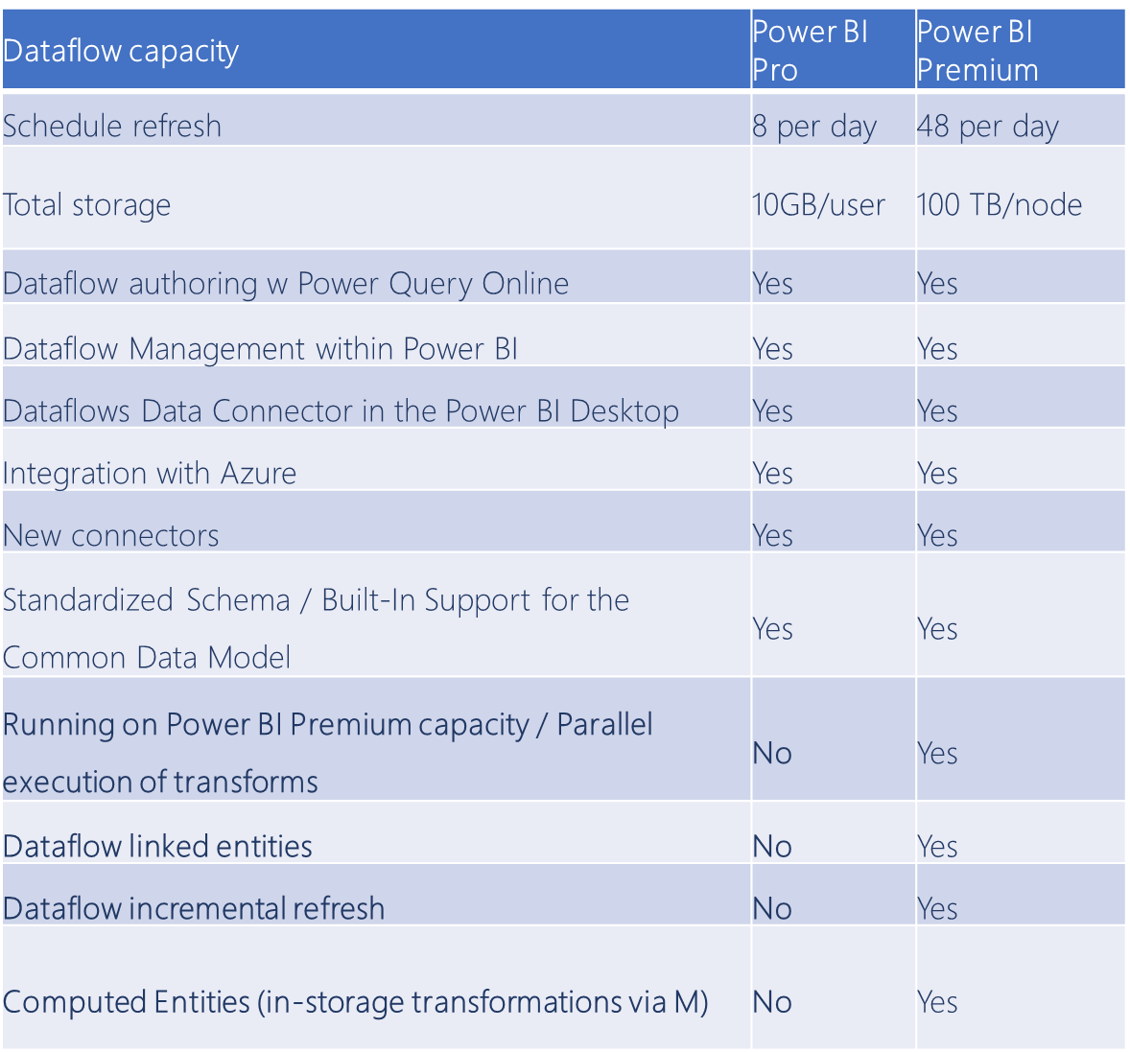
Important Considerations

Slide 13
Dataflows Use Cases for the Analyst
ETL flexibility: Decoupling the Power Query Editor (ETL) work from reporting
E.g. Experienced analyst needs to make numerous specific transformations on independent schedule from consultant
Benefit: Flexibility across teams; Interdependence
Notes:
Licensing
1. Need a license bc it uses existing capacities, not for free/tral users
2. Licensing disparities bt Premium and Pro: Storage, Linked & Computed Entities, Incremental Refresh, Parallel Executions
**Note: we will be doing all Demos using a Premium license.**
3. Available for Pro → Explain Use Cases although limited may be valuable
Citizen Developers = Same target persona
Roles: Creation vs. Consumption
Data Wrangler vs. Analyst
IT/Developers

Slide 14
Dataflows Use Cases for the Analyst
AI/ML in PBI: Leverage custom and out-of-the box ML/AI opportunities
E.g. Marketing wants to run self-service Sentiment Analysis on social media posts
Benefit: Self-Service AI; Team Interdependence sharing ML models
Notes:
Licensing
1. Need a license bc it uses existing capacities, not for free/tral users
2. Licensing disparities bt Premium and Pro: Storage, Linked & Computed Entities, Incremental Refresh, Parallel Executions
**Note: we will be doing all Demos using a Premium license.**
3. Available for Pro → Explain Use Cases although limited may be valuable
Citizen Developers = Same target persona
Roles: Creation vs. Consumption
Data Wrangler vs. Analyst
IT/Developers

Slide 15
Module 1
Sentiment Analysis on Survey Data using Dataflows in the Power BI Service

Slide 16
What is the Common Data Model?
Standard schema definitions and metadata system
Facilitate data integration and interoperability
Supported in CDS, Dynamics 365, PowerApps, Power BI… and increasingly, Azure data services
Notes:
Facilitates data interoperability
Part of bigger picture Open Data Initiative w/ Adobe, SAP and Microsoft
Part of greater ecosystem
Effort to create unified semantic meaning and understanding across data, apps, services, etc.

Slide 17
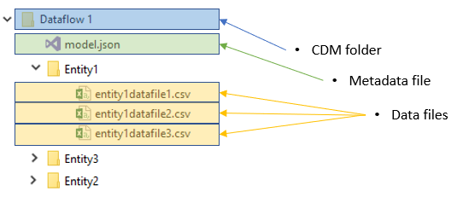
What is a CDM-compliant folder?
Data + metadata stored in CDM-compliant folders in ADLSv2
Notes:
Data ingestion from variety of sources stored in CDM-compliant folders
CDM folder = folder w data and metadata files
Metadata = model.json
Data files = .csv
Azure Data Lake Storage Gen2
Object storage + File System
Think of file storage as a warehouse. When you first put a box of files in there, it seems like you have plenty of space. But as your data needs grow, you’ll fill up the warehouse to capacity before you know it. Object storage, on the other hand, is like the warehouse, except with no roof. You can keep adding data infinitely – the sky’s the limit.
helps speed your transition from proof of concept to production by combining the power of a file system an integrated hierarchical namespace, and the massive scale and economy of Azure Blob Storage.

Slide 18
FAQ Check
Q: Do I still need a data warehouse if I use dataflows?
A: If you needed a data warehouse before Power BI dataflows, you probably still need a data warehouse. Although dataflows serve a similar logical function as a data warehouse or data mart, modern data warehouse platforms provide capabilities that dataflows do not.
Source credit: Matthew Roche, Senior Program Manager
Notes:
PBI Desktop vs. PBI Service
Entities are tables, essentially.
Desktop = all entities called the same even if Lists, Records, Tables, etc.
Service w dataflows, diff types of entities distinguished
Computed
Similar to a Reference table in PBI Desktop, except diff functionality loading data from sources
Computed entities are good for creating another branch of data transformation through another entity.
Used for aggregation like grouping → subset of data
The original query extracts data from the data source – applies data transformations, loads into ADLSv2. The second query – the computed entity – will NOT extract data from the data source. The computed entity will extract data from the result of the original table in the Azure data lake, and then apply transformations on it. ** The transformations of Computed Entity will apply on the data that seats in the dataflow section of azure data lake storage, not on the data source.**
B) The original source query MUST be set as Enable load or it’s not considered a computed entity (bc of how output is structure in ADLSv2)
C) Premium-only feature
Linked
Let’s say you do not want to do another set of transformations.
You want to just get a copy of the same entity that you have in another dataflow, in this dataflow as part of this data mart.
You may not want to make any data transformation at all, just a mere copy, or let’s say just a link. This type of entity is called a Linked Entity.
You cannot apply any data transformation on a Linked Entity. A Linked entity is just a link to the original entity, which is an entity in another dataflow. If you want to change the transformation, you have to go to the original query and change it.
Premium-only feature
Custom vs. Standard
Mapped to CDM = Standard
Non-mapped to CDM = Custom

Slide 19
FAQ Check
Q: Do I need dataflows if I already have a data warehouse?
A: Dataflows fill a gap in data warehousing and BI tools by allowing business users and analysts to prepare and share data without needing help from IT. With dataflows, users can build a “self service data mart” in Power BI that can be used in their solutions. Because each dataflow entity is defined by a Power Query “M” query, handing off the definitions to an IT team for operationalization/industrialization is more straightforward.
Source credit: Matthew Roche, Senior Program Manager
Notes:
PBI Desktop vs. PBI Service
Entities are tables, essentially.
Desktop = all entities called the same even if Lists, Records, Tables, etc.
Service w dataflows, diff types of entities distinguished
Computed
Similar to a Reference table in PBI Desktop, except diff functionality loading data from sources
Computed entities are good for creating another branch of data transformation through another entity.
Used for aggregation like grouping → subset of data
The original query extracts data from the data source – applies data transformations, loads into ADLSv2. The second query – the computed entity – will NOT extract data from the data source. The computed entity will extract data from the result of the original table in the Azure data lake, and then apply transformations on it. ** The transformations of Computed Entity will apply on the data that seats in the dataflow section of azure data lake storage, not on the data source.**
B) The original source query MUST be set as Enable load or it’s not considered a computed entity (bc of how output is structure in ADLSv2)
C) Premium-only feature
Linked
Let’s say you do not want to do another set of transformations.
You want to just get a copy of the same entity that you have in another dataflow, in this dataflow as part of this data mart.
You may not want to make any data transformation at all, just a mere copy, or let’s say just a link. This type of entity is called a Linked Entity.
You cannot apply any data transformation on a Linked Entity. A Linked entity is just a link to the original entity, which is an entity in another dataflow. If you want to change the transformation, you have to go to the original query and change it.
Premium-only feature
Custom vs. Standard
Mapped to CDM = Standard
Non-mapped to CDM = Custom

Slide 20
FAQ Check
Q: Do dataflows replace Azure Data Factory?
A: No. Azure Data Factory (ADF) is a hybrid data integration platform designed to support enterprise-scale ETL and data integration needs. ADF is designed for use by professional data engineers. Power BI dataflows are designed for use by analysts and business users – people familiar with the Power Query experience from Power BI Desktop and Excel – to load data into ADLSg2.
Source credit: Matthew Roche, Senior Program Manager
Notes:
PBI Desktop vs. PBI Service
Entities are tables, essentially.
Desktop = all entities called the same even if Lists, Records, Tables, etc.
Service w dataflows, diff types of entities distinguished
Computed
Similar to a Reference table in PBI Desktop, except diff functionality loading data from sources
Computed entities are good for creating another branch of data transformation through another entity.
Used for aggregation like grouping → subset of data
The original query extracts data from the data source – applies data transformations, loads into ADLSv2. The second query – the computed entity – will NOT extract data from the data source. The computed entity will extract data from the result of the original table in the Azure data lake, and then apply transformations on it. ** The transformations of Computed Entity will apply on the data that seats in the dataflow section of azure data lake storage, not on the data source.**
B) The original source query MUST be set as Enable load or it’s not considered a computed entity (bc of how output is structure in ADLSv2)
C) Premium-only feature
Linked
Let’s say you do not want to do another set of transformations.
You want to just get a copy of the same entity that you have in another dataflow, in this dataflow as part of this data mart.
You may not want to make any data transformation at all, just a mere copy, or let’s say just a link. This type of entity is called a Linked Entity.
You cannot apply any data transformation on a Linked Entity. A Linked entity is just a link to the original entity, which is an entity in another dataflow. If you want to change the transformation, you have to go to the original query and change it.
Premium-only feature
Custom vs. Standard
Mapped to CDM = Standard
Non-mapped to CDM = Custom

Slide 21
Notes:
Once you’re in the Online Power Query Editor, you can apply business rules and transforms just like if you were in Power BI Desktop’s Power Query Editor. The primary difference, here, is that you have access to a fewer amount of transformations. Otherwise, the query editor here is fully functional.
There are a few new options in the Online Power Query Editor, but mainly there is a button labeled “Map to Standard”. This button allows matching columns to a CDM datatype. Sometimes it does implicit matching, sometimes it needs to be manual. We’ll cover more about what this implies in a later module.

