Slide 1
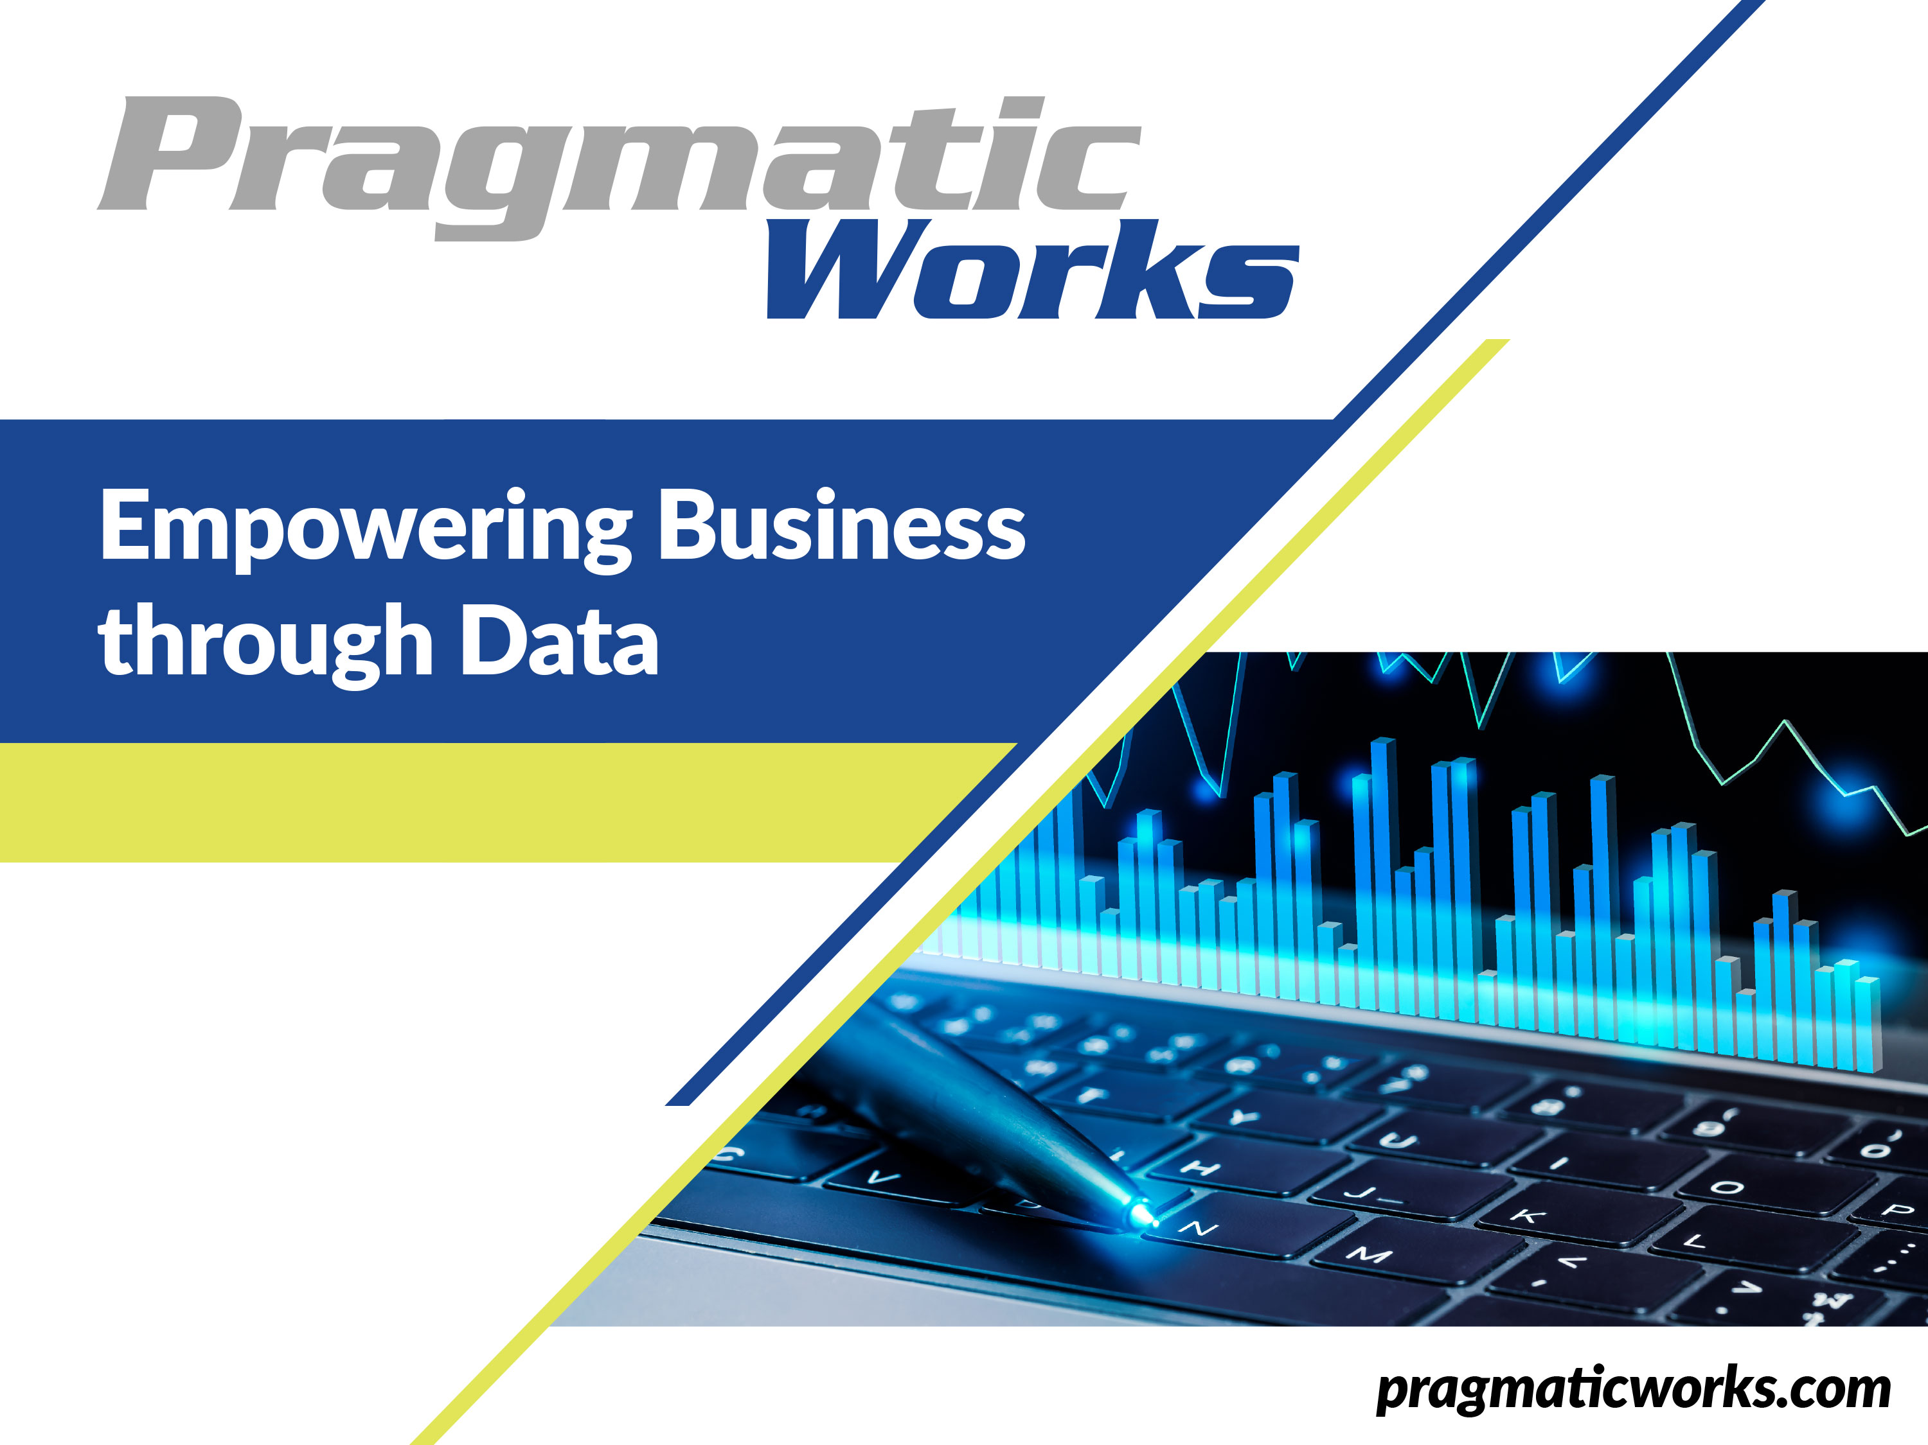

Slide 2
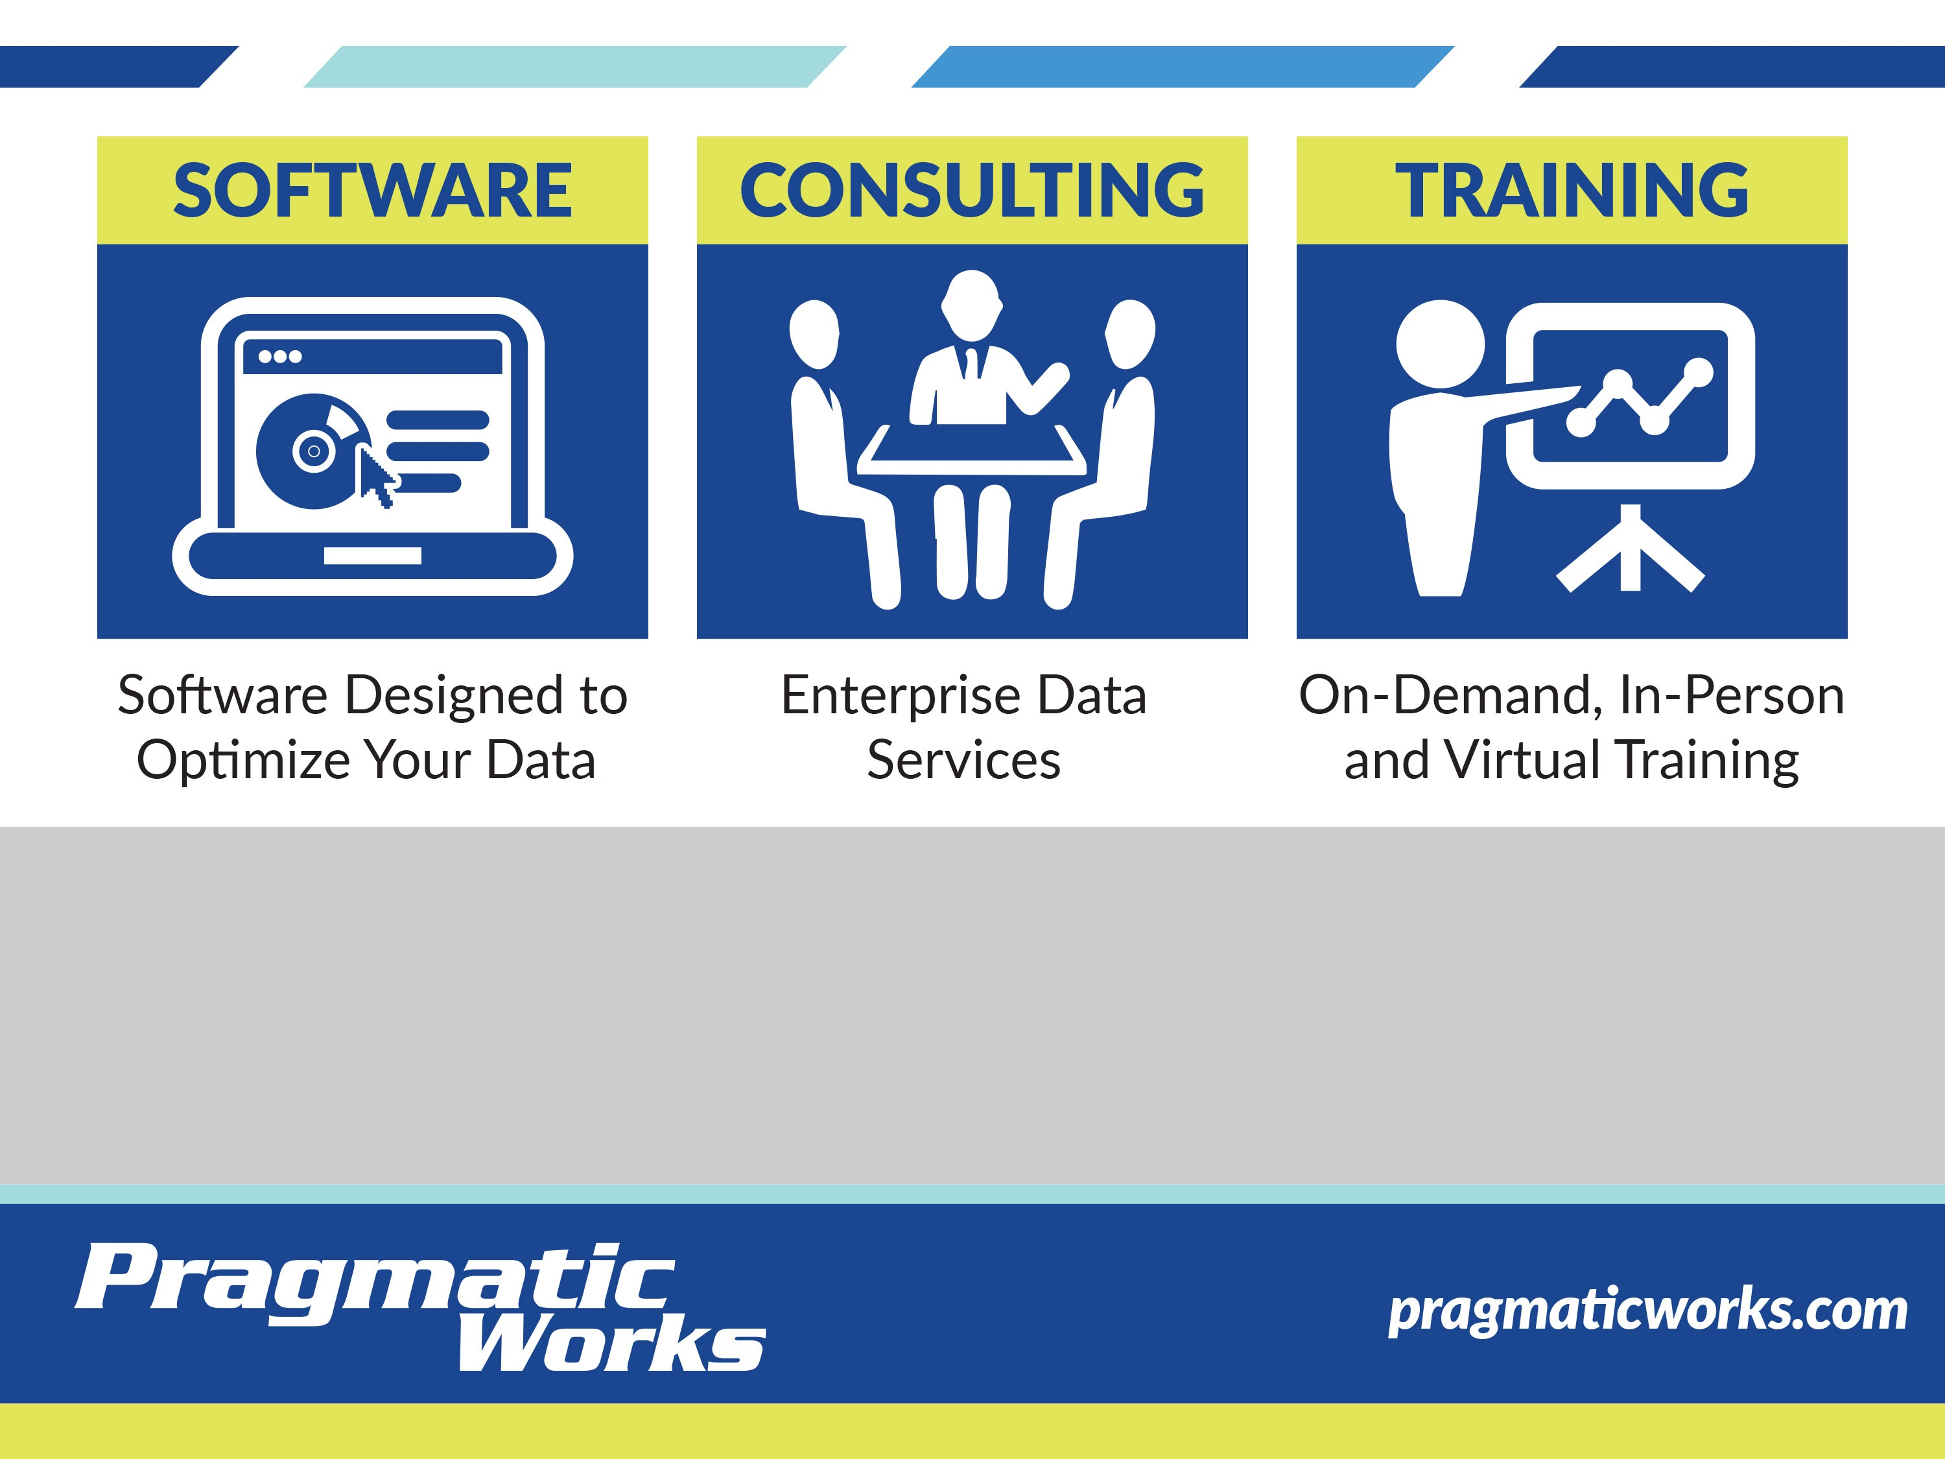

Michael French
Senior Consultant
mfrench@PragmaticWorks.com

Slide 3

A Little About Me…
20+ years of IT experience
SQLSaturday Presenter and Volunteer
B.S. in Applied Mathematics, Kent State University
National Councilor, Phi Kappa Tau

Slide 4

A Refined approach to data analytics
Consumption Based Architecture
Notes:
Origins:
Can’t take credit, was developed by respected colleague Steve Hughes
Architecture being implemented at some clients to meet organization needs
Not a brand new concept overall

Slide 5
Wait, What?!...Another Architecture?!
Not a replacement
Promotes self-service
Not a data dump
Three key concepts:
  Keep the data close to the source
  Data interfaces should be easy to use
  Modern, in-memory tools make this possible
Notes:
Is this a replacement for architectures out there today like Kimball, Inmon, Federated, etc?
NO! It’s more about creating patterns and designs that focus on putting the data in the hands of the users by leveraging existing architectures.
All data assets, we really want to give our users a single source of the truth. We want them to go to one place to get all their data, that’s the common goal in enterprise data solutions. The problem is not all the data resides in one place, especially with big data, more tech savvy users, the vast amount of data resources available… you can really get data from anywhere.
Promotes self-service by
leveraging data assets you already have
increasing your business’ consumable data based on both need and data readiness.
This is not a data dump but more about getting good data to the right business people at the right time.

Slide 6
Keep the Data Close to the Source
Move data as needed
Transform only when needed
Only transform/move to make data more consumable
Source of truth is the original source
Users verify against system of record
Adapt to fact-pace business changes
Notes:
The goal of this architecture is to move data as needed and transform it as little as possible (only when needed).
Idea is the source of truth is the original source
Users always verify their BI data against the system of record
Helps keep up with fast paced business
Less time to make changes to DW (implement, test, user acceptance, etc)
Today if a market changes and the user needs changes to their analytics to make a quick decision; they tend to pull the data and throw it into Excel, manipulating the data to get it to a point where its “good enough” to make a decision
This is not where we want to be, we need to try to provide good data, quickly to our users and not be a roadblock
Slowing down the pace could lead to missed business opportunities
Users need to be able to build a report and answer questions that may or may not have a life beyond that instance

Slide 7
Data interfaces should be easy to use
Simplifies programming
Absorb changes gracefully
Examples:
  Database Views
  Analytic Models
Notes:
Database Views:
For instance, you might have views already in place to provide data to Analysis Services
Consumption based architecture says to identify and leverage these data assets as part of your consumable data
Analytic Models:
Think of Power BI and its ability to turn a folder of files into a table structure easily

Slide 8
Modern, in-memory tools make this possible
Recent Advancements
  PowerPivot
  SQL Server Analysis Services Tabular Models
  Columnstore functionality in SQL Server
Notes:
In a way, these tools are changing the role of a data warehouse and its purpose
Tabular models are not cube, more grown up PowerPivots

Slide 9
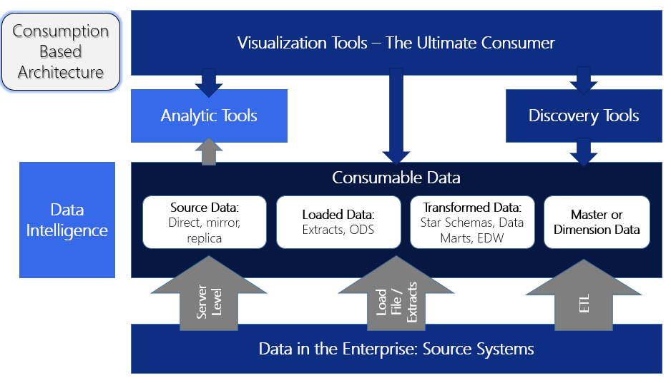
Notes:
Analytic Tools & Data Intelligences: IT Responsibility
Visualization & Discovery Tools: In the hands of the users
Consumable area is where we expose data for access to the Users
Users = Non-IT staff, could be technical analysts. (tools don’t require IT intervention to design results)

Slide 10
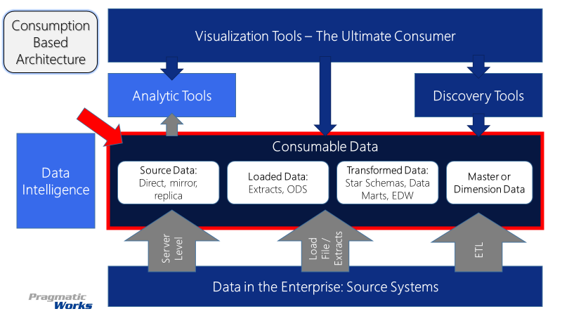
Consumable Data
Not always a physical location
Consists of:
  Source Data
  Loaded Data
  Transformed Data
  Mastered Data
SQL Server
Replication
Master Data Services
SSIS
Hadoop & Files
Azure Storage
Azure Data Lake
HDFS
Azure
Document DB
Azure SQL DB
Azure SQL DW
Notes:
We focus on making data available, not always in the same physical place For instance, you could use Power BI or Power Pivot to pull data from different locations, so the physical location of the data isn’t as important.
Examples of consumable data is part of:
Source Data – copies, replication (operational reporting relies on this data often)
Loaded Data – moved data, not exact replica of source, also includes file based sources such as mainframe reports. Think of data in a Hadoop cluster and make data available through hive, not really the source but is available for use.
Transformed Data – data is fundamentally transformed such as into a star schema, includes most EDWs and data marts. (problem is the timelines of build out and changes, data isn’t exactly how it was in the source; difficulty in testing, documenting and user acceptance.)
Master Data – data that can be used to bring all the data together, such as dimensions (anything that is regularly used can be mapped to your data sources, collect natural keys and core data – think date dimension, maybe customer, etc or even data purchased from azure marketplace)

Slide 11
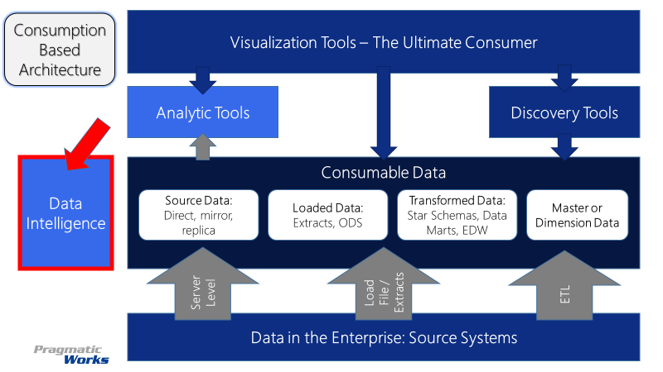
Data Intelligence
Must have a data dictionary
Maps relationships into consumable data
Metadata documented
Support Tools
SharePoint Wiki
DOCxPress – SentryOne
Azure Data Catalog
ER/Studio by Idera
Notes:
While Consumable Data is the heart of the architecture, Data Intelligence provides the map; some where there HAS TO be a data dictionary
This is essential for this architecture, as we need to be able to document what the consumable data is and how to get to it.
As well map the relationships in the consumable data and any important metadata. (Think source to target maps)
This needs to be as detailed as needed to support the user. Has to be simple enough for everyone to understand but usable and maintainable. Don’t just make a data dictionary for the sake of making a data dictionary. Maybe wiki style?

Slide 12
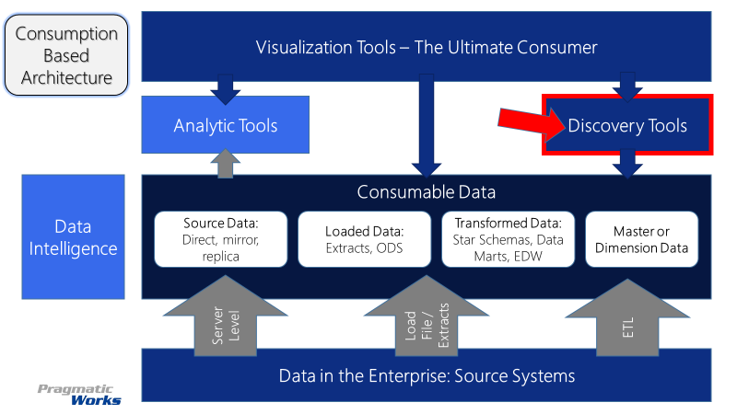
Discovery Tools
Non-IT Users tools
Minimal or no support required by IT
Users explore and discover consumable data
Example Tools
Power BI
Azure Machine Learning
R/Python
Other tools
Notes:
Users are often discovering data and mashing up thier data to try and figure out the data on their own
This does not mean that IT users can not use the Discovery Tools
What this leads to is new additions to the consumable data is driven by the User as they have more demands
Provides a great sandbox or prototype environments
You are never going to get away from the users holding on to and using a bunch of spreadsheets
This architecture allows the users to own the data
Allowing them to change for different scenarios asked by the business
Users often times will understand the data better than we do and how the data applies to their business

Slide 13
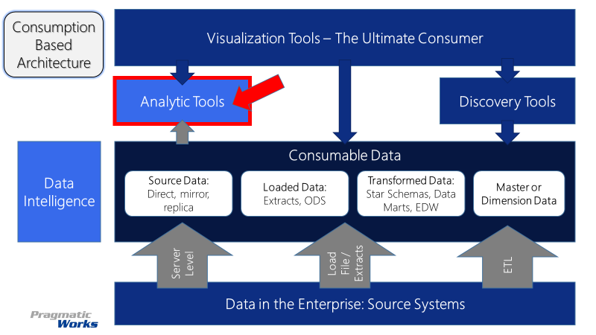
Analytic Tools
Tools used by IT
Provides enterprise support
Longer lifecycle
Example Tools
SSAS - Cubes
Data Mining
SAS
Notes:
Not build by users but put together by IT
Supports a large landscape of analytics
Because of this tends to require more support and longer development lifecycles as we know
IT has to be involved, but IT makes the data from these tools available for user consumption through discovery or visualization tools
These are IT projects that are built out with processes (unlike with mashup scenario)
Generally we have lived in this space, until modern tools like Power Pivot and Power BI came into existence
Definitely still have use cases for these tools (think large amounts of data that need an analytic model placed upon them)

Slide 14
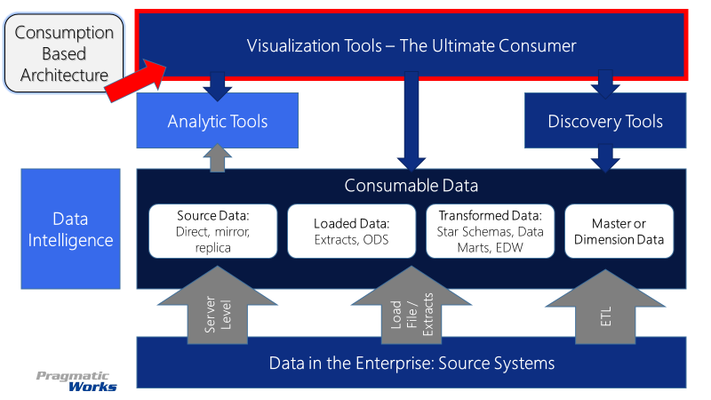
Visualization Tools
Many tools available
Can be used by IT and Users
IT needs to be enablers
IT aid with prototyping & training
Notes:
While there are many tools available out there for data visualization, still many users fall back on Excel.
However, tools such as Power BI with the use of consumable data has encouraged users to build their own visualizations without relying heavily on IT
This is where enabling users to promote Self-Service comes in.
IT can help by training and prototyping with user data, not just Adventure Works!

Slide 15


Implementation Tiers
Ideal
  MDM Source – Customer
  Fact Source – Source System 1 Order Data Replication
Notes:
In this scenario you would directly consume into your tabular model as is, with no ETL needed
You would use the source system ID or golden record ID as your Surrogate Key. Think Wide table
This would allow you to then consume the transactional data from the source system directly or a replication of the source system data.

Slide 16
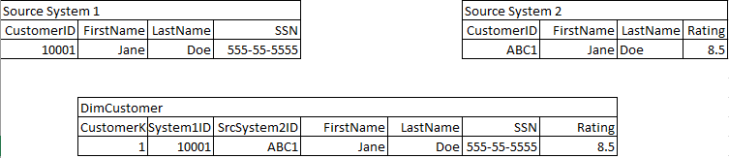
Implementation Tiers
Common
  EDW Dimension Source – Customer
  Fact Source – Source System 1 Order Data Replication
Notes:
In this scenario you would have data in format that would require transformation because it is not in a “consumable” format for tabular model
Your data would need to be consolidated and denormalized.
The idea here, again transform only when needed. The dimensions will often still need transformed with ETL (especially if they are not out of a master data tool) but in this case, because we have the natural keys in the dimensional data, we do not need to ETL the Fact table from the replicated source

Slide 17
Implementation Tiers
More Complex Example
  MDM with Golden Record Source – Customer
  Fact Source – Source System 1 Order Data Replication
  Fact Source – Source System 2 Customer Service
MDM - Customer
MDMID | ParentMDMID | FirstName | LastName | SrcSystem1 | SrcSystem2 | SrcSystem3
1 | 10 | Jane | Doe | 10001 | NULL | NULL
2 | 10 | Jane | Doe | NULL | ABC1 | NULL
3 | 20 | John | Smith | 23012 | NULL | NULL
4 | 20 | John | Smith | NULL | XYZ789 | NULL
5 | 20 | John | Smith | NULL | NULL | 10
10 |  | Jane | Doe | NULL | NULL | NULL
20 |  | John | Smith | NULL | NULL | NULL
CustomerID | OrderDate | Quatity | ZipCode
10001 | 23-Nov-16 | 10 | 15224
CustomerID | ContactData | CallLength | PhoneNumber
ABC1 | 1-Dec-16 | 5 | 111-222-3333
Notes:
In this scenario you would have data in format that would require transformation because it is not in a “consumable” format for tabular model
Your data would need to be consolidated and denormalized.
The idea here, again transform only when needed. The dimensions will often still need transformed with ETL (especially if they are not out of a master data tool) but in this case, because we have the natural keys in the dimensional data, we do not need to ETL the Fact table from the replicated source

Slide 18
Implementation Tiers
Key Map Table
CustomerKeyMap
MDMID | ParentMDMID | SrcSystem1 | SrcSystem2 | SrcSystem3
1 | 10 | 10001 | NULL | NULL
2 | 10 | NULL | ABC1 | NULL
3 | 20 | 23012 | NULL | NULL
4 | 20 | NULL | XYZ789 | NULL
5 | 20 | NULL | NULL | 10
10 | 10 | NULL | NULL | NULL
20 | 20 | NULL | NULL | NULL
Notes:
In this scenario you would directly consume into your tabular model as is, with minimal ETL needed
This is NOT a Dimension, but staged data
You would still use the source system ID and then get the Customer Data from MDM with a custom view. Think Deep table.
This would allow you to then consume the transactional data from the source system directly or a replication of the source system data.
There is an added benefit of the using the hierarchical nature of the Golden Record in Visualizations

Slide 19
Additional Resources
Blogs
  https://dataonwheels.wordpress.com/ - Steve Hughes
Webinar
  http://pragmaticworks.com/Training/Details/Webinar-1762
Contact Me
  MFrench@PragmaticWorks.com

Slide 20


