Slide 1
Cosmos DB 101
For SQL Server Admins and Developers

Slide 2
Mike Donnelly
Senior Consultant
@SQLMD
mdonnelly@pragmaticworks.com

Slide 3
Today’s Story
What is Cosmos DB
Why Cosmos DB for a project that already had a SQL database
Things DBAs care about

Slide 4
What is Cosmos DB?

Slide 5
“Azure Cosmos DB is Microsoft’s proprietary globally-distributed, multi-model database service for managing data at planet-scale launched in May 2017. It is schema-agnostic, horizontally scalable and generally classified as a NoSQL database.”

Slide 6
Cosmos DB is
Horizontally Partitioned
Using Replica Sets to Scale Horizonatally
Distributed Globally
Redundancy is built in
Built for the Cloud
Cosmos only runs on Azure there is no on-prem version

Slide 7
APIs Supported
Table API
SQL
(Document DB)
ARS – Atom Record Sequence
Notes:
Neo4J

Slide 8
Why Cosmos DB?

Slide 9
Cosmos DB Because
Lots of Serialization / Deserialization of JSON
Distributed Globally
Building in the Cloud

Slide 10
Creating a Document Container
Quick Demo

Slide 11
Mind Shift to NoSQL
New Things to think about include
Partition Keys
Consistnecy
Indexing
Request Units

Slide 12
Partitioning is Key
Picking the right Partition Key is probably the most important first step when using Cosmos DB
Logical vs. Physical
10GB Limit on Logical
Wide Range of Values

Slide 13
Consistency Levels
Strong – Similar to Read Committed Isolation in SQL Server
Bounded Staleness
Session
Consistent Prefix
Eventual
Notes:
Strong
With strong consistency, you are guaranteed to always read the latest version of an item similar to read committed isolation in SQL Server. You can only ever see data which is durably committed. Strong consistency is scoped to a single region.
Bounded-staleness
In bounded-staleness consistency read will lag behind writes, and guarantees global order and not scoped to a single region.
When configuring bounded-staleness consistency you need to specify the maximum lag by:
Operations
For a single region the maximum operations lag must be between 10 and 1 000 000, and for the multi region, it will be between 100 000 and 1 000 000.
Time
The maximum lag must be between 5 seconds and 1 day for either single or multi-regions.
Session
This is the most popular consistency level, since it provides consistency guarantees but also has better throughput.
Consistent Prefix
A global order is preserved, and prefix order is guaranteed. A user will never see writes in a different order than that is which it was written.
Eventual
Basically, this is like asynchronous synchronization. It guarantees that all changes will be replicated eventually, and as such, it also has the lowest latency because it does not need to wait on any commits.

Slide 14
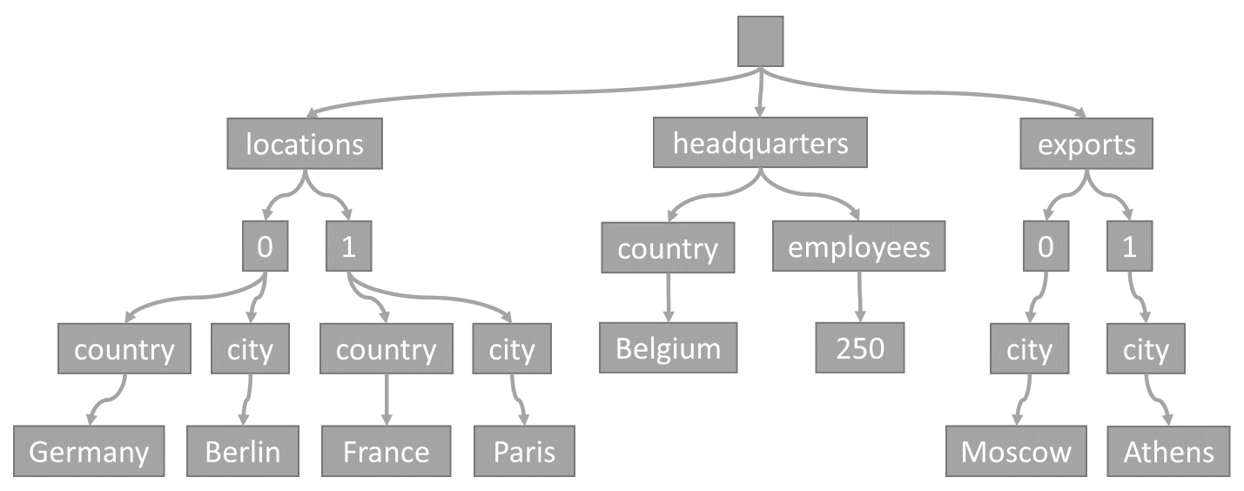
Indexing still matters
Everything is indexed by default
Add custom indexing if it makes sense

Slide 15
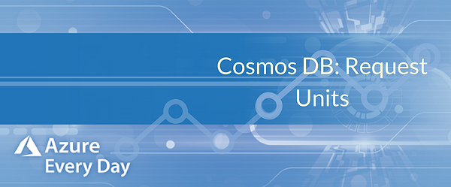
What RU?
Request Units are the DTU of Cosmos DB
1 RU corresponds to the throughput of a read of a 1 KB document.
Notes:
Database level or container level

Slide 16
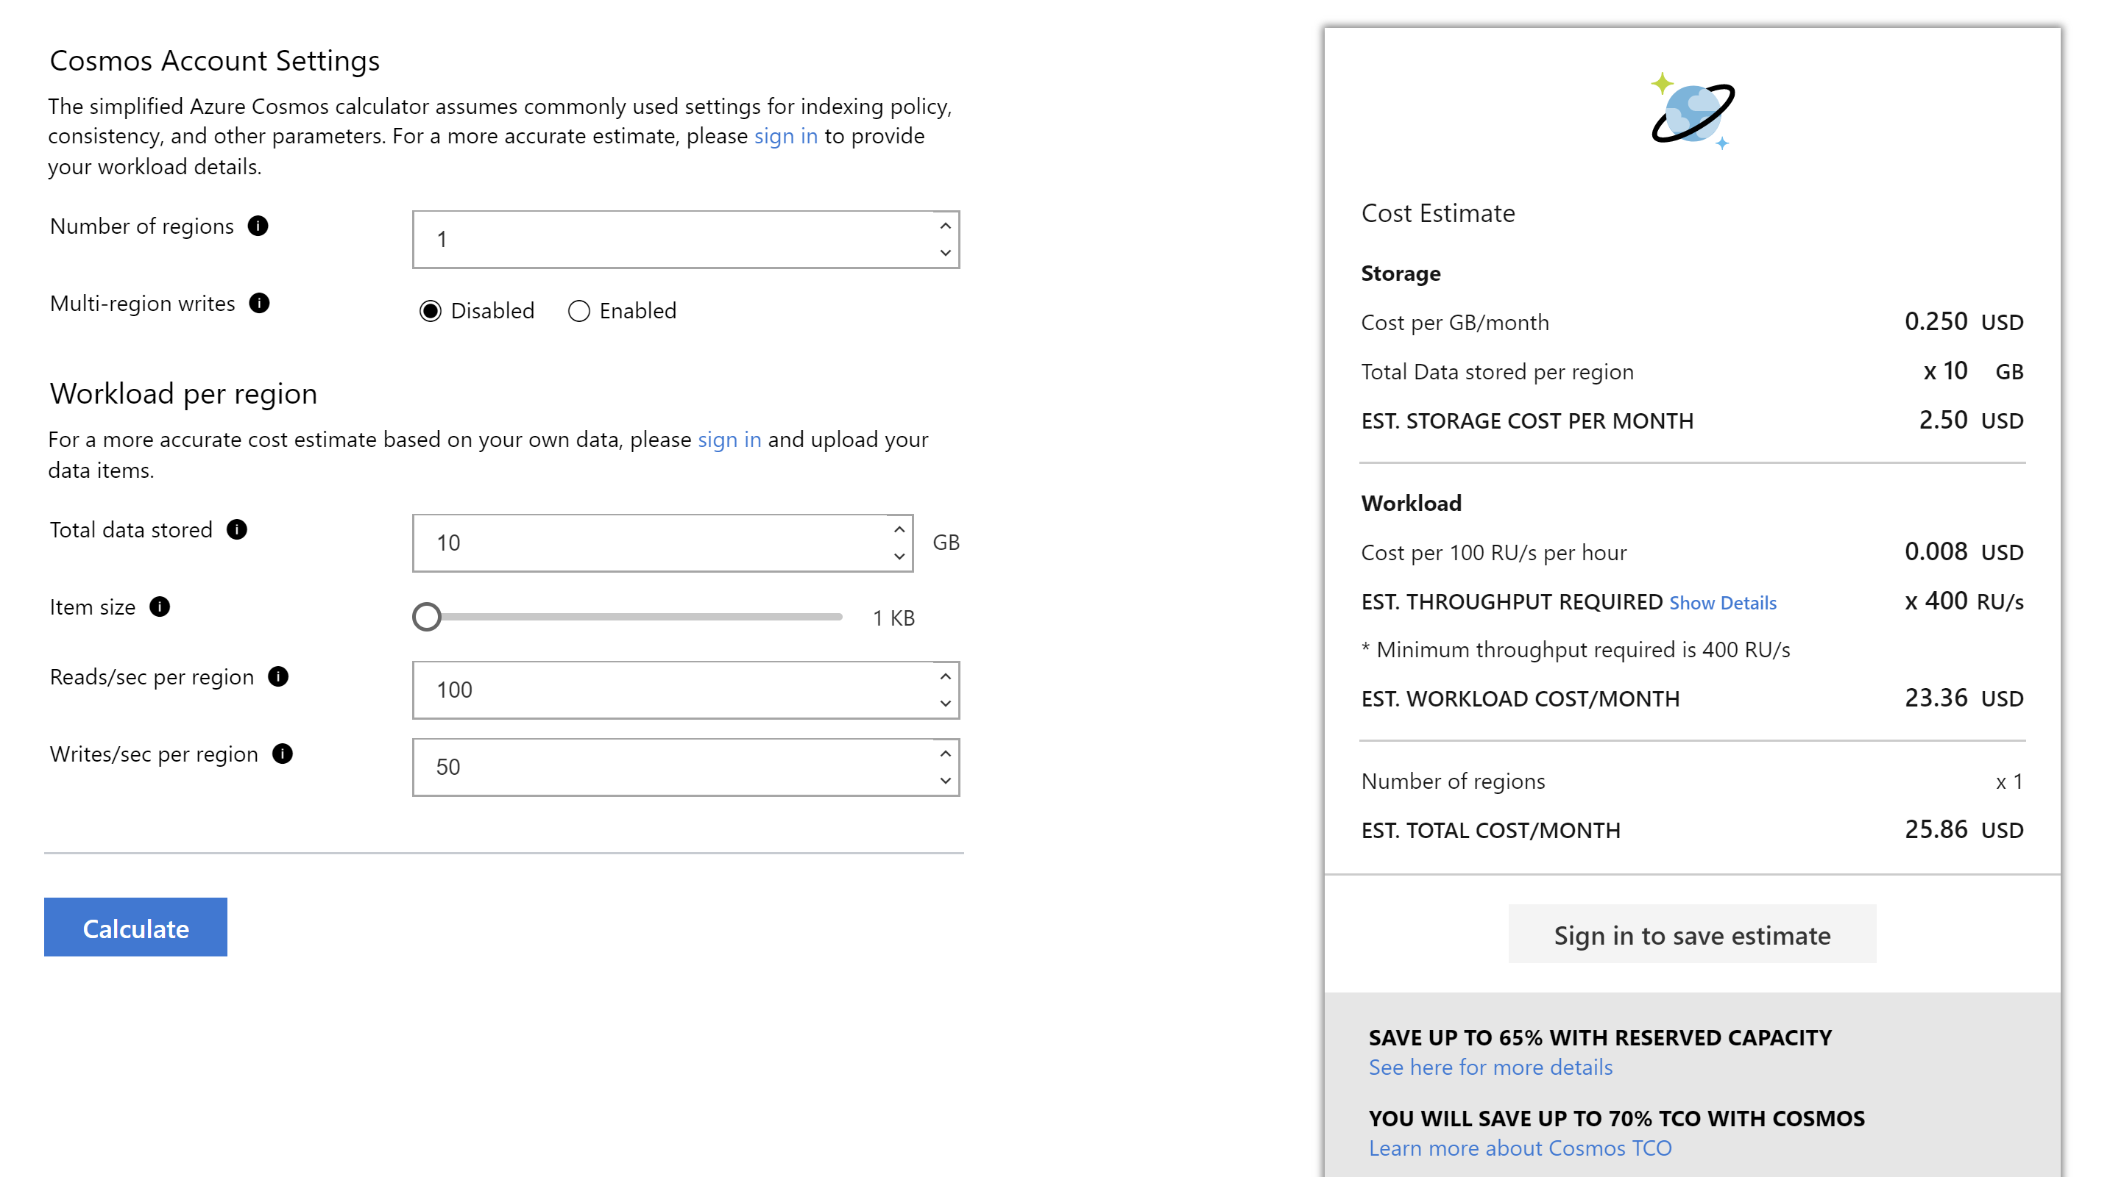

Slide 17
RU Considering the Right Things?
Item Size
Indexing/property count
Query Pattern/Scripts

Slide 18
RU on AutoPilot? (Now called AutoScale)
Allows you to set a limit and scale RU’s automatically
.1 * Tmax < T < TMax
Reserved Capacity
Reduce Cost up to 65% with 1-3 year commitment

Slide 19
Free as in Tier
First 400 RU/s and 5 GB of Storage
It’s always free for those amounts and can even be used for production loads
One Free Account per Azure Subscription

Slide 20
A Closer Look
Quick Demo

Slide 21
Cosmos DBA?

Slide 22
Cosmos DBA
Converting the Schema
It’s Not Really SQL
Transactions
Time to Live
Stored Procedures and Triggers

Slide 23
Schema-less is a Myth
Determine how the Data Should be modeled
Decide on
Embedded Data vs Reference Key
https://docs.microsoft.com/en-us/azure/cosmos-db/modeling-data
Notes:
Typically denormalized data models provide better read performance.

Slide 24
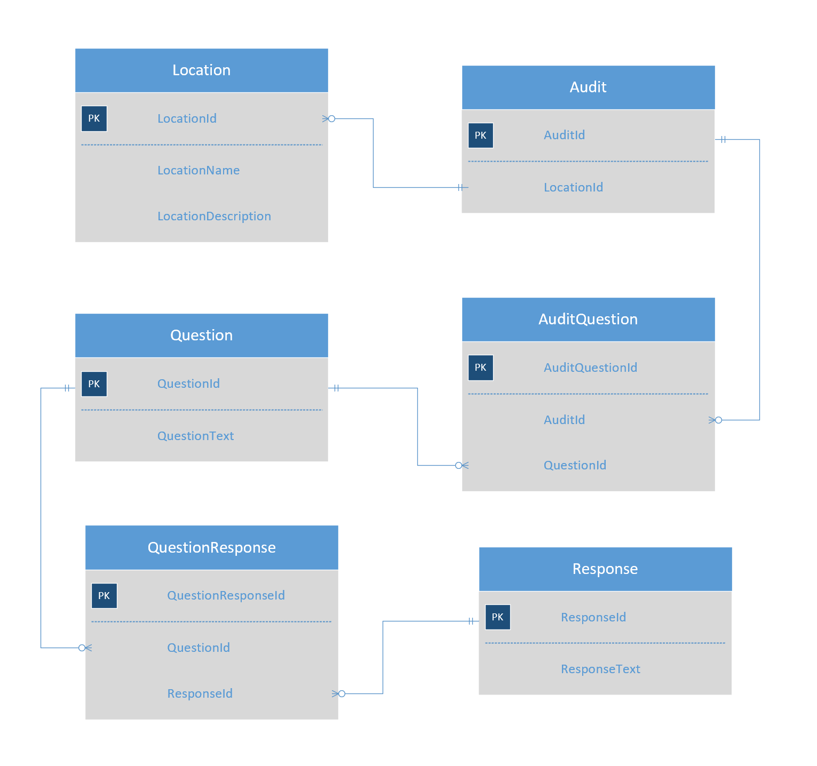
Relational
Model

Slide 25
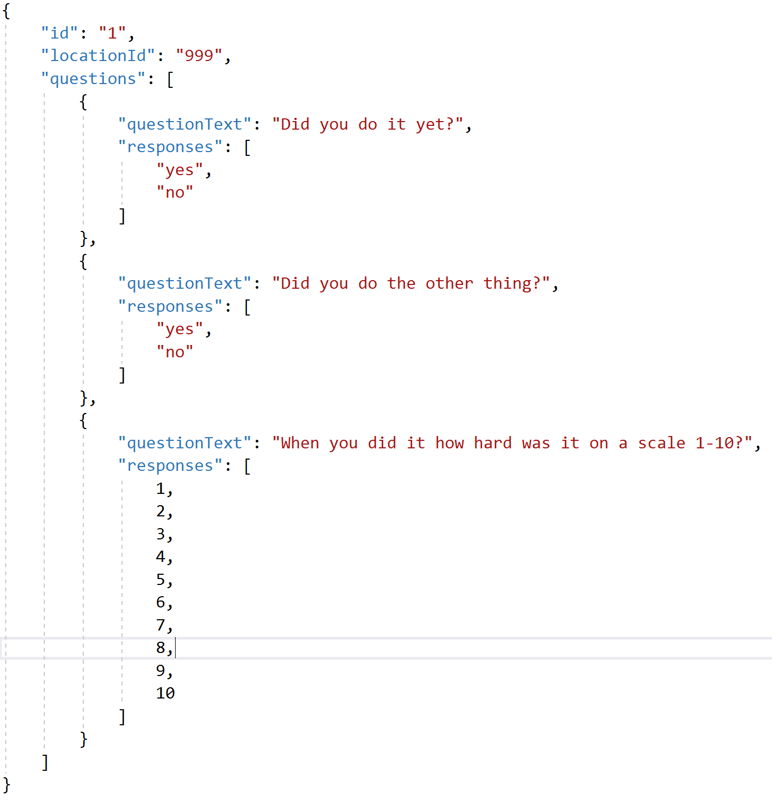
NoSQL or
JSON model

Slide 26
Cosmic Karma
I left to go work on something else

Slide 27
The SQL API is not all there
SELECT * FROM a where a.locationId = “999”
SELECT a.questions FROM a
SELECT * FROM q in a.questions

Slide 28
The SQL API is not all there
SELECT * FROM a where a.locationId = “999”
SELECT a.questions FROM a
SELECT * FROM q in a.questions

Slide 29
Let’s Look at some “SQL”
Quick Demo

Slide 30
Transactions in Cosmos
Not exactly transactions, at the Partition Key level
Old Way = Serverside Code
Use Stored Procedures to handle multi-document actions
Use triggers to enforce some relationships
New Way = Cosmos .NET SDK (version 3.4+)
Notes:
Promises.All

Slide 31
Trigger
function validateLocationIdExists() {
var collection = getContext().getCollection();
var request = getContext().getRequest();
var doc = request.getBody();
if (!doc.locationId) {
throw new Error('Document must include a “locationId" property.');
}
}

Slide 32
Example Stored Proc
function createTwoDocuments(locationName, industry, billRate) {
var context = getContext();
var collection = context.getCollection();
var firstDocument = {
location: locationName,
industry: industry
};
var secondDocument = {
location: locationName,
billing: {
discounted: false,
rate: billRate
}
};
var firstAccepted = collection.createDocument(collection.getSelfLink(), firstDocument,
function (firstError, newFirstDocument) {
if (firstError) throw new Error('Error' + firstError.message);
var secondAccepted = collection.createDocument(collection.getSelfLink(), secondDocument,
function (secondError, newSecondDocument) {
if (secondError) throw new Error('Error' + secondError.message);
context.getResponse().setBody({
locationRecord: newFirstDocument,
billingRecord: newSecondDocument
});
}
);
if (!secondAccepted) return;
}
);
if (!firstAccepted) return;
}
“Stored procedures are best suited for operations that are write-heavy and require a transaction across a partition key value.”

Slide 33
Any Questions?
Mike Donnelly
@AzureCosmosDB
https://azurecosmosdb.github.io/CosmicNotes/
@sqlmd
mdonnelly@pragmaticworks.com

