Slide 1

Hybrid Cloud Backup, Recovery, and Migration (DRaaS)
Chris Seferlis
Senior Principal Architect
t: @bizdataviz - in/cseferlis

Slide 2
How Ready are Businesses for Disruption?
“Only 18% of global disaster recovery decision makers and influencers feel very prepared to recover their data center in the event of a site failure or disaster”
“Much of the lack of preparedness is due to immature core planning processes, out-of-date plans, and very limited testing”
“While regulatory compliance continues to be important, the main driver of DR is the business need to stay online and competitive 24x7”
Immature planning and limited testing
Compliance and business needs
18%
Source: Forrester July 2017 The State of Business Technology Resiliency

Slide 3


Cause(s) of Significant Disaster Declaration(s)
56%
Source: Forrester/Disaster Recovery Journal November 2016 Global Disaster Recovery Preparedness Online Survey
38%
31%
19%
Systems
Failure
Power
Failure
Natural
Disasters
Cyber
Attack
Notes:
So, what are the causes of these disasters? – well, the results may surprise you…

Slide 4
Challenges implementing disaster recovery
Cost
  Data center cost
  Resource cost
  Hardware cost
Complexity
  Multiple data centers
  Replication technologies/restore hardware
  Managing management software
Reliability
  Recovery of data
  Providing service
Notes:
Why is it challenging to implement a DR solution?

Slide 5
Business continuity strategy
You need all three
Primary site
Primary site
Secondary site
Original
Backup
DATA
DATA
High availability
Disaster recovery
Backup
When your applications have a catastrophic failure, run a second instance
When your applications have a catastrophic failure, run them in Azure or a secondary datacenter
When your data is corrupted, deleted or lost you can restore it
Notes:
A full BCDR strategy contains all three things: HA, DR, and backup.

Slide 6
Why is disaster recovery important?

Slide 7
“Failure is ALWAYS an option.”
Adam Savage, MythBusters

Slide 8
Resiliency basics

Slide 9
Infallible truths (of cloud computing)
Software has bugs
Hardware will fail
Humans will make mistakes

Slide 10
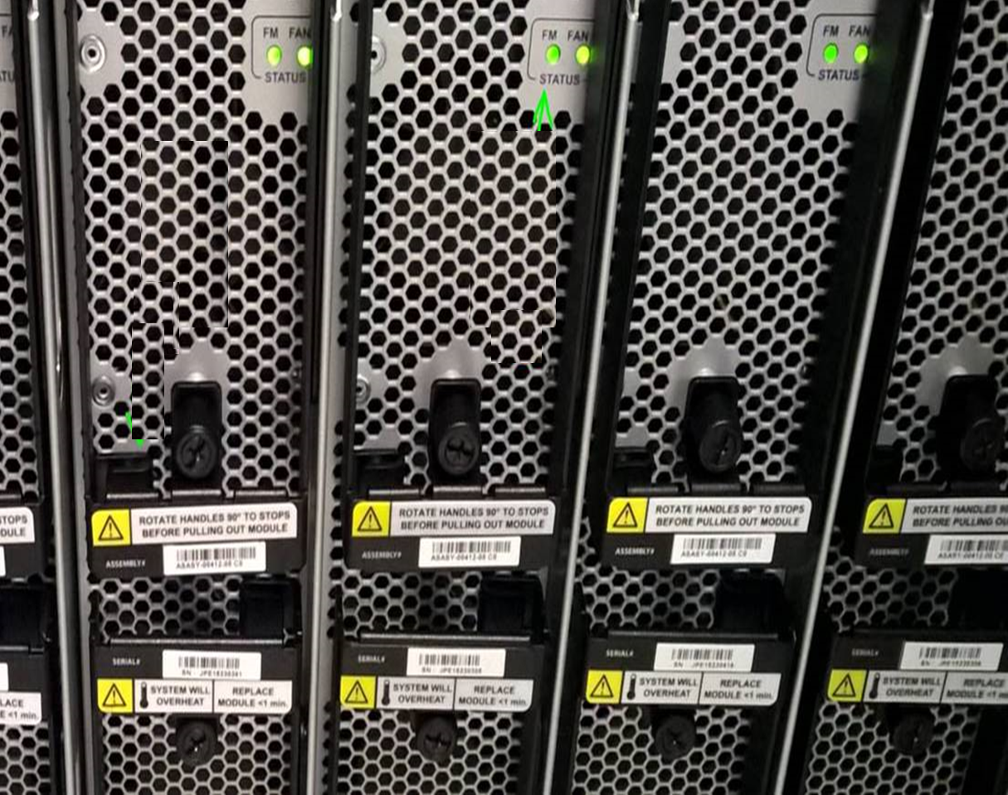
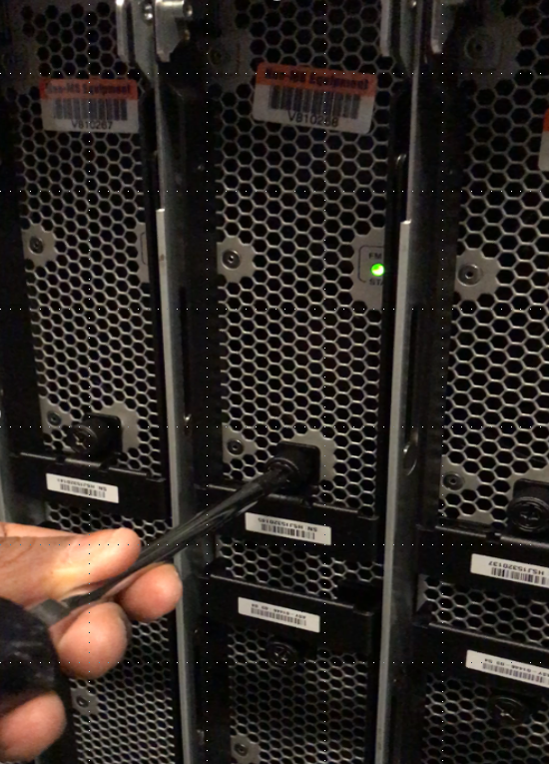

Slide 11
High availability and disaster recovery
What is one key difference between Disaster recovery and high availability?
Disaster recovery begins where high availability ends

Slide 12
High availability and disaster recovery
Disaster recovery begins where high availability ends
Virtual machine (app)
Server (app)
Availability set (HA)
Cluster (HA)
Paired region (DR)
2nd site (DR)

Slide 13
RTO and RPO
Recovery Time Objective (RTO)
  “The recovery time objective (RTO) is the targeted duration of time and a service level within which a business process must be restored after a disaster (or disruption) in order to avoid unacceptable consequences associated with a break in business continuity.”, https://en.wikipedia.org/wiki/Recovery_time_objective
Recovery Point Objective (RPO)
  “A recovery point objective, or “RPO”, is the maximum targeted period in which data might be lost from an IT service due to a major incident. The RPO gives systems designers a limit to work to.”, https://en.wikipedia.org/wiki/Recovery_point_objective
RPO
RTO
PTO*
Disaster
Lost Data
Down Time
*PTO: Take some time off. You’ve earned it. ☺

Slide 14

Picking RPO and RTO
RPO and RTO are a business decision
Get your current RPO and RTO
Test options and estimate costs
Get business owner agreement on RPO and RTO
Implement & measure

Slide 15
How does Azure help with HA?

Slide 16
Availability Sets
Protect against planned and unplanned events
Azure distributes the placement of VMs across the underlying infrastructure
Fault Domains
  share a common power source and network switch
Update Domains
  Intelligently update the host OSs that your guest VMs are running on

Slide 17
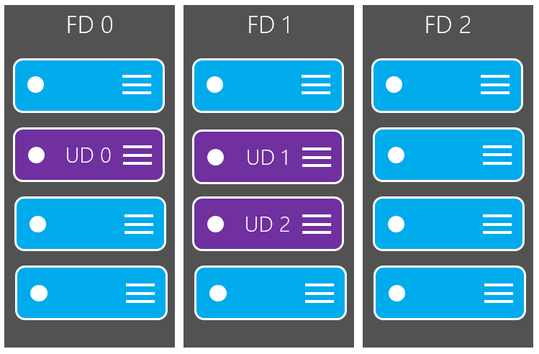
Availability Sets

Slide 18
How does Azure help with DR?

Slide 19





Azure Site Recovery: The Complete Disaster Recovery Solution
Site to Azure
Site to Site
Any Cloud
AWS*
Physical/VMware to VMware
VMware
Hyper-V
Physical
VMM to VMM
Any OS
Windows
Linux

Slide 20
Recovery Services Vault

Slide 21
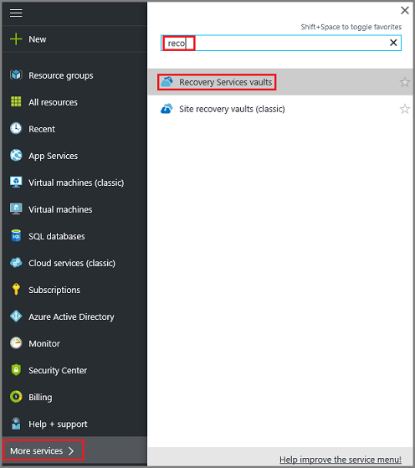
Recovery Services Vaults
A Recovery Services vault is an entity that stores all the backups and recovery points you create over time. The Recovery Services vault also contains the backup policy applied to the protected files and folders.

Slide 22
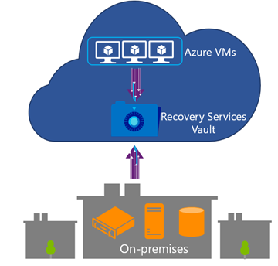
Recovery Services Vaults
Application consistent backup for Windows Azure VMs and File-system consistent backup for Linux Azure VMs without the need to shutdown VM
Bottomless Recovery Services vault to eliminate storage management complexity for backup
Efficient and reliable backups to the cloud and in the cloud
No backup infrastructure maintenance
Geo-Redundant

Slide 23
Recovery Services Vaults
Key Decisions for creating a RSV
Number of Vaults
Location
Storage Replication Type

Slide 24
Azure Backup

Slide 25
Azure Backup by the numbers…
3 PB
200,000+
195,000
Added every week
IaaS VMs
On-premises servers protected
100 PB
85%
60,000
Azure Backup Storage
Azure TOP Customers are Azure Backup customers
Customers
Didn’t realize the magnitude of backup, did you?

Slide 26

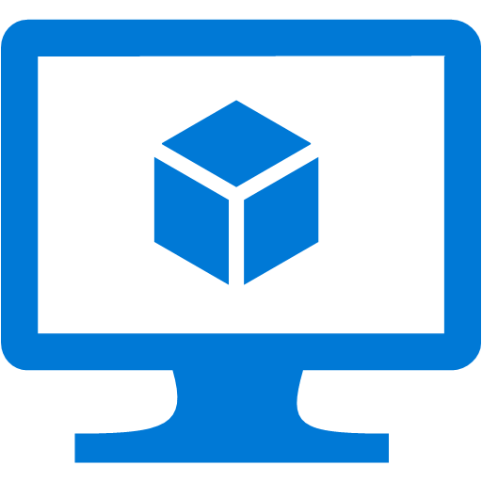


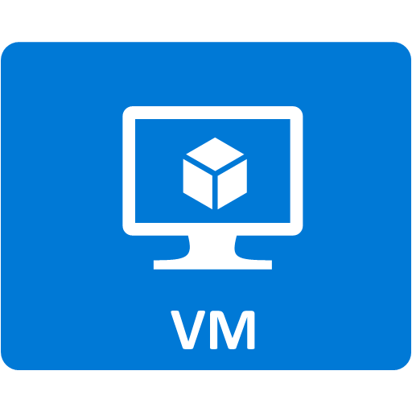






Conventional backup approaches
Custom Scripts
SQL Native backups
Backup Software
VM snapshots
Azure Storage
Azure Storage
File snapshots
Need to manage
Infrastructure
No Central Management
Infrastructure
Management
Some Central Management

Slide 27

Azure Backup
Simple and reliable cloud integrated backup as a service
Compelling cloud-based backup alternative to tape
Secure and reliable
backup as a service
Efficient and flexible online backup services
Azure
Azure
Agent F
Azure Backup
Virtual Machines
State / Config
Commvault Simpana
Azure Storage (blob)
Virtual Machines
VPC / tenant
Restore
VPC / tenant
Restore
Option 1 – Use native Azure Backup
Option 2 – Use 3rd party backup apps

Slide 28


Azure Backup – Architecture matters
Scale-Up
Within the enterprise
Azure Backup Service
Data
Plane
Recovery Point Management
Data Pruning
Backup
Extension
Storage Management
Data Packing
Scale-Out
Across Customers
Backup
Extension`
Authentication
Policy Management
Monitoring
&
Reporting
Access Control
Management
Plane
No infrastructure
Enterprise scale
Extensible
Central management

Slide 29


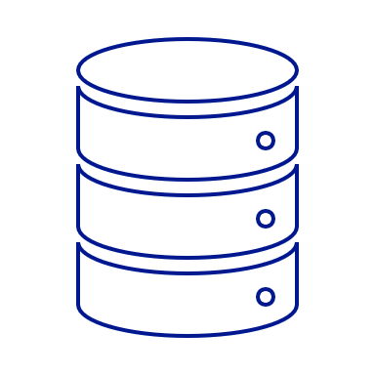
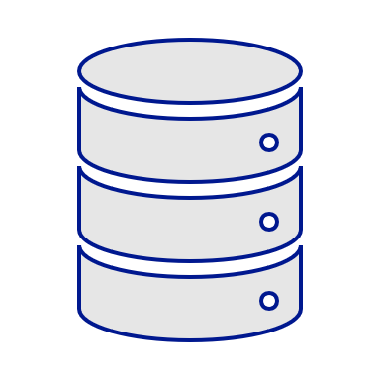

Azure Backup – Restore-as-a-Service
Azure Backup Service
Data
Plane
Azure VM
Recovery
Services Management
iSCSI Connection
iSCSI Initiator
iSCSI Target
.VHD Snapshots
iSCSI Connection
iSCSI Target
iSCSI Initiator
.VHD Snapshots
Azure Backup Agent
On-premises server
No infrastructure
Inspect before Restore
Consistent

Slide 30
Time-to-first-byte Improvements : Instant Restore!
Up until now for smaller size DS
Recovery Point
Volume
Metadata VHD Isolation
Full DS Reverse-Transformation
VHD creation for Selected Items
Time consuming part for large DS as the entire volume is reverse transformed for the first byte
Decryption
Decompression
First byte recovered!

Slide 31

Time-to-first-byte Improvements : Instant Restore!
Up until now for smaller size DS
Instant restore of Large DS items
Recovery Point
Volume
Recovery Point
Volume
Metadata VHD Isolation
Metadata VHD Isolation
Full DS Reverse-Transformation
Mount recovery point as Disk
(iSCSI)
VHD creation for Selected Items
Explore and select item(s)
Decryption
On-demand Reverse-Transformation
(without VHD Creation)
Time saving
Decompression
First byte recovered!
First byte recovered!

Slide 32
Instant Restore impact!
Drastic reduction in first byte recovered!
Datasource / Machine Characteristics | Time to first byte (without Instant Restore) | Time to first byte (With Instant restore)
200 GB | 30 mins | < 2 mins
1 TB | 3 hours | ~5 - 7 mins
4TB | 8 hours | ~10 - 12 mins
15x faster
~30x faster
~40x faster

Slide 33


Azure Backup – Sending (large) data efficiently
Offline Seeding
Several TBs
10 TB
Azure
Import
Service
Recovery Services Vault
Compression
Ship
Azure Backup
agent
Backup data
10 TB
Bitlocker encrypted
30 – 40% Reduction in size
Savings in network bandwidth & in time

Slide 34
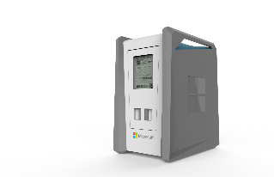
Azure Backup – Sending (large) data efficiently
Recovery Services Vault
Ship
Azure Data Box
Service
(Preview)
Azure Data Box
Up to 100 TB
Backup data from multiple sources
No procuring of disks
Parallel transfers
Safe and secure

Slide 35
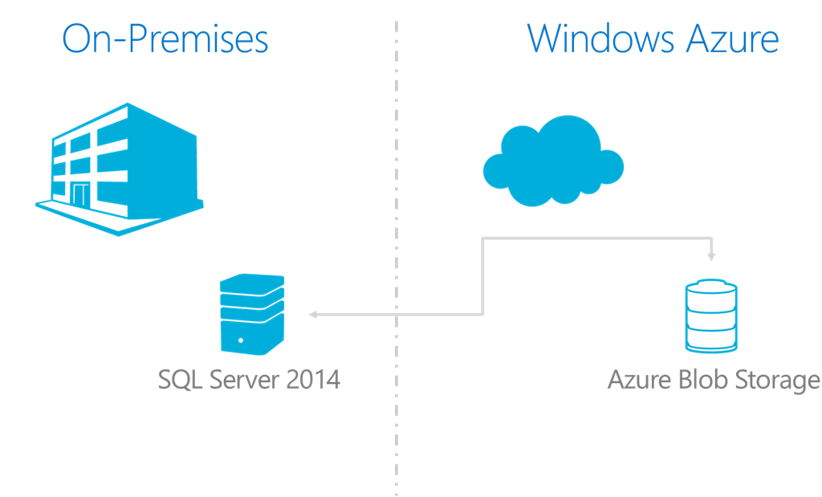







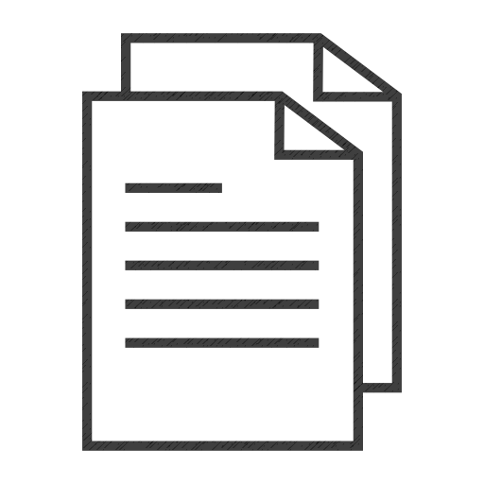

How Data Moves during Offline Backup
Classic (Non-CSP) Subscription
Azure Recovery Services Vault (ARM)
Customer Storage Account
Import Service
Azure
5
4
Write
(Classic V1)
3
“X” TB
On-premises
1
2
Write
C:\
(Local)
Write
“X” TB
“X” TB upto 10TB/disk
Backup Data
Staging Location
Backup data Encrypted
Hard-drive BitLocker Encrypted

Slide 36
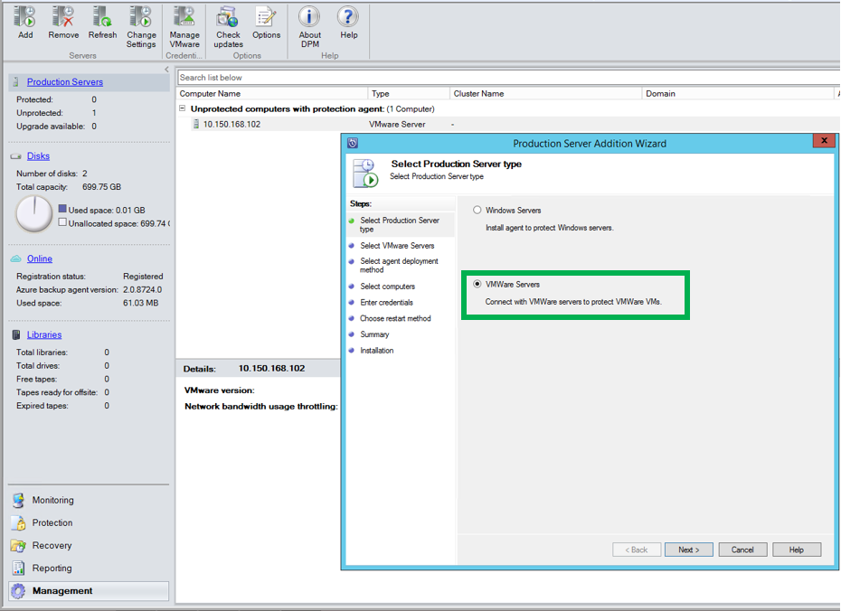
VMWare VM Backup
  Agentless Backup
  Cloud integrated
  Discovery of vCenter
  vCenter 5.5, 6.0, 6.5 support
  Folder-level Auto protection
  Protect VMs stored on NFS/SAN/DAS
  Available through MABS

Slide 37
Azure Backup Server

Slide 38
Azure Backup Server (MABS)
Designed to address the protection of data at the workload level
Functionally equivalent to System Center Data Protection Manager except:
  No integration with System Center components
  No support for tapes
  Requires an active Microsoft Azure subscription (and not a System Center license)

Slide 39
Feature Comparison
Component | Benefits | Limits | What is protected? | Where are backups stored?
Azure Backup (MARS) agent | Back up files and folders on physical or virtual Windows OS (VMs can be on-premises or in Azure) No separate backup server required. | Backup 3x per day Not application aware; file, folder, and volume-level restore only, No support for Linux. | Files Folders | Recovery Services vault
Azure Backup Server | App aware snapshots (VSS) Full flexibility for when to take backups Recovery granularity (all) Can use Recovery Services vault Linux support on Hyper-V and VMware VMs Back up and restore VMware VMs Does not require a System Center license | Cannot back up Oracle workload. Always requires live Azure subscription No support for tape backup | Files Folders Volumes VMs Applications, Workloads | • Recovery Services vault, • Locally attached disk

Slide 40
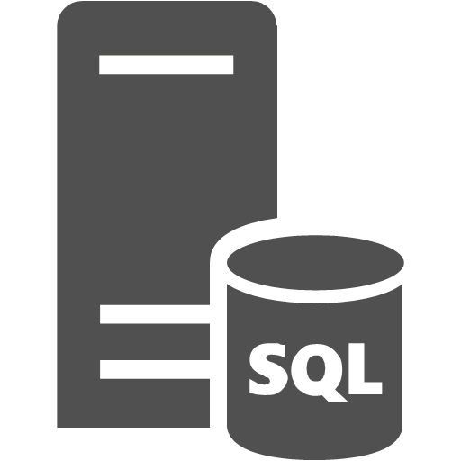
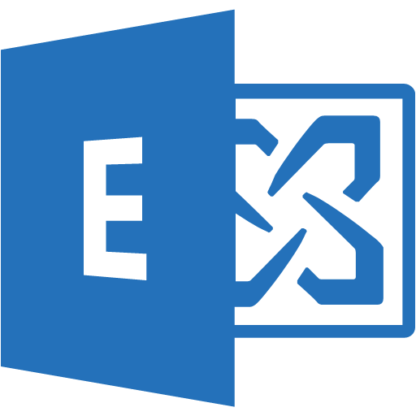
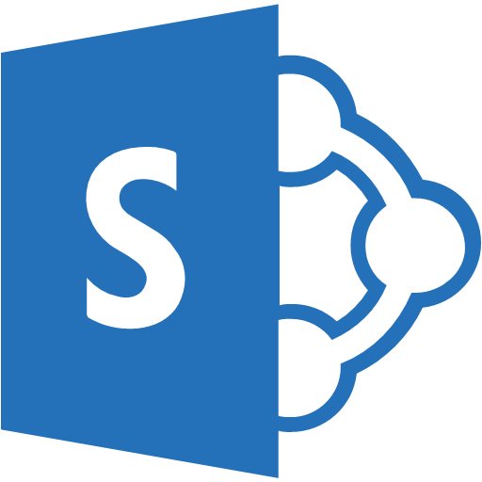




Hybrid Backup Overview
Short Term Backup
Disk Storage
Long Term Backup
SC DPM
Azure Backup Server
Azure Recovery Services Vault
Restore to Destination
Restore from Cloud
Staging Folder
App Consistent backups
SQL Server
Exchange
SharePoint
File Server
Physical
Hyper-V VMs
VMware VMs
Hyper-V
VMware
Azure
Protection at scale
Cloud Integrated Backup
Application Aware Backup
Central monitoring and Reporting
Automation

Slide 41
Azure Site Recovery

Slide 42


Azure Site Recovery
Migrate applications to Azure IaaS with confidence
Zero application data loss during migration
Near-zero application downtime during migration
Broad coverage for hypervisors, applications, operating systems, and Azure features
No-impact application testing in Azure
Free!

Slide 43


Azure Site Recovery
One solution for multiple infrastructures
Replication
Replication
SAN
SAN
Replication
Hyper-V
Microsoft
Azure
Hyper-V
Hyper-V
Hyper-V
Hyper-V
1
Hyper-V to Hyper-V
(on-premises)
2
Hyper-V to Hyper-V
(on-premises)
3
Hyper-V to Microsoft Azure
Replication
Replication
Replication
Microsoft
Azure
Microsoft
Azure
Microsoft
Azure
VMware or Physical
VMware
VMware or Physical
4
VMware or Physical to VMware (on-premises)
5
VMware or Physical to
Microsoft Azure
6
Microsoft Azure to
Microsoft Azure
Protect important applications by coordinating the replication and recovery of private clouds across sites.
Protect your applications to your own second site, a hoster’s site, or even use Microsoft Azure as your disaster recovery site.

Slide 44

Disaster Recovery for Hyper-V
Hyper-V
Server
Azure Site Recovery
443 (HTTPS)
Microsoft Azure
Data Channel
Public Internet or ExpressRoute with Public Peering
Source: Hyper-V
Microsoft Azure Recovery Services Agent
Replicates data to Azure
Documentation: https://aka.ms/asr_hyperv
Videos: https://aka.ms/asr_videos

Slide 45
Disaster Recovery for VMware
443 (HTTPS)
Config
Server
Process
Server
9443 (HTTPS)
Azure Site Recovery
443 (HTTPS)
Microsoft Azure
Data Channel
Public Internet or ExpressRoute with Public Peering
Source: VMware, AWS
& Physical Servers
Process Server
Used for caching, compression, and encryption
Configuration Server
Used for centralized management
Mobility Service Captures all data writes from memory
Documentation: http://aka.ms/asr_vmware
Videos: https://aka.ms/asr_videos

Slide 46

Application DR with ASR
Azure Site Recovery
DR Orchestration
DR Orchestration
DB Tier
ASR Replication
Azure Storage
App Tier
Web Tier
ASR Replication
Active Directory
ASR Replication
Primary Site
Azure

Slide 47
Application DR with ASR
Azure Site Recovery
DR Orchestration
DR Orchestration
DB Tier
IaaS VM
SQL Availability Group
App Tier
Web Tier
ASR Replication
Azure Storage
Active Directory
AD & ASR Replication
IaaS VM
S2S VPN
Azure
Primary Site

Slide 48

Azure Migrate

Slide 49
Vision
Make it easy for customers to migrate to Azure
Discover -> Migrate -> Optimize
Virtual machines, Databases, Data, Apps etc.
No additional cost

Slide 50



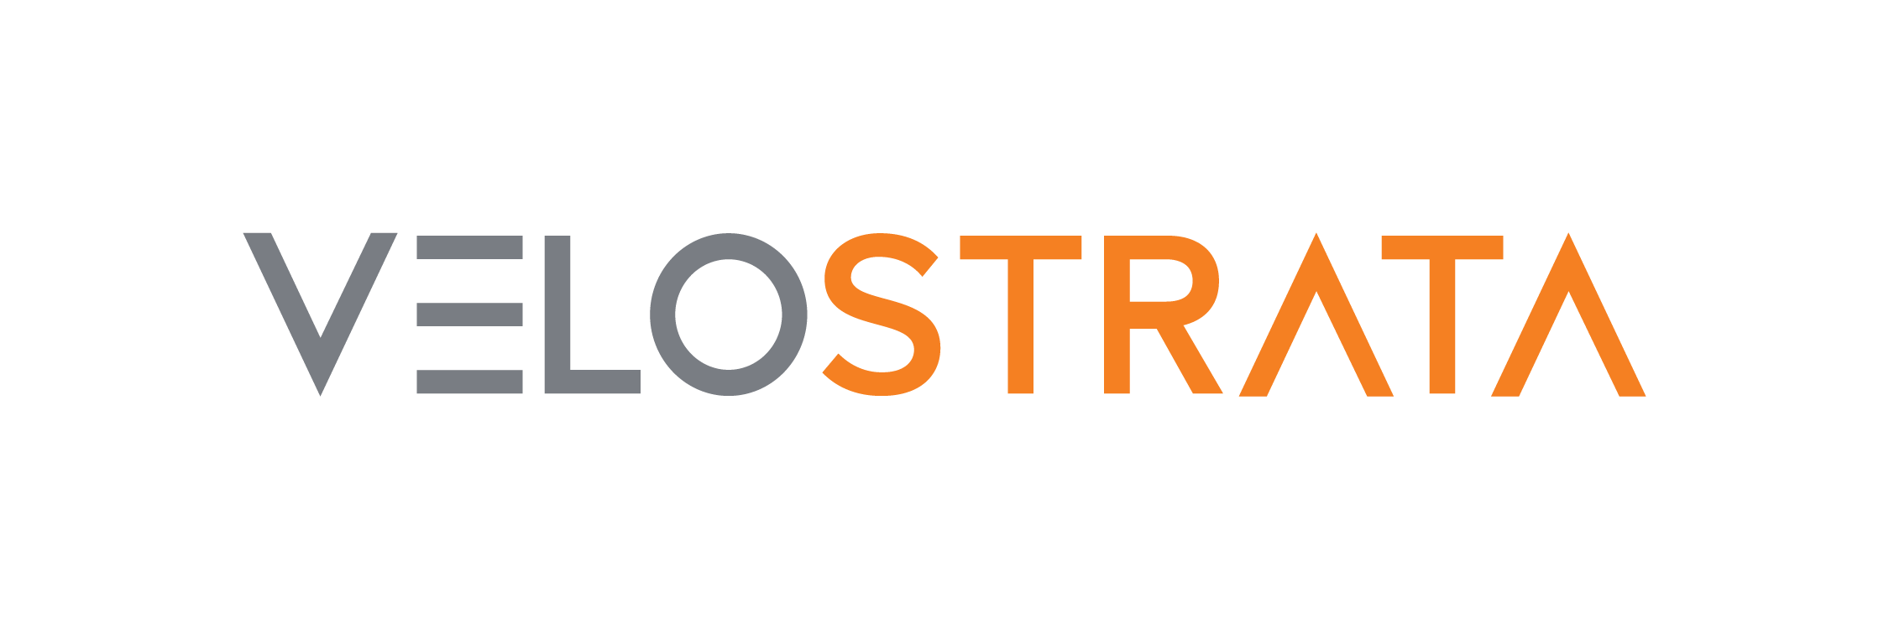








Landscape – Past
Discover
Migrate
Optimize
Microsoft
Microsoft Assessment and Planning (MAP) Toolkit
Database Migration
Assistant
Azure Site
Recovery
Database Migration
Service
Operations
Management Suite
^{Limited Preview}
Partners

Slide 51
Landscape – Present
Discover
Migrate
Optimize
Microsoft
^{Public Preview}
Azure Migrate
Database Migration
Assistant
Azure Site
Recovery
Database Migration
Service
Operations
Management Suite
^{Public Preview}
Partners

Slide 52
Landscape – Future
Discover
Migrate
Optimize
Microsoft
Azure Migrate
Azure Site
Recovery
Database Migration
Service
Operations
Management Suite
Database Migration
Assistant
Partners

Slide 53
Benefits
Discovery
  Appliance-based
  Light: Non-intrusive, Frictionless
  Deep: High-confidence
Assessment
  Azure suitability
  Right sizing
  Cost estimation

Slide 54
Appliance-based
No pre-setting or pre-configuring a machine
No installation of pre-requisite software

Slide 55
Light discovery
No agents to install and no firewall ports to open
No machine creds (host or guest)
No privileged creds (virtualization manager)
No waiting to gather performance history

Slide 56
Deep discovery
Agent-based
No guesswork anymore
No need to remember which machine belongs to which app

Slide 57
Suitability
Can I host this machine in Azure?

Slide 58
Rightsizing
What’s the best VM size based on performance history?

Slide 59
Cost
How much would the recurring cost be?

Slide 60

Details
Raw metadata
Processed metadata
Collector VM
Azure Migrate Service
Azure Migrate Portal
2. Start discovery
Raw metadata
1. Download and configure appliance
vCenter Server
User
ESXi hosts and VMs

Slide 61
Details
Raw metadata
Processed metadata
Collector VM
Azure Migrate Service
Azure Migrate Portal
Assessment
2. Start discovery
Raw metadata
3. Create assessment
1. Download and configure appliance
vCenter Server
User
ESXi hosts and VMs

Slide 62

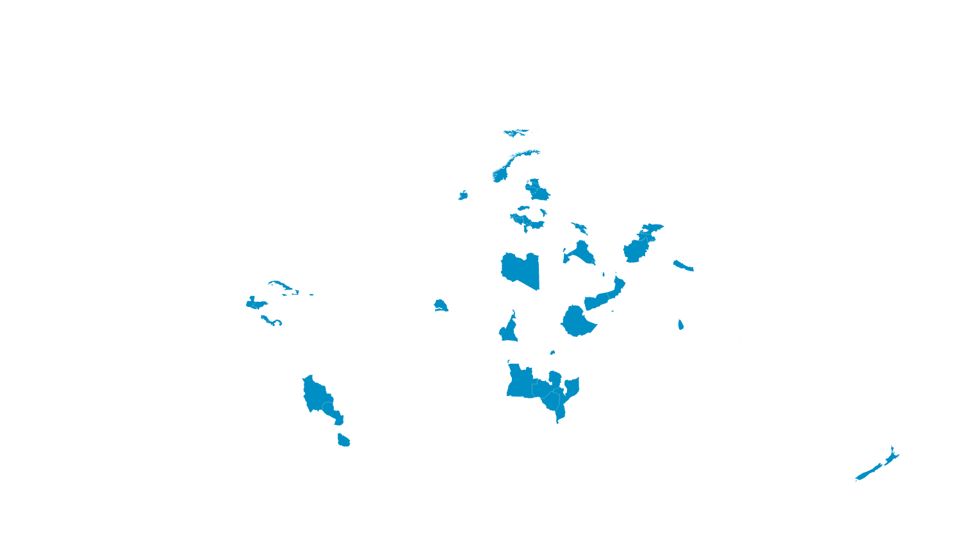


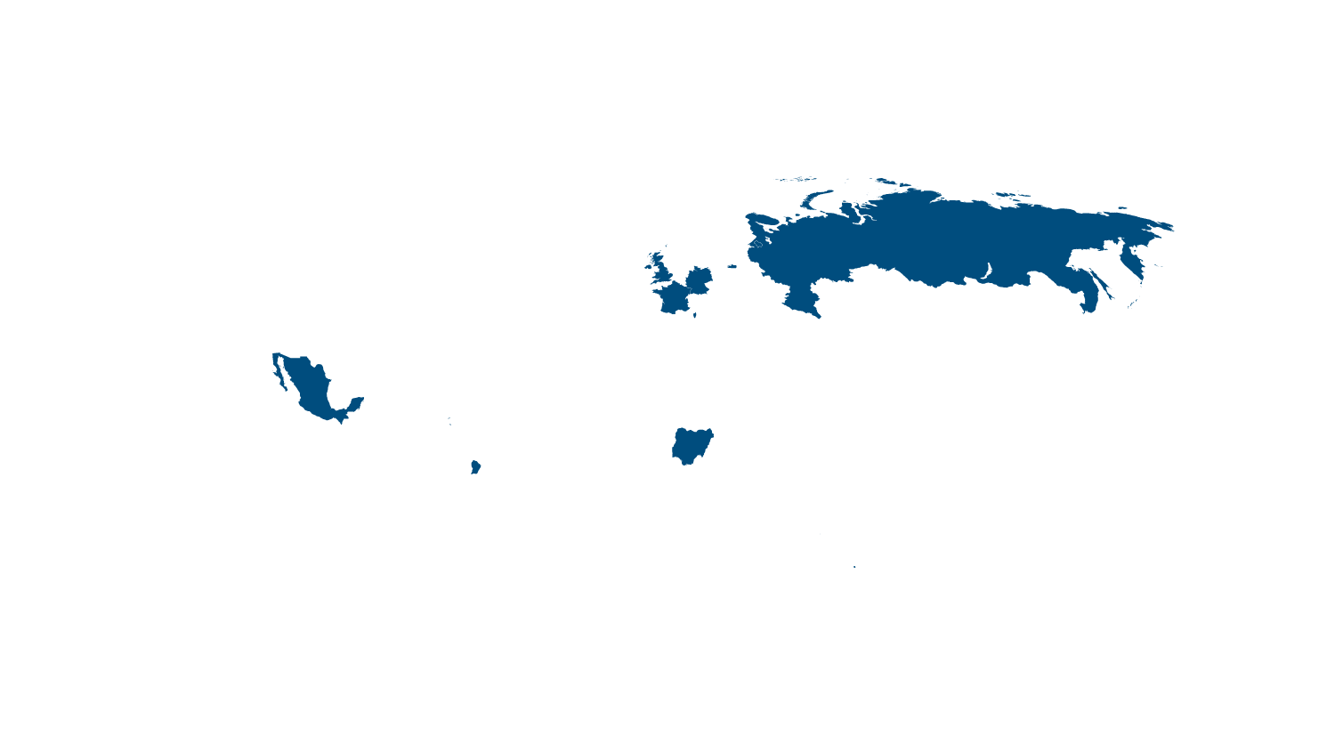


MSFT DRaaS … It’s everywhere!
CANADA CENTRAL
UK SOUTH
CHINA SOUTH
US GOV IOWA
CANADA EAST
UK WEST
WEST EUROPE
GERMANY NORTHEAST
KOREA CENTRAL
GERMANY CENTRAL
CHINA NORTH
KOREA SOUTH
CENTRAL US
JAPAN EAST
WEST US2
INDIA CENTRAL
NORTH CENTRAL US
WEST US
NORTH EUROPE
US DOD EAST
US GOV ARIZONA
US DOD CENTRAL
JAPAN WEST
SOUTH CENTRAL US
EAST US
EAST US2
EAST ASIA
US GOV TEXAS
US GOV Virginia
INDIA SOUTH
WEST CENTRAL US
SOUTHEAST ASIA
AUSTRALIA EAST
BRAZIL SOUTH
AUSTRALIA SOUTHEAST
Recently added

