Slide 1

SQL Server Data Classification with SQL Server 2019
Steve Hughes
Director of Consulting
February 2019

Slide 2
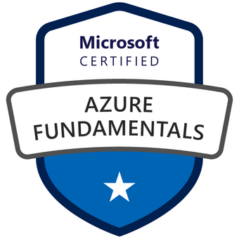



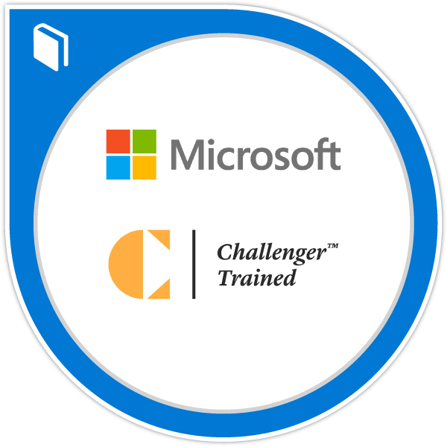

About Steve
Director of Consulting
20+ Years with SQL Server, Microsoft BI, and Azure
https://www.linkedin.com/in/dataonwheels/
steve@dataonwheels.com
Blog: dataonwheels.com

Slide 3

Beyond the Database
Current protections in SQL Server to protect the database
  Encryption
  Row Leve Security (RLS)
  Active Directory
Focus on data at rest or in motion
This Photo by Unknown Author is licensed under CC BY-SA

Slide 4
Data Classification & Labeling
Data Classification has multiple purposes
  Classify to identify sensitive data
  Classify to organize data
Labeling
  Classification labeling makes sensitive data visible
SQL Server Can Help!
  SQL Server Management Studio 17.5 or later – Data Discovery & Classification
  SQL Server 2012 and later supports classification labeling in the database

Slide 5
Today’s Demos Use
SQL Server Management Studio 18.5
  18.4+ Allows you to manage the information protection policy
SQL Server 2019 (Developer Edition)
  sys.sensitivity_classifications system catalog view
SQL Server 2012, 2014, 2016, 2017 use Extended Properties to support labeling
  sys_information_type_name
  sys_sensitivity_label_name

Slide 6
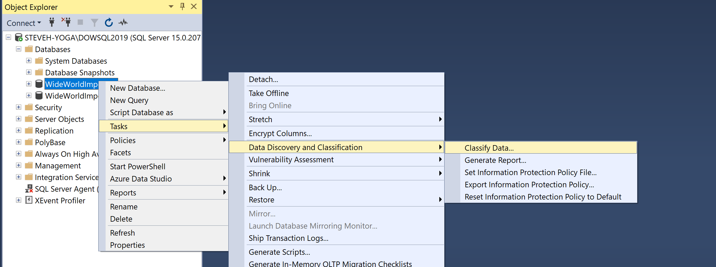
Let’s classify, label, report

Slide 7
Steps
Choose the database to discover data on
Use the Classify Data … tool
Review results by clicking results bar
  Columns discovered
  Information Type
  Sensitivity Label
Accept Selected Recommendations
Add Classification
Save
View Report

Slide 8

Be Aware
Your mileage will vary when not using English
Additional GPDR types may not be identified yet
Expect ongoing improvements
  The tool is delivered with SSMS not SQL Server

Slide 9
Built In Information Types
Networking
Contact Info
Credentials
Credit Card
Banking
Financial
Other
Name
National ID
SSN
Health
Data of Birth
n/a

Slide 10
Built In Sensitivity Labels
Public
General
Confidential
Confidential – GPDR
Highly Confidential
Highly Confidential – GPDR
[n/a]

Slide 11
Data Is Classified, Now What?
Let’s look at Information Protection Policies in SQL Server
  You can customize this to match what you need
Microsoft is looking at more improvements and capabilities
  Look for new capabilities as part of SSMS
Azure SQL Database has auditing available built in to support IP policies, SQL Server does not have this capability built in yet
  Triggers potentially can be used if Audit of these are required, but still a manual process
We have a great start here and improvements will
continue to come in SSMS.

Slide 12
Have Any Questions?

