Slide 1
Dimension Load Patterns with Azure Data Factory Data Flows
Bob Rubocki – Practice Manager, BI Architect
July 30, 2019

Slide 2
Agenda
ADF Data Flows background
Type 1, Type 2 review
Demo

Slide 3
Bob Rubocki
Practice Manager & BI Architect, Pragmatic Works
brubocki@pragmaticworks.com
linkedin.com/in/robertrubocki
@BobRubocki
bobrubocki.wordpress.com

Slide 4
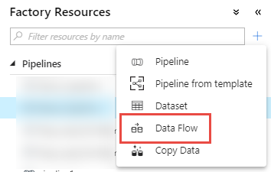
ADF Data Flows
AKA “Mapping Data Flows”
Visual data transformation tool
Create Data Flow, execute via Pipeline
Preview feature
ADF Data Flows <> Power BI dataflows

Slide 5
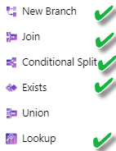
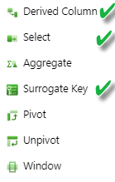
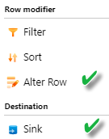
ADF Data Flows - Transformations

Slide 6
Databricks
Apache Spark
Open Source
High performance analytics, streaming, machine learning
Databricks
Fully managed Spark clusters
Workspace tools, notebooks
Azure Databricks
Azure Infrastructure
Available in AWS
Runs on a server cluster
Scheduling tool
Azure service integration

Slide 7
Dimension Load Patterns
Type 1
Insert new items
Update existing items if changed
Type 2
Historical values maintained in separate records. Each item may have more than one record.
Insert new items
Current dimension values only, no history tracked
Insert new record with current values of existing items
Update previous record with expiration date
Changed Items

Slide 8
Dimension Examples
Type 1
Type 2

Slide 9
Demo Architecture and Scenario
Source data has been extracted, loaded to ADLS Gen 2
Star schema DW in Azure SQL DB
Two demos = two dimension tables, same structure
IDENTITY not used – need to generate surrogate key

Slide 10
DEMO

Slide 11
Questions?

