Slide 1
Data Storytelling with Power BI: An Exercise in Information Leadership
LinkedIn: Erin Ostrowsky
eostrowsky@pragmaticworks.com
Blog: Data-radiant.com
Twitter: @RadiantData

Slide 2
Hello, my name is…
Erin Ostrowsky
BI Consultant/Trainer
Writer/Creator/Traveler
LinkedIn: Erin Ostrowsky
eostrowsky@pragmaticworks.com
Blog: Data-radiant.com
Twitter: @RadiantData

Slide 3
Agenda
A little different today….
High level about Leadership → Information Leadership
Interaction → Self Assessment (Self & Others)
Practical Application: Power BI & Data Storytelling Tips

Slide 5
Information Leadership?
An approach to leadership that “uses data to drive the mission, vision and values into the daily work.” (Sommers, Denise)
May involve leadership of:
Information resources and infrastructures
Social knowledge processes
Organizational learning
#Influence #MultiFaceted #Dynamic

Slide 7
Participation – What’s Your Style?
https://www.mindtools.com/pages/article/leadership-style-quiz.htm
Authoritarian or Autocratic
Democratic or Participative
Delegating or Lassez-faire
Key Q: What does the success of your mission/project/team NEED from you?

Slide 8
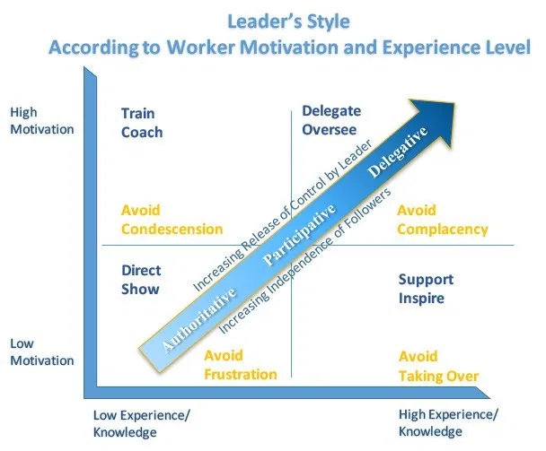
Situational Awareness

Slide 9
Dig a little deeper

Slide 10
Key Takeaway: Know Thyself… And Others!

Slide 11
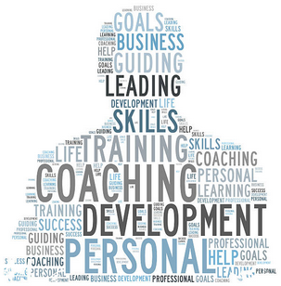
Practical Application
Take an inventory of self and others
Define your areas of influence
Understand how leadership styles impact and interact on your project(s)
Skills based focus
Training
Mentorship
Communication Skills
Are leaders born or made?
Develop yourself regardless of your answer to that

Slide 12
Business Intelligence Leadership + Power BI = A bridge between business and technology

Slide 13
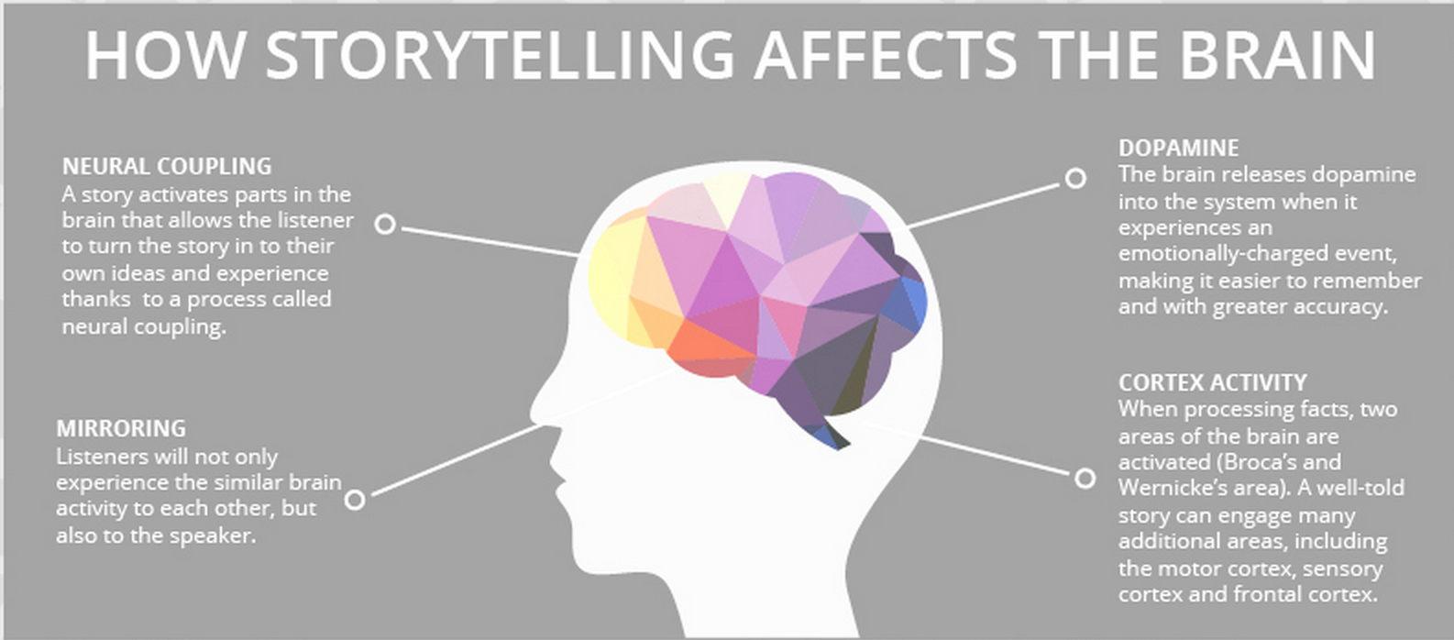
Why Is Storytelling Important?
Stories have always been one of the most effective tools for sharing information with others.
Notes:
https://www2.deloitte.com/insights/us/en/topics/analytics/data-driven-storytelling.html
Stories have always been effective tools to transmit human experience; those that involve data and analysis are just relatively recent versions of them. Narrative is the way we simplify and make sense of a complex world. It supplies context, insight, interpretation—all the things that make data meaningful and analytics more relevant and interesting.
https://www.onespot.com/blog/infographic-the-science-of-storytelling/
Storytelling is one of the oldest forms of both teaching and entertainment. It is the way history was traditionally recorded, how values were inculcated, and how families and neighborhoods bonded.
Our brain is really build for telling and listening to stories
When we hear stories it releases dopamine into our system that place emotions behind data, which make it easier to remember.
Another other neat thing about our brain is that when listening to a story our brain tends to turn the story into our own ideas and experiences
Have you ever heard a story that you weren’t a part of but when listening to it you can picture yourself there. That’s part of what makes stories so effective.

Slide 14
3 Key Elements of Data Storytelling
Notes:
https://www.forbes.com/sites/brentdykes/2017/04/25/adventures-in-data-storytelling-three-key-traps-to-avoid/#6be4e6a73234

Slide 15
Purpose / Focus
Start
Start with the end first
Call
E.g. Call to Action, Changing Minds, Culture, Belief
Build
Build the story out – One brick at a time, leading the audience to the conclusion to end of the story.
Notes:
What is the purpose of a presentation or of displaying data? When telling a data story the story should be intentional, direct, and purposed.
Do you want the hearers to open their checkbook and support a cause?
Do you want them to volunteer their time, energy, and network to help and support your cause?
Do you want to make them believe, make them believe that they can have a difference and it is possible.
Do you want to change the culture, change the environment?
Start the data story with an end in mind and then support that with a well-structured story through data.

Slide 16
A Few Guidelines
“5-Second Rule”
Rule of Odd Numbers
Symmetry vs. Balance
Flow Top Left to Right
White Space = Important
Colors Matter → Palettes

Slide 17
Themes
Custom Themes
Personal, Community
Branding, Branding, Branding
Gather HEX Codes
https://community.powerbi.com/t5/Themes-Gallery/bd-p/ThemesGallery

Slide 18
Background Images
Work Smart, Not Hard
Use Basic Tools
Consider Branding
Focus is Data, not Background
Consistency Across Design

Slide 19
Resources
Data Stories Gallery:
https://community.powerbi.com/t5/Data-Stories-Gallery/bd-p/DataStoriesGallery
Power BI Custom Visuals:
https://appsource.microsoft.com/en-us/marketplace/apps?product=power-bi-visuals
Power BI layouts and theme generator:
https://powerbi.tips/layouts/

Slide 20
Reference & Resources
https://gseuphsdlibrary.files.wordpress.com/2013/03/information-leadership-leading-with-the-end-in-mind.pdf
https://www.emerald.com/insight/content/doi/10.1108/AJIM-02-2014-0029/full/html
https://www.liveandlearnconsultancy.co.uk/different-leadership-styles/
https://www.mindtools.com/pages/article/leadership-style-quiz.htm

