Slide 1
Azure DevOps
Pragmatic Works Consulting
Jon Bloom
06/23/2020

Slide 2
About me
Jon Bloom
Pragmatic Works Lead Consultant
Azure Architect
IBM PC – 1983
Anthropologist, Banking, IT

Slide 3
Agenda
Why Azure DevOps
Continuous Deployment CI/CD
Azure DevOps – Services
Azure DevOps – Repos
Azure DevOps – Pipelines
Infrastructure as Code
Demo
Summary
Notes:
https://azure.microsoft.com/en-us/solutions/devops/#tools

Slide 4
Why DevOps?
What problem are we trying to solve?
Clients are looking for “Quick Wins”
Programming is a “Team Sport”
Deliver “Quality, Quickly, with Best Practices”
Integrates with “Data Governance”
Leverage “Azure DevOps”
Source Code management
Deployment options
Notes:
https://azure.microsoft.com/en-us/solutions/devops/#tools

Slide 5
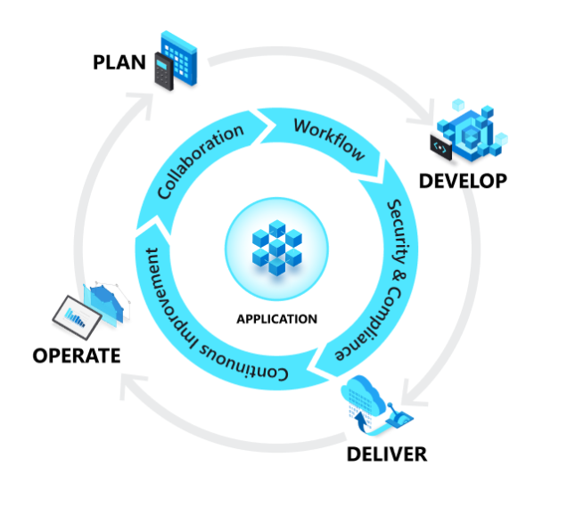
What is Azure DevOps
Azure end-to-end solutions
Plan (manage work)
Develop (Continuous Integration)
Deliver (Continuous Delivery)
Operate (monitoring, alerts, compliance)
“A DevOps culture breaks down siloed disciplines and unifies people, process, and technology to improve collaboration and coordination. As a result, code changes reach production—and new value reaches the customer—as soon as possible.”
Notes:
https://azure.microsoft.com/en-us/solutions/devops/#tools
https://azure.microsoft.com/en-us/overview/continuous-delivery-vs-continuous-deployment

Slide 6
Continuous Deployment CI/CD
Continuous Integration (CI)
Leverage source code “Repo”
Allow each developer a branch code
Merge into “root” branch
Trigger deployment
Continuous Delivery (CD)
Release continually and without errors
Automate Azure Infrastructure
Build environments seamlessly
Automate Azure code base
Deploy to Dev, Test/QA, Production
Notes:
https://azure.microsoft.com/en-us/overview/continuous-delivery-vs-continuous-deployment/

Slide 7
CI/CD Advantages
Changes are automated
build, validate, and test
Code is always deployable
no more release-day anxiety
Developers are more productive
fewer manual and administrative tasks
Small and frequent changes
failures are rare and create minimal instability.
Releases receive faster stakeholder and customer feedback
Notes:
https://azure.microsoft.com/en-us/overview/continuous-delivery-vs-continuous-deployment/

Slide 8
Infrastructure as Code
Stand up the Cloud Infrastructure / Resources
Repeatable
Reliable
Fully governed
Everything can be automated
Leverage “ARM” templates
Visual Studio Projects
Stored in Git
Deploy Resources using Release Pipelines
Automate
Triggers
Test
Approval
Notes:
https://docs.microsoft.com/en-us/azure/devops/learn/what-is-infrastructure-as-code

Slide 9
Data Governance
Azure DevOps is part of Data Governance
People
Board of Governors
Data Stewards
Data Custodians
Process
Who does what, when
Technology
Leverage Azure DevOps
Notes:
https://docs.microsoft.com/en-us/azure/devops/learn/what-is-infrastructure-as-code

Slide 10
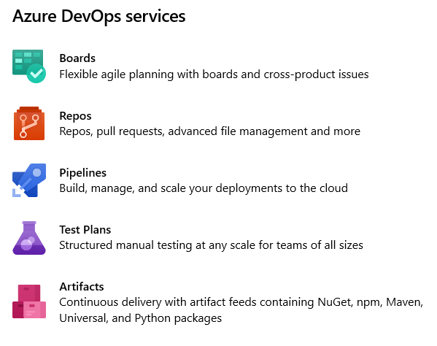
Azure DevOps - Services
Notes:
Agile planning and lean project management techniques are used to plan and isolate work into sprints, manage team capacity, and help teams quickly adapt to changing business needs. A DevOps Definition of Done is working software collecting telemetry against the intended business objectives.
Version Control, Usually With Git, enables teams located anywhere in the world to communicate effectively during daily development activities as well as to integrate with software development tools for monitoring activities such as deployments.
Continuous Integration drives the ongoing merging and testing of code, which leads to finding defects early. Other benefits include less time wasted on fighting merge issues and rapid feedback for development teams.
Continuous Delivery of software solutions to production and testing environments helps organizations quickly fix bugs and respond to ever-changing business requirements.
Monitoring and Logging of running applications including production environments for application health as well as customer usage, helps organizations form a hypothesis and quickly validate or disprove strategies. Rich data is captured and stored in various logging formats.

Slide 11
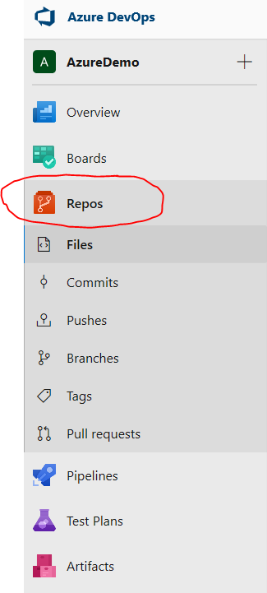
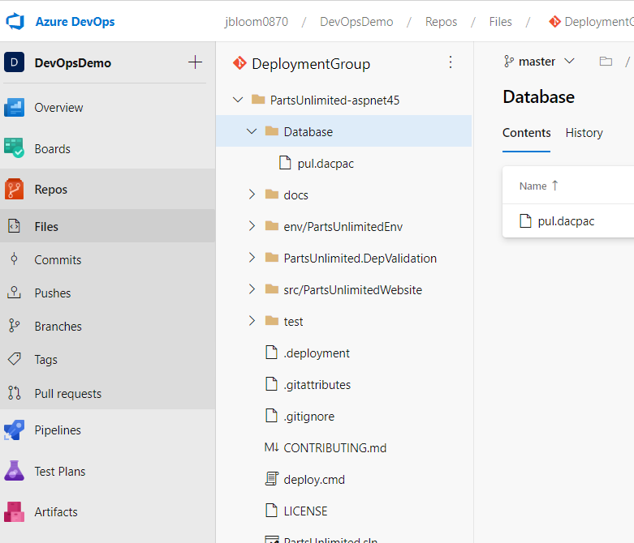
Azure DevOps – Repos
Notes:
This Webinar will discuss 2 topics, Repos and Pipelines

Slide 12
Azure DevOps – Repos
Files
Contains Source Code can have multiple Repository’s
Commits
Displays lifecycle of saves, branches, merges
Pushes
Displays each Push, as developers commits code to Repo with comment
Branches
Displays the branches for the repo, master is root branch
Tags
Use tags to mark a point in history that is relevant to the repository.
Pull Requests
Pull requests allow you to review code and help ensure quality before merge

Slide 13
Repos (Source Control)
Azure DevOps Server
Was Visual Studio Team Foundation
Git
Most used version control system today
Git creates a commit (snapshot) with every Push
Pull requests merges code
Apply CI/CD trigger execute Pipeline
GitHub offers many Git Samples
https://github.com/MicrosoftDocs/azure-devops-docs

Slide 14
Git Benefits
Simultaneous development
Faster releases
Built-in integration
Strong community support
Git works with your team
Pull requests
Branch policies

Slide 15
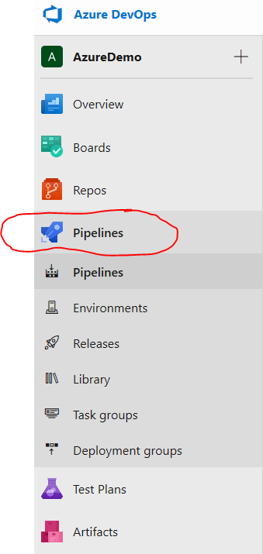
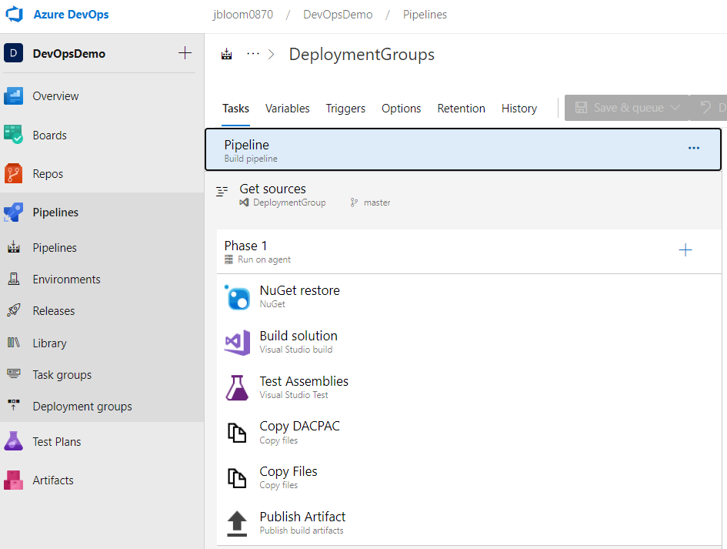
Azure DevOps – Pipelines
Notes:
This Webinar will discuss 2 topics, Repos and Pipelines

Slide 16
Azure DevOps – Pipelines
Pipelines
Automate your build and release processes
Environments
Manage deployments, view resource status and get full end to end traceability
Releases
Automation of Deployments
Library
Create groups of variables that you can share across multiple pipelines.
Task Groups
Standardize and centrally manage common build and deployment steps for your applications.
Deployment Groups
Define a logical group of target machines for parallel deployment.

Slide 17
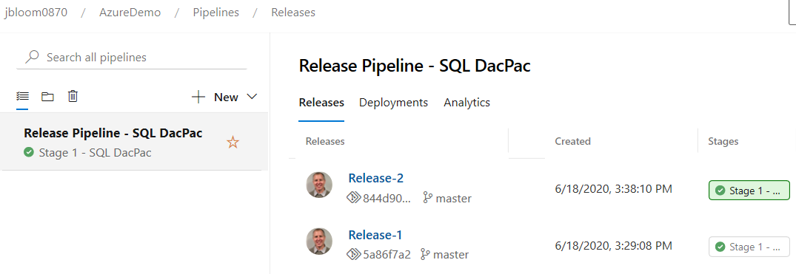
Azure DevOps – Releases
Deploy code base using Cloud based Utility
A lot of Extensions to choose from
ARM Templates, DacPac, extensions++
Repeatable, Automated, Audit Trail, Approvers, Emails

Slide 18
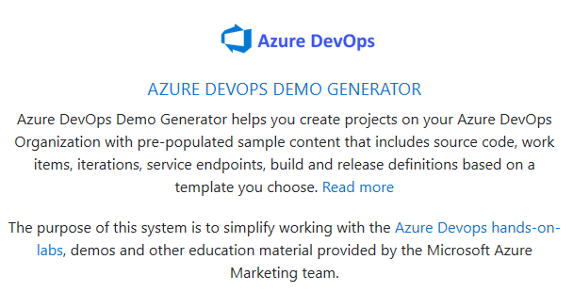
Azure DevOps Demo Generator
Search for sample projects
https://azuredevopsdemogenerator.azurewebsites.net

Slide 19
Demo…

Slide 20
Summary
Why Azure DevOps
Continuous Deployment CI/CD
Azure DevOps – Services
Azure DevOps – Repos
Azure DevOps – Pipelines
Infrastructure as Code
Notes:
https://azure.microsoft.com/en-us/solutions/devops/#tools

Slide 21
If you want to discuss Azure DevOps in detail or have questions on Azure, contact us and we will be happy to discuss it further and your team.
Phone: (904) 413-1911
Email: hello@pragmaticworks.com
THANK YOU!

