Slide 1


Introduction to DAX
Mike Davis, Consultant Architect

Slide 2

Intro to Dax
Your Presenter
Mike Davis
  BI Architect
  MDavis@Pragmaticworks.com
  MikeDavisSQL.com
  Co-author of 5 SQL Books

Slide 3

Example of a page header
Intro to DAX
Agenda
What is DAX?
Basic Functions
Calculations
Measures

Slide 4

Intro to Dax
What is DAX
Data Analysis Expression Language
  Calculated Measures
  Calculated Columns
  Calculated Tables
Why DAX?
  Similar to Excel Expressions
  Leverage knowledge of Excel Expressions
  Less of a learning curve

Slide 5

Intro to Dax
Basic Functions String Manipulation
Formatting
  FORMAT
Concatenating
  CONCATENATE
Casing
  LOWER
  UPPER
Trimming
  LEFT
  RIGHT
Splitting
  MID
Searching
  SEARCH
  FIND
Replacing
  REPLACE
  SUBSTITUTE

Slide 6

Intro to Dax
Conditional and Logical Functions
Testing (True/False)
  ISBLANK
  ISERROR
  ISNONTEXT
  ISNUMBER
  ISTEXT
Logical
  AND
  OR
  NOT
  IF
  IFERROR

Slide 7

Intro to Dax
Demo
Creating Calculated Columns
Using String Functions
Using Logical Functions
Notes:
Show intellisense
Full Name Col &
Age (datediff)
Age Groups = if nested ( 55+, 45-54, 35-44, 18-34)
Matching Parenthesis )
Multi line Shift+Enter

Slide 8

Intro to Dax
Review
Understand DAX Basics
Concatenate “&”
Conditional Logic
Nested If’s
Use “&&” for And

Slide 9
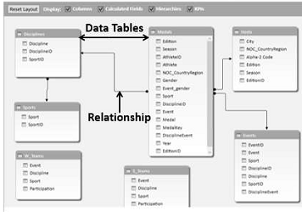
Intro to Dax
Navigation Functions
RELATED
RELATEDTABLE
Notes:
Move one column to another,
kind of like a vlookup
Whiteboard tables
Go Over Hierarchies

Slide 10
Intro to Dax
Demo
RELATED
RELATEDTABLE
SumX
Navigation
Notes:
Import and use Temperature Key
Related Region & Related monthnum
Related Table – Put SalesAmt on Sales Terr – High Vol region
SumX(RelatedTable(sales), SalesAmt)
Region Volume = if sales > 1,000,000 high, low)

Slide 11
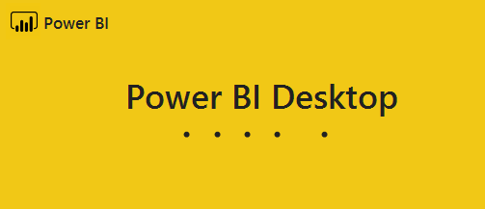
Intro to Dax
Review
Related
RelatedTable
SumX
Navigation

Slide 12

Intro to Dax
Calculated Tables
Create a Date Table
Filtered Down Tables

Slide 13
Intro to Dax
Demo
Creating Calculated Tables
Notes:
Create Date Table
Show Set as Date Table
Calendar ( startDate, EndDate)
1/1/2015 – 12/31/02018
Parse out Month , year, MonthName,

Slide 14
Intro to Dax
Review
Calculated Table
Built a Date Table

Slide 15
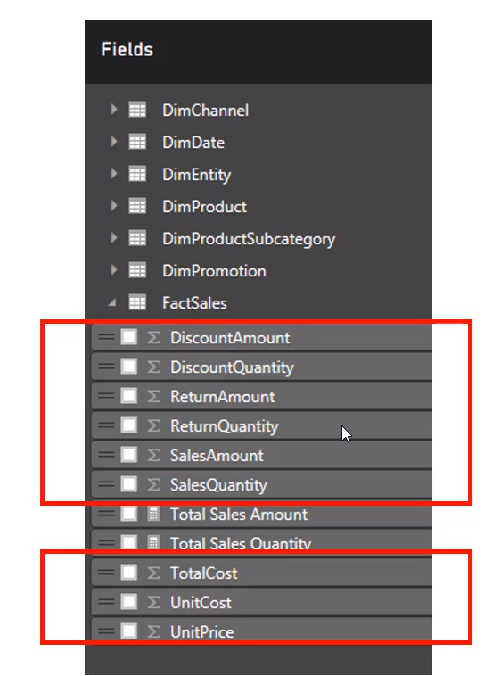
Intro to Dax
Calculated Measures
Implicit Measures
  Default Aggregations
  Numeric Columns

Slide 16
Intro to Dax
Calculated Measures
Implicit Measures
  Default Aggregations
Explicit Measures
  User Defined
  Formulas
Avoid Implicit Measures
  Explicit can Build on each other
  Explicit can be controlled

Slide 17
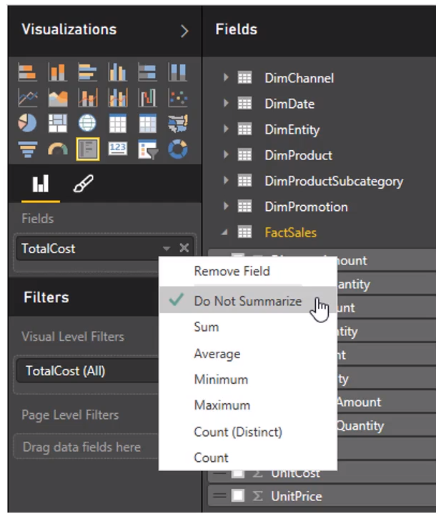
Intro to Dax
Aggregations
Average
Count
CountRows
Max
Min
Sum
SumX

Slide 18
Intro to Dax
Demo
Creating Calculated Measures
Notes:
Show Icon in field list
Sum Internet sales
Sum cost
Profit = Sales – cost
Profit Margin = Profit /Sales
Explain Divide Function
US Profit = Calculate ( profit , country = US)
Show Quick Measure

Slide 19
Intro to Dax
Review
Calculated Measures
Implicit vs explicit

Slide 20

Intro to Dax
Wrap up
Mdavis@PragmaticWorks.com
PragmaticWorks.com
  Consulting
  Training

Slide 21



Pragmatic Works Training
Bootcamps
Week long deep-dive
Workshops
One-day training primer
On-Demand Training
Web-based subscription training
Special On-Demand Training discount for Azure Data Week attendees to get $100 off a 12-month Elite subscription.
AzureDataWeek

