Slide 1
Intro to Data Storytelling with Power BI
LinkedIn: Erin Ostrowsky
eostrowsky@pragmaticworks.com
Blog: Data-radiant.com
Twitter: @RadiantData

Slide 2
Hello, my name is…
Erin Ostrowsky
Technical Trainer/Content Developer
Writer/Creator/Traveler

Slide 3
Agenda
11:00-11:15 Intro to Data Storytelling with Power BI
11:15-11:20 Showcase Power BI Data Stories
11:20-11:50 Resources & Tactics
Themes/Background Images/Custom Visuals
Bookmarking/Selection Pane
Tooltips → “Cooltips”
11:50+ Questions

Slide 4
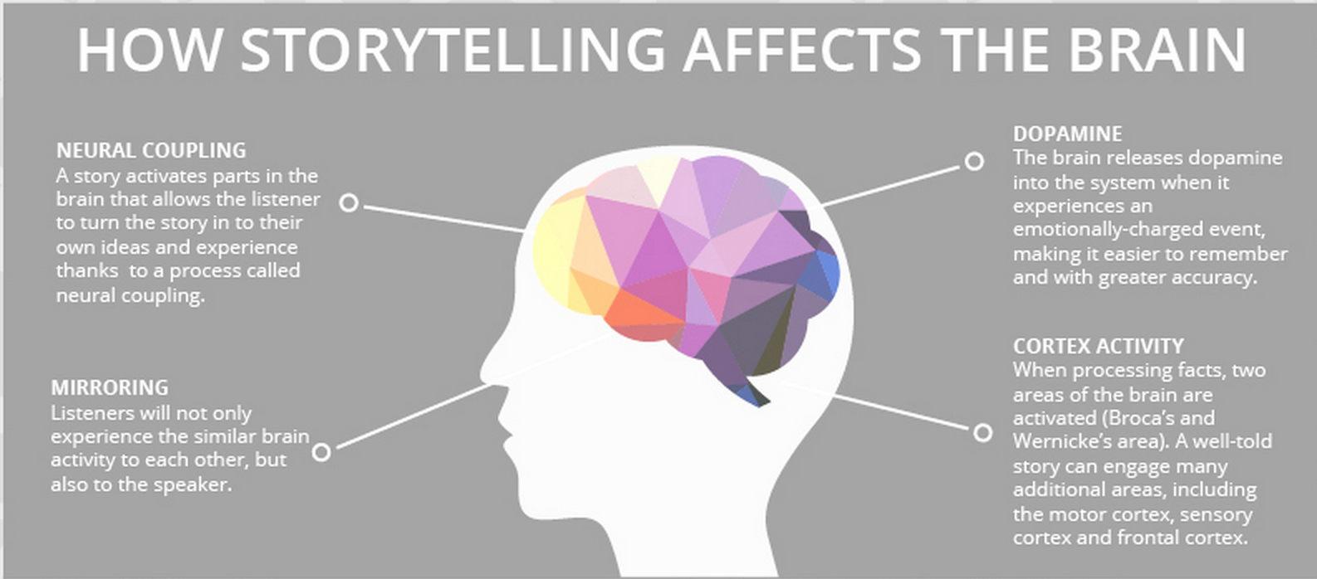
Why Is Storytelling Important?
Reason #1
Stories have always been one of the most effective tools for sharing information with others.
Notes:
https://www2.deloitte.com/insights/us/en/topics/analytics/data-driven-storytelling.html
Stories have always been effective tools to transmit human experience; those that involve data and analysis are just relatively recent versions of them. Narrative is the way we simplify and make sense of a complex world. It supplies context, insight, interpretation—all the things that make data meaningful and analytics more relevant and interesting.
https://www.onespot.com/blog/infographic-the-science-of-storytelling/
Storytelling is one of the oldest forms of both teaching and entertainment. It is the way history was traditionally recorded, how values were inculcated, and how families and neighborhoods bonded.
Our brain is really build for telling and listening to stories
When we hear stories it releases dopamine into our system that place emotions behind data, which make it easier to remember.
Another other neat thing about our brain is that when listening to a story our brain tends to turn the story into our own ideas and experiences
Have you ever heard a story that you weren’t a part of but when listening to it you can picture yourself there. That’s part of what makes stories so effective.

Slide 5
Why is Storytelling Important?
Reason #3
Stories that incorporate data are more convincing than those based on anecdotes.
Notes:
https://www2.deloitte.com/insights/us/en/topics/analytics/data-driven-storytelling.html
Most people can’t understand the details of analytics, but they do want evidence of analysis and data. Stories that incorporate data and analytics are more convincing than those based on anecdotes or personal experience. Perhaps the most compelling stories of all are those that combine data and analytics, and a point of view or example that involves real people and organizations.
Have you ever had someone try to make their points solely based on anecdotes? Or they say things like this happens all the time but they don’t have any data to back it up? Those usually are not very effective or convincing stories

Slide 6
Why Are We Not Doing This Now?
Reason #1
Those that are great at analytics often (not always) struggle with telling stories.
Notes:
https://www2.deloitte.com/insights/us/en/topics/analytics/data-driven-storytelling.html
Analytics people often aren’t that motivated or successful at communicating with carbon-based life forms. They gravitated toward structured, unambiguous, unchanging fields like math and statistics and computer science in school, and they continue to favor interaction with numbers over interaction with humans in their work careers. Of course, not all quantitative analysts are of this persuasion, and someone with a strong numerical focus can transition over time to be more human and literary in their orientations. But let’s just acknowledge that telling compelling stories to other humans may not come naturally to many analysts.

Slide 7
Why Are We Not Doing This Now?
Reason #4
It takes some analyst more time to think creatively about how to tell a good story with data.
Notes:
https://www2.deloitte.com/insights/us/en/topics/analytics/data-driven-storytelling.html
It takes a lot of analysts’ time to think creatively about how to tell a good story with data. In fact, one senior analyst at a pharmaceutical company told me that he (and most members of his analytics group) spend about half their time thinking about how best to communicate their analytical results. Many analysts will be reluctant to devote that much time to the issue, even if it would make them more effective.

Slide 8
3 Key Elements of Data Storytelling
Notes:
https://www.forbes.com/sites/brentdykes/2017/04/25/adventures-in-data-storytelling-three-key-traps-to-avoid/#6be4e6a73234

Slide 9
Purpose / Focus
Start with the end first
E.g. Call to Action, Changing Minds, Culture, Belief
Build the story out – One brick at a time, leading the audience to the conclusion to end of the story.
Notes:
What is the purpose of a presentation or of displaying data? When telling a data story the story should be intentional, direct, and purposed.
Do you want the hearers to open their checkbook and support a cause?
Do you want them to volunteer their time, energy, and network to help and support your cause?
Do you want to make them believe, make them believe that they can have a difference and it is possible.
Do you want to change the culture, change the environment?
Start the data story with an end in mind and then support that with a well-structured story through data.

Slide 10
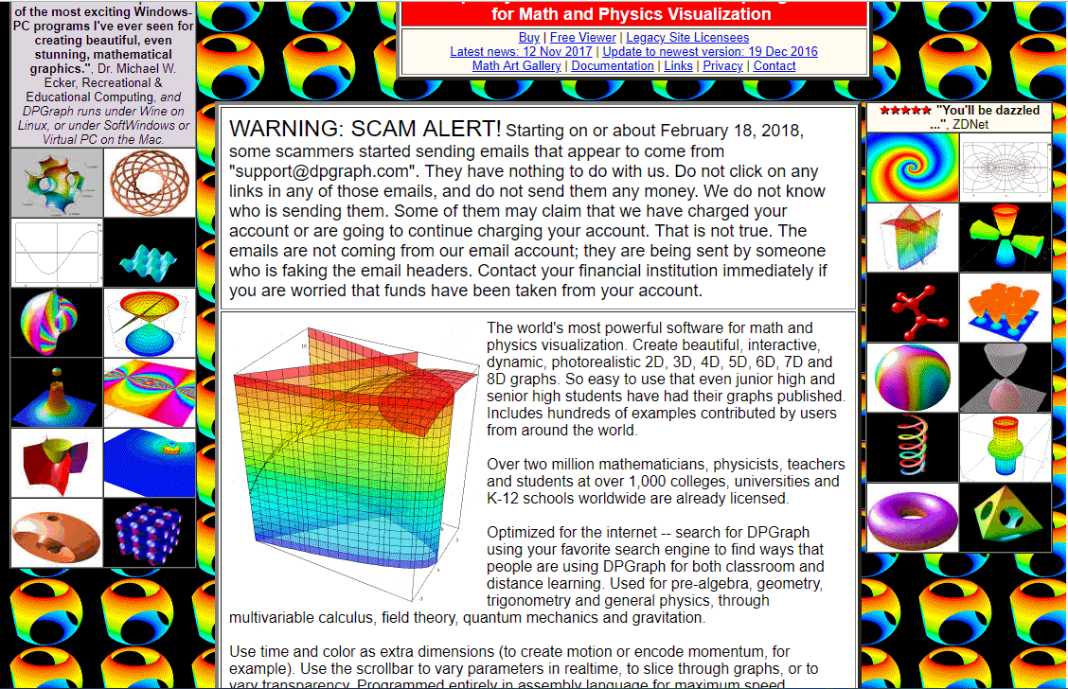
Less is More
Notes:
https://www.columnfivemedia.com/7-report-design-and-storytelling-tips

Slide 11
Resources
Data Stories Gallery:
https://community.powerbi.com/t5/Data-Stories-Gallery/bd-p/DataStoriesGallery
Power BI Custom Visuals:
https://appsource.microsoft.com/en-us/marketplace/apps?product=power-bi-visuals
Power BI layouts and theme generator:
https://powerbi.tips/layouts/

