Slide 1
Introduction to Azure Machine Learning Studio
Manuel Quintana
Email : Mquintana@pragmaticworks.com
Blog: Wordpress.sqlrican.com
Twitter: @Sqlrican

Slide 2
Agenda
Azure Machine Learning product overview
Azure ML development process
Demo – build and deploy a predictive model

Slide 3
Manuel Quintana
Training Content Manager
@SQLRican
Sqlrican.wordpress.com

Slide 4
Azure ML Basic Workflow

Slide 5
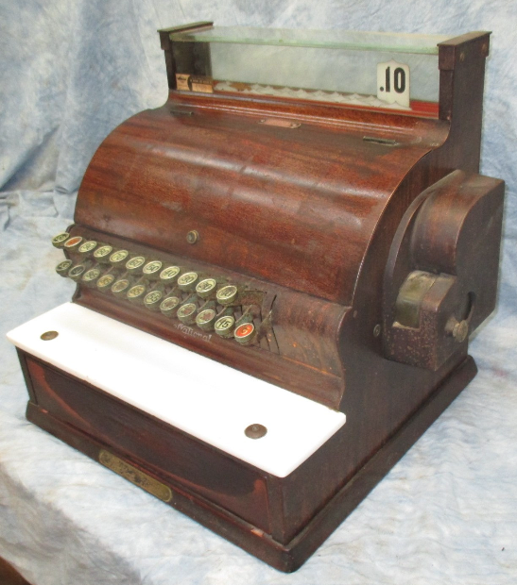
Cost
Machine Learning Workspace
Storage (req’d for Workspace)
Web Service / API
* Free Workspace also available

Slide 6
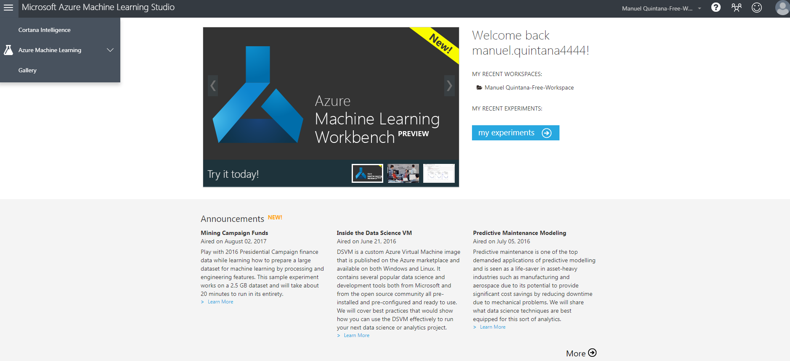
Azure ML Home Page
https://studio.azureml.net/
Links
Videos
Help
Forums
Other Resources
Notes:
Machine Learning Studio is a workbench environment that you access by using a web browser. Machine Learning Studio hosts a pallet of modules in a visual composition interface that helps you build an end-to-end, data-science workflow in the form of an experiment.

Slide 7
Data Science Terms
Data Science
Extracting knowledge from data
Statistics
Collecting and analyzing numerical data for the purpose of inferring proportions in a whole from those in a representative sample.
Machine Learning Algorithms
Computer algorithms that can grow and change when exposed to new data
Predictive Analytics
Practice of extracting information from existing data sets in order to determine patterns and predict future outcomes and trends
Descriptive Analytics
Looks at data and analyzes past events for insight as to how to approach the future
Model
A set of data, statistics, and patterns that can be applied to new data to generate predictions and make inferences about relationships. A representation of reality

Slide 8
Model Types in Azure ML
Anomaly Detection
Identify and predict rare events
Fraudulent transactions, test-taking patterns
Classification
Binary outcome or category
Spam, will a customer buy/leave, movie rating
Regression
Predict a value
MPG, new building utility usage, temperature
Clustering
Group items based on common features
Customers with similar buying patterns
Recommendation
Suggest things a person may like/not like
“You may also like…,” movies, music, restaurants, products

Slide 9
6 Steps to Machine Learning
Get the Data
Clean the Data
Transform the Data
Model the Data
Score and Evaluate the Model
Deploy the Model

Slide 10
Demo ML Experiment
Predict Acceleration
Make/Model, horsepower, weight, MPG, etc.
Supervised Learning – we know acceleration for training data
Regression – Predicting a value

Slide 11
Azure Machine Learning Environment
Predicting Automobile Acceleration with
Azure Machine Learning

