Slide 1

High Availability and Disaster Recovery
Michael Wall

Slide 2
Who am I??
Senior Database Administrator with years of experience supporting a variety of database engines (Oracle, SQL Server, Ingres) on multiple OS platforms (Windows, UNIX, VMS, Azure).
Local SQL Server User Group Leader and Regional Supporter
SQL Saturday Presenter
Big on Community
Go to http://pass.org and sign up!
Go to http://sqlsaturday.com and look for SQL Saturdays coming to your neck of the woods.

Slide 3
Highly Availability – Continuity
First of all, HA is not DR, and DR is not HA.
High Availability (Highly) is there to keep the data and the applications available for the business, ie, your users
This all flows back to IT maintaining business continuity.
This also is an opportunity for Senior IT staff to work with the business to understand what systems really need to be running.

Slide 4



Ways to provide HA
Hardware
Software
Data
There are number of different ways for IT to provide HA.

Slide 5

HA – How your hardware is at risk
Power supplies – most systems have dual power supplies that are hot swappable
Network cards – dual NICs are fairly common
Error Checking RAM
Storage layer – both local and network storage
RAID levels help protect your disks
Data Center connectivity??
Notes:
Servers have been evolving for the past twenty years with many new improvements like redundant power supplies, dual network cards, ERROR checking RAM, but the disks are always going to be one of the main problems.
Locally attached disk utilizes RAID technology along with hot swappable disks to maintain the server and the applications running on it. RAID 5 and RAID 10 are both great examples of ways for your local storage to protect your data. But….does the disk array have redundant connectors???
Also, even if your data is protected this way, is the OS disk also protected? A downtime is a downtime, and if the OS disk dies, no server.
In addition, what about a UPS for your server? It might be just enough to keep the server running without interruption while the main power is restored/redirected.
If your company has direct interaction with the people managing the data center, whether it be onsite or at a remote location, it’s best to find out what sort of redundant features are in place to make sure that there aren’t any blips in delivering data and applications to the business.
What about your connection to the data center? If your “pipe” goes down, no one can connect to the applications. Having a backup WAN connection can be a really good idea.
It’s a little dizzying thinking about all of the permutations which is why it’s best to have a good conversation with the business about what really needs to be up and running!

Slide 6
HA – How your software can provide continuity
Backup and Restore – kind of in both the HA and DR camps
Log Shipping – an oldie but a goodie
Mirroring – still working as well as before
Always On Availability Groups – the latest and greatest
Windows Failover Clusters – It has to be there for Always On to work
Replication – It just works
Notes:
SQL Server comes with a lot of features that provide Highly Available data and applications. Some of these features are as old as SQL Server 2000, but they’re all valid and have their own pros and cons
Backup and Restore – A good backup plan provides High Availability and a good restore plan provides Disaster Recovery. By taking regular backups, your data is protected and those backups can be restored (logs mostly) to allow a quick recovery back to before the problem started.
Log Shipping – a very dependable technology that provides automatic restores of logs to maintain an additional copy of the database. One side benefit is the fact that depending upon the interval and your response time, that second copy will have a NON-affected copy of the data which means
a) Stop the restore of the logs
b) Get a copy of that non-affected database back as soon as possible.
Mirroring – As long as a witness is being utilized, a Synchronous failover will happen, ie, the mirror will be current. Note – there will be some scripting involved to point any clients at the new location of the database. If the witness is not being used, the failover cannot be automatic and the mirror will not be completely in sync (ie, asynchronous). Mirroring is mirroring to another SQL Server instance.
Always On AGs – the latest and greatest for SQL Server HA. They work just fine, but Windows Failover Cluster also has to be installed on the servers, increasing the overall cost. Synchronous or Asynchronous?
Replication – It still works just fine and allows a form of HA. By using replication of databases, MULTIPLE copies (ie, subscribers) can be created, thereby providing availability of the data to the business. Note, while the replicated copy could be used with an application, a lot of scripting would need to be performed to repoint everything.
In all of these options, the standby, the secondary, the subscribers can all be used by the business at a minimum for readonly.

Slide 7
HA – Stupid Data Tricks
Using SQL commands to make sure that certain key tables are always available for the business.
Scripting out your database objects and keeping them in additional locations.
Notes:
While replication and restores can be used to make sure that tables are available, sometimes just a simple copy of the table is all that’s needed for the business.
Just like I mentioned in my Backup and Recovery Webinar at the beginning of the month, there are some simple tricks that can be used to keep those tables available.
Also, keeping key DB objects may be a good plan for your business. Using SSRS as an example, there can be stored procedures, views, etc that are necessary for the generation of the reports. What happens if the data is available, but not the database objects that are necessary to make the reports run? You can keep this from becoming a DR scenario by making sure the objects are available.

Slide 8




Big Picture Stuff - HA
HA is there to keep the business running but….
Mistakes are going to be made and eventually there might be a DR or Disaster Recovery scenario
Notes:
Remember, it’s actually Highly Available. In other words, the data, the application, the needs of the business can be made highly available, but not ALWAYS available.
Take a deep breath and step back.
First of all, even though it might seem like the weight of the world is on your shoulders and all the responsibility is yours, really the responsibility is to have the discussion with the business about their options.
You’re going to perform heroic actions no matter what to keep everything running, but at the end of the day, there is a limit to what you can actually keep running.
Second, after having the discussion with the business about the RPO and RTO for EVERY system – come up with a plan on how best to meet those demands. That IS your responsibility.
Third, implement it all as best as you can and then document the whole plan.
Make sure you do this while keeping all the systems running and everything else…. Right?

Slide 9
Dealing with Disasters
Disaster Recovery – once you’ve gone past the point of Highly Available
Any recovery is a disaster, no matter how small.
Where does the DBA fit in to all of this?
Notes:
All of the clever tricks and software has finally failed. The system is down. The users are unable to connect. You might have to start calling people.
That’s ok. Keep your head. No matter how tough a situation it is, there is probably a solution, and the best to get there is to be calm about it and just move forward.
It’s not just the data at risk, it’s also the time of your customers and your company.
Ideally the DBA will be one of the key people that will know where the important parts are located, how to implement the plan, and how to recover the system and the data.

Slide 10
Dealing with Disasters
Take a breath….it’s not necessarily all your fault.
It’s your fault when you didn’t have the conversation with the business, much like during the HA conversation.
Remember, HA is keeping the disaster from happening as long as possible, while DR is dealing with it after the fact.
Four main topics, Hardware, Software, Data, and People
Notes:
First off, assess the situation.
Look at the scope, triage the problem. While there may be a bigger issue that needs to be fixed, due to the time it will take to recover the system (bring offsite tapes onsite or copying the backups onsite or spinning up that secondary server), there may be something else smaller that can be done right now!
Since you had the conversation with the business and you know what’s important, it will be easier to make that decision and implement it!
It also could be that another system is ready to tip over the cliff, but you can put some measures into place to keep it from becoming another disaster!

Slide 11
DR – Hardware Style
Secondary servers – either hot or cold
Alternate data centers
What about legacy equipment?
Notes:
The primary server is gone, whether it’s in house, in another data center, or up in the cloud.
What’s the plan?
Ideally there will be a secondary server available, one that is either Hot (up and running and ideally current), or Cold, meaning it has to be started up and then have the last backup restored onto it.
If it’s a hot server, perhaps certain applications and or services have to be shutdown due to this server now becoming the primary!
If it’s cold, let the customers know and make a cup of coffee.
If your DR plan involves another data center, the hot/cold conversation still applies along with any other changes like pointing applications to the right place!
Don’t forget about the storage discussion. Perhaps the servers are just fine, but your SAN or NAS has given up the ghost. Was the right person making sure that that device/infrastructure was being copied to another location? If a multi-terabyte disk array goes kaput, it might take a little while for it to come back online!
Part of your discussion with your data center provider should encompass the following topics – network redundancy, server redundancy, power redundancy for the whole data center (ie, battery backup and generator) as well as PEOPLE redundancy. What measures do they have in place to make sure they have the staff to cover during a disaster.
Legacy equipment. What if you have some old servers that need specific harddrives or other parts to function? Better make sure those are on the shelf and ready to go!

Slide 12
DR – Software – Backup and Recovery
Now that recovery strategy is put into play
RPO should already be agreed upon by the business.
RTO comes into play.
How long to have access to the backups?
What needs to be restored to bring the business online?
Where are you going to restore the backups?
Notes:
The actual servers have been planned out, maybe even a blended strategy that involves both an alternate terrestrial data center as well as one in Azure.
If backups are not being automatically restored on these server, how long will take to get the backup to the server and how long will it take to restore it on the server??
Anything else that needs to restored in order get the business online? Users/Roles/Security in general? DNS records need to be changed? Perhaps there is a critical shared file that is missing? All of this has to be planned for as best as possible.
Another fun gotcha, make sure there is enough space to restore the backups!

Slide 13
DR – Software – Grey Areas
Log Shipping – primary database was lost, now the secondary is your only hope.
Mirroring – you’ve failed over, now what?
Always On AG – Hope one of your secondaries was in a different location!
Replication – How do you switch the business to use one of your subscribers
Notes:
These are all issues that you may run into if you try to use your secondary databases as primary.

Slide 14
DR – Data – Can you run a business?
Another grey area and really part of backup and recovery
What critical tables/objects/rights/users are needed to make the business limp along?
Notes:
Perhaps the business can get by with certain tables. As a clever DBA, you were already making copies of these tables to make sure they were there for the business just in case….
They might be half measures, but if you have some critical data available that will allow the business to function well enough even if you don’t have all the transactions available at this point in time.

Slide 15

DR – People!!!!
People will be needed to make sure everything is up and running.
This has to be part of the original plan agreed upon by the business, whether it be inhouse staff or outsourced staff, there has to be a plan in place.
Notes:
Work with HR…..work with HR……work with HR……
In order to make any HA and/or DR plan work, the business has to make sure the people resources are available for when the crisis hits.
Simple things like team calendars can make it a lot easier for planning and perhaps keep from losing too many resources at once.
Have a phone list available.
The business can also plan on having extra resources available oncall for such a situation.

Slide 16
DR – Work Environment
Part of the people discussion, but what if “the office” is no longer accessible.
Randolph West has a great blog post about keeping a copy of your personal tools and work environment in the cloud:
https://bornsql.ca/blog/disaster-recovery-tools-edition/
Notes:
How long does it take to recreate your work environment when you get a new laptop at work? How long would it take when the network was down and you were under stress? Perhaps in a natural disaster, you are stuck on the wrong side of the bridge/lake/city/ocean. But, if you were able to get any network connection, you could then login to your trusty extra development workstation with all of your tools and connections and passwords and start fixing things!
Randolph’s article is a good point of how you can be a little more ready.

Slide 17
A word from Microsoft...
https://cloudblogs.microsoft.com/sqlserver/2019/10/30/new-high-availability-and-disaster-recovery-benefits-for-sql-server/
Changes were made to the Software Assurance Licensing model in late 2019
Notes:
Our friends at Microsoft want to make sure that if you are paying for Software Assurance, you have some good solid options.
Microsoft has added extra benefits for existing Software Assurance customers.
Before they were allowed one extra instance for HA only, but now you can have both the included HA instance
as well as up to two stand-by (ie, asynchronous instance) instances for DR purposes. In addition, the HA (synchronous) instance can also be in Azure,
so the only cost there will be for the server costs, not the licensing anymore.
“All supported versions” are covered under this, so it may go back as far as 2008R2.

Slide 18
A word from Microsoft...
What’s the difference between synchronous and asynchronous???
To synch or to asynch, that is the question….
Notes:
A synchronous replica is being written to at the same time as the primary storage. This allows for automatic failover scenarios.
An asynchronous replica is being written to after the primary storage has been written to. This can be a very short delay, but it means it will still be slightly behind and there could be data loss.
But, advantages include a big savings on bandwidth and it can also help improve performance. It usually gets down to I/Os, so in an asynchronous situation, the writes will be serial instead of being parallel, which will save a lot of time and effort.

Slide 19
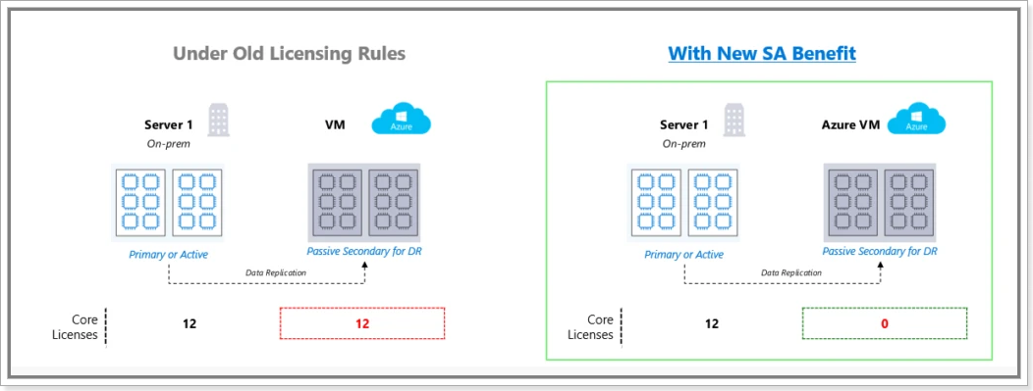
A Word from Microsoft…

Slide 20
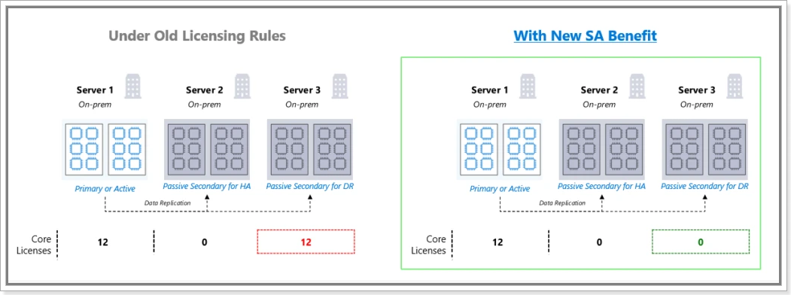
A Word from Microsoft…

Slide 21
A word from Microsoft...
That’s great, but I can’t afford SA!!!
You just have to be more creative….
Notes:
Look at your hardware needs and your licensing costs.
Microsoft does licensing for both Enterprise and Standard based on the CORE price. If your HA or DR server has fewer cores, it’s a lower cost.
The Server + CAL model is still a viable option. The Server standalone price is VERY low, but you have to have CALs with it. In a DR scenario, perhaps only a few critical staff are needed to make the business run, so the Server + CAL model might work just fine.
The truth is, do what you need to do to get the business working – ie, ask for forgiveness rather than permission. Worry about a licensing audit down the road.
Finally, have that conversation with the business about how creative you might need to be in order to get the job done and keep the business running!
How much is your time worth? Perhaps it would be better for the DBA to be working on additional plans instead of worrying about saving some dollars on licenses. I am guilty of this one as well!

Slide 22
Utilizing Azure for your HA and DR needs.
This is where the cloud can really shine.

Slide 23
Advantages of Azure
First of all, your data center is already located “offsite”.
Second, Microsoft is making sure that even the most minimum (ie, cheapest) options already have multiple forms of redundancy in place.
Third, depending upon your business needs, your DR instances can easily be shutdown and brought back up, again saving on cost.

Slide 24
Disadvantages of Azure
Your network was already your biggest bottleneck, now it’s your only lifeline.
Microsoft does a really good job, but there are outages and also you have to understand how to best take advantage of the options.
Depending again on the needs of the business, having something “more local” means that your business is in control of the communication, not the vendor.

Slide 25
Disadvantages of offsite options in general
These problems are with any offsite datacenter, whether it be Azure or any other vendor.
Your data and your HA/DR options are connected via ….. NETWORK.
Don’t make the mistake of spending lots of money on a solid HA/DR solution and then only have one network option…

Slide 26
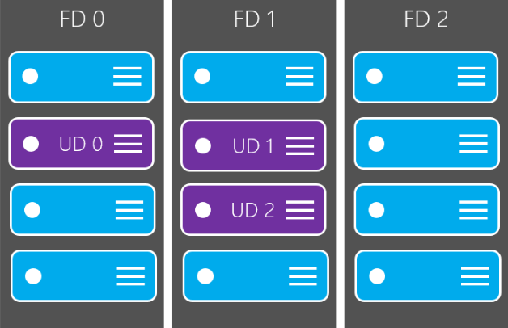
Why Azure is pretty neat!
Every Azure Data Center is set up with Fault Domains and Update Domains
Notes:
Each Fault Domain represents a standalone server rack with redundant network connections and power supplies, just like in an on-prem data center.
Update Domains are used for patching and maintenance and are spread across Fault Domains within an Availability Set.
The point of all of this is to make sure that Azure VMs are not impacted by downtimes at a server (rack) level either through hardware/network issues or due to maintenance issues.

Slide 27
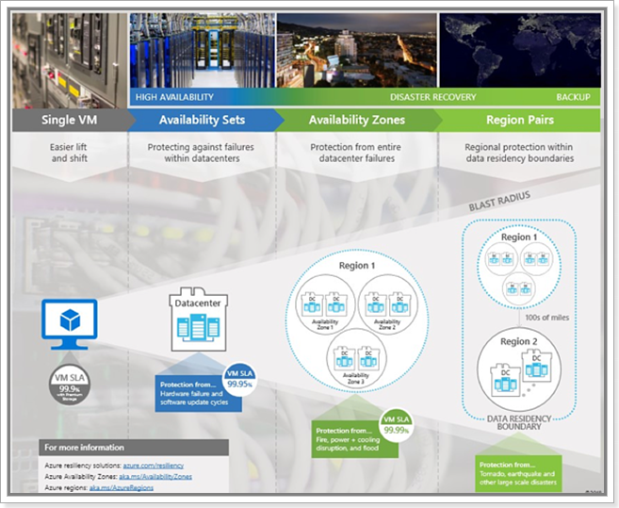
Why Azure is pretty neat!
Availability Sets and
Availability Zones and
Region Pairs
oh my!
Notes:
Availability Sets – covers a single data center
Availability Zones – covers multiple data centers in a Region
Region Pairs – offers protection across regions
Each one of these options offers progressively more protection and more expense.
These options and concepts were certainly available before through data centers, especially the larger companies; Microsoft is just packaging it all under the Azure name.

Slide 28
This is a little complicated…
It is, but whether having a local onsite option or working with another vendor to provide offsite support, it’s essential to keeping the business running.
Remember the basics, Hardware, Software, Data, and People

Slide 29
Checklist Time!!!
Working with the business:
  Each System – Criticality Level and RTO/RPO
  What are ALL of the components needed for the application?
  Can we limp along with table X or component Y?
  Who are the staff members needed during a crisis?
  Is it documented?

Slide 30
Checklist Time!!!
Working with the Infrastructure Team:
  Each System – Hardware Redundancy and Storage
  Legacy Systems – do we have hard to find components available?
  Networking – is there redundancy there?
  Who are the staff members needed during a crisis?
  Is it documented?

Slide 31
Checklist Time!!!
Working with the data team
  What measures are being used for HA and DR?
  Is it documented?
  Is it automated?
  Who are the staff members needed during a crisis?
  Critical workstations/tools/passwords/accounts/phone numbers

Slide 32
Checklist Time!!!
Communicate, communicate, communicate!!!
Don’t hide problems, make sure your management and the executive team are aware of them!
Document, document, document and then have a REVIEW!
Don’t work in a vacuum, cover yourself and cover the business.

Slide 33
Something completely random…
And yet on point…
Don’t forget about using SQL Azure for your Log Shipping/Mirroring/Replication needs. It’s a low cost way to provide HA and DR type features for your business.

Slide 34
Something completely random…
And their take on SQL Azure HA capabilities…
The Azure SQL Database platform takes responsibility for maintaining High Availability (HA) by tightly integrating with Azure Service Fabric (ASF). ASF allows persistence of data and log files using N-way replication on local SSD disks. We can take advantage of having data and log files on local SSD for maximum possible performance - without risking a single point of failure.

Slide 35
What didn’t we cover???
Pricing for all the different options
How to configure these different options
Random Chaos – testing the disaster before the disaster – always a good idea!
Anything else?

Slide 36
What did we cover??
The differences between HA and DR as a concept
HA features in current server hardware
HA and DR features in SQL Server offerings
The pros and cons of using Azure (and any other data center vendor)
Some of the cool features that are available in Azure to promote business continuity
Plan, talk, collaborate, document, review, and present.

Slide 37
Have Any Questions?
Thank you!!!!

