Slide 1

SQL Server Security Best Practices
Michael Wall

Slide 2
Who am I??
Senior Database Administrator with years of experience supporting a variety of database engines (Oracle, SQL Server, Ingres) on multiple OS platforms (Windows, UNIX, VMS, Azure).
Local SQL Server User Group Leader and Regional Supporter
SQL Saturday Presenter
Big on Community

Slide 3
Security – Yeah, it’s your job
Everyone should be mindful of security, but the DBA is in a special place.
Know your systems, know your customers, know your data.
The DBA is still usually considered the gatekeeper to the data in the organization.
Notes:
The DBA is dead, long live the DBA!
The database administrator’s job, while much maligned and expected to die out at any time is still very much alive and well, thanks to the incredible amount of data out there which is only growing in leaps and bounds.
We’re going to cover recommended practices for securing your servers and environment.
The DBA needs to be aware of their whole enterprise so they can make the business appropriate decision. They need to take into account the business practices and needs and balance them against good solid security practices.
Unfortunately, it’s not always simple, and it’s not always an easy conversation, but it’s one of those things that has to be covered to protect the data, the business, and your job.

Slide 4




Big Picture Stuff
Gone are the days are using Domain Admin accounts for the SQL Server user. Local accounts are cool and reduce the attack surface.
Get ahold of a copy of Password Safe or some other password keeper to keep track of the SA passwords for each instance!
Notes:
I’m not saying that you can’t have a domain account named SQLServer, it just can’t have any rights, especially any domain rights. Having a SQLServer domain account is useful for sending email and even alerts if you want, but it should not have any filesystem access nor any service access.
It’s really simple now to set up SQL Server using local Service accounts. These are going to meet most of your needs.
The individual names are created by default in the SQL Server install process and will have access to their respective services and filesystems where appropriate.

Slide 5
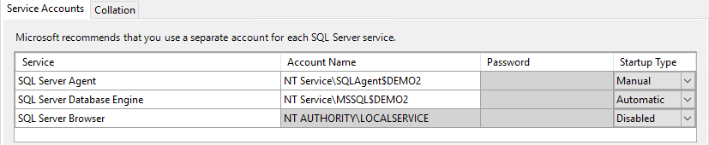
Local Service Accounts (Virtual Accounts)

Slide 6
Local Service Accounts (Virtual Accounts)
These are created automatically. No passwords to worry about and are designed with the rights that are needed.
Practical for most situations except for clustering.
For clustering it is recommended to use gMSAs, or group Managed Service Account.
This is a good time (during the install), to not install non-essential services.
Notes:
This presentation does not cover the use of gMSAs, but they are useful because they are recognized by the SQL Server Service(s) – SQL Server Engine, Agent, SSRS, and SSAS, and will work on a multi-node cluster. In this case, the service is started on another node using the same group MSA principal, minimizing any service disruption for the users.
Local Service Accounts take a lot of the guesswork out of usernames and passwords. There are not any passwords visible at all as they are all maintained by the server. At this time, think about whether you really need to install SSAS or some of the other services. Each one is just taking up extra resources from your server and increasing your exposure.
If you install something you don’t need, be sure to set it to disabled as a service. Since installing a new feature WILL be a downtime, it is often times better to install everything you think you might need up front and keep it disabled until needed.

Slide 7
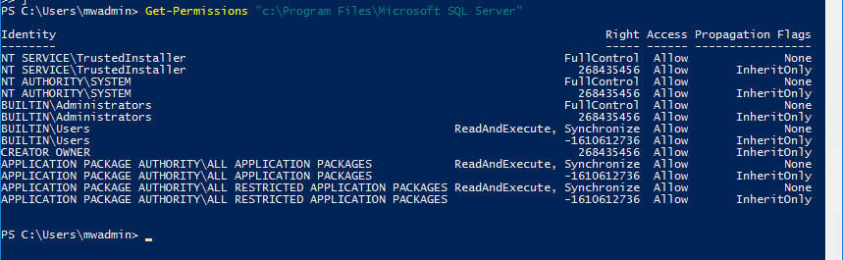
Which File Systems??
Notes:
PowerShell does really good job of showing the individual permissions as the Windows GUI does not expand.
In this case, the NT Service\MSSQLSERVER local account does not even have any control over the base (and default) c:\program files\Microsoft SQL Server filesystem.

Slide 8
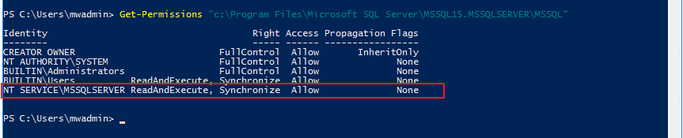
Which File Systems??
C:\program files\Microsoft SQL Server\MSSQL15.MSSQLSERVER\MSSQL – read and execute only
Notes:
PowerShell does really good job of showing the individual permissions as the Windows GUI does not expand.
Down a little deeper, the MSSQLSERVER user has read and execute access in the base MSSQL file system.

Slide 9
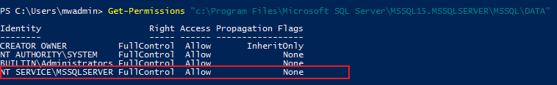
Which File Systems??
C:\program files\Microsoft SQL Server\MSSQL15.MSSQLSERVER\MSSQL\DATA – Full Control
Notes:
PowerShell does really good job of showing the individual permissions as the Windows GUI does not expand.
Going even deeper, in the DATA file folder, the default location for the .MDF files for the database, the NT Service\MSSQLSERVER local service account does finally have FULL Control over the filesystem. Up higher, it just wasn’t necessary!

Slide 10
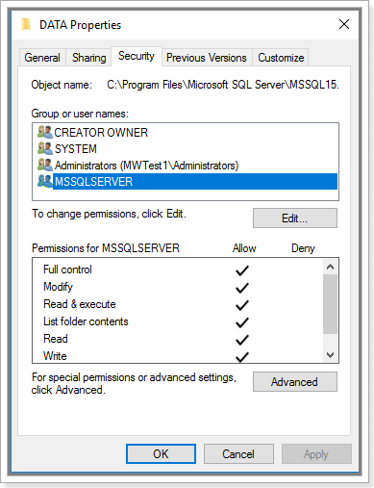
Which File Systems??
Notes:
Just for fun, the Windows GUI showing the rights on the filesystem.

Slide 11
Filesystems – why is this important?
These filesystem permissions are a good example of the Principle of Least Privilege.
Our friends at Microsoft have determined the minimum rights needed for the SQL Server user to run the SQL Server database.
This is an important concept to be used on systems, databases, data, and applications. In fact…..
Notes:
Just for fun, the Windows GUI showing the rights on the filesystem.

Slide 12

Filesystems – why is this important?
You should tattoo it somewhere…
Notes:
Remember, as a DBA, you have to balance between practicality and security. Sometimes you will need to grant more rights than you feel comfortable about in order to get the job done. That’s ok, do that, keep track of it, and come up with a good permanent solution.
Mention OneNote – even show a page.
Principle of Least Privilege is a guideline and a goal, not always a hard and fast rule.
But what does it mean? It means to give the user/application/service only the rights needed in order for them to get the job done.
One advantage of taking the time to perform this work up front means it will be documented and quite possibly can be reused in the future!

Slide 13
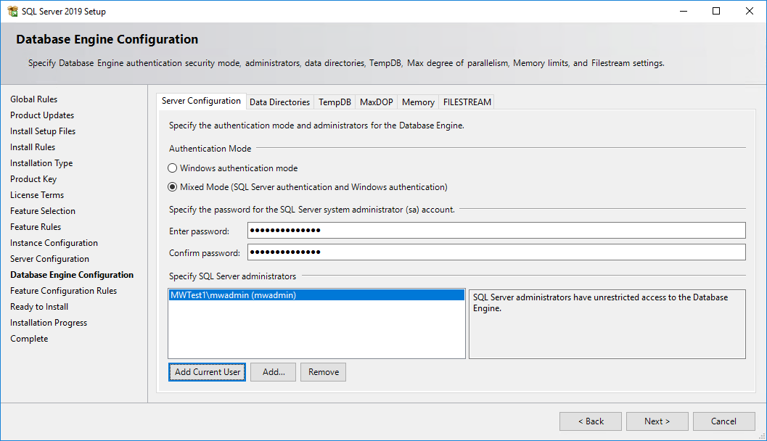
SQL Server Install - continued
That SA account….mixed mode authentication
Notes:
Speaking of balance, the SA account and mixed mode authentication are the cause for lots of discussion about security.

Slide 14
SQL Server Install - continued
That SA account….mixed mode authentication
Tons of information out there on securing the SQL Server
Set up a huge secure password
Rename the account (even though the SID will be same)
Disable the account
Remember – even if in Windows Authentication only, the SA account is still there
Notes:
Whether mixed mode authentication is enabled or not, the SA account and password will still exist as they are the owners of Master, MSDB, Tempdb, and Model. Remember, this is mixed mode AUTHENTICATION – can I connect to the SQL Server instance with a sql login in addition to a windows login?
If you choose not to enable Mixed Mode Authentication, please be sure to set the SA password securely anyway! If the server were hacked, it would just take a registry hack and restart to enable mixed mode authentication with a weak/none password for SA!
First of all, secure the account with a huge complicated password.
Second, you can rename the account to confuse attackers (briefly)
Third, disable the account. It will still retain ownership of databases and run SQL Agent Jobs.
Note – disabling the account is a practice that should be documented. Best practice in this case would be to plan on reenabling the SA account for any updates and patches. Setting up a huge secure password will go a long ways towards keeping all of this safe.

Slide 15

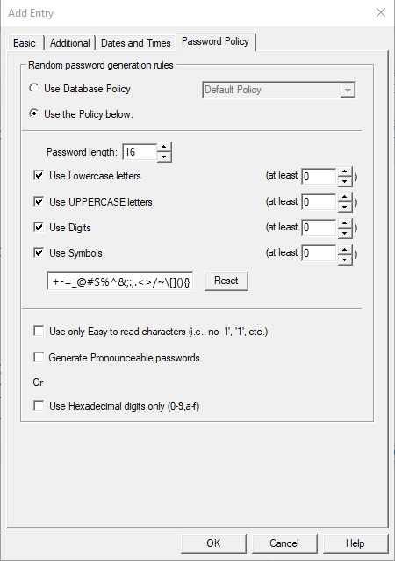
SQL Server Install - continued
Use a Password Keeper/Generator!!!
You’ll need an entry for the SA password on each install (at least you should….)
Notes:
Personally I use Password Safe. There is a perfectly good free version, and the paid version is pretty cool because it allows you to use a USB key to have a portable copy of your Password Safe. It also supports Yubikey for MFA. There are a lot of different products out there, none that are very expensive, but they will take the guesswork and danger out of password management.
Using the USB key will add an extra layer of security as there will not be a copy of the password file on your network at all…
The default policy is for an eight character password, go to your own policy, set the length to at least 16 and use all the symbols.
Be sure to use this for each SQL Server install (ideally).
In addition, use this tool to keep track of your other important passwords!

Slide 16
SQL Server Install - continued
Other reasons for mixed mode authentication
Legacy application requires it due to lack of support of Windows Authentication
Connection from a non-trusted domain is required to the application.
Linked Servers – Yes, you can use Windows Authentication, but it’s a lot easier using SQL Authentication.
SQL Azure – you don’t have a choice on this one.
Notes:
Often times, this can’t be avoided. There are lots of legacy (and not so legacy) applications that will not support Windows Authentication.
In addition, if it is needed to enable access from a non-trusted domain, a SQL Account will be the best option.
But, in this case, a better suggestion would be (if possible), to set up a “jump” box within your network. Allow the user from the non-trusted domain to logon to that jump box. From there, within in your network, connections can be made using Windows accounts. This option is only going to work when a human is involved. Things like ACH transfers and other automated types of jobs may still very much need to have a SQL authentication.
Linked servers – definitely will work with Windows Authentication, but it is complicated across multiple servers due to Kerberos authentication. Make sure the accounts are secure and locked down. You are the DBA, set up the accounts so they work. No one has to know the username or the password, just the linked server so they are able to get their work done.
Finally, SQL Azure instances, not SQL Azure MANAGED instances all require SQL Authentication. Here’s an opportunity to use that password keeper and generate some really nifty passwords.

Slide 17
Password policies…
First of all, SQL Server has robust password policy capabilities.
There is not any reason not to have your users generate complex passwords.
But…forcing them to change them often might create more problems…
Notes:
SQL Server can be setup to require all sorts of password policies, from length of password, to complexity, to required characters, to change requirements.
The question is, will the users come up with a brand new password each time, or will they just change their original Password1 to Password2?
This is an opportunity to make sure your monitoring is up to snuff. Make sure that you have failed logons checked in your security tab and set up a SQL Agent job that will automatically alerts you when there are too many failed logons in a row.
At that point, then contact the user and suggest/require that they change their password.
Also suggest that they look at setting up a password keeper….

Slide 18
Logins and Users
The Login is the access to the SQL Server instance – permission to walk in the door of the house.
The user is the access to the individual database – permission to go in the room of the house.
Zombie users - affects both Windows and SQL Users
Caused by restores of databases without re-linking the login and user and/or lack of login in general
It’s important to understand these fundamentals as they will always be a “gotcha”.
Notes:
After going down a detour on the SA account and SQL Logins, it’s important to take a step back and cover these important basics.
The login is the entrance to the server; without a login, there is no entrance.
The user is the entrance to the individual database; ie, the access to the data in the database.
While logins can exist and function without users, the users can only exist (ie, zombie users), but not function without a login.
Normally this is caused by the restore of a database to an instance that either does not have the corresponding login for the user or they need to be relinked. This is usually tied to SQL logins.
This issue can be fixed by recreating the login and then relinking the connection.
AD or windows logins cause their own issue when a user is termed from the company and then the administrators remove the AD account. This will leave behind debris of both the login and user.
It’s a good practice to clean your instances every couple quarters to make sure there aren’t any extra accounts sitting around as well as being a good security practice.

Slide 19
Logins and Users - continued
Working with your AD administrators and using AD logins and AD groups can be a huge time-saver.
The DBA does not have to worry about password policies or employee terming or onboarding.
In addition, AD groups can remove the DBA from the daily administration even further as the AD group is already setup with the needed rights and roles.
Notes:
AD logins can both be a headache and a time-saver.
Absolutely it’s an advantage to have another team take over the password management of the users. But, it can create issues when troubleshooting access issues. With a SQL login, the DBA has full control over the username and password and can make sure that the access is working appropriately ahead of time. With AD logins, the DBA is either working with the user on login issues or will need to add themselves to an AD group to test access.
By being further removed from the process of user administration, the DBA still needs to be vigilant about cleaning up “user debris”. Then again, they need to do this as well with SQL logins.
AD groups are a really great way to manage users. Not only is another department handling the user administration, the AD group, as its own entity, can make security administration much easier for the DBA as they can be added as members to roles.

Slide 20



All types of roles
Server Roles
Database Roles
Cinnamon Rolls
What’s a role? It’s a set of security instructions to which a user can be granted access by being made a member of the role.

Slide 21
Roles – how to make them useful
Remember this tattoo?
Notes:
While Cinnamon rolls are delicious, they’re not the type of roll that we need to worry about here in this presentation.
Ultimately, the rights of a SQL Server login or user get down to what abilities they have to influence the SQL Server Instance (Server Roles), the SQL Server Database (Database roles) or the data itself (Custom roles).

Slide 22
Server Roles
Impact the whole SQL Server instance
Their powers range from minor to destructive.
Grant these roles with caution.
There are custom Server roles – especially treat those with caution
Notes:
Sysadmin is the one that is written about all the time and it should be as it has complete power over the environment.
But, securityadmin is just as dangerous as it can grant you sysadmin rights…..

Slide 23
Database Roles
A DBA is going to spend a lot of their time at this level.
The roles for each database are limited to only the database and CANNOT affect other databases.
Most of your users will only need the db_datareader, even db_datawriter is dangerous!!!
Notes:
Dbo or database owner is going to be the one that most people will ask for when they are asking for rights.
Ultimately, the three that you will use the most will be db_datareader, db_datawriter, and db_ddladmin (in order to give the right to execute stored procedures)

Slide 24
Custom Roles
This is where a DBA can really shine.
By applying the Principle of Least Privilege, you can craft practical and useful roles for your customer that will protect the database, the data, and the user.

Slide 25
Adding members to a role
Logins are added to Server roles because they have the power to impact the whole instance.
Users (whether they be from SQL logins, AD user logins, or AD groups) are added to Database and Custom roles.

Slide 26
Adding members to a role – how it works
The initial role is designed in a database – it will have access to tables and columns.
A user of the database (whether it be a SQL User, AD user, or AD group) will then be added as a member to the role.
They will then have all the access of that role.

Slide 27
Basic Role
USE Database
Create login [LOGIN_FORMYROLE]
Create user [USER_FORMYLOGIN]
Create role [role_formydatabase]
Grant Insert on table to [role_formydatabase]
Grant Update on table.column to [role_formydatabase]
EXECUTE sp_addrolemember ‘ROLE_FORMYDATABASE’,’USER_FORMYLOGIN’
Notes:
Simple enough role here – it’s set up to have access to two tables in a database. A service-type login is created specifically to tie to this role. This is where roles will make a lot of sense for a service account. The user (because database roles are at the database level) is added as a member to the role. Any number of users can be added as members to the role.
If an AD group is created and added as a member to the role, then any AD user that is added to the AD group will automatically be added as a member of the role!

Slide 28
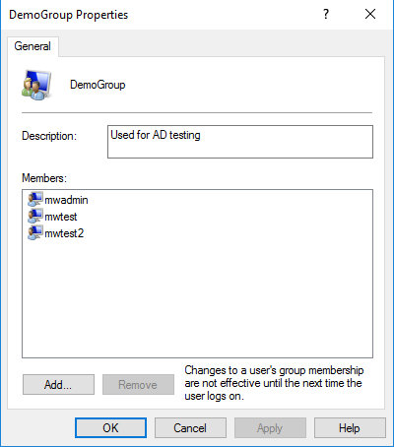
Basic Role – Breaking it down
Notes:
Creating my windows group and adding users to it.

Slide 29
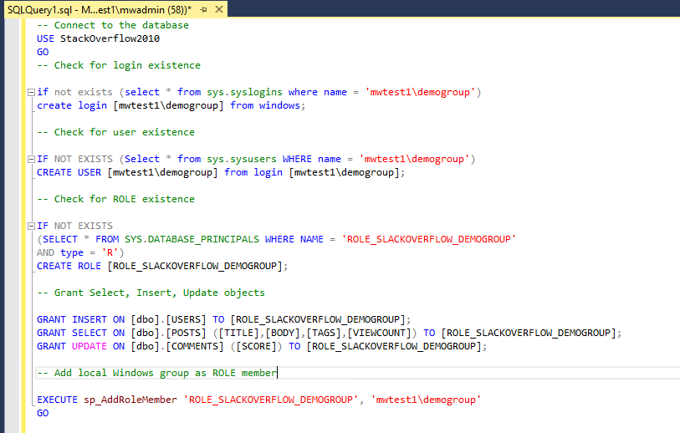
Basic Role – Breaking it down
Notes:
Here is the script for creating the role.

Slide 30
Basic Role – Breaking it down
-- Connect to the database
USE StackOverflow2010
GO
-- Check for login existence
if not exists (select * from sys.syslogins where name = 'mwtest1\demogroup')
create login [mwtest1\demogroup] from windows;
-- Check for user existence
IF NOT EXISTS (Select * from sys.sysusers WHERE name = 'mwtest1\demogroup')
CREATE USER [mwtest1\demogroup] from login [mwtest1\demogroup];
Notes:
Point out the defensive code here – useful to keep from having errors.

Slide 31
Basic Role – Breaking it down
-- Check for ROLE existence
IF NOT EXISTS
(SELECT * FROM SYS.DATABASE_PRINCIPALS WHERE NAME = 'ROLE_SLACKOVERFLOW_DEMOGROUP'
AND type = 'R')
CREATE ROLE [ROLE_SLACKOVERFLOW_DEMOGROUP];
Notes:
Point out the defensive code here – useful to keep from having errors.

Slide 32
Basic Role – Breaking it down
-- Grant Select, Insert, Update objects
GRANT INSERT ON [dbo].[USERS] TO [ROLE_SLACKOVERFLOW_DEMOGROUP];
GRANT SELECT ON [dbo].[POSTS] ([TITLE],[BODY],[TAGS],[VIEWCOUNT]) TO [ROLE_SLACKOVERFLOW_DEMOGROUP];
GRANT UPDATE ON [dbo].[COMMENTS] ([SCORE]) TO [ROLE_SLACKOVERFLOW_DEMOGROUP];
-- Add local Windows group as ROLE member
EXECUTE sp_AddRoleMember 'ROLE_SLACKOVERFLOW_DEMOGROUP', 'mwtest1\demogroup'
GO
Notes:
Key points here – granulated rights on columns in a table, follows PLP practices.
Adding the group as a member of the role.

Slide 33
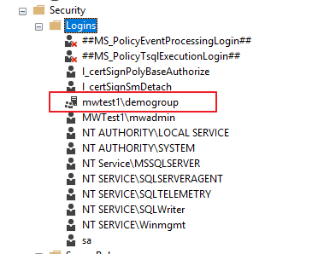
Principle of Least Privilege in action
Notes:
No need for individual accounts anymore due to the group having access.

Slide 34
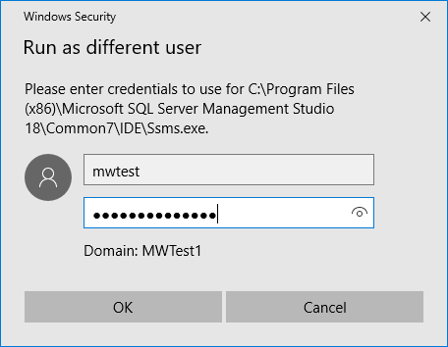
Principle of Least Privilege in action
Notes:
Running SSMS as another user in the group that only has rights via the group.
Important note, this group has no filesystem access whatsoever!!!

Slide 35
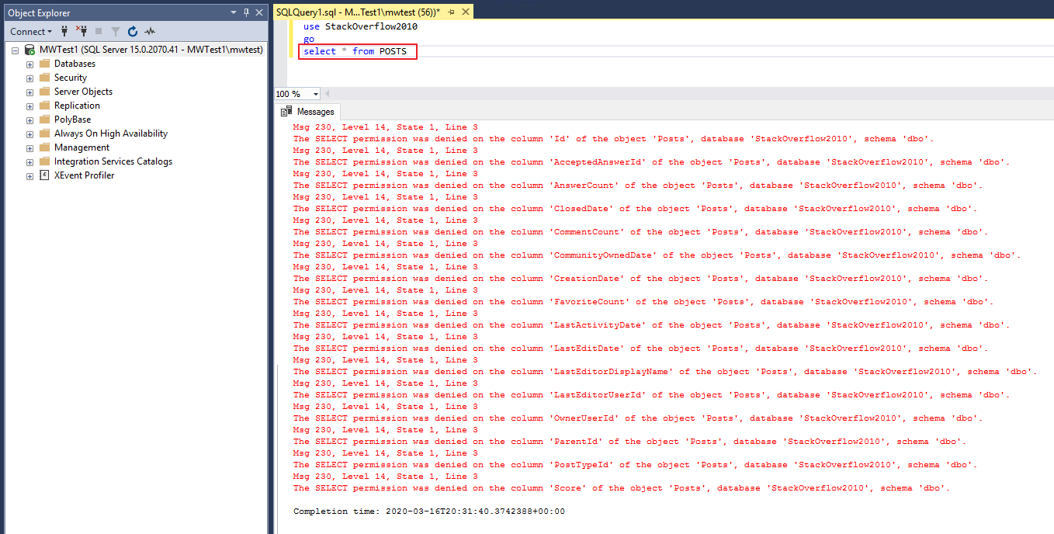
Principle of Least Privilege in action
Notes:
Obviously we can’t do a select * from table due to the restrictions in the ROLE.

Slide 36
Principle of Least Privilege in action
GRANT SELECT ON [dbo].[POSTS] ([TITLE],[BODY],[TAGS],[VIEWCOUNT]) TO [ROLE_SLACKOVERFLOW_DEMOGROUP];
Notes:
Here is the line in the role for that table. Note that the group only has access to select four of the tables.

Slide 37
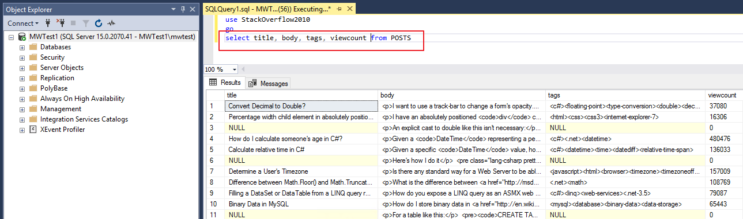
Principle of Least Privilege in action
Notes:
When the allowed columns are selected, everything works just fine.

Slide 38
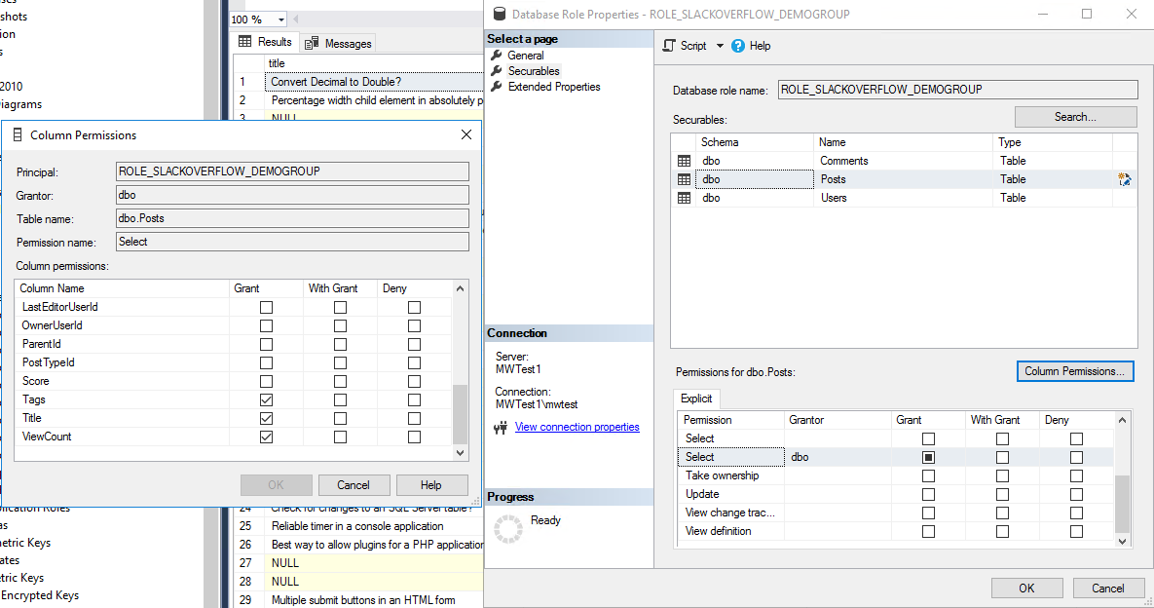
Principle of Least Privilege in action
Notes:
Here is the view from SSMS on the role. Notice the rights on the columns in the GUI.

Slide 39
What didn’t we cover???
Server Hardening
Encryption in its evolution in SQL Server
Appropriate use of AD groups in the environment
Explicit examples of using the pre-created roles at the SQL Server Server role level and the database level.
Anything else?
Notes:
Server Hardening – any DBA worth their salt should know
The general practices on hardening a server and
Working with the infrastructure team and giving your input on what you’d like done. They know what they are doing, but it can still be a collaborative environment for a great outcome that provides security to the company.
Encryption – tons of great material out there on the various encryption techniques available for SQL Server – much more material than can be covered in this webinar!!!
Appropriate use of AD groups in the environment – outside the scope of this webinar. Work with your infrastructure team. Request names of groups that are sensical for the role that you want to mate with the group. If the group needs filesystem permissions, then that’s another discussion point with the infrastructure team. The main point here is that AD groups are a very good way to grant permissions in roles to a group of users in the business, keeping the management to a minimum.
Explaining all the premade server and database roles. Again, there is a lot of information out on the internet explaining each one. The main thing is to understand their uses and then maintain your environment appropriately!

Slide 40
What did we cover??
The traditional role of the DBA in regards to security
Best Practices for the SQL Server install – local service account and group Managed Service Accounts and how they are setup with the filesystems.
The controversy over mixed mode authentication and the SA account
Ways to manage your passwords responsibly
The difference between logins and users
The Principle of Least Privilege
How to make roles work for you and the business.
Notes:
It’s your job, accept it and own it. It’s not always the easiest thing to keep track of security and it can be VERY frustrating to track down why a user or service can’t get access to the data, but it’s still your job.
Local Service Accounts and group Managed Service Accounts – they’re relatively easy to use (at least the local ones) and they will keep your life and environment much simpler and safer.
Mixed mode – it’s not going away anytime soon. Just use common sense and test out your password skills.
Logins and Users – other than the Principle of Least Privilege, this is probably the single most important topic to understand and own.
Principle of Least Privilege. It has to be understood and managed.
Roles – there is a lot of information out there on roles, but I am hoping that now you have a basic understanding of how much easier they can make your life!

Slide 41
Have Any Questions?
Thank you!!!!

