Slide 1
Data Modeling Solutions
for Challenging Data Modeling Problems
Paul Turley
Lead Consultant, Microsoft Data Platform MVP SqlServerBi.blog @paul_turley

Slide 2
Data Modeling Solutions for Challenging Data Modeling Problems
Do your Power BI models suffer from “ambiguous relationships”? Have you expanded your vocabulary while encountering errors trying to relate multiple tables in a data model?
Data modeling is an essential skill in Power BI design and hard problems require creative solutions. In this session, we will enumerate common challenges and demonstrate modeling techniques to resolve them.

Slide 3
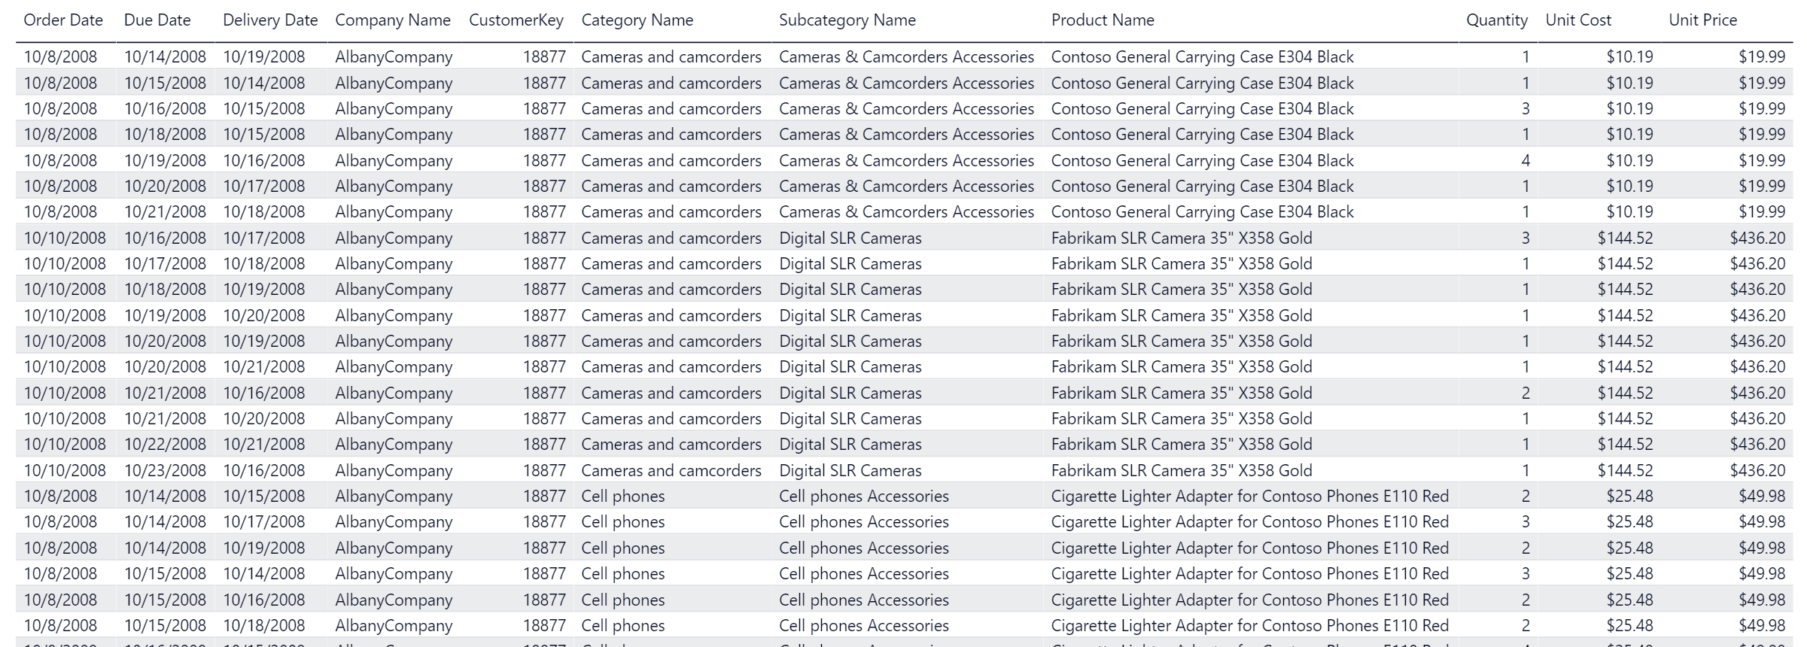
The World is not Flat
Flat Table

Slide 4
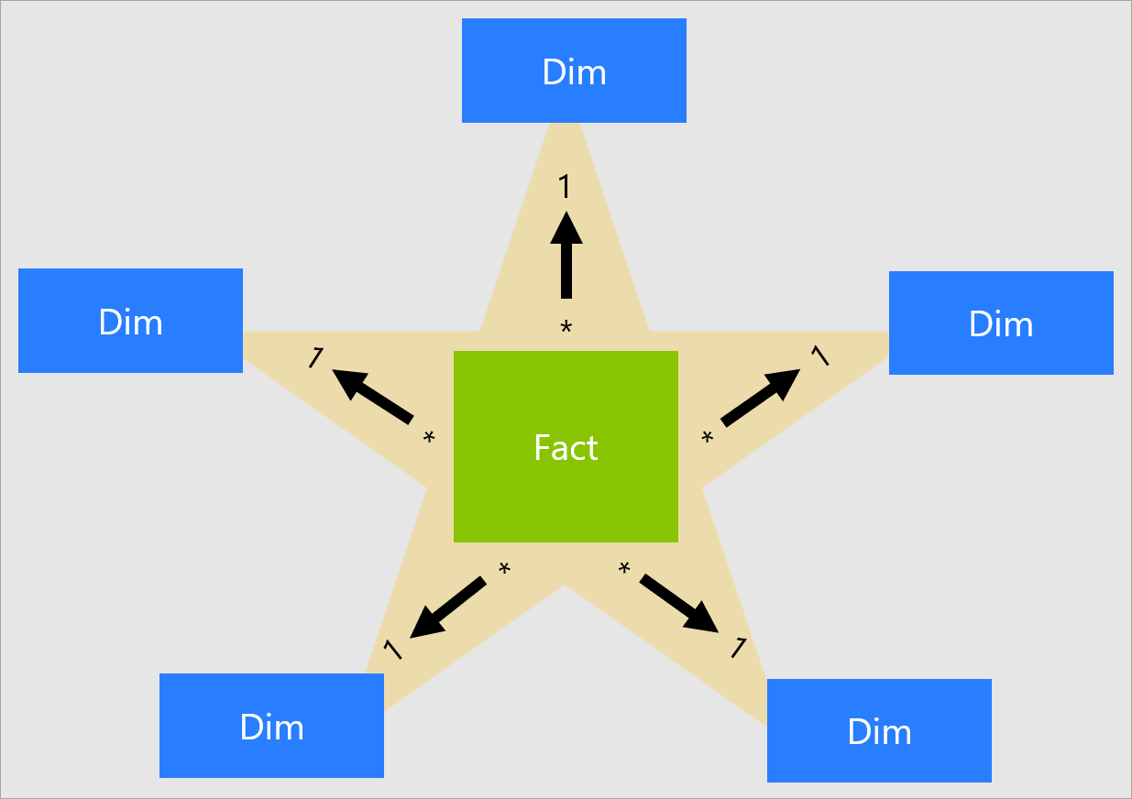
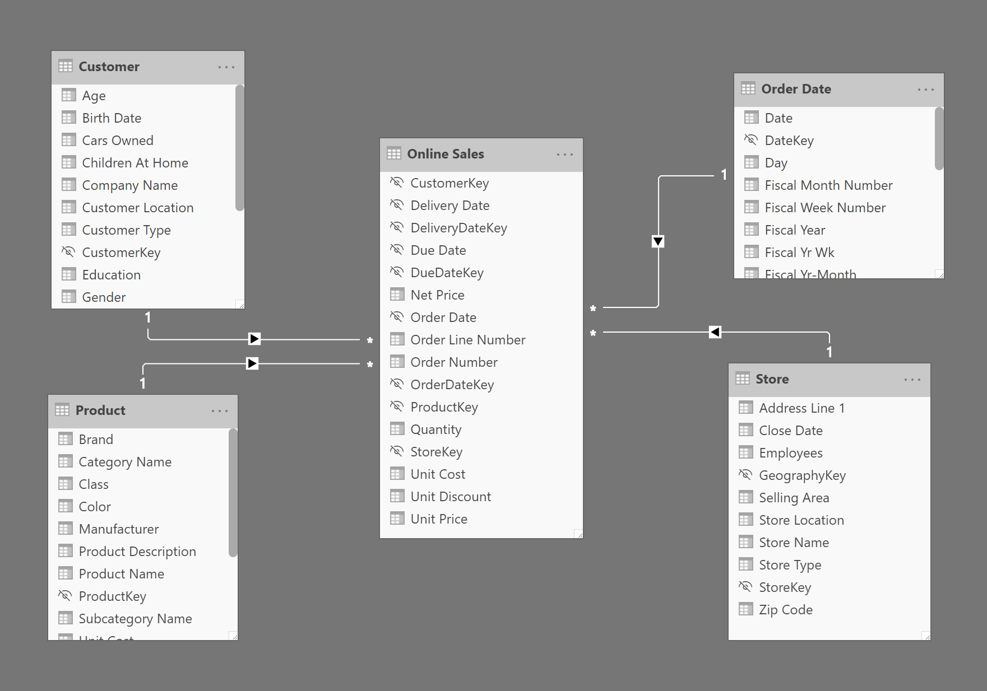
A Star Is Born
Dimensional Model
General best practice
Improved performance
Accurate results
Not an absolute for simple attributes
There are (rare) exceptions

Slide 5
A Star Is Born
Dimensional Model
General best practice
Improved performance
Accurate results
Not an absolute for simple attributes
There are (rare) exceptions

Slide 6
Dimensional Modeling Rules
Who defined them?
…these people:
…not to be confused with these people:
KimballGroup.com

Slide 7
Dimensional Modeling Rules
Who defined them?
Process:
Select the business process
Declare the grain
Identify the dimensions
Identify the facts
…these people:
Steps:
Load detailed atomic data into dimensional structures
Structure dimensional models around business processes
Ensure that every fact table has an associated date dimension table
Ensure that all facts in a single fact table are at the same grain or level of detail
Resolve many-to-many relationships in fact tables
Resolve many-to-one relationships in dimension tables
Store report labels and filter domain values in dimension tables
Make certain that dimension tables use a surrogate key
Create conformed dimensions to integrate data across the enterprise
Continuously balance requirements and realities to deliver a DW/BI solution that’s accepted by business users and that supports their decision-making
KimballGroup.com

Slide 8
Role Playing
Role Playing

Slide 9
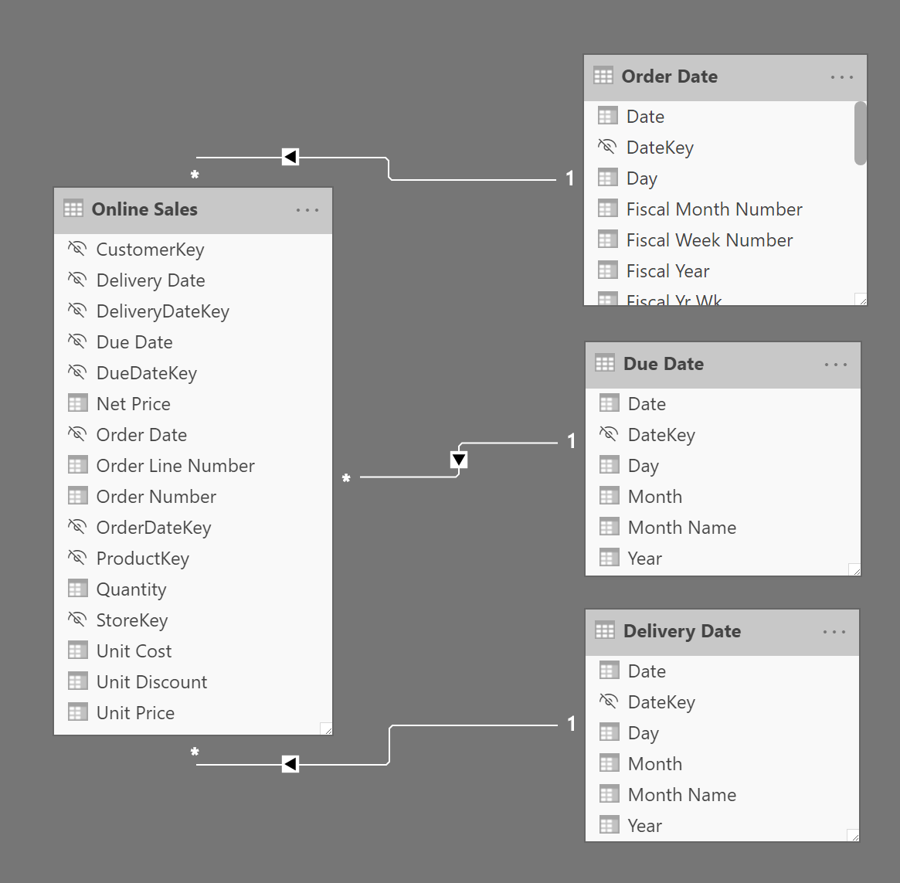
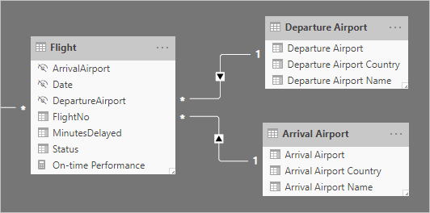
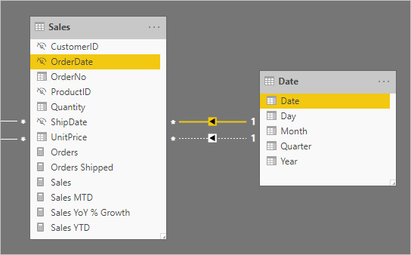
Role Playing
Role Playing

Slide 10
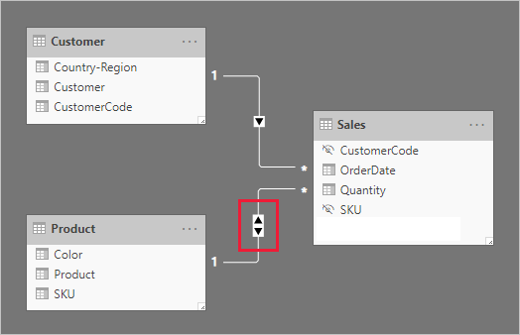
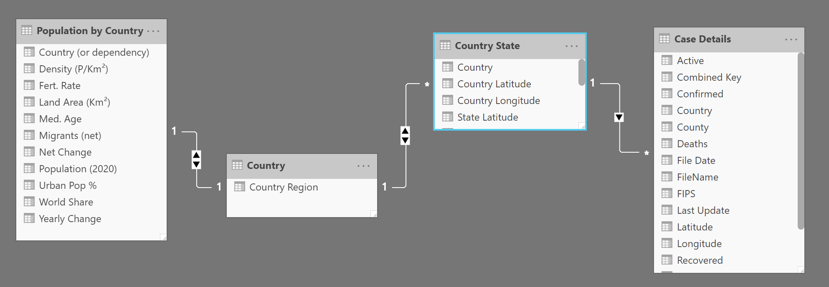
Bi Di
Bidirectional Filters

Slide 11
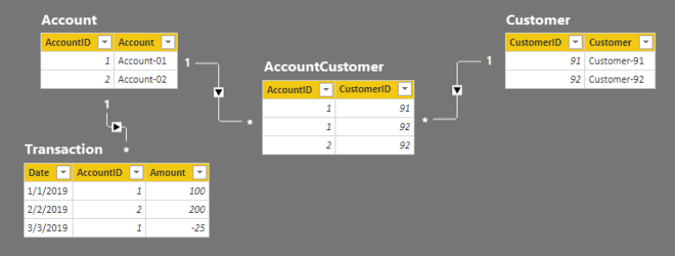
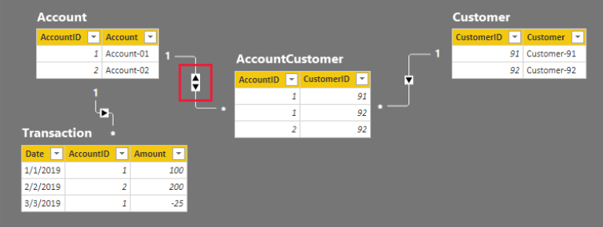
M2M
Many To Many relationships

Slide 12
Who Needs Relationships Anyway?
Disconnected tables
Driving dynamic calculations
The SWITCH( ) function

Slide 13
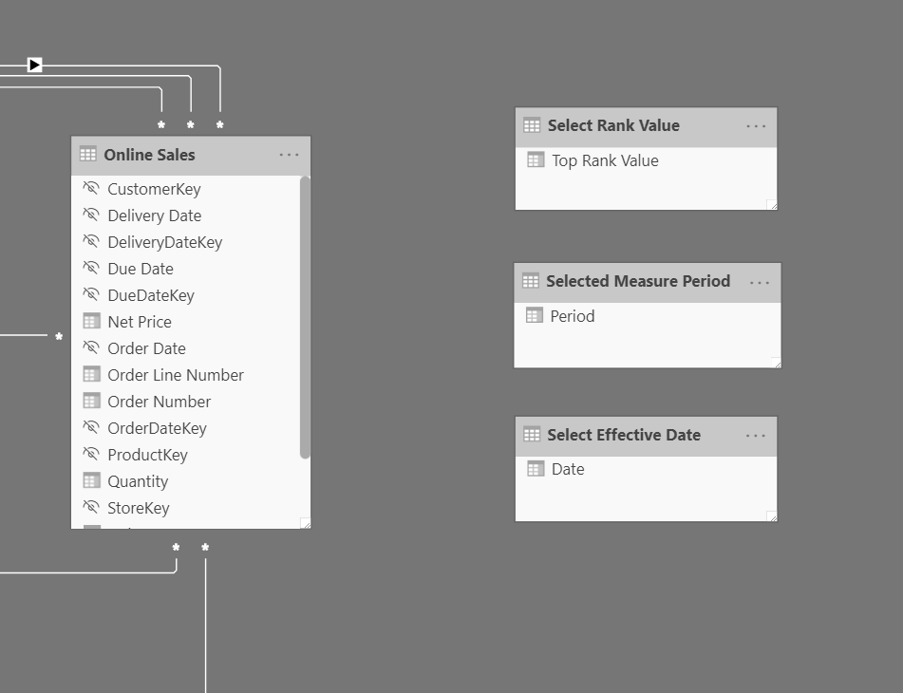
Disco
Disconnected Tables

Slide 14
SWITCH
Switched Dynamic Measures

Slide 15
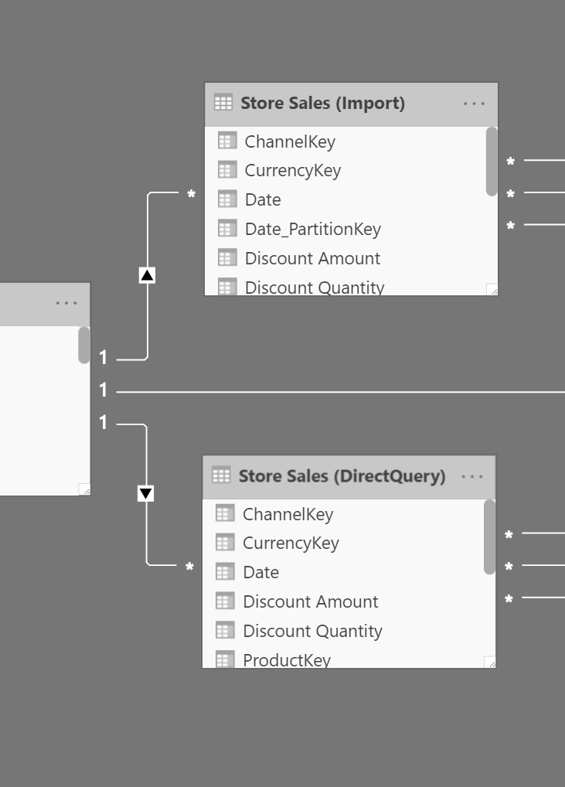
DQ
DirectQuery & Composite Models

Slide 16
Demos
Demonstrations
Switched dynamic time-series measure
Disconnected tables & dynamic measures
Dynamic Rank X
Orders Pending Delivery

Slide 17
Optimization, Guidelines & Resources
Star Schemas https://www.sqlbi.com/articles/the-importance-of-star-schemas-in-power-bi/ https://docs.microsoft.com/en-us/power-bi/guidance/star-schema
Many to Many Relationships https://docs.microsoft.com/en-us/power-bi/guidance/relationships-many-to-many
Model Optimization https://docs.microsoft.com/en-us/power-bi/guidance/import-modeling-data-reduction
DirectQuery Guidance https://docs.microsoft.com/en-us/power-bi/guidance/directquery-model-guidance

