Slide 1

Outperform the Competition with Azure SQL Data Warehouse
Bob Rubocki – Practice Manager, BI Architect
March 12, 2019

Slide 2
Agenda
Azure SQL DW product overview
Cloud Scale Analytics Market
GigaOm benchmark study, product comparison
What’s new with Azure SQL Data Warehouse
Demo

Slide 3



Bob Rubocki
Practice Manager & BI Architect, Pragmatic Works
brubocki@pragmaticworks.com
linkedin.com/in/robertrubocki
@BobRubocki
bobrubocki.wordpress.com

Slide 4
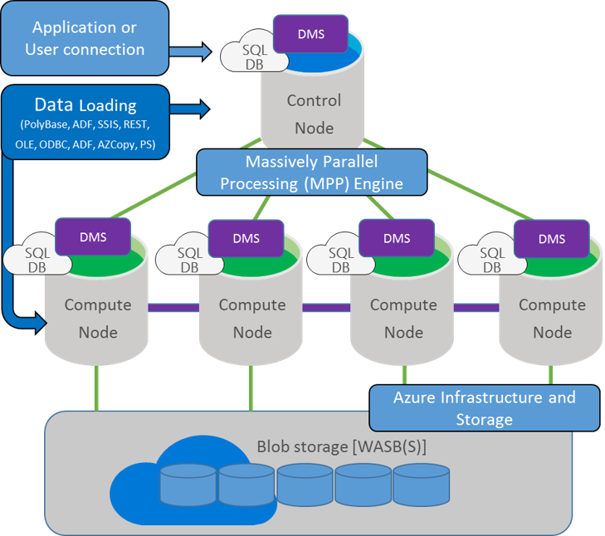
Azure SQL DW – Massive Parallel Processing
Compute nodes are separate from data storage
Client tools/apps connect to control node, just like SQL Server
Scale up/down to add/remove compute nodes
Pause compute when not in use ($)
Control node distributes query to compute nodes and distributions
Compute nodes read from blob storage, send results to control node

Slide 5
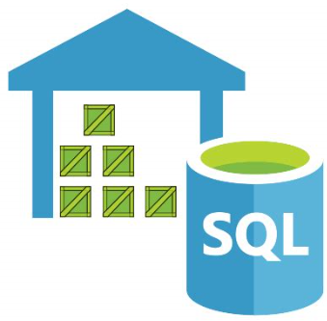
Why Azure SQL DW?
Massive data scale
Designed for analytic and aggregate query loads

Slide 6

Market Features
Cloud based
Relational (SQL)
Structured and semi-structured data
Scale out architecture
Columnar compression

Slide 7




The Competitors

Slide 8
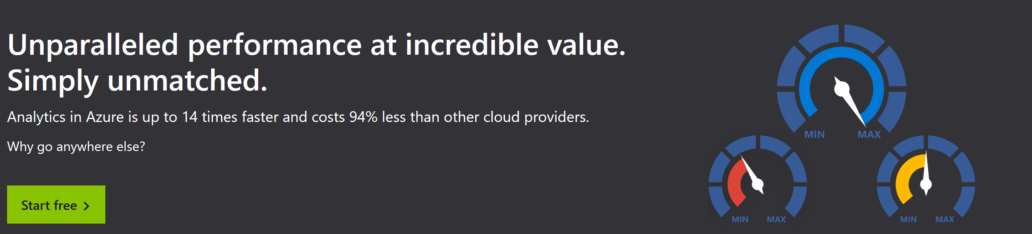
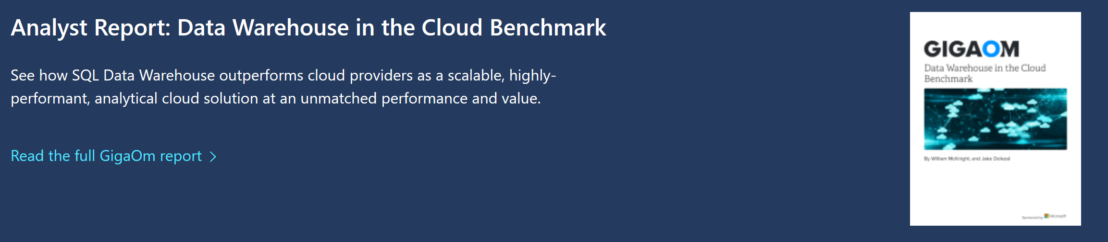
Industry-leading price performance
https://azure.microsoft.com/en-us/services/sql-data-warehouse/compare/
Notes:
You can download the report as well as sign up to use ADW for free at the Azure.com link above

Slide 9
Background
TPC-H decision support benchmark
TPC - Transactional Processing Performance Council
Benchmarks originally created to standardize OLTP testing
OLTP testing grew from ATM testing
http://www.tpc.org/
http://www.tpc.org/information/about/history.asp

Slide 10

TPC Members

Slide 11
Methodology
Based on TPC-H benchmark
  Schema design
  Queries to execute
~30 TB data set
22 queries
Each query executed 3 times, fastest time used for results.
Test Environments →
Comparable performance tiers
BigQuery not configurable
Azure SQL DW | Amazon Redshift | Snowflake | Google BigQuery
3 | 3 | 3 | 1

Slide 12
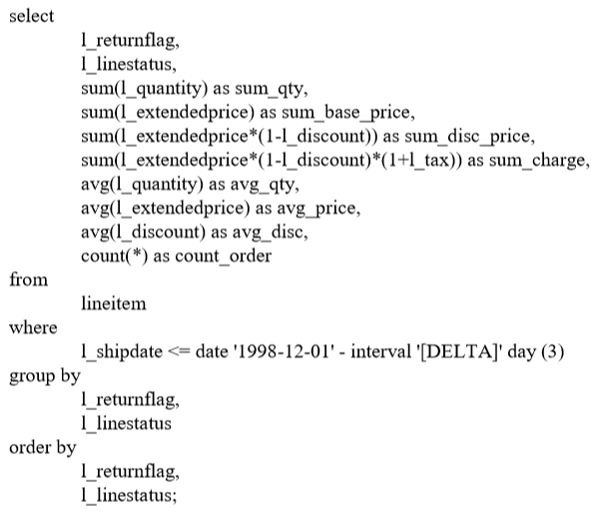
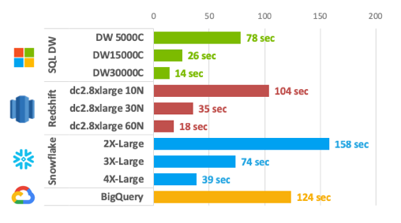
Pricing Summary Report (TPC-H Q1) Performance
Azure SQL DW performed faster than all competitors for TPC-H Query 1
Notes:
Showing Query 1 as a sample of the output format, and an example where Microsoft Azure SQL DW outperformed the competition.

Slide 13
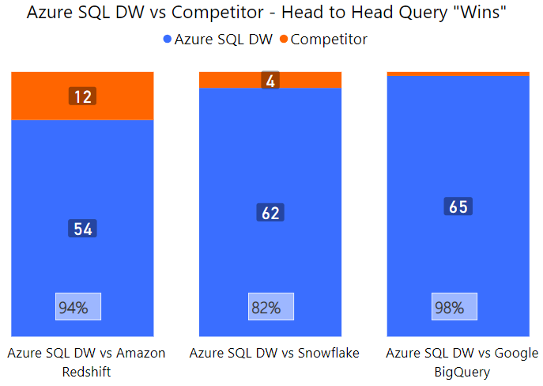
Performance Summary

Slide 14
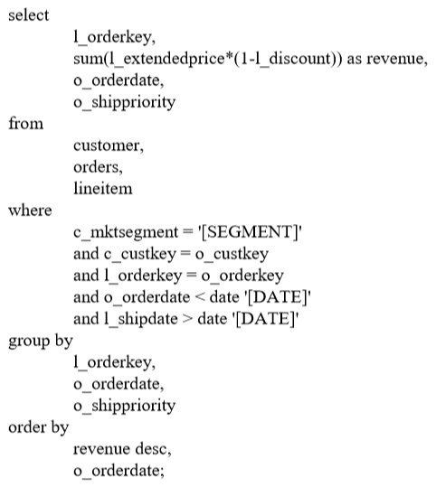
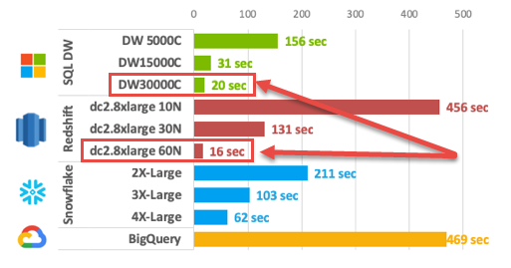
Shipping Priority (TPC-H Q3) Performance
One Amazon Redshift tier performed best with Query 3

Slide 15
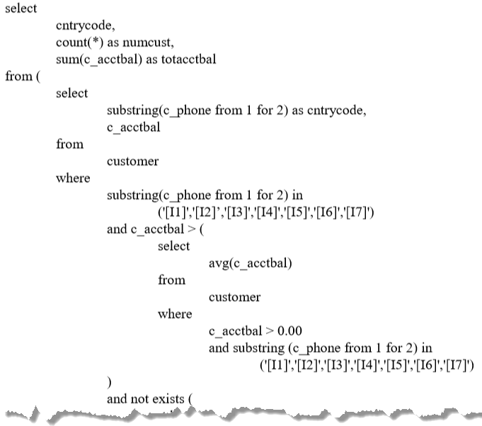
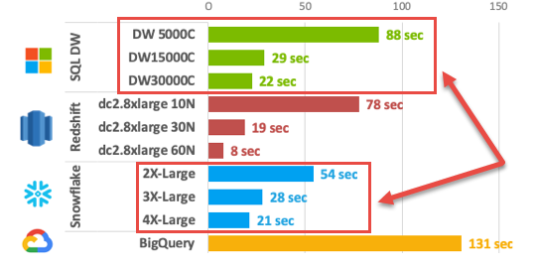
Global Sales Opportunity (TPC-H Query 22) Performance
Snowflake outperformed Azure SQL DW and Amazon Redshift on TPC-H Query 22. (Subqueries)

Slide 16
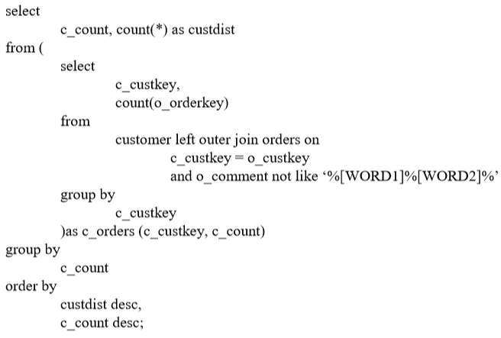
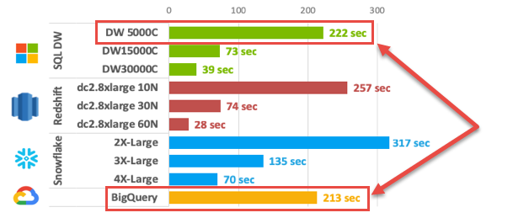
Customer Distribution (TPC-H Query 13) - Performance
The 1 of 66 queries where Google BigQuery outperformed Azure SQL DW

Slide 17
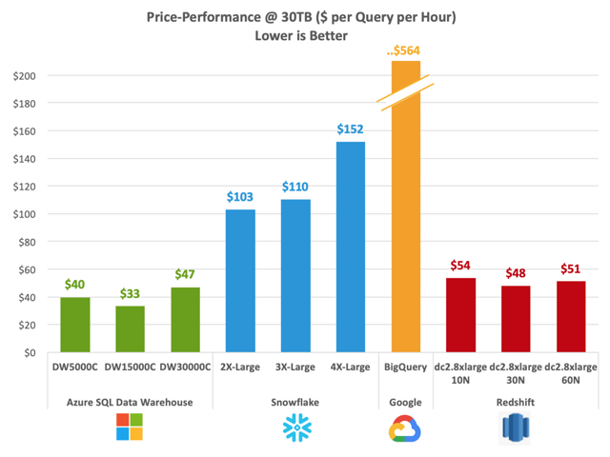
Price Per
Performance
Total duration of 22 test queries
Cost of operating service for that duration
BigQuery charges by data volume processed, not by time
https://gigaom.com/report/data-warehouse-cloud-benchmark/#post-id-959633

Slide 18
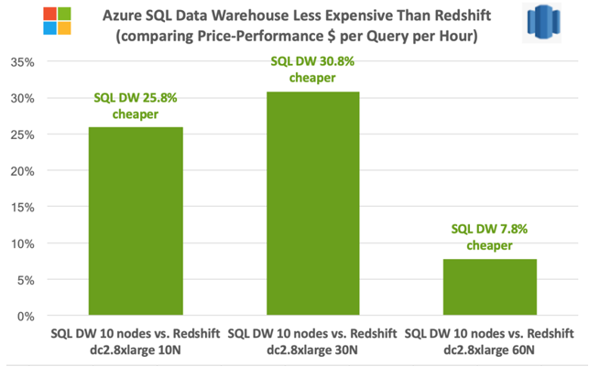
Azure SQL DW vs Amazon Redshift

Slide 19
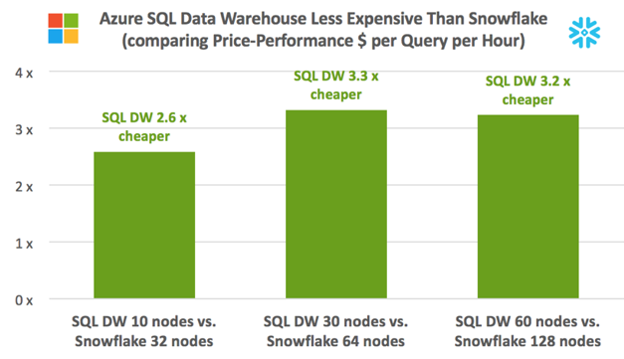
Azure SQL DW vs Snowflake

Slide 20
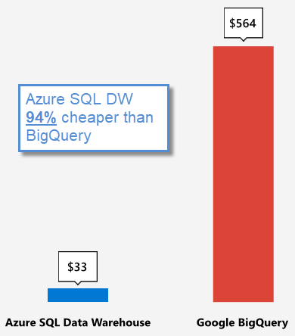
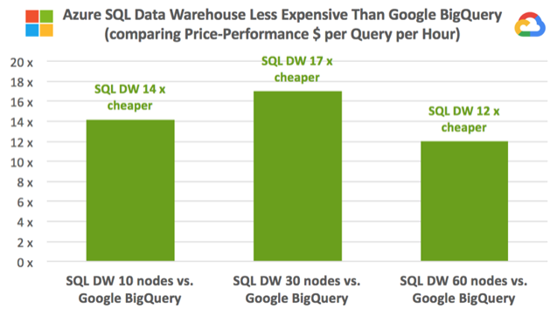
Azure SQL DW vs Google BigQuery
https://azure.microsoft.com/en-us/services/sql-data-warehouse/compare/

Slide 21
What’s New In Azure SQL DW
Azure SQL DW Gen 2 released April, 2018
Includes new, more powerful Azure hardware
Addresses challenges with I/O operations on remote storage
New “optimized for compute” SKUs

Slide 22
Adaptive Caching
New Azure hardware
Compute nodes include NVMe solid state disks (Non-Volatile Memory Express)
Based on query history and patterns, algorithm determines column store data likely to be used in queries, caches data on SSD on compute node
Queries satisfied with data in cache do NOT read from remote blob storage
Faster query performance

Slide 23
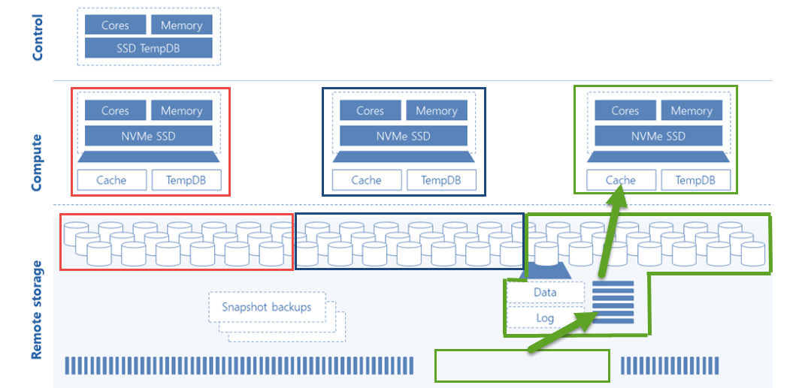
Adaptive Caching

Slide 24
Max Concurrent Query Limit
Gen 1 (pre-Gen 2)
Gen 2
128
32
Gen 1 (post-Gen 2)
128

Slide 25
Additional Performance Tiers
Gen 1 – max 6,000 DWU
Gen 2 – max 30,000 DWU
Gen 2 – new lower priced tiers (DW100c, DW200c, DW300c, DW400c, DW500c)
Gen 2 pricing originally started at DW1000c (more expensive to get started with Gen 2)

Slide 26
DEMO

Slide 27
Azure SQL Data Warehouse (ADW)
Developer productivity
Industry-leading security
Intelligent workload management
Data flexibility
Best in class
price-performance
Enterprise class application lifecycle management
Defense-in-depth security and 99.9% financially backed availability SLA
Separation of compute and storage
Prioritize resources for the most valuable workloads
Query directly over the Data Lake
Support for structured and semi-structured data
Up to 94% less expensive than competitors
Notes:
Here are the 5 reasons that we think ADW provides compelling business value:
First, as you build your cloud analytics solution, you can use the similar set of widely available developer skills & tools that you are using to manage on-prem SQL environments. The fact that ADW is a managed Azure cloud service means that you can set up your DW environments in minutes
Second, while the Azure platform leads the industry on security & compliance certifications, ADW’s built in granular security at the row and column level means that you can make the power of your analytics solution available to a wider set of users (e.g. geo diverse employees and vendors) , without the need to create multiple copies of the DW.
Third, the most significant piece of innovation has been to separate compute & storage that allows customers to not only control costs, but also finely align the workloads with performance. This means that for the time that you don’t run the DW, you don’t pay for the compute resources…just the storage. This also allowed us to provide high performance storage cache close to compute, thereby driving the major performance improvements over the last several quarters.
ADW further supports business agility by allowing you to define workload prioritization…so that the most business critical workloads and requests can take priority on the DW resources (enabled via defining workload classification and importance)
Fourth, ADW is one single solution that lets to work with a variety of datatypes, and seamlessly works with a number of first-party Azure and ISV partner services for ingestion, transformation, modeling, and serving of data
Last, and the most important piece is the continued market leadership of ADW around – both on price, as well as raw performance and price per performance
============
Azure SQL Data Warehouse
Azure SQL Data Warehouse storage is separate from the compute Data Warehouse Unit (DWU). This enables Azure SQL Data Warehouse to scale columnar storage capacity and compute resources independently. This capability adjusts to various workload demands, offering potential cost savings when demand is low. Azure SQL Data Warehouse can pause and resume compute billing, where only storage is billed during the paused time. Azure SQL Data Warehouse achieves good balance in both configurability and simplicity, in a way that is both easy to administer and flexible in handling almost any usage pattern.
Azure SQL Data Warehouse is fully ANSI-SQL compliant and users familiar with SQL Server will be very comfortable using this environment.
Azure SQL Data Warehouse can export data to a local file the same way an on-premises SQL Server can, e.g., via the SQL Server Import and Export Wizard.
Although concurrency was not tested in the benchmark, Azure SQL Data Warehouse supports 128 concurrent queries. This is many more than BigQuery, which supports a maximum concurrency of 50 per project. Snowflake’s maximum concurrency is difficult to calculate because it is a function of the number of queries, the submitted queries’ execution plan, the size of the warehouse, and the maximum number of multi-cluster setting. In our experience we saw an X-Large (16 node) Snowflake warehouse run 6 concurrent simple scan queries (SELECT with a single column filter WHERE clause) before starting to queue. Thus, if we set the maximum multi-clusters at 5, we would likely hit a max concurrency of 30 in that scenario. Your results may vary.

Slide 28
We Can Help!
Pragmatic Works can help you migrate or manage your data warehouse environment in Azure.
Respond YES to the exit survey for more information.

Slide 29
Thanks!
GigaOm Analyst Report - https://gigaom.com/report/data-warehouse-cloud-benchmark/
TPC-H Benchmark spec - http://www.tpc.org/tpc_documents_current_versions/pdf/tpc-h_v2.17.3.pdf
Microsoft Azure SQL DW Comparison - https://azure.microsoft.com/en-us/services/sql-data-warehouse/compare/
Loading NYC Taxi data to Azure SQL DW - https://docs.microsoft.com/en-us/azure/sql-data-warehouse/load-data-from-azure-blob-storage-using-polybase

