Slide 1
Power BI Development Best Practices
Making Your Power BI Environment Great

Slide 2
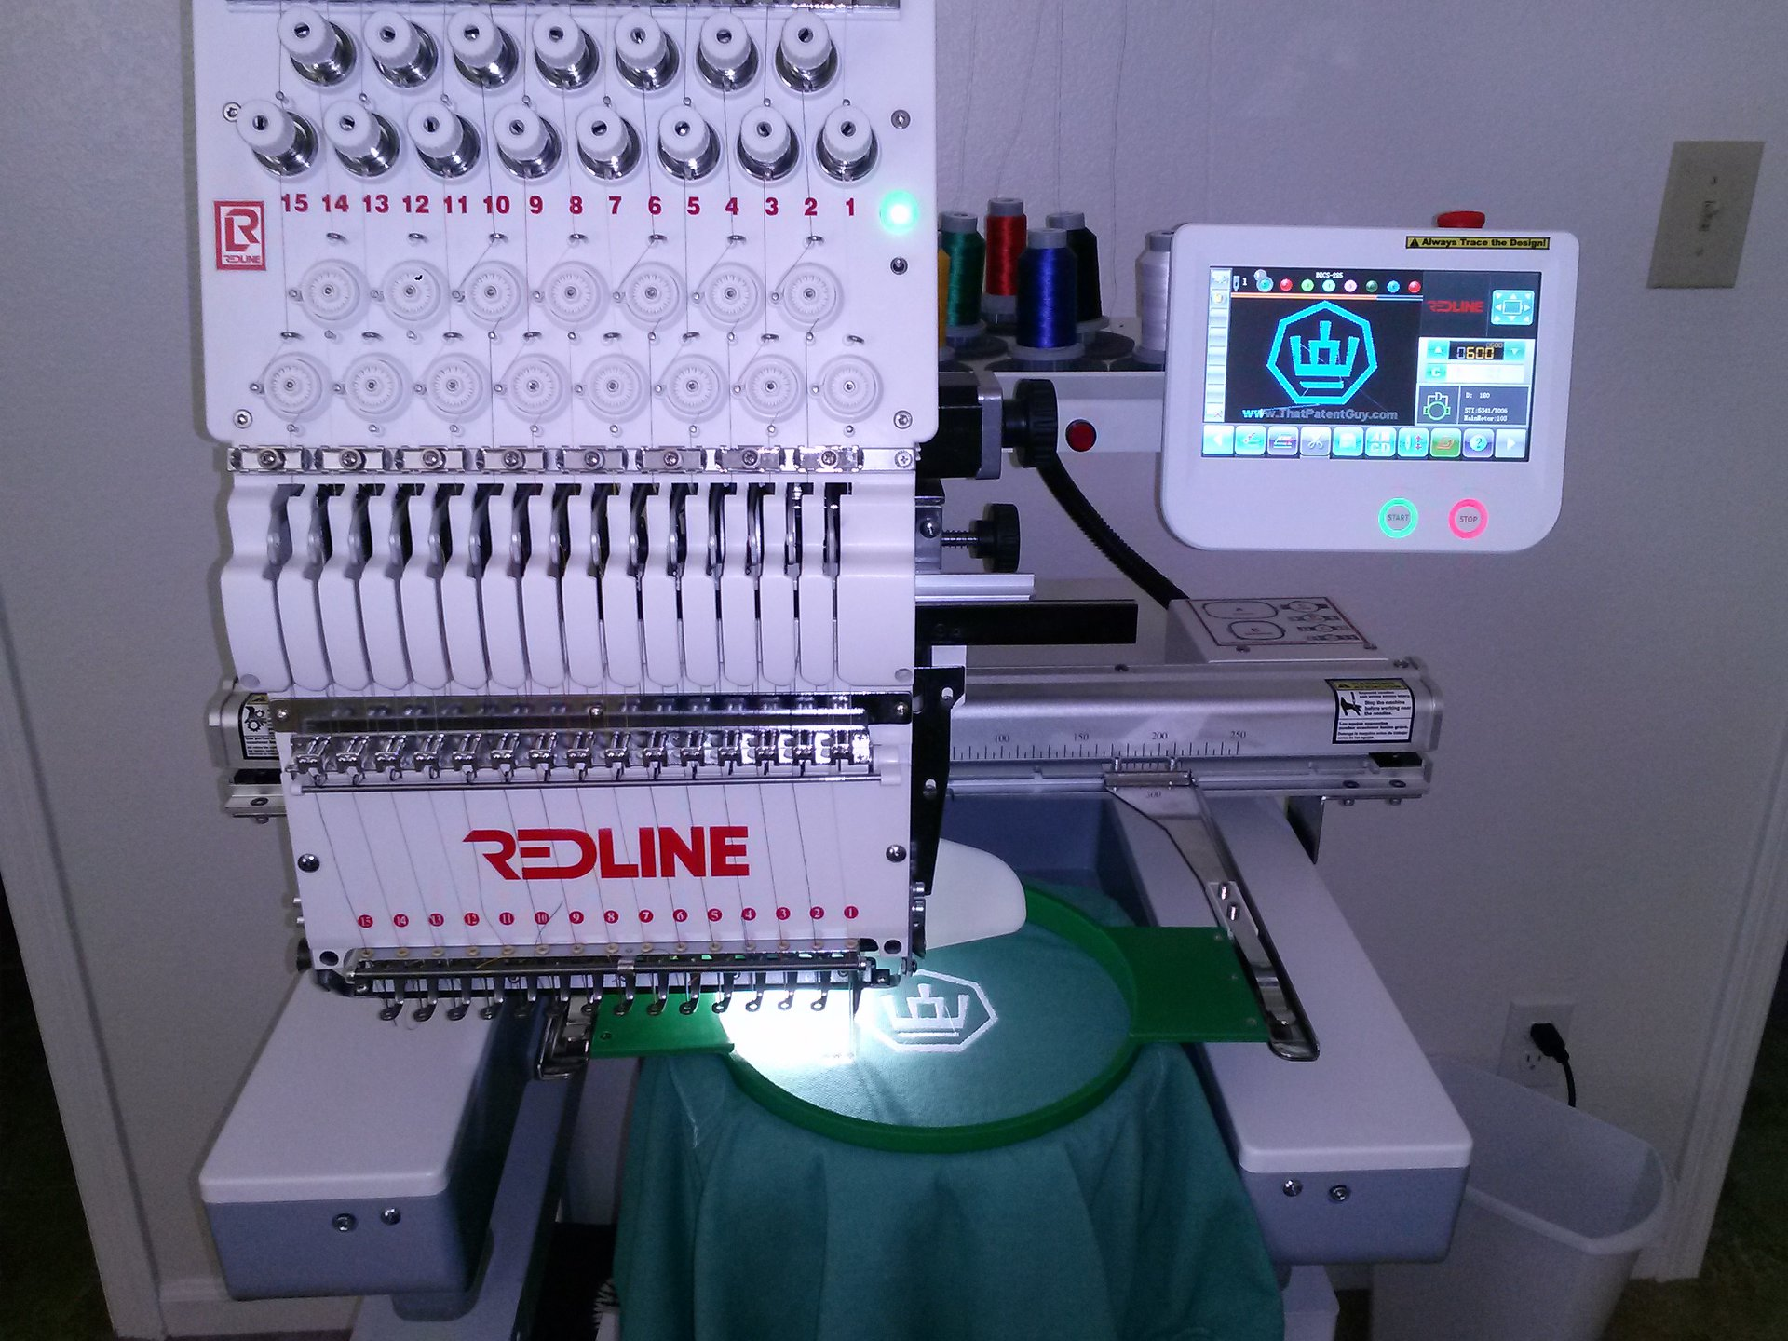
About Me
BI Consultant with Pragmatic Works
20+ years as a MSSQL Server Developer & DBA for financial and accounting software industries.
Email: ALetourneau@PragmaticWorks.com
Twitter: @LadyRuna

Slide 3
So Many Reports. So Little Time.

Slide 4
Reining in the Report Development Backlog
What reports do we need?
Are they duplicates?
Are they relevant / correct?
Who is working on them?
How can we track progress?

Slide 5
Tracking Backlog
DevOps – dev.azure.com
OneNote
Excel
Planner in Office 365 – tasks.office.com

Slide 6
DEMO
Notes:
Planner:
https://tasks.office.com

Slide 7
Managing the Backlog
Remove Duplicates
Prioritize items
Estimate work effort
Iterative approach
Assign to Content Creators

Slide 8
Report Efficiencies
Create Measure Tables

Slide 9
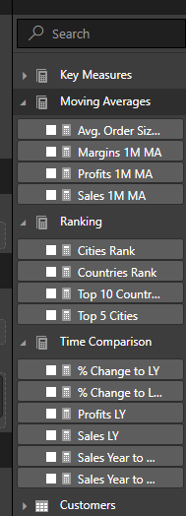
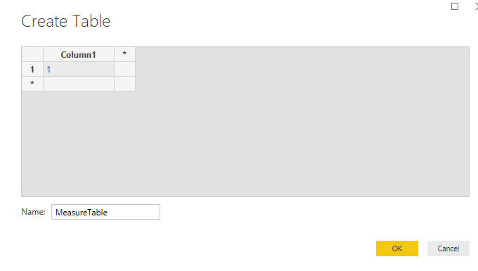
Report Efficiencies – Measure Table
In Edit Queries, Click Edit Data to create a one column one row table
Click OK
Close & Apply
Select Measure
On Modeling Tab, set Home Table to Measure Table
Hide “column1” in Measure Table

Slide 10
Report Efficiencies
Create Measure Tables
Use Shared Data Models

Slide 11
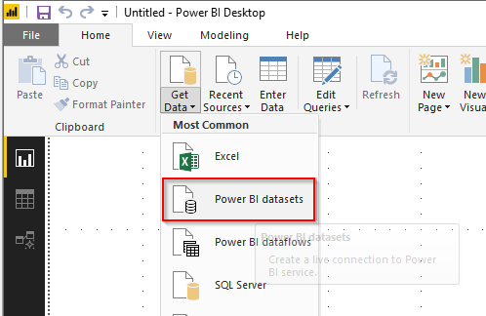
Report Efficiencies – Shared Data Model
Create Master Data Model
Data Model Only in PBIX file
“One Source of the Truth”
Contains all measures
Deploy to PowerBI.com
Use “Power BI Datasets” as source for report data

Slide 12
Report Efficiencies
Create Measure Tables
Use Shared Data Models
Use Source Control

Slide 13
Report Efficiencies – Source Control
Notes:
Git, GitHub, GitLab, Apache Subversion, SVN, Azure Repos in DevOps, (and for end-users creating reports) Sharepoint

Slide 14
Report Efficiencies
Create Measure Tables
Use Shared Data Models
Use Source Control
“KonMari” your Existing Reports

Slide 15
Report Efficiencies – “KonMari” Reports
There is no “joy” in
Duplicate reports
Unused reports
Empty or Wrong reports
Reports referencing retired systems

Slide 16
Report Efficiencies – “KonMari” Reports
KonMari Steps
See who is using the reports
Remove access to reports
Tag “official” reports

Slide 17
Report Efficiencies - Other
Handle transformation logic closest to source
Leverage query folding
Use self-describing names for Columns and Measures
Remove Unnecessary columns
Avoid bidirectional filters

Slide 18
Keeping up with Power BI Features

Slide 19
Keeping up with Power BI
Power BI Blog

Slide 20
Keeping Up With Power BI
Follow Power BI Blog (RSS Feed)
Notes:
DEMO – add RSS Feed to Teams
RSS feed: https://powerbi.microsoft.com/en-us/blog/feed/
we use Teams to discuss things about power bi. like the fact that we can now do paginated reports.
https://powerbi.microsoft.com/en-us/blog/power-bi-desktop-april-2019-feature-summary/

Slide 21
Keeping up with Power BI
Power BI Blog
Lunch & Learn
https://powerbi.microsoft.com/en-us/blog/feed/

Slide 22
Keeping Up With Power BI
Lunch & Learn

Slide 23
Keeping up with Power BI
Power BI Blog
Power BI SME
https://powerbi.microsoft.com/en-us/blog/feed/

Slide 24
Keeping Up With Power BI
Get a Power BI SME (Subject Matter Expert)
Notes:
Pragmatic Works On Demand Training https://pragmaticworks.com/training/on-demand-training ← FREE Dashboard in a day Course! (can’t beat FREE)
Links to past Pragmatic Works webinars: https://pragmaticworks.com/Training/Courses#type=Free

