Slide 1
Power BI for the Consumer
Manuel Quintana
Twitter: @SQLRican

Slide 2
Manuel Quintana
Training Content Manager
Software Engineer
Business Intelligence Trainer
5 Years at Pragmatic Works
Blog at SQLRican.wordpress.com
@SQLRican

Slide 3
Agenda
Power BI Service Basics
Working with Datasets
Working with Reports
Excel Integration
Mobile Power BI

Slide 4
Power BI Service Basics
Getting Connected to the Power BI Service
Navigating through Power BI
Getting the environment ready for this class with samples
Notes:
Why Implement Business Intelligence?
Self-Service BI Lifecycle
Understanding the Role Self-Service BI Plays with IT

Slide 5
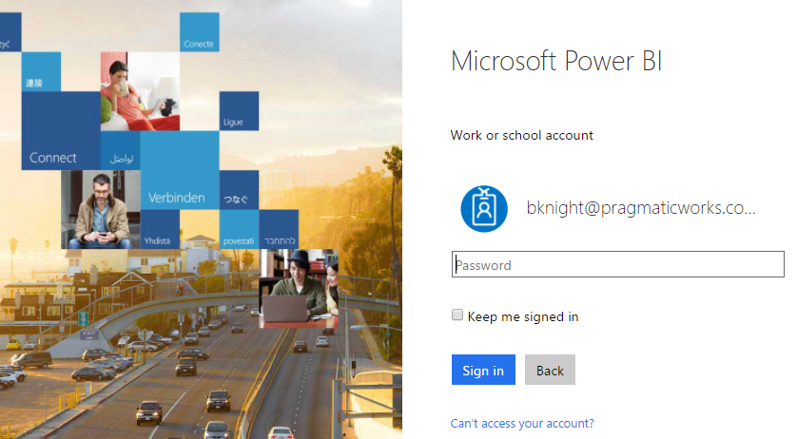
Connecting to the Power BI Service
Module 1
Go to PowerBI.com
Works in most browsers Sign in with Office 365 user name and password
Data Explorer

Slide 6
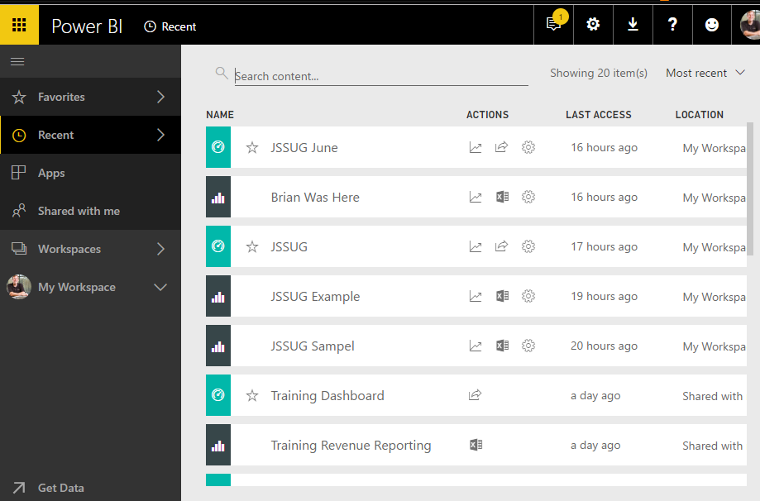
Timeout
Goal
Sign into your own environment
Data Explorer
Notes:
DEMO
Walk-through the log in process

Slide 7
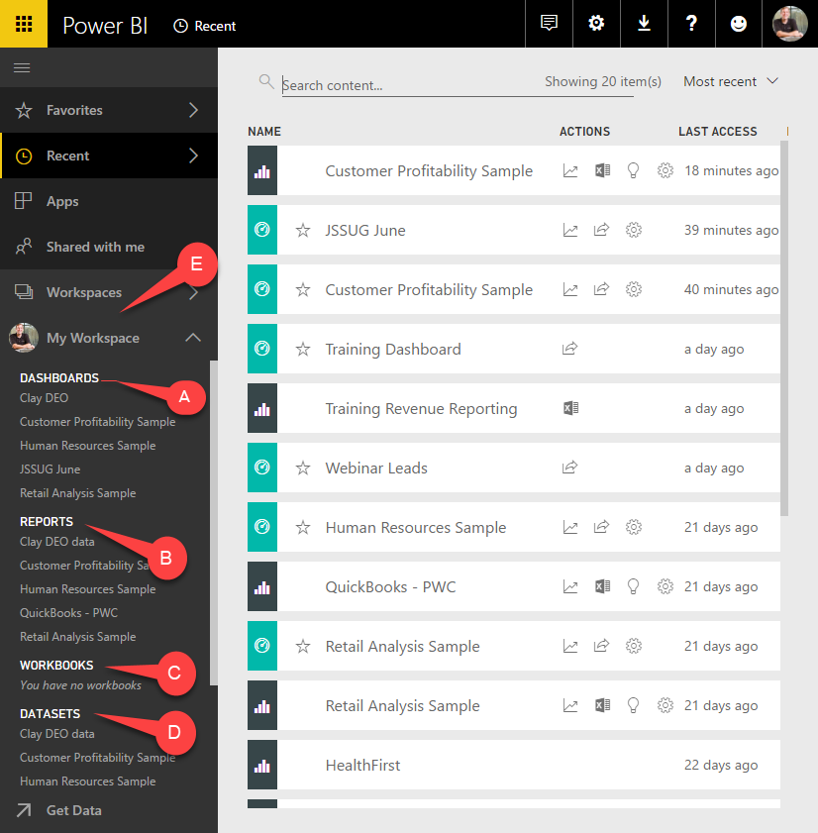
Explore Power BI Services
Module 1
D - Datasets
C - Workbooks
B - Reports
A - Dashboards
E - Workspaces
Data Explorer

Slide 8
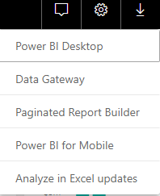
Download Panel
Power BI Desktop
Paginated Report Builder
Power BI for Mobile

Slide 9
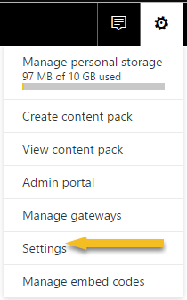
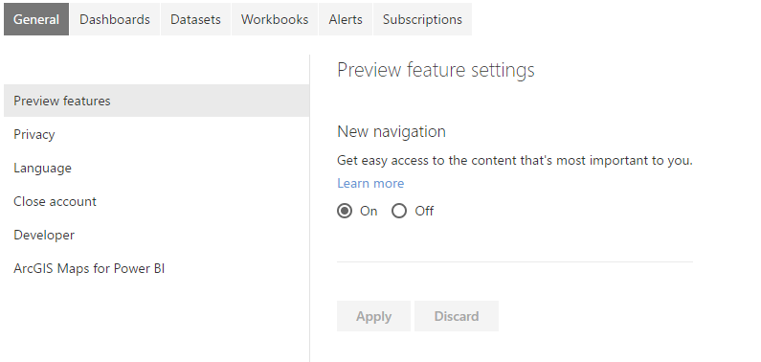
Personal Settings
Space used
Preview Features
GIS settings
Dashboard settings

Slide 10
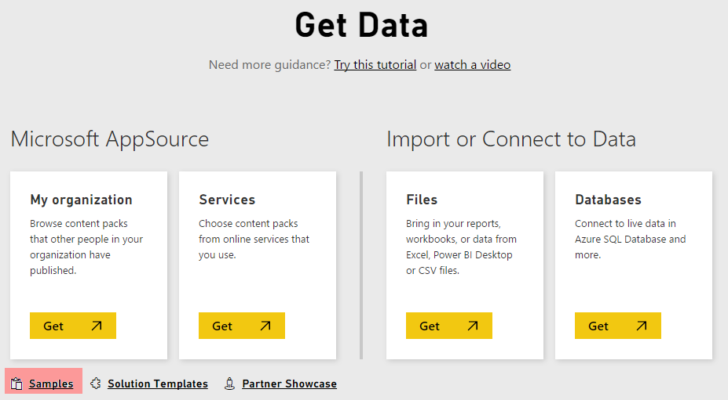
Get Data
Organization
Services
Import data
Samples and templates

Slide 11
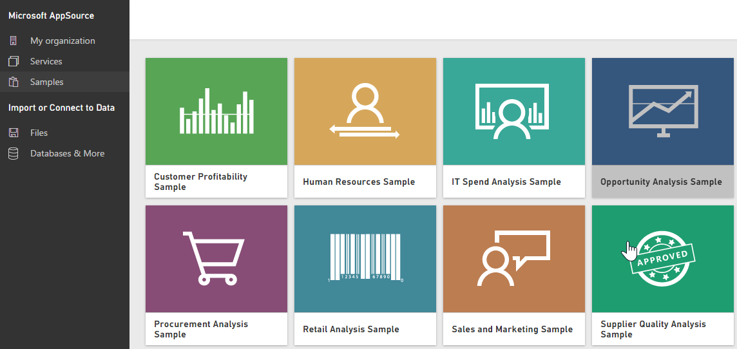
Industry Samples

Slide 12
Exploring the Power BI Service
Using the Samples
Notes:
DEMO
Showcase the elements of the My Workspace
Show the options when looking at the dataset section
Go through a couple of the objects and just show that they display. (report, dashboard)
Go to Get Data and select Samples and choose Human Resource Sample

Slide 13
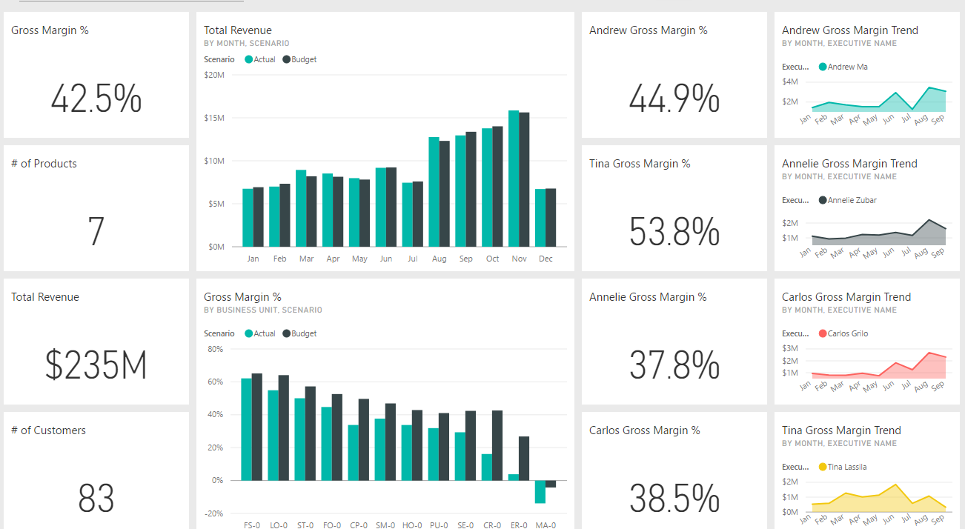
Timeout
Goal
Import the Customer Profitability Sample
Explore the dashboard
Drill into the report
Data Explorer

Slide 14
Interacting with Datasets
Quick Insights
Using the Excel plugin
Notes:
Why Implement Business Intelligence?
Self-Service BI Lifecycle
Understanding the Role Self-Service BI Plays with IT

Slide 15
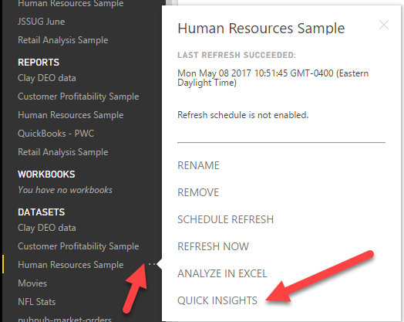
Quick Insights
Don’t know what questions to ask of your data?
Finds patterns in your data

Slide 16
Exploring the Quick Insights

Slide 17
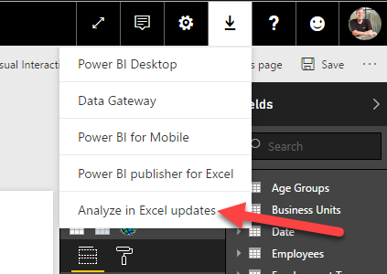
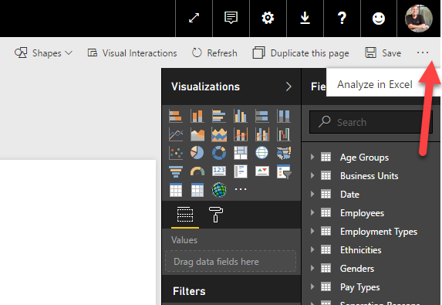
Analyze with Excel
Step 2 – While in dataset, click Analyze in Excel
Step 1 – Download and Install

Slide 18
Analyzing datasets with Excel
Notes:
Analyze the Human Resource Sample in Excel

Slide 19
Working with Reports
Interacting with Reports
Applying a Report Filter

Slide 20
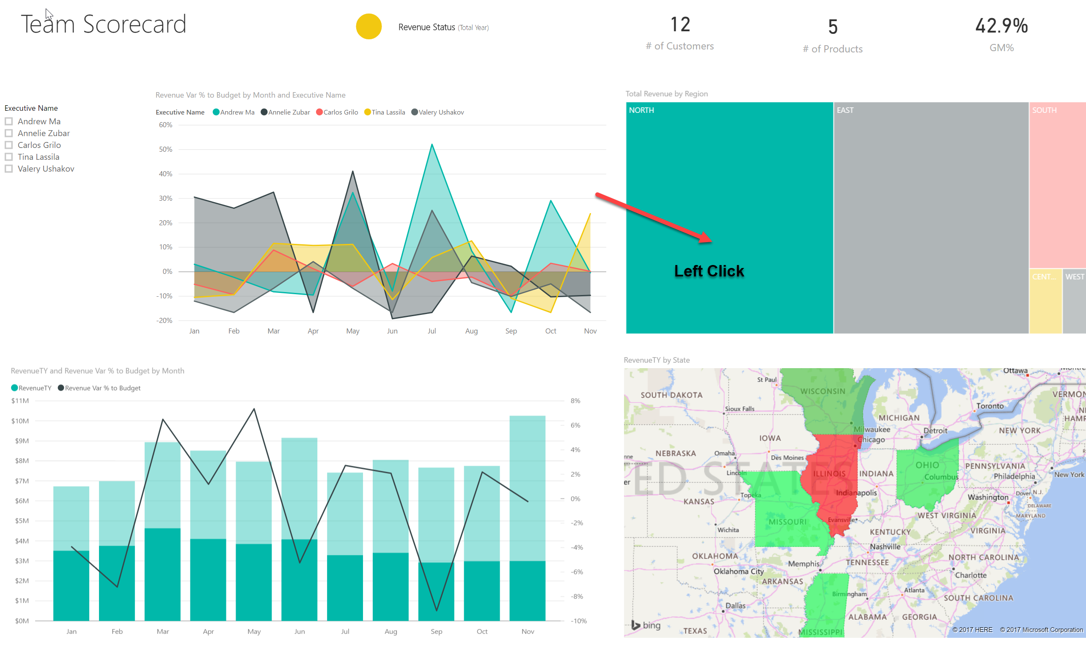
Interactive Filtering
Click any object to implicitly filter related graphs

Slide 21
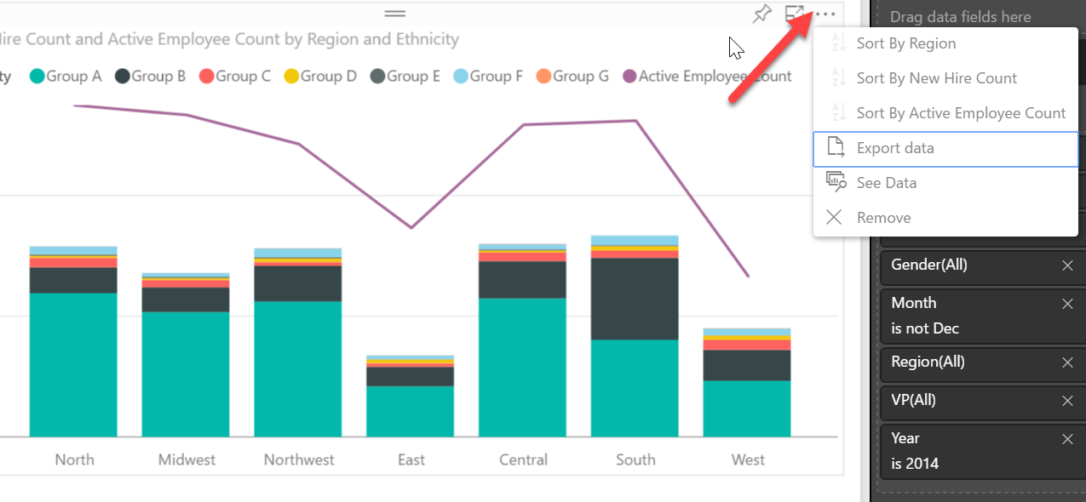
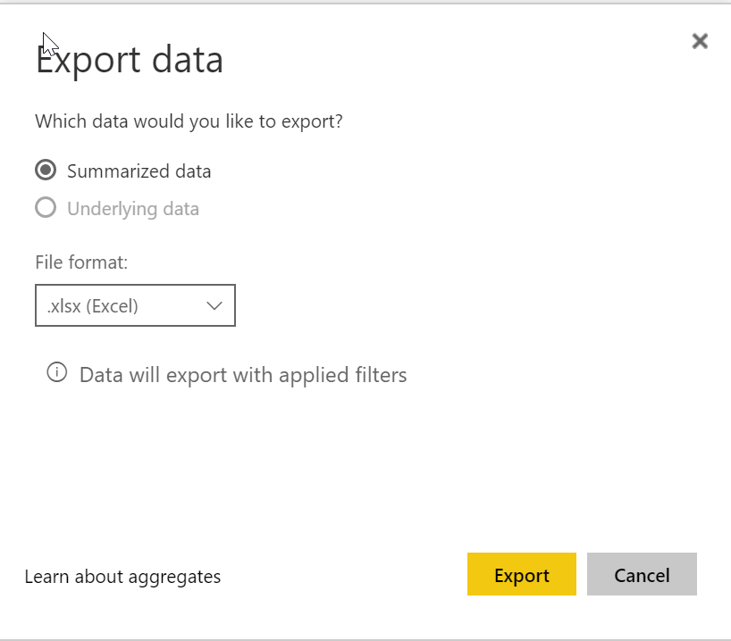
Sorting and Exporting Data
Select the “…” ellipsis for added power

Slide 22
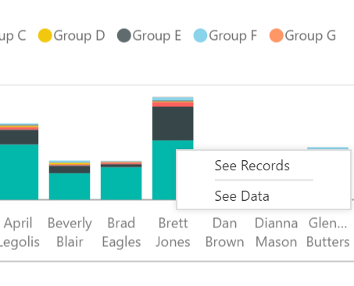
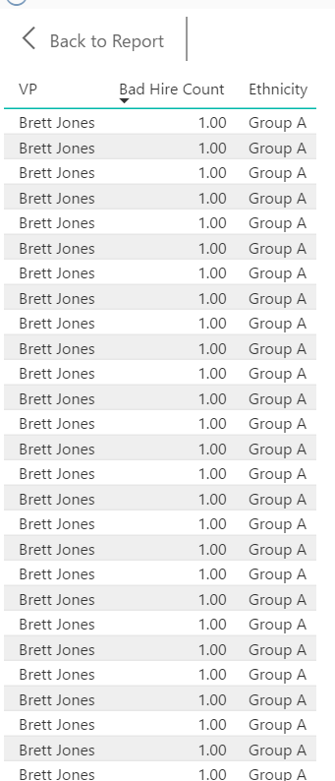
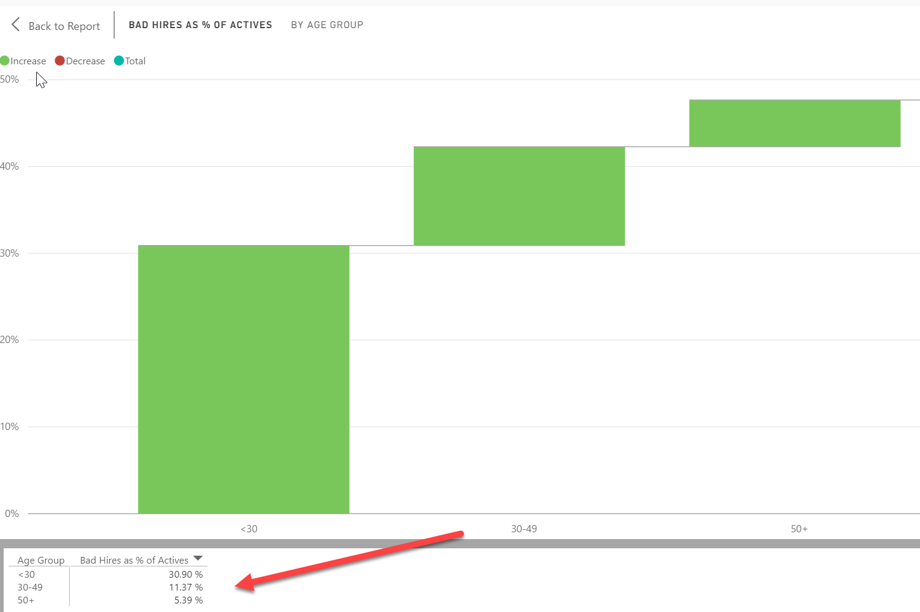
See Data
Right-click on graph
See Records
See Data

Slide 23
Sorting, exporting and interacting with the report

Slide 24
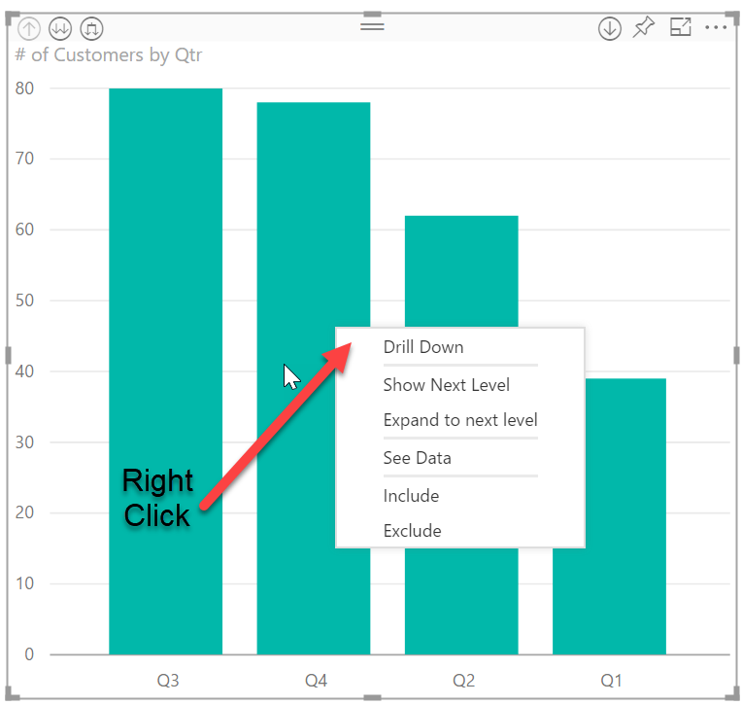
Hierarchy Drilling Down
Module 11
Drill Down
Next Levels
Include and Exclude filters

Slide 25
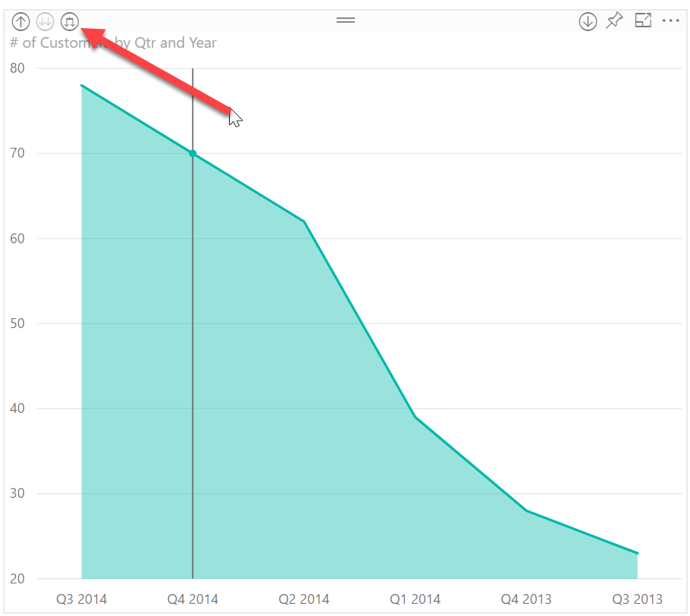
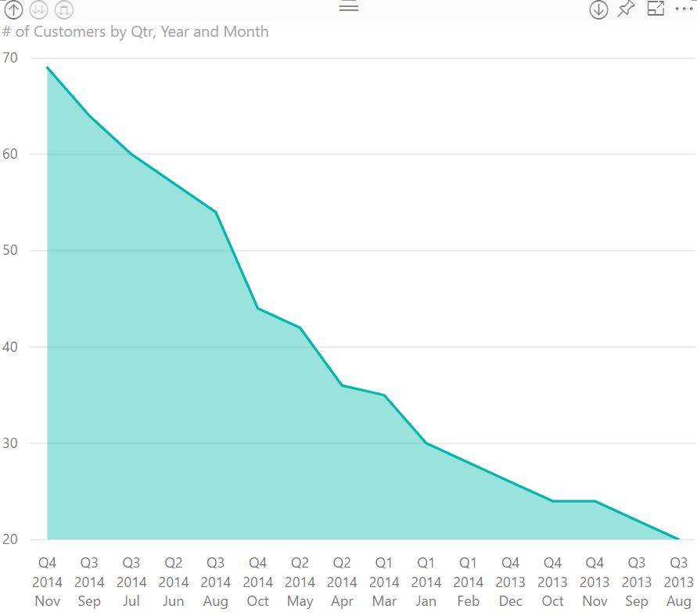
Using Date Drilldowns
Module 11
Before (quarter-level)
After (month-level)

Slide 26
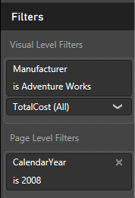
Using View Filters
Module 9
Filters Area
Filters Area is a Collapsible Pane that Controls Filtering on a Power BI Report
Filters Scope
Allows Filtering Entire Page, Just One Visualization, or Entire Report

Slide 27
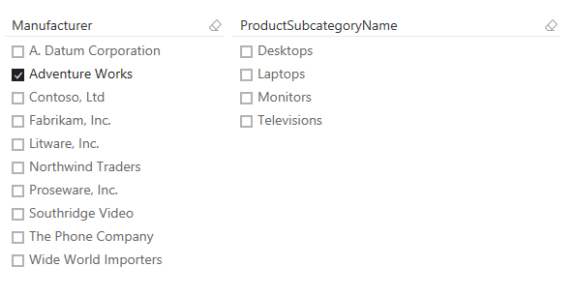
Using Slicers for Filtering
Module 11
What Are Slicers?
Same Concept as Excel Slicers
Visual Report Filter
Cascading Slicers
Filters Secondary Slicers to Only Show Related Rows

Slide 28
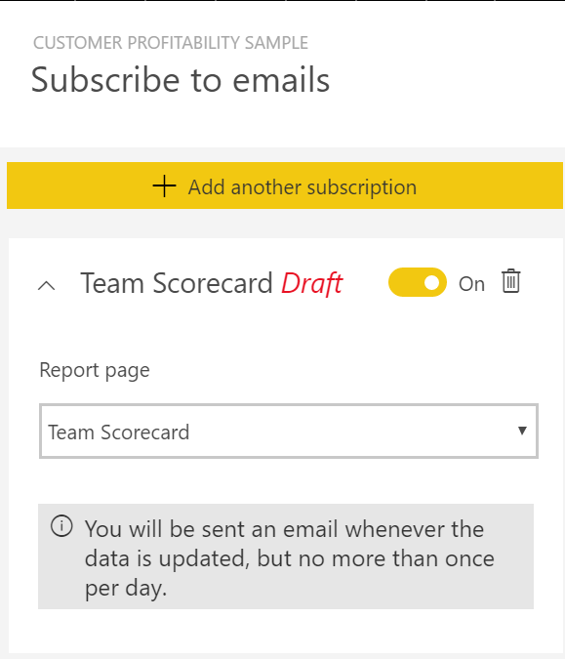
Subscriptions
Be emailed when data changes
Select the report page to monitor

Slide 29
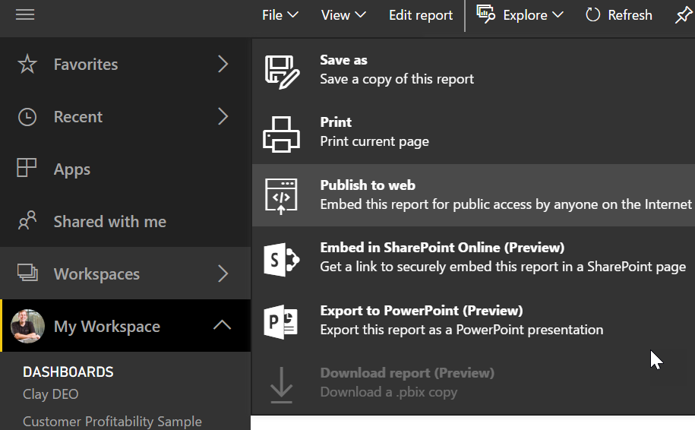
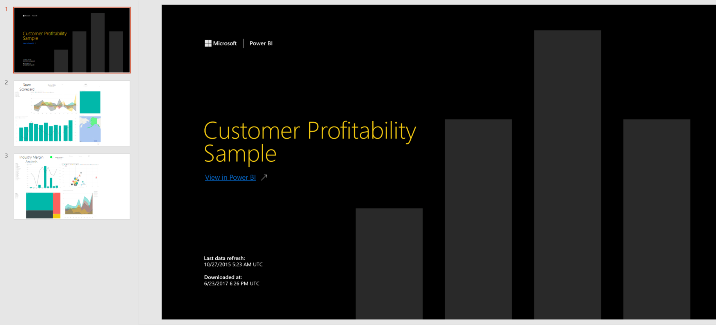
Export
Export to Power Point and SharePoint

Slide 30
Using Drilldowns, Slicers and Filters to Filter Reports
Notes:
Showcase the various scoping of filters for the Human Resources Sample

Slide 31
Using and Creating Dashboards
Using a dashboard
Creating your own dashboard
Sharing a dashboard

Slide 32
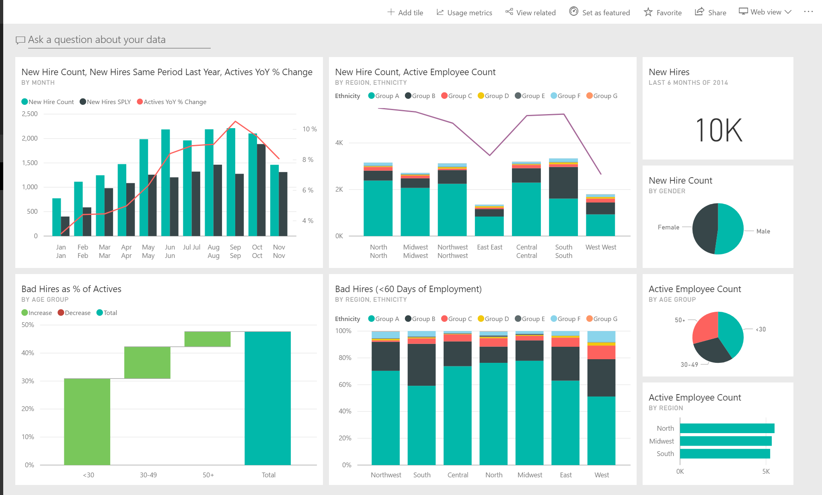
Dashboards
Brings together lots of reports into one view.
Drills into reports

Slide 33
Q&A – Talking to your dashboard
Asking questions of your data
Creating featured questions
Refining the results

Slide 34
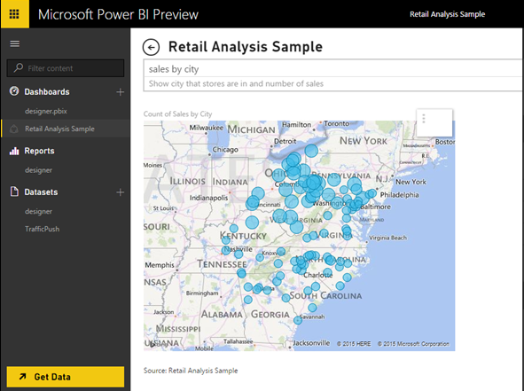
User Interaction with Q&A
User Experience
Type questions in plain English
Power BI Q&A will return the answer
Filters, sorting, aggregates and grouping all work based on key words in your questions
Uses Natural Query Language to return results
Results
Pin the results to your dashboard
Notes:
Key message:
One of the unique capabilities of Power BI is that it lets you ask questions of your data the same way you’d ask a person
Talking points:
Now, even the least quantitatively inclined person can find answers quickly by phrasing data questions in plain English
Type a question, and powerbi.com answers by generating a relevant chart
Pin the subsequent chart directly on a dashboard
Enable the best results by using key phrasing as you build models in Power BI Desktop
Power BI’s Natural Language Query, or Q&A feature, intelligently filters, sorts, aggregates, groups and displays data based on the key words in the question asked

Slide 35
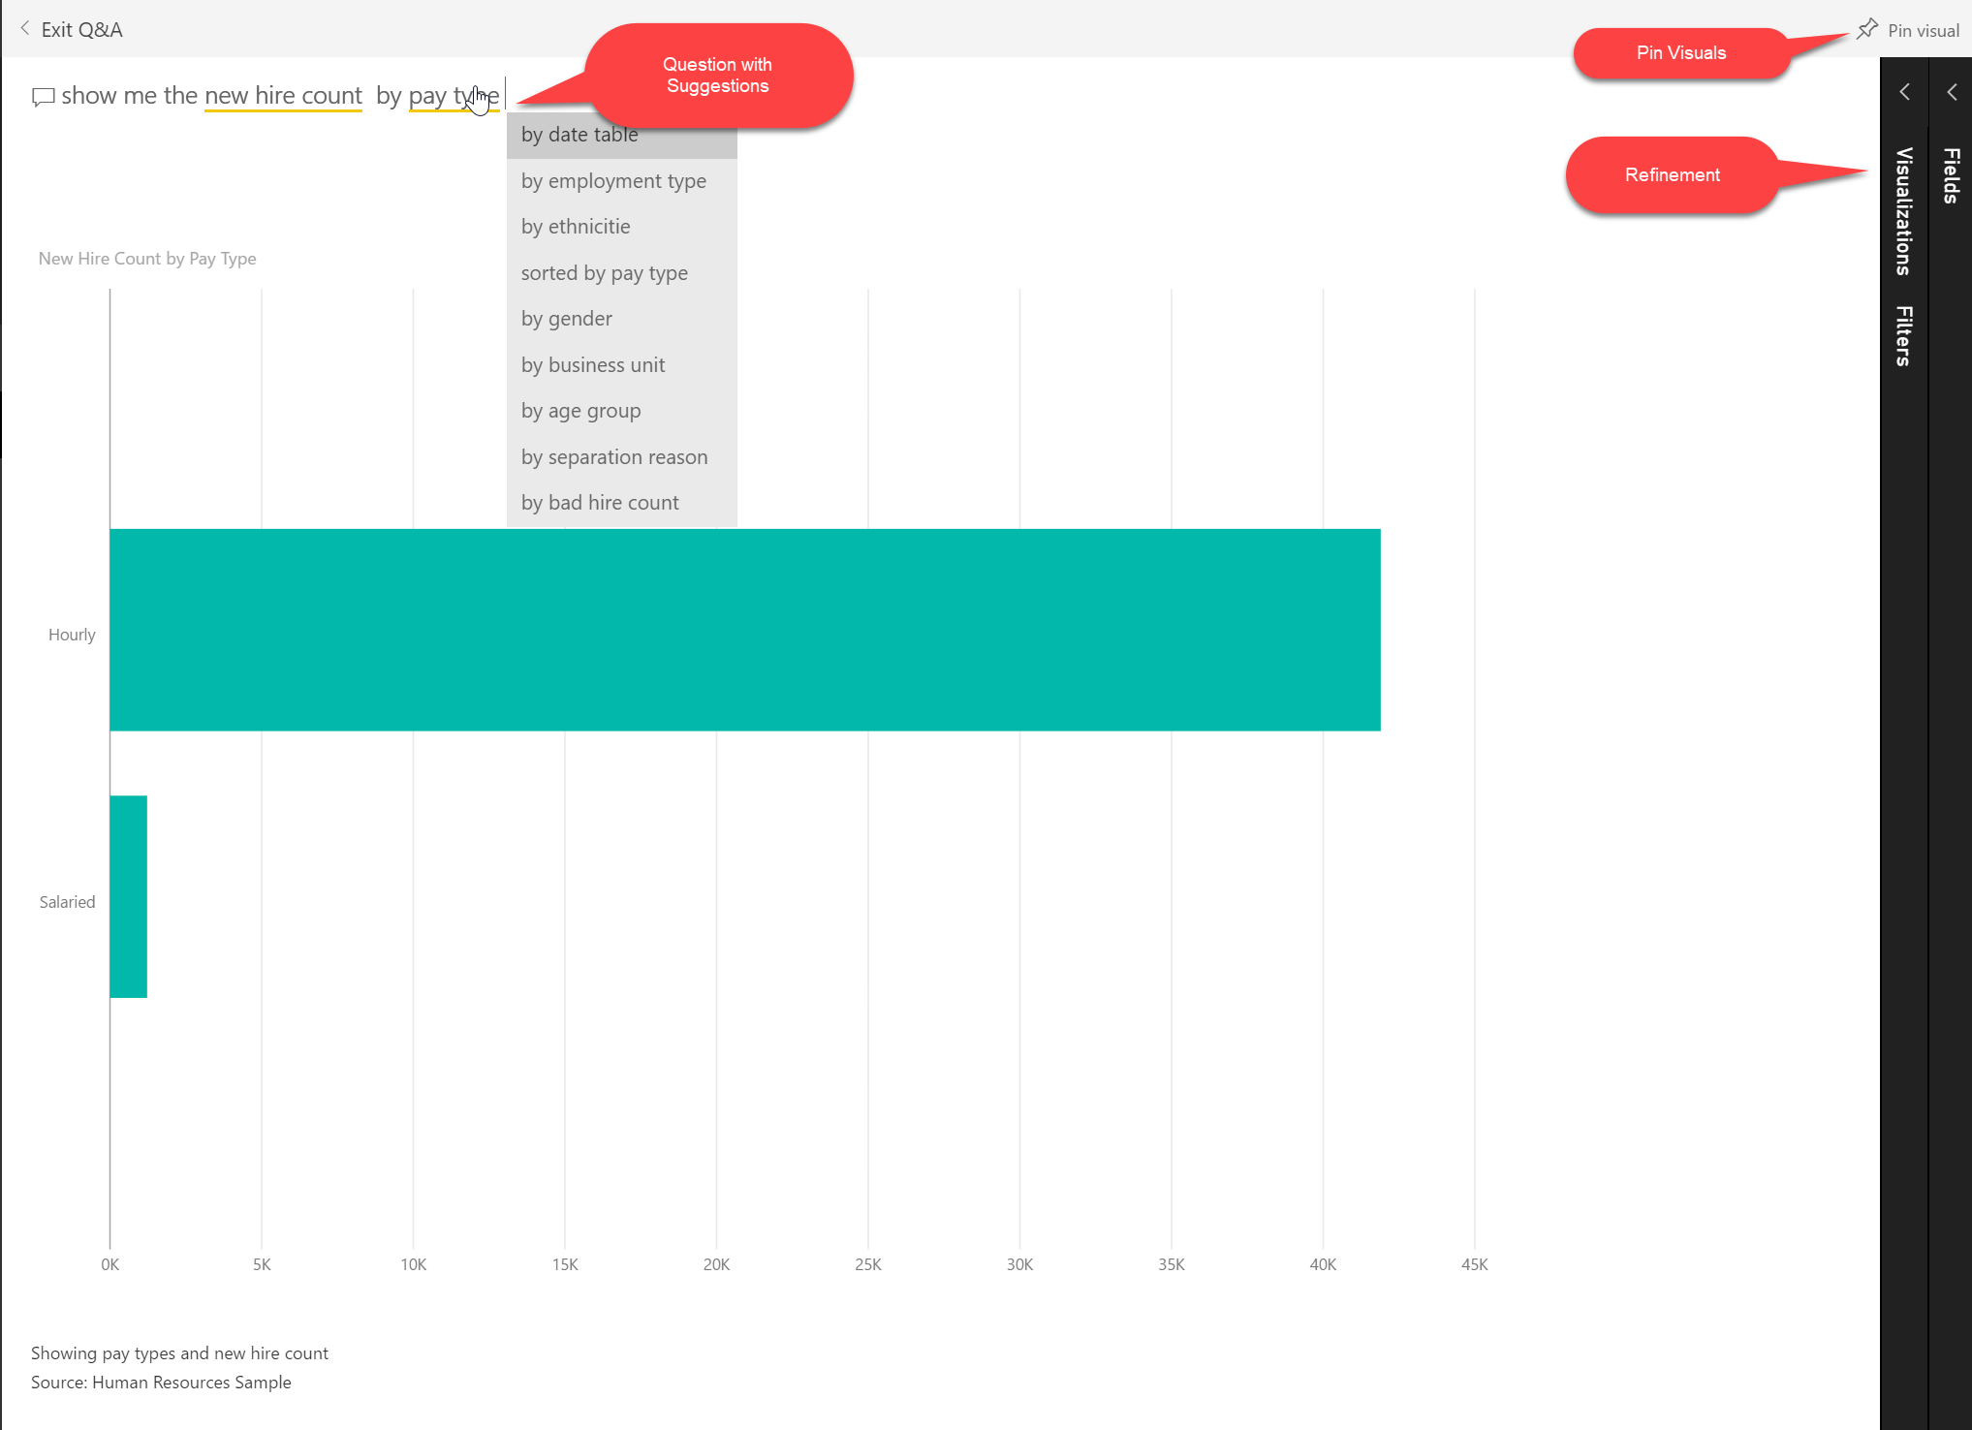
Using Q&A
Featured questions
Ask what you want
Ask how you want it
Refine

Slide 36
Working with Q&A
Notes:
Using the Human Resource Sample
Head to the dashboard
First QA – show me the number of employees
Second QA – show me the number of active employee count
Third QA - show me the number of active employee count by type
Fourth QA - show me the number of active employee count by type in a pie chart

Slide 37
Mobile BI
Power BI on Every Device
Using Mobile Annotations
Setting Favorite Visuals
Configuring Alerts

Slide 38
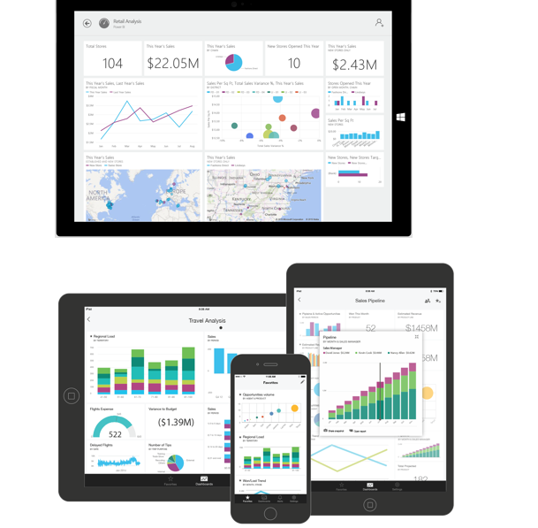
Power BI on Every Device
Stay Connected
Access dashboards using native mobile apps
Set favorites for most important visuals
Annotate visuals and share
Configure alerts to get notifications
Notes:
Key message:
Power BI mobile apps for Windows, iOS and Android make it possible to stay connected to your dashboards and reports from any device.
Talking points:
Power BI native applications are available for Windows, iOS and Android devices
These applications make it easy to access live dashboards and reports securely from anywhere
You can set favorites for easy access to the most important visualizations
Zoom in and out of a visualization to look at data more closely
Annotate a report or visualization and share your marked-up snapshot with others
Configure alerts to get instant notification of important changes
You can configure your settings to receive alerts and notifications as data reaches or drops below pre-defined thresholds, or based on other indicators

Slide 39
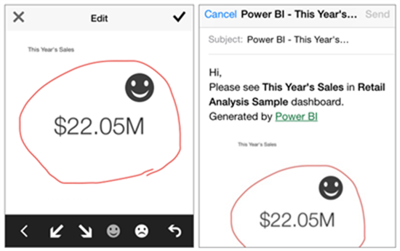
Using Mobile Annotations
Share with Others
Snapshots of tiles
Annotate visuals and share with anyone
Annotations in Action
Tap Share
Add lines, text, or stamps
Mail to recipients

Slide 40
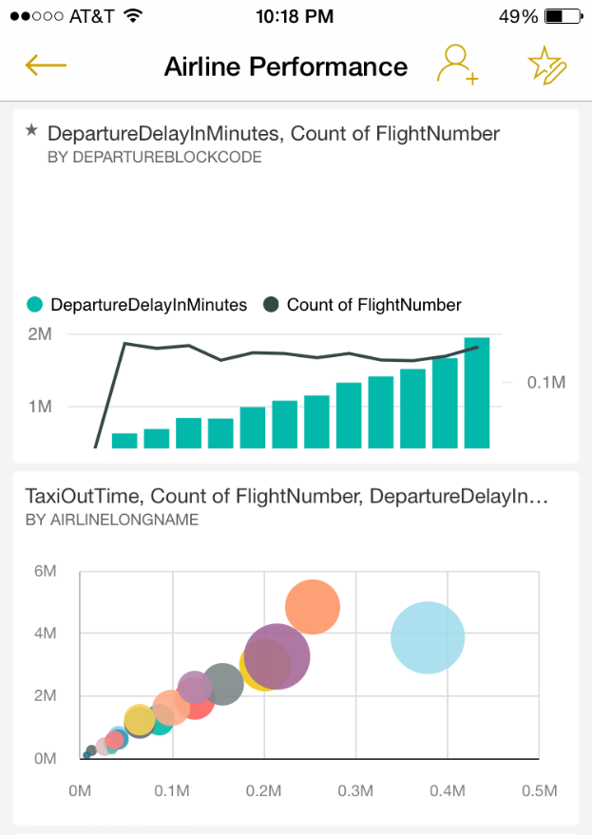
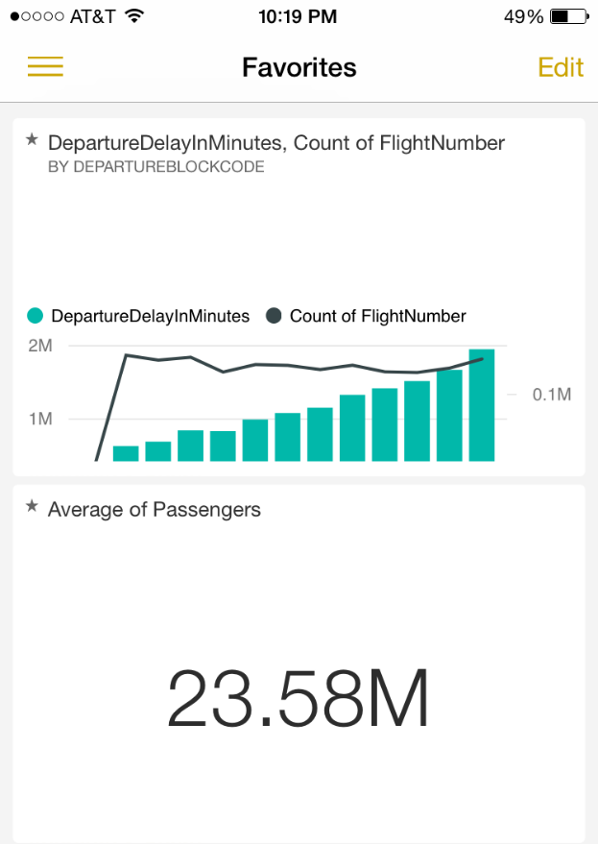
Setting Favorite Visuals
Favorites Overview
Make it quick and easy to find the most important visuals
Visuals appear in a separate “favorites” dashboard
Setting Favorites
Tap favorite icon
Then tap visuals to add
Notes:
Suppose you want to collect your favorite tiles together in one place. Just tap to mark specific tiles as favorites. They appear in a separate “favorites” dashboard.

Slide 41
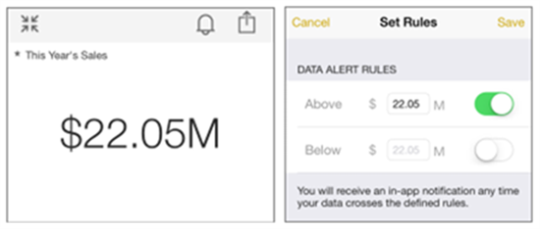
Configuring Alerts
Alerts Overview
Gain Insights no matter where you are
Data driven push notifications
Setting Alerts
Only available on single number tiles
Set data alert rules
Notes:
Want to be notified when your data change beyond certain levels? You can set rules to be alerted when single number tiles in your dashboard exceed limits that you set. With data-driven alerts, you can gain insights and take action wherever you’re located.

Slide 42
Using and Phone Power BI Application

Slide 43
Review
Module 1
The Power BI mobile experience is a native app for all devices.
You can create data alerts to be notified of data changes.
Add notes to dashboards with annotations.
Data Explorer

