Slide 1

Power BI Governance Strategies
Chris Seferlis – Practice Manager – NE/NY

Slide 2

About me:
Former CIO – 20+ years in IT
Worked with Microsoft Data Platform for about 10 years
Speak, blog, tweet @bizdataviz
US Army Veteran
LinkedIn: cseferlis
blog.pragmaticworks.com
blog.bizdataviz.com

Slide 3
What is Data Governance
Wikipedia: Data governance is a data management concept concerning the capability that enables an organization to ensure that high data quality exists throughout the complete lifecycle of the data. The key focus areas of data governance include availability, usability, consistency, data integrity and data security. This includes establishing processes to ensure effective data management throughout the enterprise such as accountability for the adverse effects of poor data quality and ensuring that the data which an enterprise has can be used by the entire organization.

Slide 4
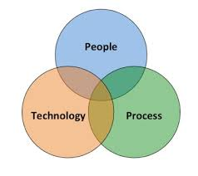
Governance… aka:
Wikipedia: Data governance is a data management concept concerning the capability that enables an organization to ensure that high data quality exists throughout the complete lifecycle of the data. The key focus areas of data governance include availability, usability, consistency, data integrity and data security. This includes establishing processes to ensure effective data management throughout the enterprise such as accountability for the adverse effects of poor data quality and ensuring that the data which an enterprise has can be used by the entire organization.

Slide 5
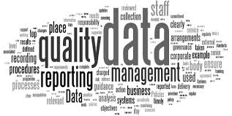
Qaulity Data… what is?
Generally:
  Verified/Validated
  Consistent
  Without Duplicates (Clean)
What does it mean to you?
What does it mean to your organization?
How do we get there?
Who is responsible?

Slide 6
What else?
Availability
Usability
Consistency
Data Integrity
Data Security
Underlying Process

Slide 7
The Evolution of BI
3rd wave
End user BI
Everyone
2nd wave
Self-service BI
Analyst to end user
1st wave
Corporate BI
IT to end user
Notes:
The way business intelligence is used in organization has changed significantly over the years. One way of understanding these changes is using the analogy of these three waves of BI:
In the early days of BI, organizations would typically have a team or person handling all the requests for insights from the business. This model is not very scalable, and it can take a long time for the answer to get back to the user. By the time it does, a new question probably has already come up.
To solve for this lack of scalability and gap between BI team and end users, the second approach to BI was to get BI capabilities in the hands of analysts, who understand the business and are able to support decisions with analytics.
With Power BI, we want to enable everyone in the organization to analyze their data, ask the questions will help them run their business better, and act based on the insights they find.

Slide 8
Approaches to Data Prep:
Access
Clean
Mash-up
Explore
Visualize
Share

Slide 9
Deployment Approaches
Business-Led Self-Service BI Bottom-Up Approach | IT-Managed Self-Service BI Blended Approach | Corporate BI Top-Down Approach
Analysis using any type of data source; emphasis on data exploration and freedom to innovate | A “managed” approach wherein reporting utilizes only predefined/governed data sources | Utilization of reports and dashboards published by IT for business users to consume
Ownership: Business supports all elements of the solution | Ownership: IT: data + semantic layer Business: reports | Ownership: IT supports all elements of the solution
Scope of Power BI use by business users: Data preparation, data modeling, report creation & execution | Scope of Power BI use by business users: Creation of reports and dashboards | Scope of Power BI use by business users: Execution of published reports
Governed by: Business | Governed by: IT: data + semantic layer Business: reports | Governed by: IT

Slide 10

Phases of Delivery
Phase 2:
Prototyping
Phase 3:
Publishing & Monitoring
Phase 4:
Support & Scalability
Phase 1:
Current State Assessment

Slide 11

Phase 1: Assessment
Evaluate Current vs Desired State
  User Surveys
  Cross-functional team development
  SME interviews
Outcome: Use Case Development
  Low complexity – quick wins
  High value – build confidence
Governance impact
  Establish early on who should be able to access what, when, and how

Slide 12
Phase 2: Prototyping
Use Case Development
  What’s required?
    Extraction
    Cleansing/Mashing
    Modeling
    Measures/Calculations
    Reports
  Who are the key personnel – who takes point?
“Better a diamond with a flaw than a pebble without” - Confucius
Governance!

Slide 13
Phase 3: Publishing and Monitoring
Workspace Management (Dev, UAT, Prod)
Data Refresh/Validation
Report/Dataset User Security and RLS
Data Classification Tags
Incremental Improvements
Data Catalog
Data Dictionary
Usage Patterns

Slide 14
Phase 4: Support and Scalability
Evaluate stability of deployment
  Will it support enterprise-level scale? Does it need to?
  How do reports/refresh perform?
  Is consolidation required?
What is your line of defense for Developers and Users?
How are new users added? How do we keep track of licensed users?
Are reports being deployed efficiently? Are we refreshing the same model multiple times?
Are deployed reports being used and taking up unnecessary space in your tenant?

Slide 15
Training
How is the process defined/information disseminated?
Who is developing what?
What is the best method for your environment?
  Workshops?
  On-Demand?
  Ad-Hoc?
How do you ensure standards are followed?

Slide 16

Congrats!
You’ve now deployed your use case and are harnessing the value of Power BI! So, now what?
Well…

Slide 17
Power BI: Total Support Requires Collaboration
Office 365 Admin
Power BI
Admin
Data
Stewards
IT Help
Desk
DBA
Team
Architecture
Team
Development Teams
PBI License Management
User
Security
Data
Governance
PBI User
Support
Data Refresh Management
Workspace & App Architecture
New Report
Development
PBI Environment Management
Dataset
Monitoring
Personal Gateway Support
Enterprise Gateway Mgmt
Development Best Practices
Report
Maintenance
Code & Design Review
PBI Data
Security
Compliance
Reporting
Internal Data Q&A
PBI on Premises
Server Support
Performance
Optimization
PBI Update
Management
PBI
Architecture
PBI Developer Support
PBI Developer Support

Slide 18







Top Customer Challenges with Power BI
Security and
License Management
Compliance & Governance
PBI user and developer Support
Backup & Recovery of Reports
Monitoring & Automation
Report development backlog
Architecture standards & Update management
Notes:
Review how this is based on research of our 5000 customers
What are the challenges in the current setup? Specific Pain Points?

Slide 19
Security and License Management
Challenges:
Ensure proper distribution of licenses to users by role and needs.
Understanding who has access to what reports.
Who has access to the data sources.
Be alerted of violations

Slide 20

Data Proliferation and Compliance
Challenges:
Knowing who has access to what datasets
Widespread dataset duplication across the enterprise
Understand what reports have personal / HIPPA data in them

Slide 21
Power BI Tenant Metadata Considerations
Reviewing report usage patterns
Ensuring data balances
Monitoring security for reports and data
Monitoring licenses extended and being used
Eliminating data duplication
Checking capacity status and refresh times

Slide 22
Power BI Usage Metrics
Log in to your Power BI Admin Portal to review information about:
  Users
  Global Tenant Settings
  Capacity Settings (Premium or Pro)
    Premium offers breakdown of CPU and memory Usage
  Dataflow Storage (preview)
    Use ADLS Gen2!
    https://docs.microsoft.com/en-us/power-bi/service-dataflows-azure-data-lake-integration
https://docs.microsoft.com/en-us/power-bi/service-admin-portal

Slide 23
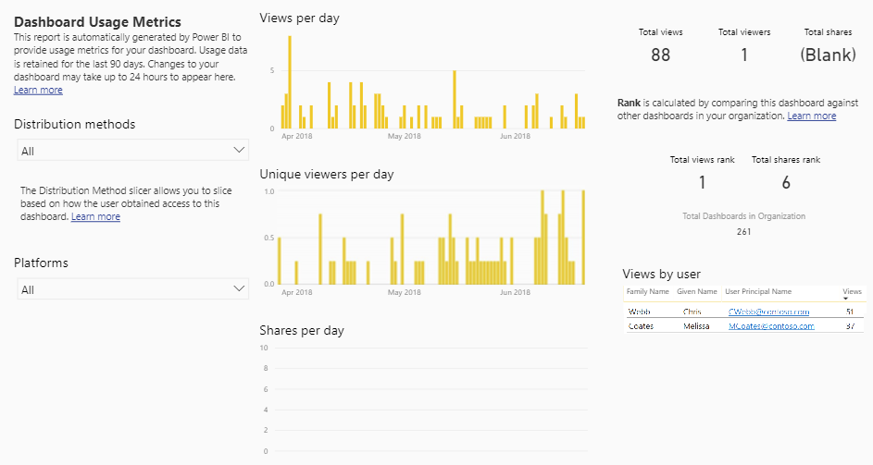
Power BI Tenant Metrics

Slide 24
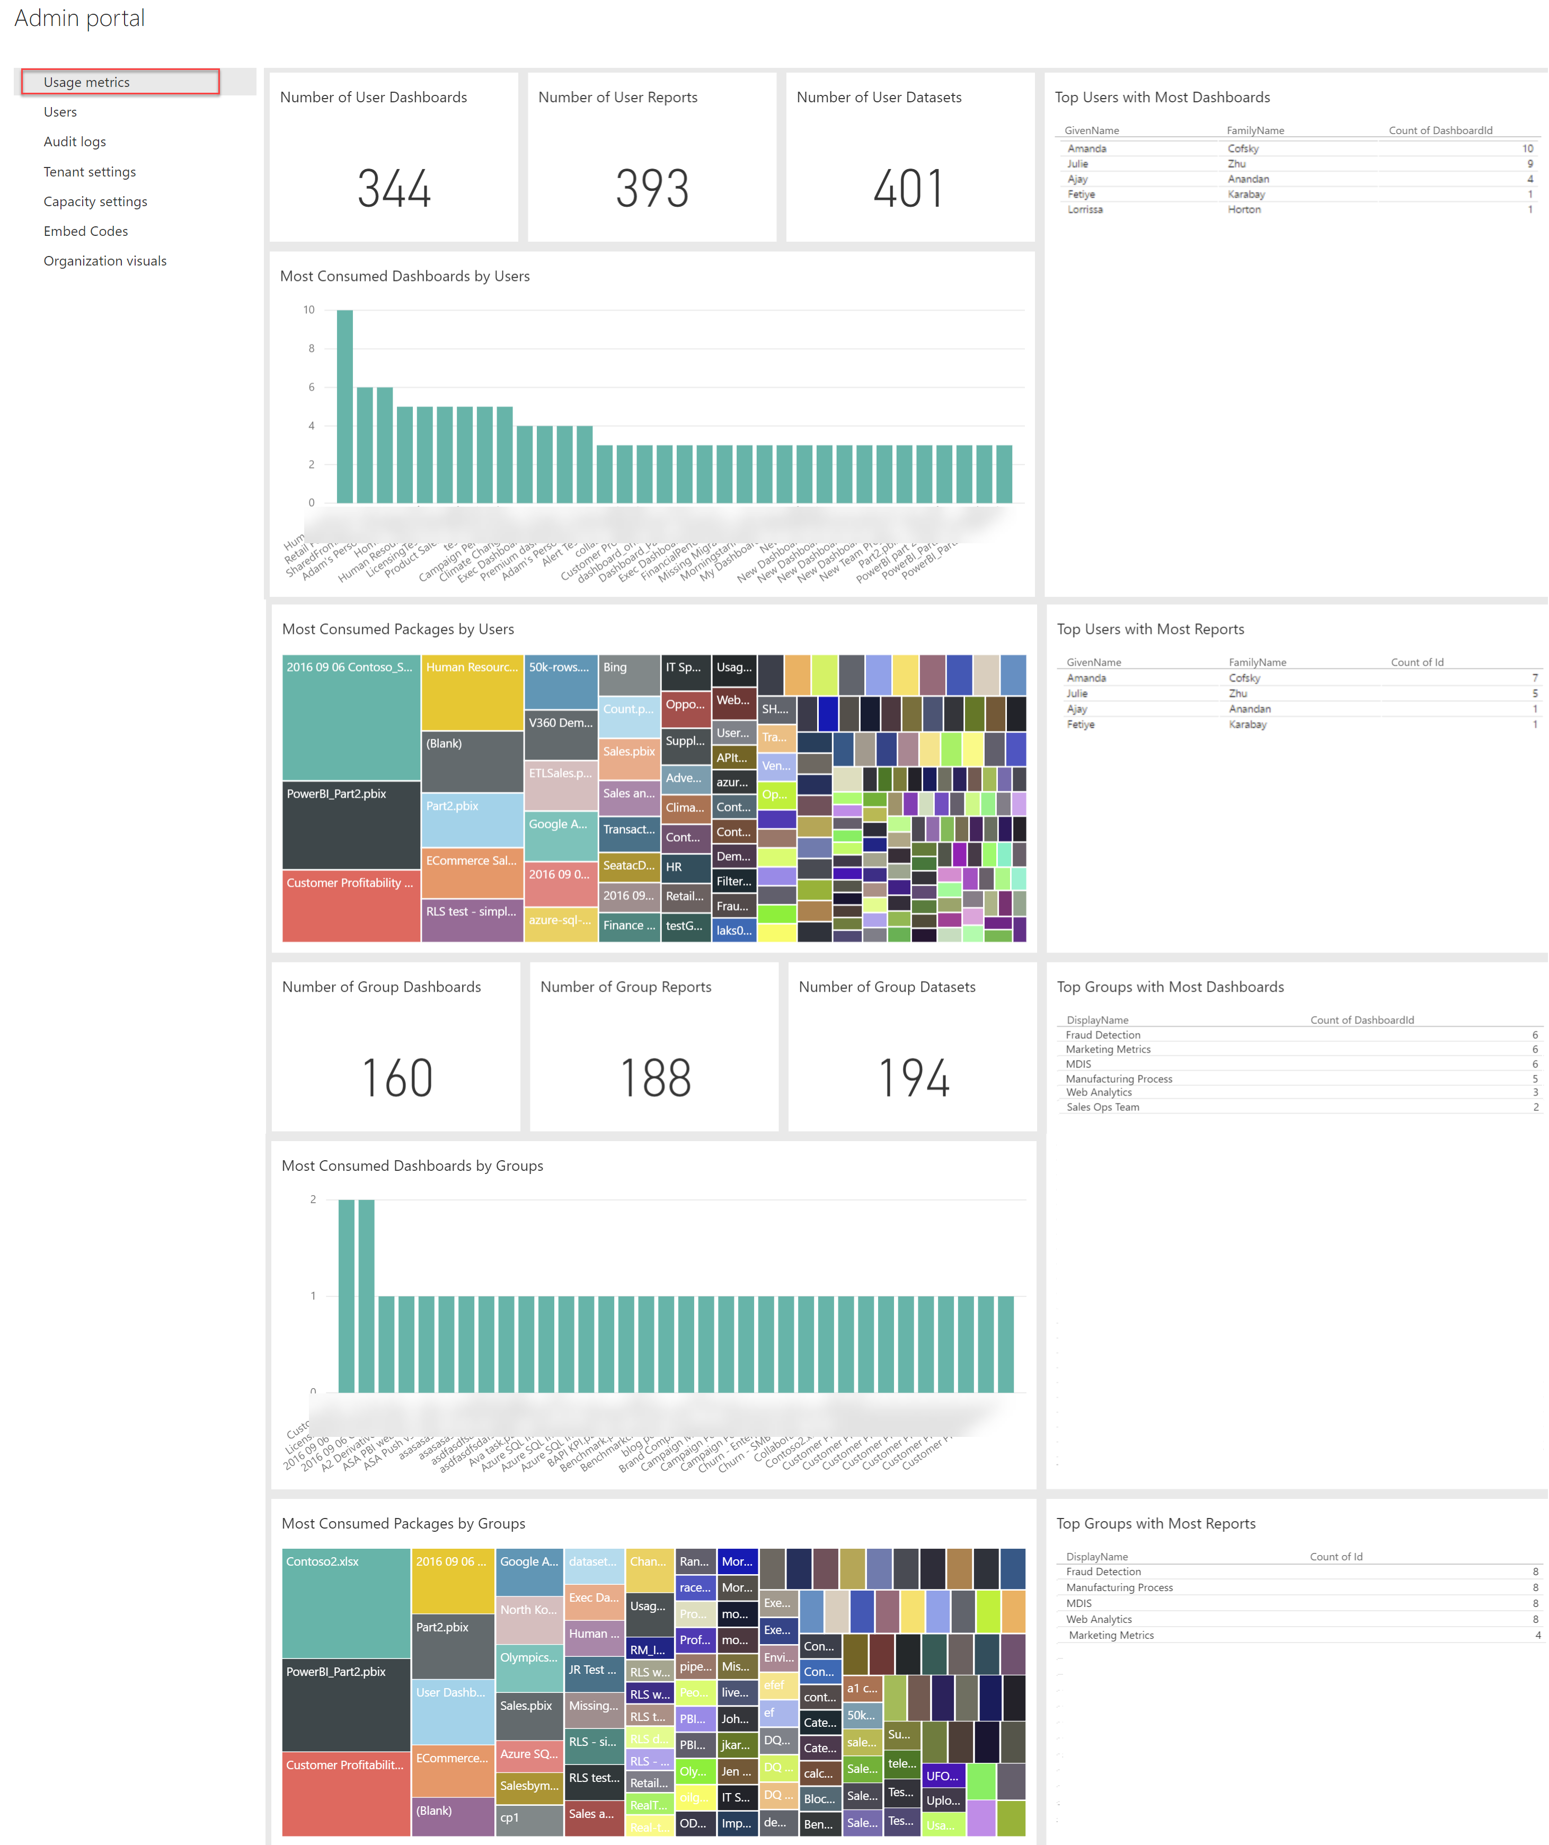
Power BI Tenant Metrics

Slide 25
Getting Your Security Audit Logs
Office 365 Audit Logs (in the O365 portal):
  Get access to the logs and download them
  Search for only PowerBI Activities
  Review or Export the data for further analysis
  Over 70 Power BI events are captured
Use PowerShell to export and search audit logs
  Many parameters and operations to work with
API call from within Power BI in JSON format – but only gives 7 days
https://docs.microsoft.com/en-us/power-bi/service-admin-auditing

Slide 26
Tracking Power BI Service Health
Log in to your Microsoft 365 Tenant
Check the Service Health Specifying Power BI
Review details of advisories or adverse health conditions
https://docs.microsoft.com/en-us/power-bi/service-admin-health

Slide 27
Management with PowerShell
Data Module
  PowerBIDatasource
  PowerBIDataset
  PowerBITable
  PowerBIRow
  PowerBIColumn
Profile Module – PowerBIServiceAccount, PowerBIAccessToken, PowerBIRestMethod, PowerBIError
Reports Module – PowerBIReport, PowerBITile, PowerBIDashboard, PowerBIImport
https://docs.microsoft.com/en-us/powershell/power-bi/overview?view=powerbi-ps

Slide 28
Power BI: Total Support Requires Collaboration
Office 365 Admin
Power BI
Admin
Data
Stewards
IT Help
Desk
DBA
Team
Architecture
Team
Development Teams
PBI License Management
User
Security
Data
Governance
PBI User
Support
Data Refresh Management
Workspace & App Architecture
New Report
Development
PBI Environment Management
Dataset
Monitoring
Personal Gateway Support
Enterprise Gateway Mgmt
Development Best Practices
Report
Maintenance
Code & Design Review
PBI Data
Security
Compliance
Reporting
Internal Data Q&A
PBI on Premises
Server Support
Performance
Optimization
PBI Update
Management
PBI
Architecture
PBI Developer Support
PBI Developer Support
Who gets assigned what tasks?

Slide 29
Other Important Docs
Power BI Governance and Deployment Approaches Whitepaper This whitepaper discusses governance and ways to deploy Power BI. It was published March 2016, but the ideas and processes discussed are still relevant. https://powerbi.microsoft.com/en-us/documentation/powerbi-admin-governance/
Best Design Practices for Reports and Visuals This page provides a wealth of information about design principles for effective Power BI data visualizations. https://docs.microsoft.com/en-us/power-bi/power-bi-visualization-best-practices
Bidirectional Filtering in Power BI This whitepaper discusses the impact of using bidirectional cross-filtering in Power BI Desktop (and Analysis Services), including behaviors a data modeler/author needs to be aware of in order to use the capability without unintended side effects. https://docs.microsoft.com/en-us/power-bi/desktop-bidirectional-filtering

Slide 30
Have Any Questions?
Thank you!
@pragmaticworks @bizdataviz
blog.pragmaticworks.com youtube.com/pragmaticworks

