Slide 1
Power BI Dataflows
Bring Your Own Data Lake

Slide 2
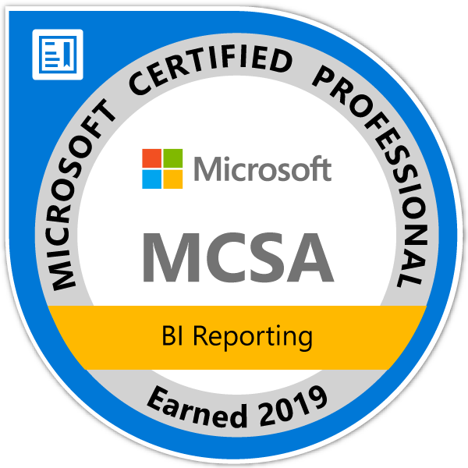
About Me
Michelle Browning
Pragmatic Works Consultant since September 2019
Data, BI, and Application Development Background
MCSA: BI Reporting
Geek, Crafter, Crazy Cat Lady
Inigo Montoya
Email: mbrowning@pragmaticworks.com

Slide 3
Agenda
Requirements
Azure Setup for Power BI Access
Power BI setup for using your Azure Data Lake
Attaching a CDM Folder to Power BI Dataflows

Slide 4
Power BI Requirements
Power BI paid license
Premium license for Computed Entities

Slide 5
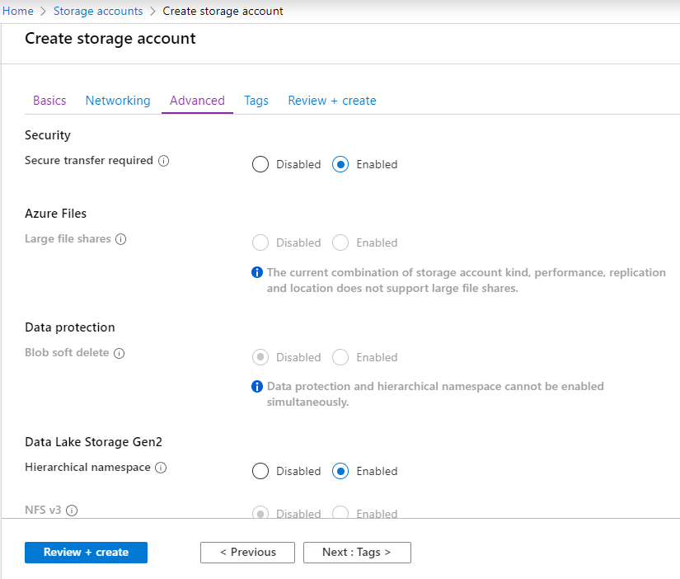
Azure Requirements
Active subscription
Storage account with
Hierarchical namespace enabled
http://bit.ly/CreateADLg2

Slide 6
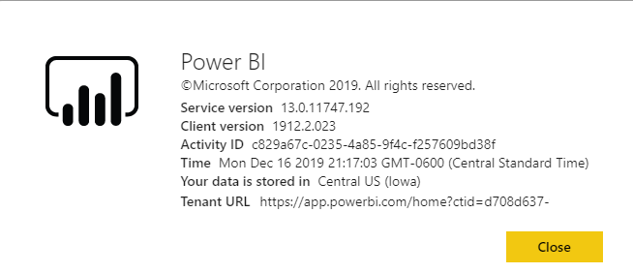
A Caveat
The Azure Data Lake Storage Gen2 account must be created in the same region as your Power BI tenant.

Slide 7
Azure Setup
Assign the Power BI Service to the Reader role for the storage account
Another gotcha:
Changes to access control on the Azure storage account may take up to 30 minutes to take effect
Create a new blob container for Power BI
Add permissions for Power BI and Power Query
Add Permissions for any Power BI users

Slide 8
Power BI Setup
Connect Power BI to the Azure Data Lake Storage Gen2 account
Requires Global Administrator permissions
Only one storage account can be connected to Power BI
Once configured, the storage location cannot be changed
Allow admins to assign workspaces to the storage account
Dataflows cannot be created in the default workspace – “My workspace”

Slide 9
Making the Connection with CDM Folders
Common Data Model
Microsoft standard for metadata
Consist of csv files for data with model.json file for metadata
https://docs.microsoft.com/en-us/common-data-model/

Slide 10
Demo Time!

Slide 11
Have Any Questions?
mbrowning@pragmaticworks.com

