Slide 1
Power BI –
Introduction to Dataflows
Public Preview Feature
Date: January 15, 2019
Joe Abbott, Consultant

Slide 2




About Joe Abbott
Consultant at Pragmatic Works
Power BI, Azure, Logic Apps, ADFv2…
10+ years working in the Actuarial field
Speak at user groups, webinars, SQL Sat.
Grew up in Green Bay, WI

Slide 3
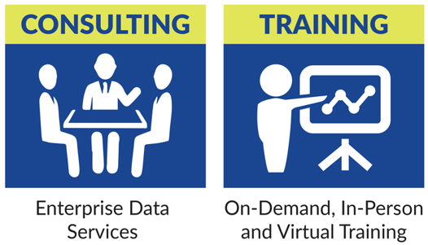
Joe Abbott
Consultant
jabbott@pragmaticworks.com
@GrumpyDataGuy

Slide 4

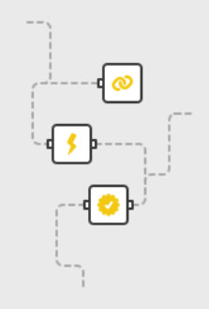
Agenda
What is a Power BI Dataflow?
Why would I use it?
  Dataflow vs. Dataset
How do I create one?
How do I use it?
Pro vs. Premium Comparison
Security Considerations
Bring your own Azure Data Lake

Slide 5
Power BI Dataflows
What is Power BI?
What is a Power BI Dataflow?
Why would I use one?

Slide 6

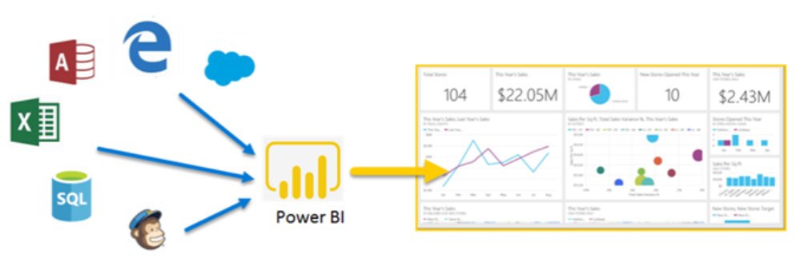
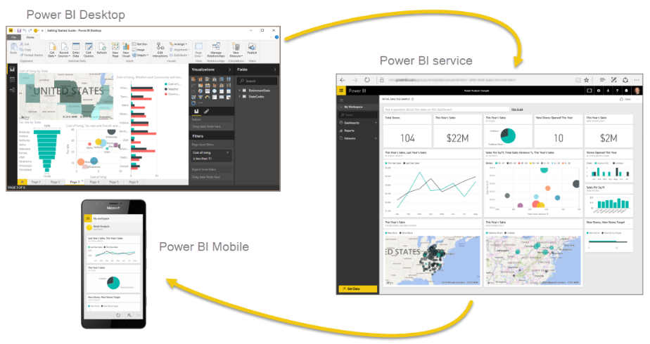
What is Power BI?
Power BI is a business analytics solution from Microsoft that lets you visualize your data and share insights across your organization, or embed them in your app or website. Connect to hundreds of data sources and bring your data to life with live dashboards and reports.
Power BI Desktop
Power BI Service
Power BI Mobile
Notes:
Power BI Dataflows is NOT available for Power BI Report Server (On Prem)

Slide 7
What is a Power BI Dataflow?
Many different definitions…
Self-service data prep
Self-service ETL (Extract-Transform-Load)
A collection of entities
  Entities are similar to tables
Common misconception:
A Dataflow is NOT a Dataset
*Not available for Power BI Report Server (On Prem)
Notes:
In the modern BI world, data preparation is considered the most difficult, expensive, and time-consuming task, estimated by experts as taking 60%-80% of the time and cost of a typical analytics project.
Power BI provides analysts today with industry leading data preparation capabilities using Power Query in Power BI Desktop.
Power BI Dataflows brings Power Query to the Power BI Service.

Slide 8
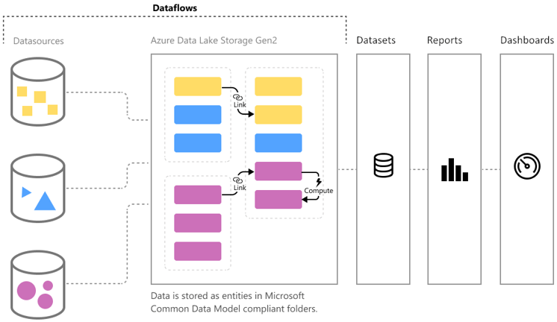
What is a Power BI Dataflow?
What is a Common Data Model?
The Common Data Model (CDM) is a set of a standardized data schemas and a metadata system to allow consistency of data and its meaning across applications and business processes.
Notes:
Common Data Model (CDM)
A set of standard business entities such as Account, Product, and Location.
You can map your columns to these pre-defined commonly used concepts and activities.
The added benefit of this is to simplify the creation, aggregation, and analysis of your data.

Slide 9

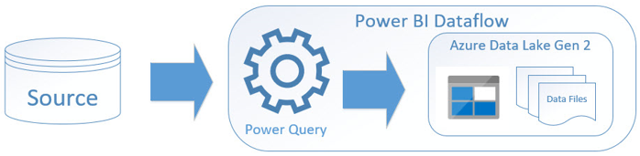
Why would I use a Power BI Dataflow?
Easily ingest, cleanse, transform, integrate, enrich, and schematize data.
Traditional ETL (SSIS)
Power BI Dataflows
Notes:
In the modern BI world, data preparation is considered the most difficult, expensive, and time-consuming task, estimated by experts as taking 60%-80% of the time and cost of a typical analytics project.
Power BI provides analysts today with industry leading data preparation capabilities using Power Query in Power BI Desktop.
Power BI Dataflows brings Power Query to the Power BI Service.

Slide 10


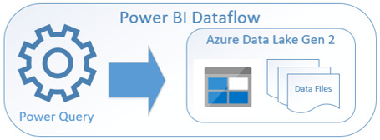
Why would I use a Power BI Dataflow?
The power of M (Power Query) comes to the Power BI Service!
Power BI Desktop
Dataset
Power BI Service
Power BI Service
Dataset
Notes:
In the modern BI world, data preparation is considered the most difficult, expensive, and time-consuming task, estimated by experts as taking 60%-80% of the time and cost of a typical analytics project.
Power BI provides analysts today with industry leading data preparation capabilities using Power Query in Power BI Desktop.
Power BI Dataflows brings Power Query to the Power BI Service.

Slide 11

Why would I use a Power BI Dataflow?
Five (5) Reasons to use Power BI Dataflows (or at least try them)
Intuitive and familiar authoring
  Power Query (Excel and Power BI users)
Auto Orchestration
  Automatically handles full orchestration of transformations
Big Data ready
Common Data Model
Native integration
  Sits side-by-side with Datasets, Reports and Dashboards
  Added benefits Power BI Service Datasets cannot offer
Notes:
Tens of millions of Excel and Power BI users are familiar with Power Query
Dataflows is similar to Excel in how it builds a dependency graph and knows how to properly execute the dataflows, in the right order
Dataflows are designed to work with massive amounts of data, and storing data in Azure Data Lake Storage (Gen 2) can be accessed by other Azure Data Services
Dataflows supports the Common Data Model (CDM) – which is a standard set of business entities such as Account, Product, Opportunity, Location, etc.
Dataflows share workspaces along with other Power BI artifacts

Slide 12
Power BI Dataflows
How do I create one?
How do I use it?

Slide 13

How do I create a Power BI Dataflow?
Step 1
Confirm Tenant Settings are Enabled (https://app.powerbi.com)
  Requires Admin access (Power BI Administrator role)
Step 2
Navigate to desired App Workspace
  Create > Dataflow > Add new entities
  Dataflows are NOT available in “My Workspace”
Step 3
Choose data source > Enter Credentials > Select data/tables/etc.

Slide 14
Demo
How do I create a Power BI Dataflow?
Notes:
Verify Admin Portal Settings
Show “My Workspace”
Build Dataflow with Append Query to show Lightning Bolt and computed entities (requires Premium Capacity to refresh)
Build Dataflow without the Append
Go back to the App Workspace and show off the Dataflow > Kick off a refresh > Schedule a refresh

Slide 15
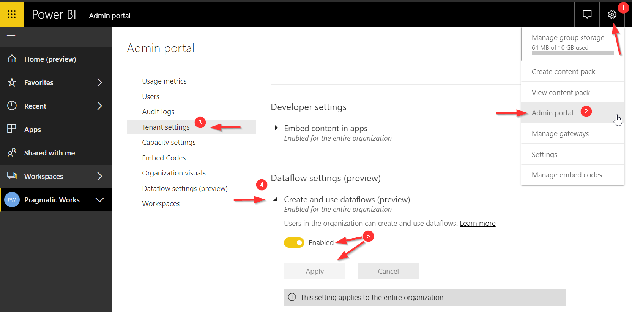
Step 1 - Confirm Tenant Settings are Enabled (https://app.powerbi.com)
Notes:
Requires Admin access (Power BI Administrator role)

Slide 16
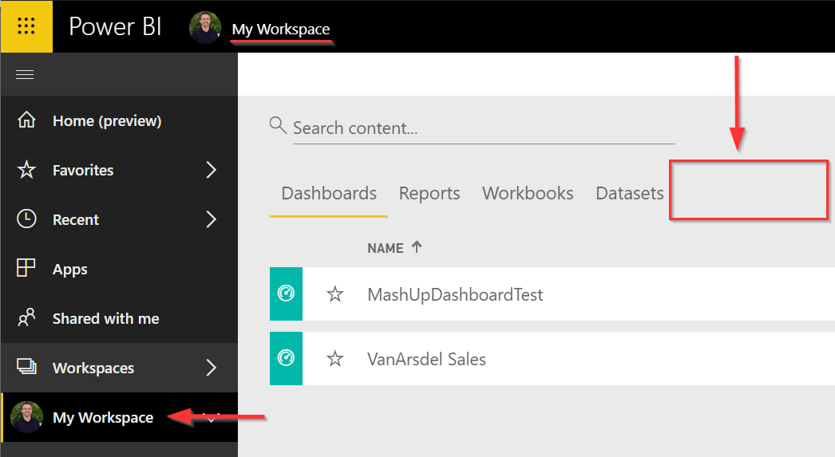
Step 2 – “My Workspace” – No Dataflows option
Notes:
Dataflows are NOT available in “My Workspace”

Slide 17
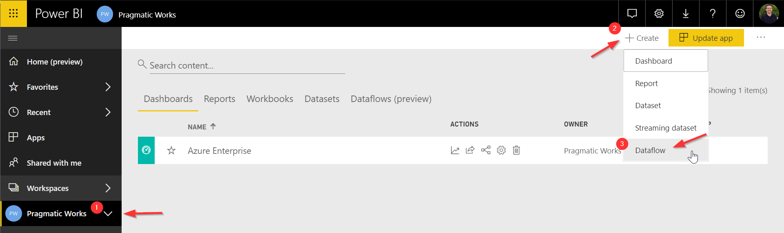
Step 2 – App Workspace > Create > Dataflow > Add new entities
Notes:
Dataflows are NOT available in “My Workspace”
You must be in an actual App Workspace to Create a Dataflow.

Slide 18
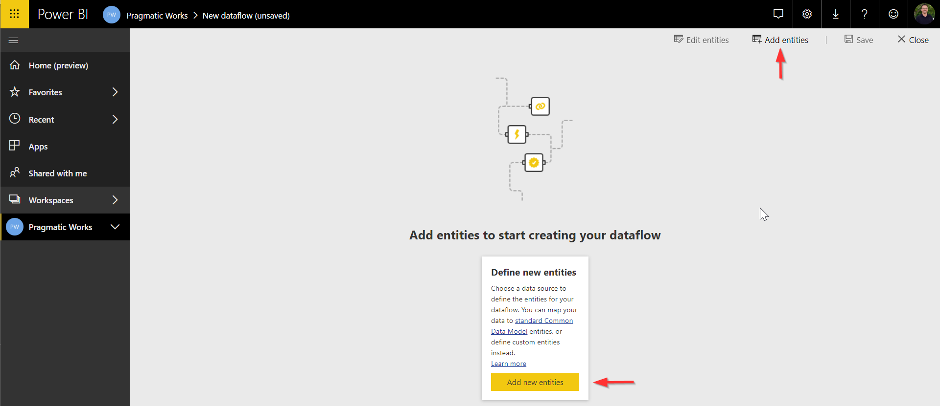
Step 2 – App Workspace > Create > Dataflow > Add new entities
Notes:
Dataflows are NOT available in “My Workspace”
You must be in an actual App Workspace to Create a Dataflow.

Slide 19
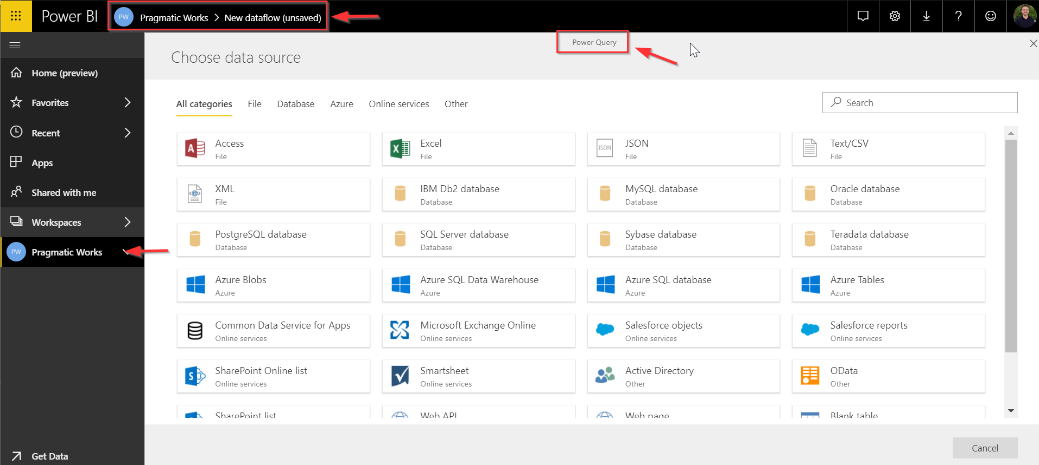
Step 3 – Choose Data Source > Enter Credentials > Select Data/Tables/etc.
Notes:
As you can see, you are now in the Power Query section of the Power BI Service.
Select your Data Source > Enter Credentials > Select Data/Tables/etc.
Build Dataflow with Append Query to show Lightning Bolt and computed entities (requires Premium Capacity to refresh)
Build Dataflow without the Append

Slide 20
How do I refresh the data?
Similar to Power BI Datasets
Manual Refresh, Scheduled Refresh
  This will depend on the permissions of the member and App Workspace
Unique to Dataflows
External referenced data changed
  Dataflows can refer to data that is not owned by the workspace
  The Dataflow will proactively look for changes in the data
  When changes are detected, a recalculation is triggered automatically

Slide 21
How do I use a Power BI Dataflow?
Step 1
Open Power BI Desktop
Step 2
Get Data > Power BI dataflows (beta)
  Connector is in Preview – read/acknowledge message
Step 3
Select Dataflow > Choose Load or Edit
Notes:
Show how you can select multiple Dataflows, across workspaces.
You cannot do this when you connect to Power BI Service datasets.

Slide 22
Demo
How do I use a Power BI Dataflow?
Notes:
Show how you can select multiple Dataflows, across workspaces.
You cannot do this when you connect to Power BI Service datasets.

Slide 23
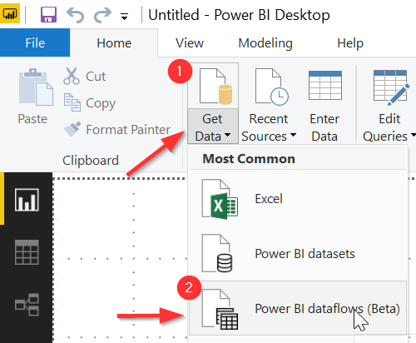
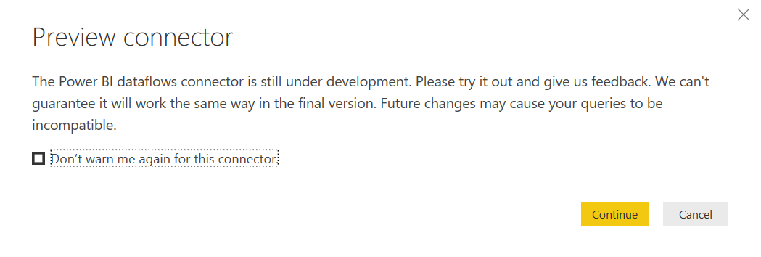
Step 2 – Power BI Desktop > Get Data > Select dataflow
Notes:
Get Data > Power BI datasets (Beta)
Read/acknowledge this is a Preview connector

Slide 24
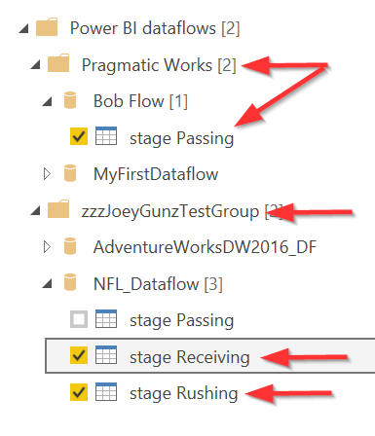
Step 3 – Select Dataflow > Choose Load or Edit
Notes:
Show how you can select multiple Dataflows, across workspaces.
You cannot do this when you connect to Power BI Service datasets.

Slide 25
Pro vs. Premium Comparison
Dataflow Capability | Power BI Pro | Power BI Premium
Scheduled Refresh | 8 per day | 48
Total Storage | 10 GB/User | 100 TB/node
Dataflow Authoring with Power Query Online | ü | ü
Computed Entities (in-storage transformations via M) | ✗ | ü
Dataflow incremental refresh | ✗ | ü
Running on Power BI Premium capacity / Parallel execution of transforms | ✗ | ü
Dataflow linked entities | ✗ | ü
Standardized Schema / Built-In Support for the Common Data Model | ü | ü
Dataflow Management within Power BI, Connector in the Power BI Desktop, Integration with Azure | ü | ü
Notes:
Link entities between dataflows: (https://docs.microsoft.com/en-us/power-bi/service-dataflows-linked-entities)
You can reuse entities that have already been ingested, cleansed and transformed by other dataflows owned by others without the need to maintain that data
The linked entities simply point to the entities in other dataflows, and do not copy or duplicate the data

Slide 26

Power BI Dataflows – Security
All data processed by dataflows is secured in Azure data lake
Azure Data Lake Store Gen2 uses standard Access Control Lists (ACLs) to restrict data files to authorized users only.
*** WARNING – For the initial release*, access is granted to the entire dataflow***
Row-level security is NOT currently supported
  RLS can be implemented at the dataset level
Recommended best practice is to only grant access to Dataflows to those individuals who will be creating the datasets.
  General report users/consumers should continue to use Datasets, Reports and Dashboards
* Future releases plan to move to more granular levels of security

Slide 27

Bring your own Azure Data Lake
Azure Data Lake Storage (generation 2) issued behind the scenes
  Common Data Model folder structure transparent to tenant and user
  No path/connection string
Organizations can use their own Azure Data Lake Store
  Dataflow data and definition files can be used by developers
  Leverage Azure Data and artificial intelligence (AI) services
  Integrate dataflow data into internal applications
There is a process documented, with best practices, should you or your organization want to use your own Azure Data Lake.

Slide 28

Conclusion
What is a Power BI Dataflow?
Why would I use it?
How do I create one?
How do I use it?
Pro vs. Premium Comparison
Security Considerations
Bring your own Azure Data Lake
Thank you for your time!

Slide 29
Joe Abbott
jabbott@pragmaticworks.com
@GrumpyDataGuy
www.pragmaticworks.com

Slide 30
References
Power BI Whitepapers (first link “Power BI and Dataflows”)
Self-Service data prep in Power BI
Creating and using dataflows in Power BI
Linked Entities (requires Power BI Premium)
Bring your own Azure Data Lake

