Slide 1
Modern Data Warehouse:
On-Premise vs. Cloud – Which is Right?
Practice Manager: David Hay
09/01/2019

Slide 2

The world is changing

Slide 3
Data will grow to
44 ZB in 2020
Today, 80% of
organizations
struggle with cloud
or on-premises decision
strategies
AI investment
increased by
300% in 2018

Slide 4
Predictive Analytics and ROI: Lessons from IDC’s Financial Impact Study
Both predictive and non-predictive projects yielded high median ROI, 145% and 89%, respectively.
The major benefits of business analytics projects that employed predictive analytics centered on business process enhancement, especially improving the quality of operational decisions.
Predictive analytics projects required higher investment levels and yielded significantly higher overall returns over five years, implying that these projects tackled problems of greater scope and complexity.
Working with Pragmatic Works will allow you to cut the delta (~56%)
Business Intelligence + Predictive Modeling
Business Intelligence
Alone
Provides Businesses with an average of 89% Return on Investment
Provides Businesses with an average of 145% Return on Investment

Slide 5

Insights is a Journey
What happened?
Why did it happen?
What will
happen?
What should
I do?
Insight
Reports
Interactive
Dashboards
Predictive
Models
Recommendations
& Automation

Slide 6
Analytical Maturity Curve
DATA SCIENCES
Prescriptive
Real-time Predictive Modeling & Mining
Real-time Analytics
Predictive
Event-based
Data Discovery
DECISION SUPPORT
Exploratory Analytics
Temporal Analysis
Continuous Update
Rule-based Alerting
WORKLOAD COMPLEXITY
Diagnostic
Foundational Analytics
Closed Loop Forecasting
Self-Service
Reporting
Descriptive
Large Adhoc
Scorecarding
OPERATIONAL MANAGEMENT
Technical Capabilities Should Facilitate Movement Along the Maturity Curve
Basic
Reporting
Batch
Limited Adhoc
Single Version of Truth
WHAT HAPPENED?
WHY DID IT HAPPEN?
WHAT MAY HAPPEN?
WHAT IS HAPPENING?
WHAT ACTION SHOULD WE TAKE?
DATA SOPHISTICATION

Slide 7








DATA ARCHITECTURE
erp
Real Time Processing
Marketing
Marketing
Executives
Marketing
Executives
scm
Applications
INTEGRATED DATA WAREHOUSE
Operational
Systems
1
Operational
Systems
crm
DATA
PLATFORM
Business
Intelligence
Customers
Partners
Images
Customers
Partners
2
3
Data
Mining
Frontline
Workers
Web and
Social
Knowledge
Workers
Business
Analysts
Machine
Logs
Math
and Stats
Business
Analysts
Integrated Discovery platform
Data
Scientists
Text
Data
Scientists
5
Languages
Audio
and Video
Engineers
4
Engineers
Search
Users
Sources
Analytic tools & apps
Users

Slide 8
DATA ARCHITECTURE
erp
Real Time Processing
Data in Motion
Marketing
Marketing
Executives
Marketing
Executives
scm
Applications
INTEGRATED DATA WAREHOUSE
Operational
Systems
1
Operational
Systems
crm
Business Intelligence
DATA
PLATFORM
Business
Intelligence
High Concurrency & Strict SLAs
Customers
Partners
Images
Customers
Partners
Operational Intelligence
Fast Loading
2
3
Data
Mining
Frontline
Workers
Web and
Social
Knowledge
Workers
Filtering and Processing
Business
Analysts
Machine
Logs
Math
and Stats
Business
Analysts
Exploratory Analysis
Integrated Discovery platform
Online Archival
Data
Scientists
Text
Data
Scientists
5
Data Discovery
Languages
Path, graph, time-series analysis
Audio
and Video
Engineers
4
Engineers
Integrated Analytics
Search
Users
Sources
Analytic tools & apps
Users

Slide 9













The SQL Server & Azure Data Estate Combined
DATA SOURCES
DATA MANAGEMENT
DATA INSIGHTS
DATA SOURCES DATA MANAGEMENT DATA INSIGHTS
Structured
OLTP
Data virtualization
Operational data
ON-PREM CLOUD
Data integration
Business intelligence
Power BI Embedded
SQL Server Reporting Services and Mobile BI
SQL Server
Azure
SQL Database
Azure Document DB
MOBILE
ERP
LOB
Data warehousing
Advanced Analytics & AI
SQL Server Analysis Services and R built- in
Azure
Machine Learning
Azure
Stream Analytics
Azure
Cognitive Services
Unstructured
Graph
SQL Server
Data Warehouse
Azure SQL
Data Warehouse
Social
Big data processing
IoT
Apache Hadoop
Azure HDInsight
Azure Data Lake
Media
Least vulnerable data platform, with more certifications than any other cloud provider
SECURITY
More certifications than any other cloud provider
SECURITY
FLEXIBILITY
FLEXIBILITY
Any language, any platform, anywhere .NET JAVA Azure
₃rd

Slide 10





Knowing the various SQL Server & Azure Big Data Solutions
CONTROL
EASE OF USE
Data Engineering in a
Job-as-a-service model
Azure & SQL Server
Data Lake
Analytics
Azure Databricks
SQL Server Analytics
Frictionless & Optimized Spark clusters
Azure HDInsights
SQL Server Analytics
Integration Services
Workload optimized, managed clusters
Reduced Administration
Azure Marketplace
SQL Server Studio
HDP | CDH | MapR
Any Hadoop technology, any distribution
BIG DATA
ANALYTICS
IaaS Clusters
Managed Clusters
Big Data as-a-service
Azure Data Lake Analytics
Azure and SQL Server Studio Data Lake Store
BIG DATA STORAGE
Azure and SQL Server Studio Storage

Slide 11
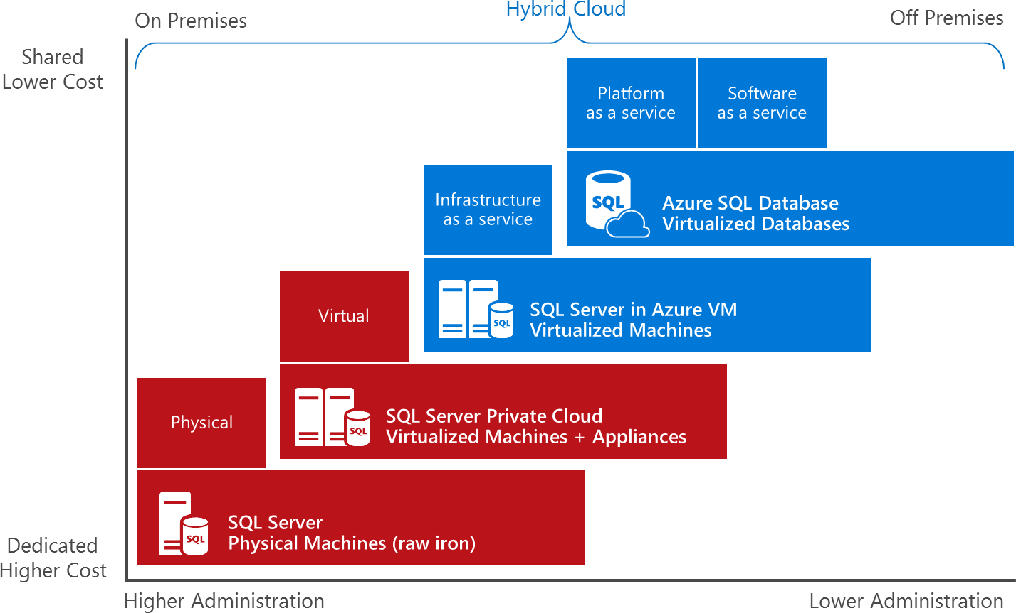
Choosing a Strategy
“What’s the best path for me?”

Slide 12






























Azure solution paths
Highly customized system to address the application’s specific performance
and availability requirements.
Do not have to manage any VMs, OS or database software, including upgrades, high availability, and backups.

Slide 13




Azure migration tools and services
Assess
Migrate

Slide 14
Implementing Common Data Architectures: SQL Server or Azure

Slide 15
Big Data & Data Warehouse
LOB
CRM
INGEST
STORE
PREP & TRAIN
MODEL & SERVE
BI + Reporting
Graph
Image
Advanced Analytics
Social
Data orchestration
and monitoring
Big data store
Analytics engines
Data warehouse
Real Time Analytics
IoT
Azure Data Factory
SQL Server Integration Services
Azure Blob storage
Azure Data Lake Store
SQL Server
Azure Databricks
Azure HDInsight
Azure Data Lake Analytics
SQL Server R and Python Integration Services
Azure SQL Data Warehouse
Azure Analysis Services
SQL Server
SQL Server Analysis Servers
Cloud

Slide 16
Modern Data Warehouse
INGEST
STORE
PREP & TRAIN
MODEL & SERVE
-Azure Databricks
(or Azure HDInsight, Azure Data Lake Analytics)
-SQL Server R and Python Integration Services
Logs, files and media
(unstructured)
-Azure Data Factory
-SQL Server Integration
Services
-Azure Blob Storage
-SQL Server
Polybase
Business/custom apps
(Structured)
-Operational Reports
-SQL Server Reporting Services
&
-Analytical Dashboards (PowerBI)
-Azure Data Factory
-SQL Server Integration Services
-Azure SQL Data Warehouse
-SQL Server
-Azure Analysis Services
-SQL Server Analysis Services

Slide 17
Advanced Analytics
INGEST
STORE
PREP & TRAIN
MODEL & SERVE
-Azure Machine Learning
-SQL Server Machine Learning Services
-Azure Databricks
(Spark ML, SparkR) , ---SQL Server R and Python Integration Services
Logs, files and media
(unstructured)
-Azure Data Factory
-SQL Server Integration
Services
-Azure Databricks
(or Azure HDInsight, Azure Data Lake Analytics)
SQL Server Analytics Interrogation Services
-Azure Blob Storage or
-Azure Data Lake Store
-SQL Server
Polybase
Business/custom apps
(Structured)
-Operational Reports,
-SQL Server Reporting Services
&
-Analytical Dashboards (PowerBI)
-Azure Data Factory
-SQL Server Integration
Services
-Azure SQL Data Warehouse
-SQL Server
-Azure Analysis Services
-SQL Server Analysis Serves

Slide 18
Real Time Analytics
INGEST
STORE
PREP & TRAIN
MODEL & SERVE
-Azure Machine Learning
-SQL Server Machine Learning Services
-Azure Databricks
(Spark ML, SparkR)
-SQL Server R and Python Integration Services
Logs, files and media
(unstructured)
Azure IoT Hub
Azure HDInsight (Kafka)
-Azure Databricks
Structured Streaming
(or Azure HDInsight, Azure Stream Analytics)
-SQL Server Analytics Integration Services
Sensors and IoT
(unstructured)
Polybase
Business/custom apps
(Structured)
-Operational Reports
-SQL Server Reporting Services
&
-Analytical Dashboards (PowerBI)
-Azure Data Factory
-SQL Server Integration Services
-Azure Blob Storage or
-Azure Data Lake Store
-SQL Server
-Azure SQL Data Warehouse
-SQL Server
-Azure Analysis Services
-SQL Server -Analysis Services

Slide 19

Intelligent applications
INGEST
STORE
PREP & TRAIN
MODEL & SERVE
Cosmos DB
Logs, files and media
(unstructured)
Azure IoT Hub
SQL
SQL Database
Predictive apps
Azure HDInsight (Kafka)
-Azure Databricks / HDInsight
-SQL Server R and Python Studio
Sensors and IoT
(unstructured)
Polybase
Business/custom apps
(Structured)
-Operational Reports
-SQL Server Reporting Server
&
-Analytical Dashboards (PowerBI)
-Azure Data Factory
-SQL Server Integration Services
-Azure Blob Storage
-SQL Server
-Azure SQL Data Warehouse
-SQL Server
-Azure Analysis Services
-SQL Server Analysis Services

Slide 20
Microsoft business analytics and AI
Intelligent
Trusted
Flexible
Faster, more accurate insights and predictions
Improve performance
Reduce time to value
Redefine interaction through AI
^{2x-10x faster}
Microsoft Machine Learning Algorithms running close to the data on premises and in the cloud
Simplified access to machine learning models and seamless transition from experimentation to production
Speech, Vision, Language and Search APIs built on decades of research & investment

Slide 21
Microsoft business analytics and AI
Intelligent
Trusted
Flexible
Most secure, compliant and scalable
Own, protect & control
your data
Meet your compliance
requirements
Grow effortlessly with
your business
The least vulnerable database over
seven years*
Meets global and industry-specific compliance standards, as well as country-specific standards
Highly scalable and performant data services with
ML based automatic index tuning

Slide 22



Microsoft business analytics and AI
Intelligent
Trusted
Flexible
Works with what you have
Get the most from all
your data
Maximize your existing
investments
Build on open source
innovation
Cloud
Hybrid
On-premises
The least vulnerable database over
seven years*
Meets global and industry-specific compliance standards, as well as country-specific standards
Highly scalable and performant data services with
ML based automatic index tuning

Slide 23
Business analytics Solutions
Operations
Marketing
Finance
Workforce
Service
Sales
Predictive
maintenance
Demand
forecasting
Operational
efficiency
Inventory
optimization
Operations
anomaly insights
Quality assurance
Connected devices
and smart buildings
Supplier and
spend insights
Personalization
Customer
insights
Churn
analytics
Dynamic
pricing
Product
innovation
Marketing
optimization
Product
recommendation
Finance
forecasting
Fraud
management
Rise
management
Employee insights
HR insights
Resource matching
and planning
Intelligent
contact center
Patient care
and healthcare analytics
Lead and
opportunity
scoring
Sales insights

