Slide 1
Predictive Models with SQL Server Machine Learning Services
Bob Rubocki – Practice Manager, BI Architect
January 22, 2019

Slide 2



Bob Rubocki
Practice Manager & BI Architect, Pragmatic Works
brubocki@pragmaticworks.com
linkedin.com/in/robertrubocki
@BobRubocki
bobrubocki.wordpress.com

Slide 3

Agenda
R, Python Overview
SQL Server Machine Learning Services
Development Experience
Executing R, Python from SQL Server
Demo (R only)
  Patterns apply to Python
  Not an R or data science deep-dive
  Very cool SQL Server integration!

Slide 4

R Overview
S – built at Bell Labs
  “S” for stats
  Naming style like “C”
R
  Built by Ross Ihaka and Robert Gentleman at U of Auckland (NZ)
  Name close to S
Built for statistical analysis
Managed by Comprehensive R Archive Network (CRAN)
  cran.r-project.org
Open source – continuously new and updated packages

Slide 5

Python Overview
General purpose language
Managed by Python Software Foundation
  www.python.org
Open source - continuously new and updated packages
Machine learning via packages
  numpy
  scikit-learn
  Many others…

Slide 6
SQL Server Machine Learning History
SQL Server R Services
SQL Server Machine Learning Services
Azure SQL DB Machine Learning Services
R
SQL Server 2016
SQL Server 2017
R and Python
Azure SQL DB (preview)
R
Python?

Slide 7




Should I use R or Python?

Slide 8

Answer
Quartz - If you want to upgrade your data analysis skills, which programming language should you learn?
https://qz.com/1063071/the-great-r-versus-python-for-data-science-debate/

Slide 9
Why Use SQL Server Machine Learning Services?
Our app data is in SQL Server
Keep data close to R/Python process – reduce latency
Integrate advanced analytics into apps
R version provides parallelism, performance for large data sets
R/Python version management

Slide 10
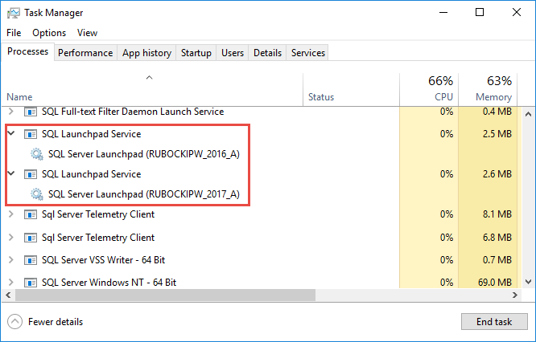
SQL Server Machine Learning Services
Not installed by default
R/Python run outside SQL Server
SQL Server Launchpad to call R/Python

Slide 11
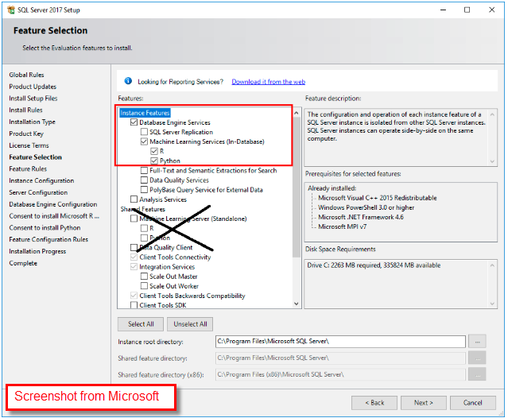

Installation
Enable external scripts
Restart SQL Server instance for configuration to take effect

Slide 12
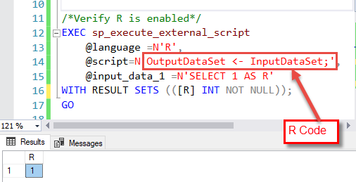
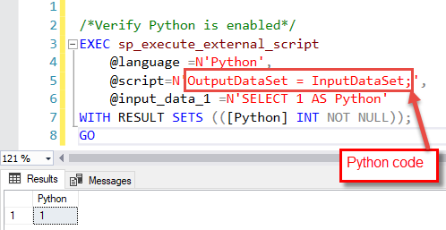
Hello World!
R
Python

Slide 13
R/Python Versions included with ML Services (As of 2019-01-21)
R
RevoScaleR
Python
revoscalepy
MicrosoftML
microsoftml
R Open (MS), R 3.5.1
Python 3.5.2, Anaconda 4.2
RevoScale
Name from Revolution Analytics
Acquired by Microsoft
MicrosoftML
Additional ML functionality
R Open
Microsoft’s enhanced R distribution
Multithreading
Release Stability
High performance, parallelism
Pretrained models for image classification,

Slide 14
Updating R and Python
SQL Server Cumulative updates – service packs
Bind to Machine Learning Server
  Run Machine Learning Server Installer
  R/Python components now registered as Machine Learning Server Components
  More frequent updates than SQL Server
Manual – not recommended

Slide 15
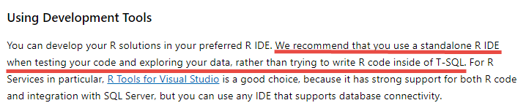
Tools and Developer Experience
R
R Studio
Visual Studio
Python
Visual Studio Code
Others
Others

Slide 16
Tools and Developer Experience
R/Python IDE
SSMS
Experimenting, model selection
Feature Engineering
Operations
Data Exploration
App integration

Slide 17
Executing R, Python from SQL Server
sp_execute_external_script
R/Python script as input parameter
Executes R/Python external process
R/Python code to create and train a model
Execute Prediction functions in R/Python using trained model
  R – rxPredict
  Python – rx_predict

Slide 18

PREDICT T-SQL Function
SQL Server 2017 and later, including Azure SQL DB
Runs within SQL Server process, NOT external process
Requires trained model binary in native format (perhaps stored in a table)
Does NOT require Machine Learning Services (R/Python) to execute

Slide 19
Development and Deployment Pattern
Use R Studio for experimentation, determine best model(s)
Use SQL Server for…
1
Create Model Stored procedure
INSERT trained model object to a table
Prediction Stored Procedure
Output trained model binary
Create trained model with R
Trained model as input
SQL data set as input
Procedure returns predictions
Table keeps model versions
Store models with different algorithms
Retrain periodically
2
3

Slide 20
Demo
Predict number of ski rentals based on historical data
Based on demo from Microsoft
  https://microsoft.github.io/sql-ml-tutorials/R/rentalprediction/
  https://microsoft.github.io/sql-ml-tutorials/python/rentalprediction/
R Studio – use R, build two regression models, choose best
SQL Server – use R from step 1, build trained model in SQL, execute predictions

Slide 21
Conclusion
R, Python Overview
SQL Server Machine Learning Services
Development Experience
Executing R, Python from SQL Server

Slide 22
brubocki@pragmaticworks.com
@bobrubocki
linkedin.com/in/robertrubocki/

