Slide 1
SSIS in the Cloud
Manuel Quintana

Slide 2
What is SSIS in the Cloud
  Running SSIS Packages that move data to/from cloud sources
  Executing SSIS packages within a Virtual Machine in Azure
  Using Azure Data Factory and what is called Lift and Shift
  Using Pipelines/Data Flows within Azure Data Factory

Slide 3
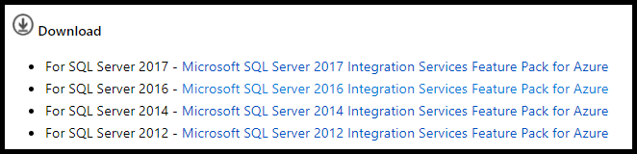
Azure Feature Pack
Connection Managers
  Azure Storage, Azure Subscription, Azure Data Lake , Azure Resource Manager, Azure HDInsight
Tasks
  Blob Upload, Blob Download, Azure SQL DW Upload, Azure Data Lake Store File System,
  HDInsight Hive, HDInsight Pig, HDInsight Create Cluster, HDInsight Delete Cluster, Flexible File Task
Data Flow Components
  Blob Source, Blob Destination, Data Lake Store Source, Data Lake Store Destination, Flexible File Source
  Flexible File Destination
Azure Blob & ADLS File Enumerator
  For Each Loop
https://tinyurl.com/AzureFeaturePack

Slide 4
Azure Feature Pack for SSIS
Demonstration

Slide 5

Azure Blob Source
Connection Manager
  AzureStorage connection manager type
  Storage Account name
  Account Key
Limitations
  Text Qualifiers
  Delimiters
  Default Data Type
  Blob Name is case sensitive

Slide 6
Loading Azure SQL DB
On-Prem File to Azure SQL DB
  Flat File Source
Flat File Source
  More flexibility
  More design options
  Out of box component
Limitations
  More complex for SSIS Lift and Shift scenarios
Notes:
Limitations: We will discuss more around the limitations of SSIS Lift and Shift in our next section which discussed these specific scenarios.

Slide 7

Provisioning Azure Data Factory
Data Factory
  The name must be globally unique.
  Subscription
  Resource Group
  Version (V1 vs V2)
  Location
  Version Control

Slide 8
Lift and Shift
What is it?
  Executing SSIS packages stored in Azure
  Using Azure resources, not on-prem resources
Requirements
  Azure Subscription
  Azure Data Factory
  Azure-SSIS Integration Runtime (IR)
  Azure SQL DB Server (or) Azure SQL Managed Instance –
  SSIS Catalog as well as the SSISDB
Notes:
Azure SQL DB (or) Azure SQL Managed Instance
Click Next to configure SQL settings for Azure to create and manage SSISDB. This is
required and needs to be either an Azure SQL DB Server or Azure SQL Managed Instance.
This is where the SSIS catalog will exist as well as the SSISDB.

Slide 9
Why Lift and Shift?
Other Considerations
  Reduced Operational Cost
  Familiar Toolset
  SQL Agent, PowerShell, or ADF Pipeline Activity
  High Availability with multiple nodes
  Scale up or scale out

Slide 10
Provision Azure-SSIS Integration Runtime
What is the Azure SSIS IR
  The compute that runs SSIS packages
  Azure SSIS IR runs on VMs that Azure manages
Azure SSIS IR configuration
  Location
  Node Size – Resources for the VM
  Standard_D4_v2 8 Cores
  Node Number – 2
  Azure SQL DB Server (or) Azure SQL Managed Instance
  Max Parallel Executions Per Node
  Select a Vnet
  *Pause or Delete your Azure-SSIS IR when not using Lift and Shift
Notes:
Notes from ADF SSIS in the cloud eBook (Josh O)
Max Parallel Executions Per Node
Here you can configure how many executions are spread per node. As a rule, I would not configure this to be more than the number of cores you assigned to your VM.
VNet
If you have an Azure VNet configured to be able to access on-premises resources, you can also configure that now.
The following table describes the capabilities and network support for each of the integration runtime types:
Azure - Data Flow,Data movement,Activity dispatch
Self-hosted - Data movement, Activity dispatch
Azure-SSIS - SSIS package execution

Slide 11
SSIS Deployment
Azure SSIS-IR
  Server
  Database
Visual Studio
  ISPAC
  DEPLOY
Management Studio
  Project Deploy
Notes:
Before we start, if you are using the Azure SSIS Feature Pack, please make sure this is
installed on the computer that is deploying the ISPAC file.

Slide 12
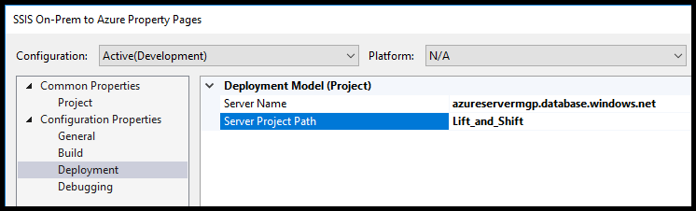
Deployment
Configuration Properties
  Server Name
  Server Project Path
Server Name
  <azure server name>.database.windows.net
Deploy
  Deploy Project

Slide 13
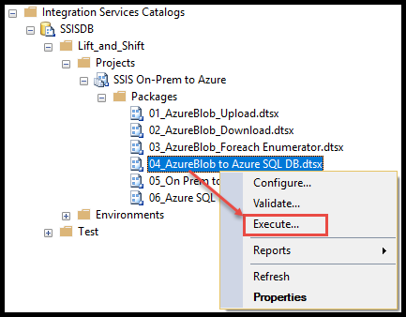
On-Prem Sources
Azure Vnet (Lift and Shift)
  For on-prem data sources
  VPN gateway or ExpressRoute
  P2S vs S2S
Self-Hosted IR (ADF)
  Can now be used as a Proxy for Lift and Shift
  https://docs.microsoft.com/en-us/azure/data-factory/self-hosted-integration-runtime-proxy-ssis
Notes:
Before you start, make sure you have version 17.2 or later of SQL Server Management Studio (SSMS).
If the SSISDB Catalog database is hosted on SQL Database Managed Instance (Preview), make sure you have version 17.6 or later of SSMS. To download the latest version of SSMS.

Slide 14
Self Hosted Integration Runtime
Integration Runtime
  Compute Infrastructure used by ADF
  Provides data integration capabilities across different network environments
Self-hosted integration runtime
  Capable of running copy activities between cloud data stores and private data stores
Notes:
The Integration Runtime (IR) is the compute infrastructure used by Azure Data Factory to provide the following data integration capabilities across different network environments:
Data movement: Copy data across data stores in public network and data stores in private network (on-premises or virtual private network). It provides support for built-in connectors, format conversion, column mapping, and performant and scalable data transfer.
Activity dispatch: Dispatch and monitor transformation activities running on a variety of compute services such as Azure HDInsight, Azure Machine Learning, Azure SQL Database, SQL Server, and more.
SSIS package execution: Natively execute SQL Server Integration Services (SSIS) packages in a managed Azure compute environment.
A self-hosted integration runtime is capable of running copy activities between a cloud data store and a data store in private network and dispatching transform activities against compute resources in an on-premises or Azure Virtual Network. Install Self-hosted integration runtime needs on an on-premises machine or a virtual machine inside a private network.

Slide 15
ADF Pipeline Activities
What does an activity do?
  The activities in a pipeline define actions to perform on your data.
Activities
  Batch Service (custom activity)
  Databricks
  Data Lake Analytics
  HDInsight
  Machine Learning
  Copy Data
  Stored Procedure

Slide 16
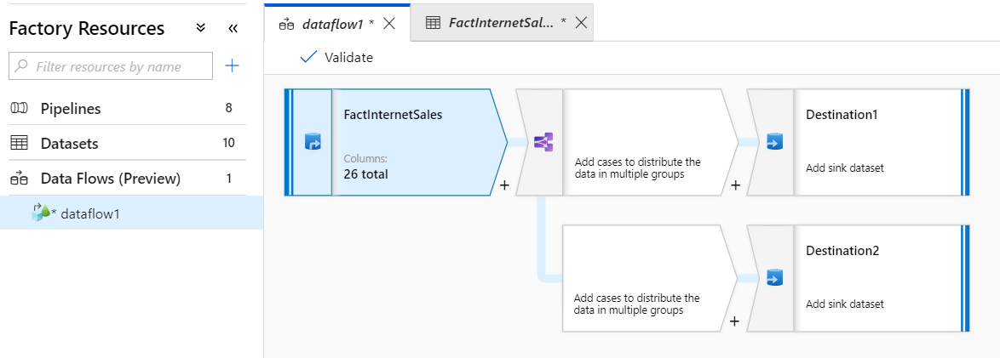
ADF Data Flows
Purpose
  Allows for data transformations
Items
  Source
  Transformations
  Sink
How to Execute
  Debug
  Data Flow Activity

Slide 17
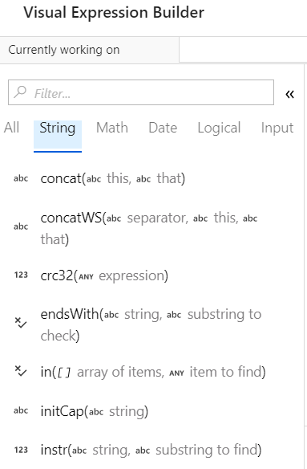
ADF Expression Language
Visual Expression Builder
  Certain transformations require the usage of the ADF expression language
Debug
  Lets you see live in-progress preview of your data results from the expression you are building

