Slide 1

Tips for Migrating Data Warehouses to Azure
Bob Rubocki – Practice Manager, BI Architect
January 21, 2020

Slide 2

Agenda
Scenario overview
Database objects
Data migration
ETL
Reports
Complete cutover

Slide 3




Bob Rubocki
Practice Manager & BI Architect, Pragmatic Works
brubocki@pragmaticworks.com
linkedin.com/in/robertrubocki
@BobRubocki
bobrubocki.wordpress.com

Slide 4
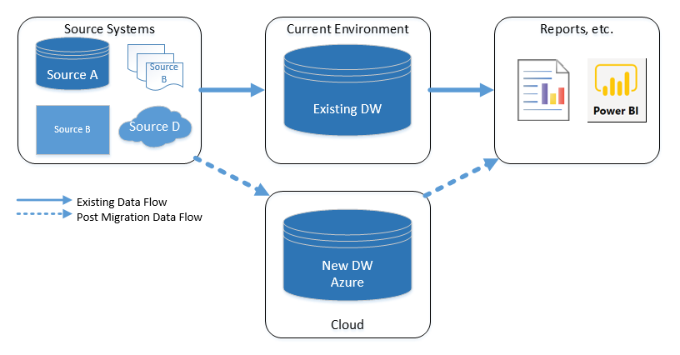
Migration Scenario
Existing DW platform varies (SQL, Teradata, Netezza, Oracle, etc.)
New DW is a SQL Server variety
Minimal reporting downtime
> 200 GB

Slide 5

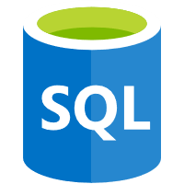

Azure SQL Server Targets
Platform as a Service
(PaaS)
Infrastructure as a Service (IaaS)
Azure SQL Database Managed Instance
Azure SQL Database Single Database
Azure Synapse Analytics (SQL DW)
SQL Server on Azure VMs

Slide 6
PaaS Selection Factors
Azure SQL DB
Synapse (SQL DW)
Managed Instance
> 250 GB
Fact Tables > 60 million rows
<250 GB
Fact Tables < 60 million rows
Migrating existing SQL Server databases
Need near-full feature compatibility

Slide 7
Migrate Objects - Scripts
Tables
Data Type Compatibility
Indexes
Views &
Stored Procedures
SQL Syntax
Cross Database Joins
Synapse Table Distribution

Slide 8
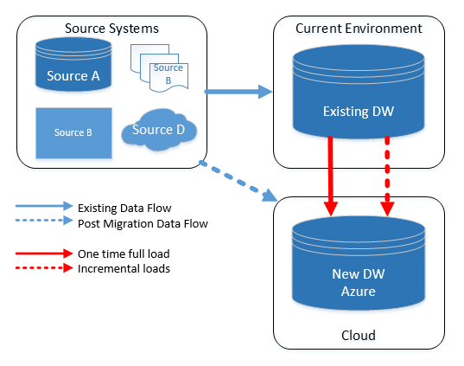
Data Migration

Slide 9
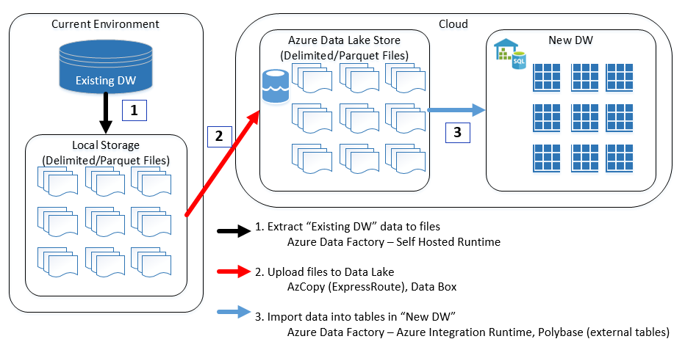
One Time Full Load

Slide 10
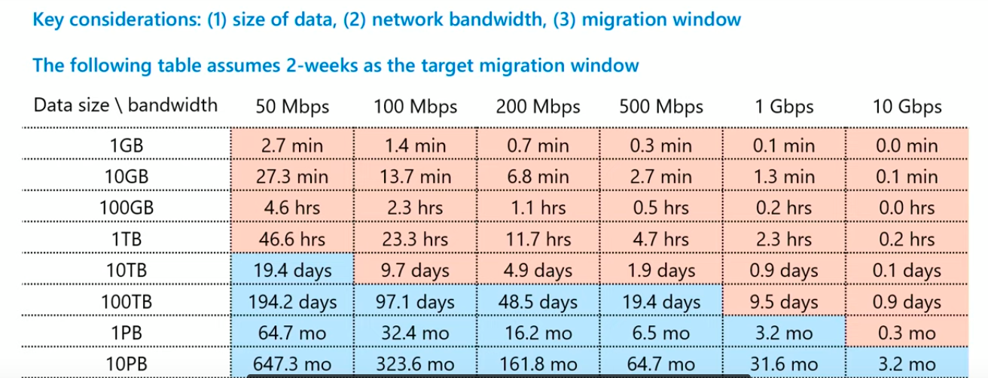
Data Transfer Time
Source: Linda Wang, MS Program Manager​
“Achieving petabyte-scale data ingestion with Azure Data Factory”​
Microsoft Ignite 2019 – BRK3046​
https://www.youtube.com/watch?time_continue=2&v=g2Whs-1ftXU&feature=emb_logo​

Slide 11
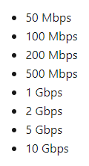

Azure ExpressRoute
Secure
Private/dedicated
Redundancy
F A S T

Slide 12


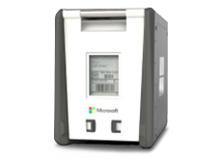

Azure Data Box
Data Box | Data Box Disk | Data Box Heavy
100 TB (80 TB usable) | 40 TB | 1PB (770 TB available)
10 Gbps | USB 3.1 | 40 Gbps

Slide 13
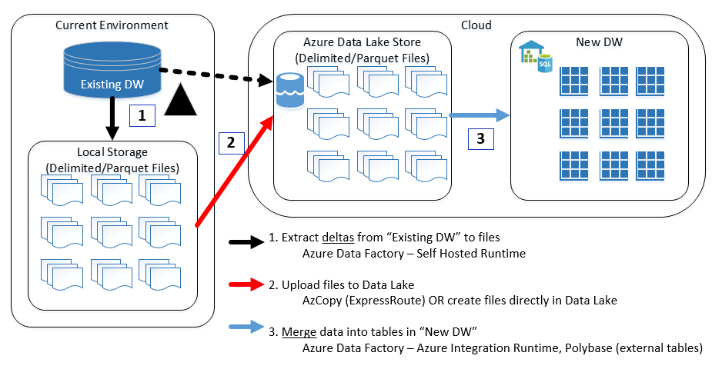
Incremental Load

Slide 14

ETL Tool Selection
Existing tools
Azure Data Factory!
  “Serverless” architecture
  Azure service integration
  SQL execution
  Data Flows

Slide 15
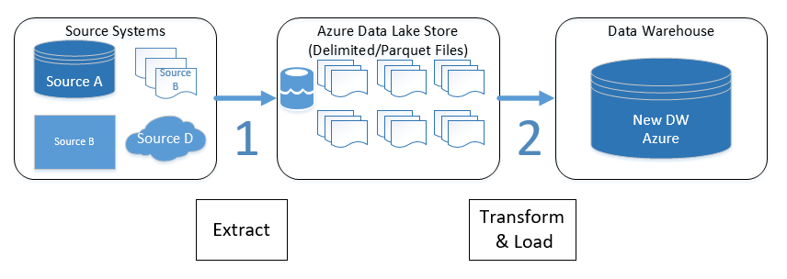
ETL Development
Reuse as much source extract logic as possible
Reuse existing incremental extract logging data (i.e. last extract date)
SQL DB vs Synapse (SQL DW) load patterns
Consider “modern cloud architecture”

Slide 16



Reports
Connectivity
Authentication
SQL Syntax
Report Volume
Retool vs Recreate

Slide 17
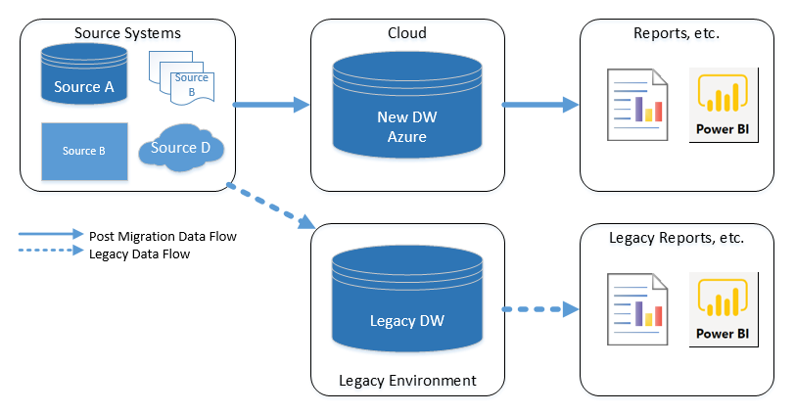
Switch Over to End State!

Slide 18
Pragmatic Works Can Help!
Planning
DW Architecture
Data migration
ETL
Reporting

Slide 19
Top Challenges for Your Business
Lack of in-house resources and/or trouble recruiting or retaining talent and/or in-house resources lack expertise in certain areas
Insufficient budget to support a full-time in-house DBA
Inability to provide 24/7 monitoring/support by local in-house resources
Large number of incidents and performance issues

Slide 20
DBA Managed Service Overview
Combines the best parts of “off the shelf” enterprise monitoring and remote DBA services
Complete solution for managing and optimizing your SQL environments
Includes:
  Kickoff environment assessment & stabilization efforts
  Quarterly environment reviews
  Open source monitoring solution with system analysis, alerting and reporting in Azure
  Hours from our expert DBA resources to resolve issues as needed (additional hours billed at discounted rate)
  Support for 24/7 or third shift options
  Expert staff based in Eastern Europe (Former MSFT Premier support)
  Flat monthly fee for monitoring and support for up to 100 instances (Enterprise Plan / 12-month commitment)

Slide 21
Questions?

