Slide 1


Transforming into a Cloud Business
A Pragmatic Works Story
Steve Hughes
Director of Consulting
December 4, 2018

Slide 2
Cloud disrupts business as usual
Cloud technologies require us to revisit how we are doing business today
  Trust
  Availability
  Control
At Pragmatic Works, we needed to understand how the cloud changes our company, as will you

Slide 3


The History of Pragmatic Works, Founded 2007
Thank you for visiting the Pragmatic Works website. We specialize in building solutions on the Microsoft platform. We can help you tune your system or help you build a data warehouse and scorecard. If you're already well on your way to a Microsoft solution, we build components to make your job easier like SSIS scoping tools, and add-ons.

Slide 4
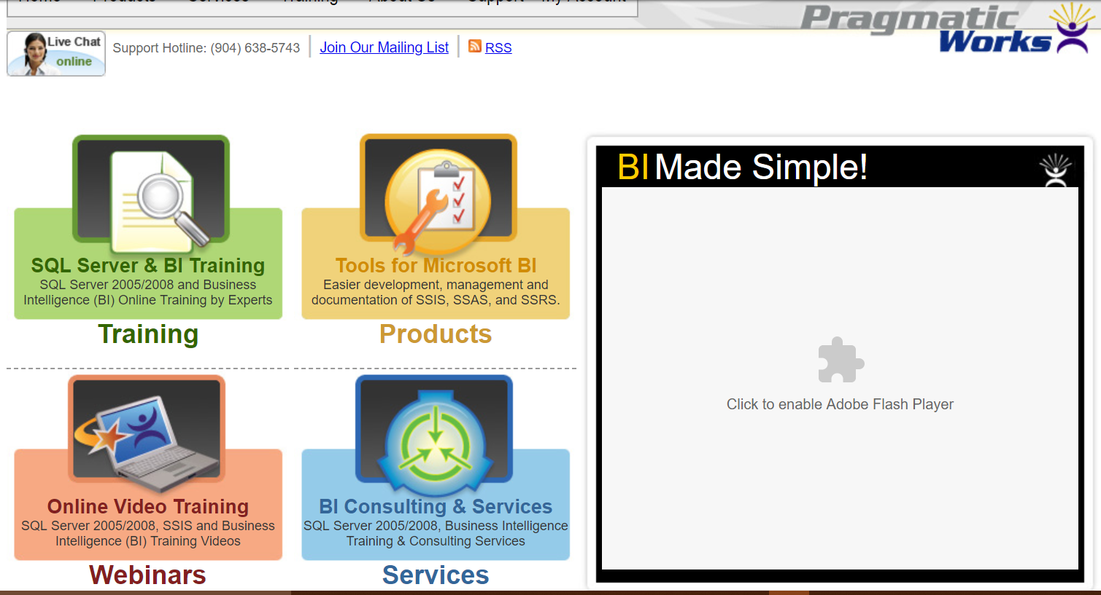
2011 – Continued growth in products and opportunities

Slide 5
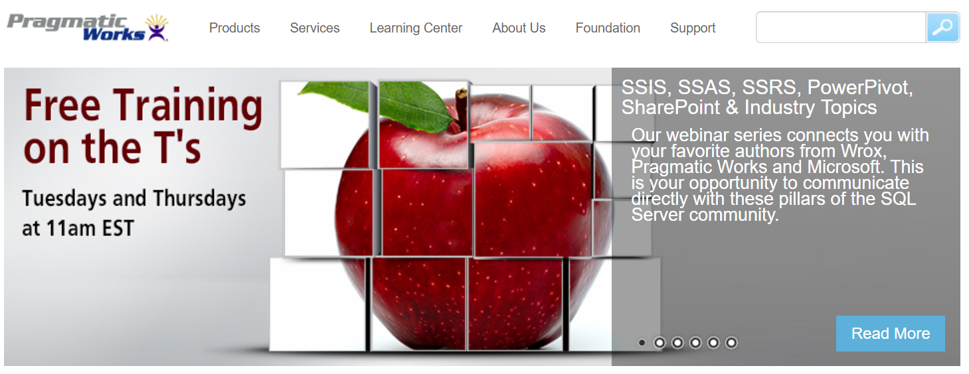
2013 – Welcome PowerPivot and SharePoint BI

Slide 6
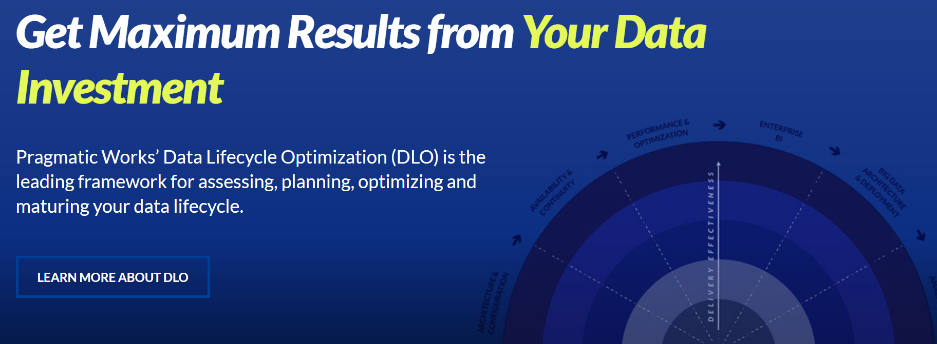
2016 – Data Lifecycle Optimization, Maturity on Premises with some Cloud (So the Journey Begins)

Slide 7
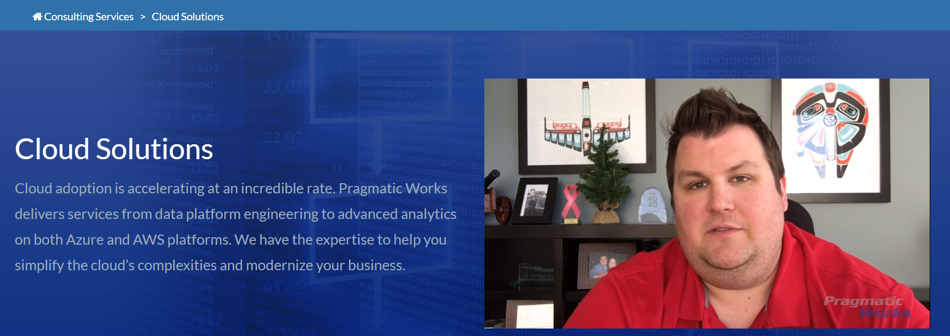
Today – We are a cloud company

Slide 8


Pragmatic Works – Then, Now
We have not abandoned our past, we have changed our focus
SQL Server Focused
  SSIS
  SSAS
  SSRS
  SQL Data Engine
Data Warehouse and BI Solutions
Azure Focused
  Azure Data Factory
  Azure Data Warehouse
  Azure SQL Database
  Azure Databricks
  Azure Data Lake
  …
Azure & SQL Server Solutions

Slide 9


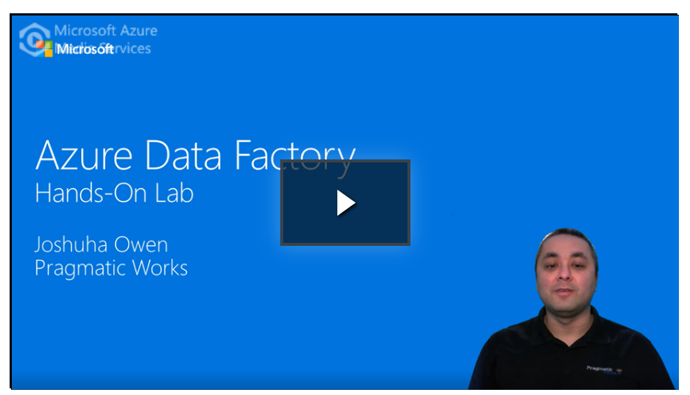
Transforming our company: The People
We needed to retool our personnel
Transition was two years
Focus
  Summer of Azure
  Azure Certifications
  Created Azure training for Microsoft
    Azure Data Factory Labs
    Azure Data Warehouse Bootcamps for other partners

Slide 10
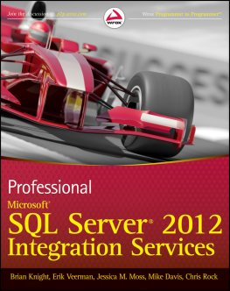
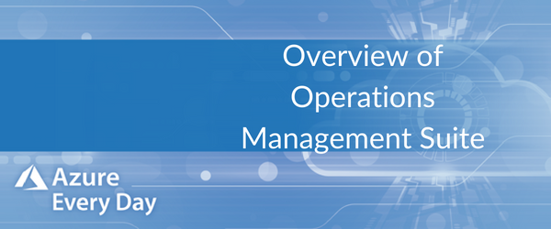
Transforming our company: Sales and Marketing
From Books to Video
  Over 30 books have been authored by our team on SQL Server technologies
  Shifted to a focus on videos for the modern consumer – over 300 videos have been produced by Pragmatic Works consultants to date
Move focus of marketing content and sales offerings to focus on Azure opportunities
  Azure Migrations
  Azure Data Warehouse Solutions
  Azure and Power BI Managed Services

Slide 11

Transforming our company: Internal solutions
We embraced cloud for our internal solutions
Microsoft 365 – email, collaboration, workflow, reporting
Azure services – Azure SQL Database, VMs, LogicApps, App Services
Ongoing optimization – moving from IaaS to PaaS whenever possible

Slide 12



Transforming your company
Cloud is the future, what will you do?
Security is primarily a political, legal issue, not a technical issue.
Is your team ready? Cloud requires an expanded knowledge base, DBAs need to understand networking for example.
Azure changed how we work and what we do, it will change your business as well, if you let it.

Slide 13
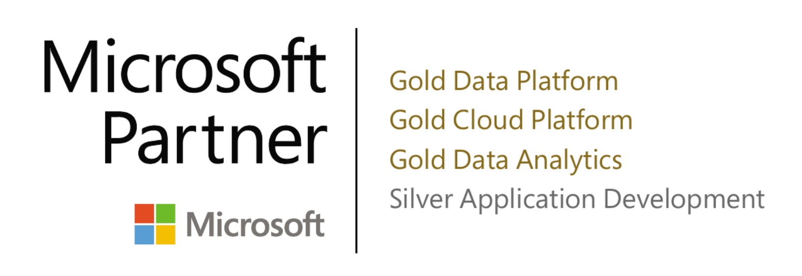
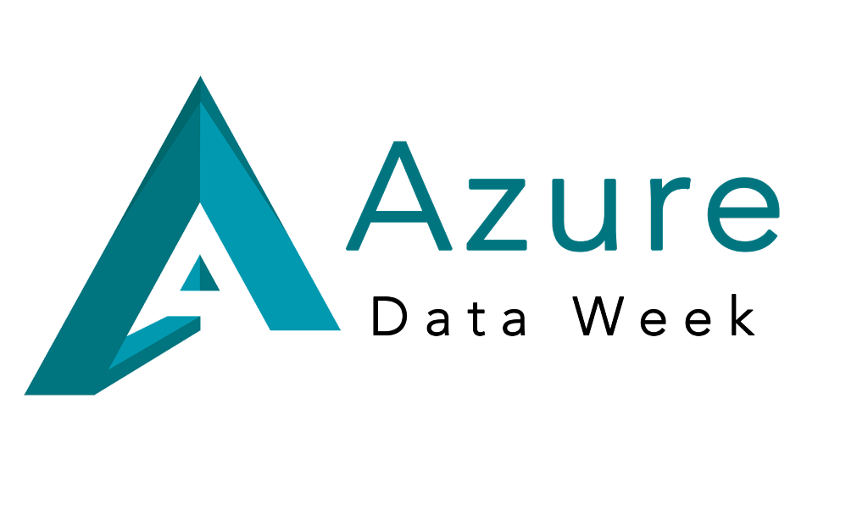
Where we are today
Top 0.5% of Global Microsoft Partners on Azure
95% of our consultants are now Azure Certified
Over 80% of our 2018 contracts are Azure based (up from 10%, 1 year ago)
Azure Every Day – every day since February 1
Azure Data Week – over 1400 registered attendees, presenters from Microsoft and Pragmatic Works

Slide 14

Why Should You Consider a Move to Azure?
Platform as a Service (PaaS) reduces your dependency on hardware and software management. It can also optimize your maintenance.
Azure can help you scale up to meet increasing data volume and needs in your organization.
Modernize your business and plan for the future.
Looking to move to Azure?
Lean on our experience to help you modernize your business
and take advantage of Azure for your cloud platform

Slide 15


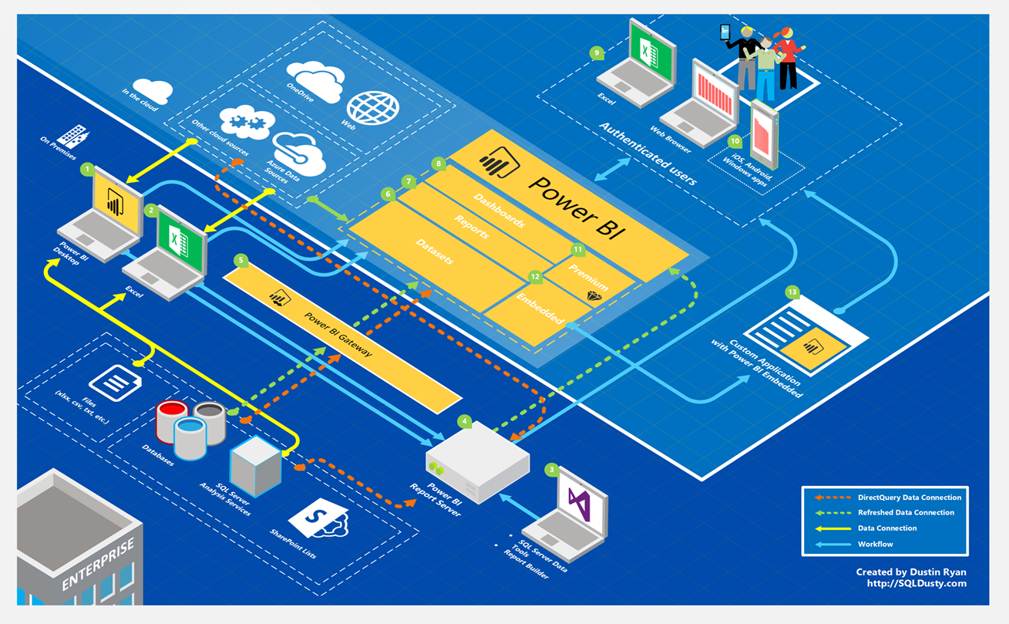

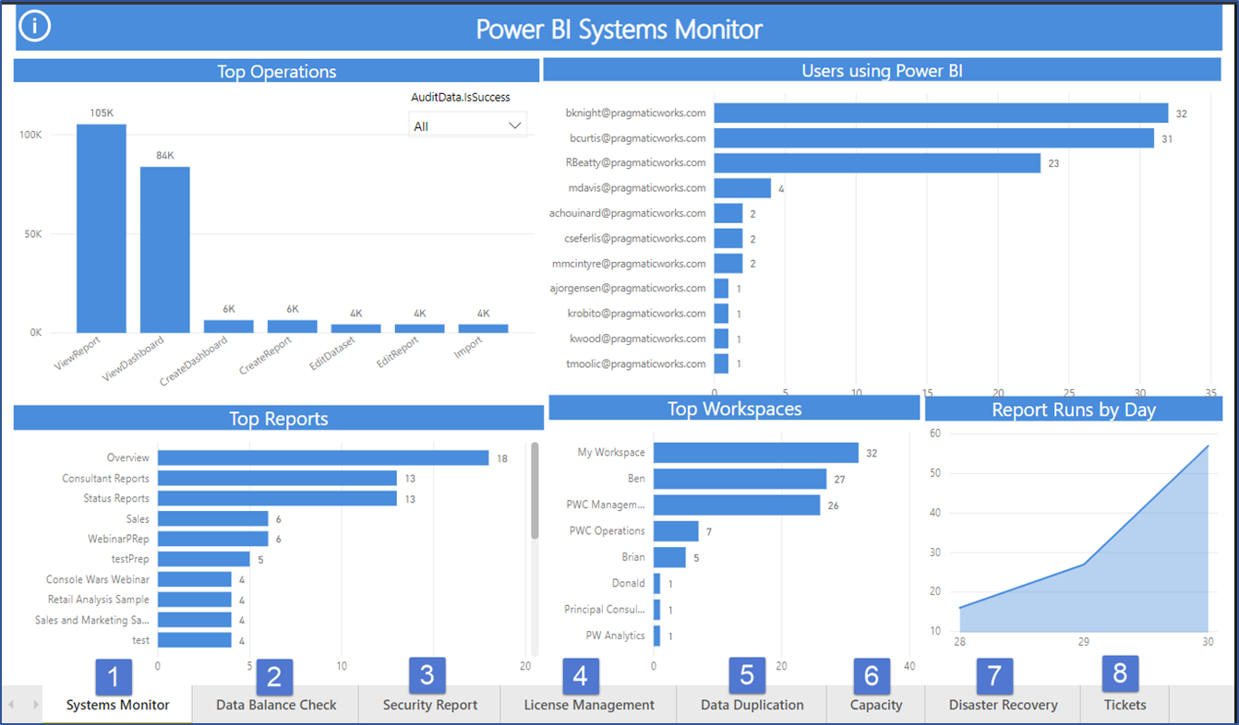


25
Power BI -Managed Services-2019
User support
Skills and Development
Ecosystem Management
Plan, Configure, Remediate
Systems Monitor
Daily validation of your Power BI ecosystem.

