Slide 1
Power BI Mapping
Nick lee
nlee@pragmaticworks.com
Backtosql.wordpress.com
@backtosql

Slide 2

About Nick
My parents always told me that my life won’t go anywhere if I’m on the computer all day and night.
Trainer and Consultant
Technical Editor of Books
Presenter in JSSUG
Blogs at backtoSQL.wordpress.com
Twitter: @backtoSQL
nlee@pragmaticworks.com

Slide 3
Power BI Maps
Types of maps
Use-cases
Best Practices
Tips and Tricks
Notes:
Why Implement Business Intelligence?
Self-Service BI Lifecycle
Understanding the Role Self-Service BI Plays with IT

Slide 4
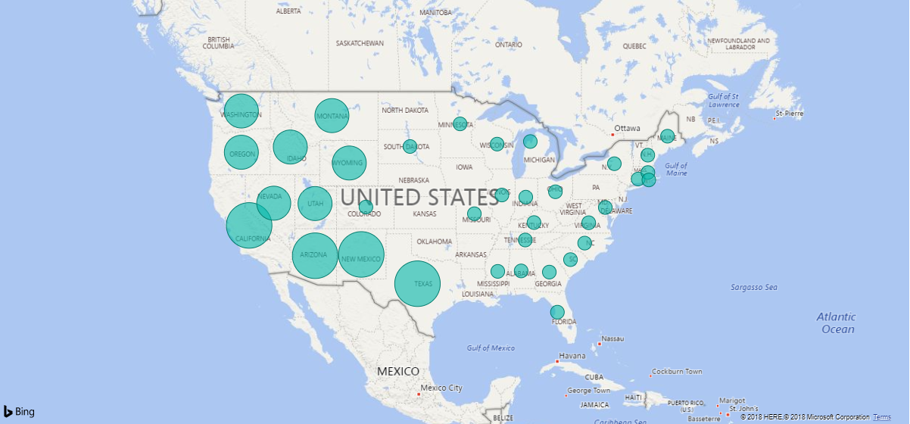
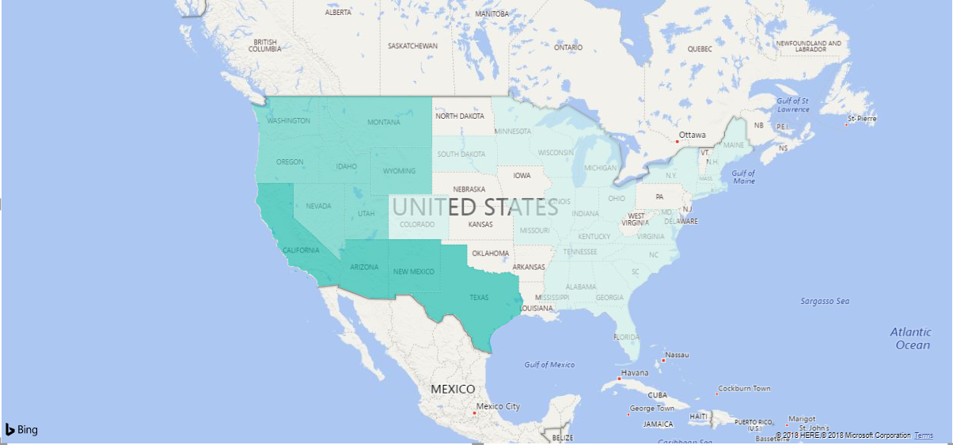
Types of Maps
Module 1
Map
Fill Map
Shape Map
ArcGIS Map
10+ Custom Visual Maps
Data Explorer

Slide 5
When do we use maps?
Module 1
Sales/Production by geographical area
Geographical Trends
Geographical Insights
Data Explorer

Slide 6



Best Practices
Module 1
Using Hierarchies
  Premade fields
  Ad Hoc Hierarchies
Combining Fields
DAX
Query Editor
Data Categorizations
State or Province
City
Place

Slide 7
Module 1
Power BI Mapping

