Slide 1
Creating Your Power BI Reports With “Wow”
Nick lee
Blog: backtosql.wordpress.com
EMAIL: nlee@pragmaticworks.com
TWITTER: @backtosql

Slide 2

About Nick
My parents always told me that my life won’t go anywhere if I’m on the computer all day and night.
Trainer and Consultant
Technical Editor of Books
Presenter in JSSUG
Blogs at backtoSQL.wordpress.com
nlee@pragmaticworks.com
Twitter: @backtoSQL

Slide 3


Key Design Factors
Module 5
Consider your Audience
Avoid Information Overload
Consistency is key

Slide 4

Consider your Audience
Module 5
What do they want?
To know how much money they’re making
How do they want it?
Perfect
When do they need it?
Literally right now

Slide 5
Information Overload
Module 5
Too Much Non-Relevant Data
Too Much Relevant Data
“We are overwhelmed by information, not because there is too much, but because we don’t know how to tame it.
-Stephen Few”
        -Michael Scott

Slide 6
Consistency is Key
Module 5
Intuitiveness
  Navigation
  Deciphering Data
  Finding Answers
Formatting
  Nomenclature
  Design Style

Slide 7
Alternative Uses for Existing Visuals
Module 5
Using Tools from Your Own Shed
Creativity goes a long way

Slide 8
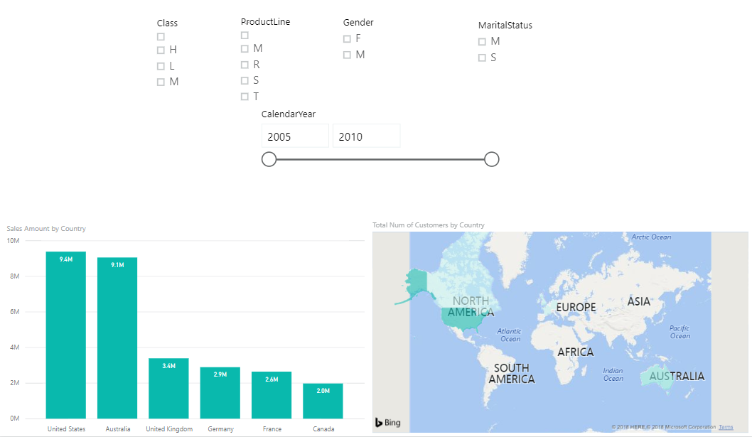
Slicers
Module 5
Help Answer Many Questions
Intuitive way to filter data
Easy to design & use
Multiple Slicers
Clutter
A Necessary Evil

Slide 9
Alternative Usage with Slicers

Slide 10


Combo Chart
Pro: Innately Shows Trends in Data
Con: Innately Shows Trends in Data
e.g. Comparing two measures to each other

Slide 11
Alternative Usage with Combo Charts

Slide 12
Themes
Colors
Fonts & Font Sizes
Customization per visual
Using Office Themes: https://community.powerbi.com/t5/Community-Blog/How-to-use-your-Office-Theme-as-Power-BI-Report-Theme/ba-p/210813
Report Themes Gallery: http://community.powerbi.com/t5/Themes-Gallery/bd-p/ThemesGallery
Theme Generator by Charles Sterling: https://github.com/CharlesSterling/themecreator
Theme Generator by Powerbi.Tips: https://powerbi.tips/tools/report-theme-generator-v3/

Slide 13

Page Backgrounds
Adds Depth to Reports
  Helps accentuate certain fields
Page by Page
Adds a “WOW” factor

Slide 14
Templates
Makes a Developer’s Life Easy
Saves All of the MetaData in a .pbix File
Includes:
-Business Rules / Transformations -All Page & Visual Formatting options
-Design Surface / Visualization Layouts -Themes

Slide 15
Creating Your Power BI Reports With “Wow”
Nick lee
Blog: backtosql.wordpress.com
EMAIL: nlee@pragmaticworks.com
TWITTER: @backtosql

