Slide 1

Azure Automation or DevOps
Which is right for me?
May 28, 2019

Slide 2


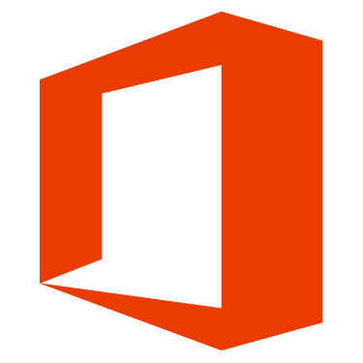
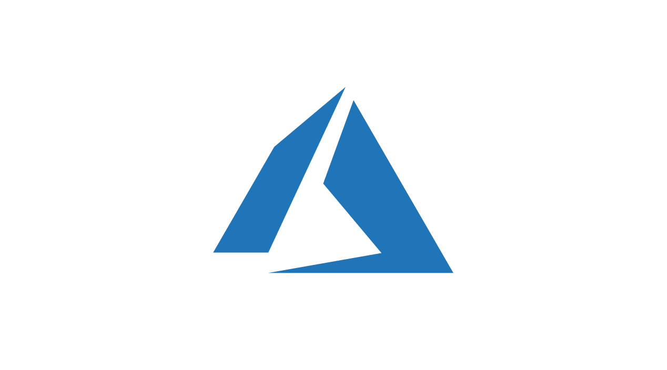




About Me
Joshua Gural
Senior Consultant at Pragmatic Works
Azure, IT Infrastructure, Office 365
Located near Pittsburgh, PA
Exercise, Outdoors, Time with Fiancée and Dog
Notes:
To get started, I wanted to introduce myself as the presenter
My name is Joshua Gural and I am a Sr. Consultant coming from a strong Cloud Computing (Azure focused), IT Infrastructure, and Office 365 background.
Even though Pragmatic Works is headquartered in FL, I am personally located just south of Pittsburgh, PA
In my free time, I enjoy exercising, being outdoors either hunting, fishing, or hiking, and spending time with my fiancée and dog (Dexter) who you can see in the upper right above my head with one of his many toys

Slide 3

Agenda
What is Azure Automation?
What is Azure DevOps?
Which is right for me?
Azure Scaffold

Slide 4

What is Azure Automation?
An Overview of the Service

Slide 5

Azure Automation
Automate, configure, and install updates across hybrid environments
Save time and lower overhead costs
Update systems across hybrid environments
Simplify configuration management
Track inventory and changes
Integrate with services
Deliver more reliable services
Notes:
Azure Automation delivers a cloud-based automation and configuration service that provides consistent management across your Azure and non-Azure environments. It consists of process automation, update management, and configuration features. Azure Automation provides complete control during deployment, operations, and decommissioning of workloads and resources.
Save time and lower overhead costs
Automate frequent, time-consuming, and error-prone cloud management tasks. Azure Automation service helps you focus on work that adds business value. By reducing errors and boosting efficiency, it also helps to lower your operational costs.
Update Windows and Linux systems across hybrid environments
Monitor update compliance across Azure, on-premises, and other cloud platforms for Windows and Linux. Schedule deployments to orchestrate the installation of updates within a defined maintenance window.
Simplify configuration management in the cloud
Author and manage PowerShell configurations, import configuration scripts, and generate node configurations—all in the cloud. Use Azure Configuration Management to monitor and automatically update machine configuration across physical and virtual machines, Windows, or Linux—in the cloud or on-premises.
Collect inventory and track changes
Get an inventory of operating system resources including installed applications and other configuration items. Use rich reporting and search to quickly find detailed information on everything that’s configured within the operating system. Track changes across services, daemons, software, registry, and files to promptly investigate issues—and turn on diagnostics and alerting to monitor for unwanted changes.
Integrate with the services you depend on
Write runbooks graphically in PowerShell or Python to integrate Azure services and other public systems required for deploying, configuring, and managing your end-to-end processes. Orchestrate across on-premises environments using a hybrid runbook worker to deliver on-demand services.
Trigger automation from ITSM, DevOps, and monitoring systems to fulfill requests and ensure continuous delivery and management.
Deliver more reliable services, faster
Rely on serverless runbooks to automatically grow as your operational tasks increase. Deliver services more quickly and consistently by focusing on adding business rather than maintaining the management system.

Slide 6
Azure Automation Use Cases
Build / Deploy resources
Configure VMs
Monitor
Protect
Govern
Notes:
Azure Automation manages across the lifecycle of your infrastructure and applications. Transfer knowledge into the system on how the organization delivers and maintains workloads. Author in common languages like PowerShell, desired state configuration, Python, and graphical runbooks. Get a complete inventory of deployed resources for targeting, reporting, and compliance. Identify changes that can cause misconfiguration and improve operational compliance.
Build / Deploy resources - Deploy VMs across a hybrid environment using Runbooks and Azure Resource Manager (ARM) templates. Integrate into development tools like Jenkins and Azure DevOps.
Configure VMs - Assess and configure Windows and Linux machines with the desired configuration for the infrastructure and application.
Monitor - Identify changes on machines that are causing issues and remediate or escalate to management systems.
Protect - Quarantine VM if security alert is raised. Set in-guest requirements.
Govern - Set up role-based access control for teams. Recover unused resources.

Slide 7

Azure Automation Capabilities
Configuration Management
Collect Inventory, track changes, and configure desired state
Update Management
Assess compliance and schedule update installation
Shared Capabilities
RBAC, Scheduling, Shared Modules, Source Control, Auditing, Tagging
Diverse
Windows & Linux, Azure & on-prem, Gallery
Process Automation
Orchestrate processes using graphical, PowerShell, and Python runbooks

Slide 8
Configuration Management
Manage DSC resources & apply configurations
Monitor and automatically update machine configuration across physical and VMs, Windows or Linux, in the cloud or on-premises
Rich reporting, inventory, and search capabilities
Track changes across services, daemons, software, registry, and files
DSC can help diagnose and alert when unwanted changes occur
Notes:
Desired State Configuration (DSC)

Slide 9
Update management
Update Windows & Linux systems across hybrid environments
Visibility of update compliance across Azure, on-prem, & other clouds
Ability to exclude updates from a deployment
Schedule deployments to orchestrate the installation of updates within a defined maintenance window

Slide 10
Process automation
Automate frequent, lengthy, and error-prone cloud management tasks
Integrate services for deploying, configuring, and managing processes
Author runbooks graphically, in PowerShell, or Python
Runbooks allow orchestrating across hybrid environments
Webhooks trigger automation from ITSM, DevOps, and monitoring systems

Slide 11
Shared resources
Schedules
Modules
Modules gallery
Python 2 packages
Credentials
Connections
Certificates
Variables
Notes:
Azure Automation consists of a set of shared resources that make it easier to automate and configure your environments at scale.
Schedules - Trigger automation on predefined times
Modules - Manage Azure and other systems
Modules gallery - Integration to PowerShell Gallery to view runbooks and import them into the Automation Account
Python 2 packages - Add Python 2 packages to use in Python runbooks
Credentials - Store sensitive info used by runbooks and configurations at runtime
Connections - Store name/value pairs that contain common information when connecting to systems. Connections are defined by the module author for use at runtime in runbooks and configurations
Certificates - Store and make available at runtime used for authentication and securing deployed resources
Variables - Hold content used across runbooks and configurations. You can change values without having to modify any of the runbooks and configurations that reference them

Slide 12
Diverse
Windows and Linux
Designed to work across hybrid cloud and for Windows & Linux
Source Control Integration
Integrate with source control which promotes configuration as code
Role Based Access Control (RBAC)
Control access to the Automation Account and its resources
Automation Community Gallery
Runbooks and modules to get started integrating and authoring your processes
Notes:
Windows and Linux
Consistent way to automate and configure workloads deployed
Source control integration
Runbooks or configurations can be checked into a source control system

Slide 13

What is Azure DevOps?
An Overview of the Service

Slide 14
What is DevOps?
Unifies people, process, and technology across development and IT to automate and increase software delivery speeds
Development, IT operations, quality engineering, and security teams work closely together
Five core practices: planning/tracking, development, build/test, delivery, and monitoring/operations
Notes:
The promise of DevOps
DevOps automates and speeds software delivery. It makes your process and your products more reliable. When you implement DevOps technologies and practice, you’ll provide value to your customers faster—in the form of new and innovative products, or enhancements to existing ones.

Slide 15
DevOps Model
Plan and track
Identify and track work visually with project boards and agile
Develop
Write code using version control like Git to integrate continuously to the master branch
Build and test
Checking in starts an automated build process where the code is tested and validated (CI)
Deploy
Once tested and validated, each change is deployable to the production environment
Monitor and operate
Monitoring delivers information about performance and usage patterns
Notes:
Plan and track
Identify and track work using practices and processes like Kanban boards and agile. When work is tracked visually, stakeholders have clear insight into the development team’s capacity and can better plan and prioritize tasks—and avoid fire drills.
Develop
Write code using modern version control systems like Git to integrate continuously and safely to the master branch. When a feature is complete, the developer submits a pull request and once approved, changes are merged to master and the old branch is deleted.
Build and test
Checking in code to Git or another version control system kicks off an automated build process. The code is tested and validated, ensuring that bugs are caught early in development—when they’re fresh in the developer’s mind and less costly to fix. This process of automating build and test is called continuous integration (CI). A production-deployable artifact is the result of successful build and integration, enabling continuous delivery (CD)—the ability to deploy to production at any time.
Deploy
Once tested and validated, each change is deployable to the production environment. Using continuous delivery practices, final deployment to production is a manually controlled business decision.
With continuous deployment, the entire process from code commit to production is automated. When your code is automatically deployed, your customers get access to new features as soon as they’re ready.
Monitor and operate
Once live in production, monitoring delivers information about your app’s performance and usage patterns. Achieve high availability by getting immediate, rich diagnostic data that your team can act on quickly. Mitigate issues for users and gather data to make informed business decisions about future development. And, with automated compliance policies using infrastructure as code and policy as code, you’ll ensure that the apps you deploy to production use desired-state configurations that align to security best practices.

Slide 16





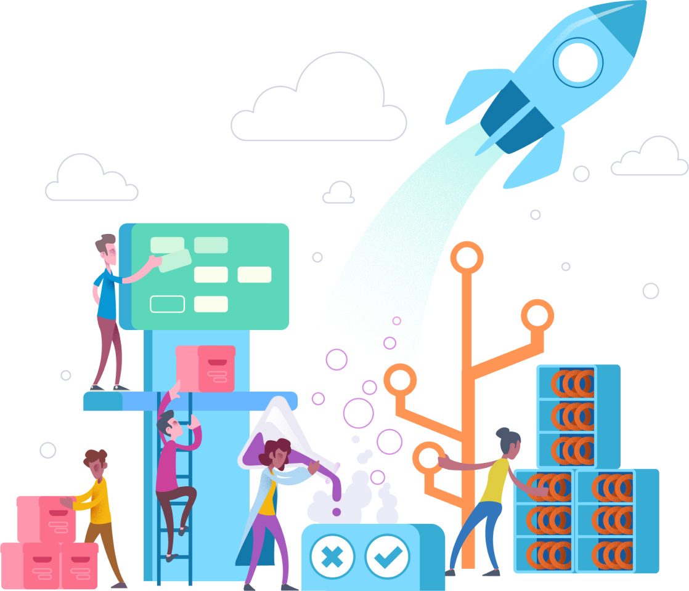
Azure DevOps
Azure Boards
Azure Pipelines
Azure Repos
Azure Test Plans
Azure Artifacts
Notes:
Azure DevOps provides developer services to support teams to plan work, collaborate on code development, and build and deploy applications. Developers can work in the cloud using Azure DevOps Services or on-premises using Azure DevOps Server, formerly named Visual Studio Team Foundation Server (TFS).
Azure DevOps provides an integrated set of features that you can access through your web browser or IDE client. You can acquire one or more of the following services based on your business needs:
Azure Repos provides Git repositories or Team Foundation Version Control (TFVC) for source control of your code
Azure Pipelines provides build and release services to support continuous integration and delivery of your apps
Azure Boards delivers a suite of Agile tools to support planning and tracking work, code defects, and issues using Kanban and Scrum methods
Azure Test Plans provides several tools to test your apps, including manual/exploratory testing and continuous testing
Azure Artifacts allows teams to share Maven, npm, and NuGet packages from public and private sources and integrate package sharing into your CI/CD pipelines
Collaboration tools that include customizable team dashboards with configurable widgets to share information, progress and trends; built-in wikis for sharing information; configurable notifications and more.
In addition, the Azure DevOps ecosystem also provides support for adding extensions and integrating with other popular services, such as: Campfire, Slack, Trello, UserVoice, and more, and developing your own custom extensions.
How does this fit in to the 5 steps of DevOps
Plan and track
Develop
Build and test
Deploy
Monitor and operate

Slide 17

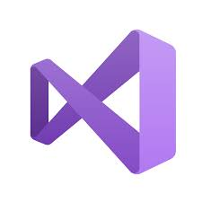

Plan and track
Develop
Build and test
Deploy
Monitor and operate
Notes:
DevOps products work together and have a role in every one of the 5 categories of DevOps, however I highlighted the main products in each category
Plan and track
Boards and Artifacts
Develop
Repos and Artifacts (plus Visual Studio, which integrates with Azure DevOps natively)
Build and test
Pipelines, Repos, test plans, and Artifacts
Deploy
Pipelines, Repos, and Artifacts
Monitor and operate
Boards and Artifacts

Slide 18
Azure Boards
Deliver value to users faster using proven agile tools to plan, track, and discuss work across your teams
Connected from idea to release
Track ideas at every development stage and keep teams aligned with code changes linked directly to work items
Scrum ready
Use built-in scrum boards & planning tools to help teams run sprints, stand-ups, and planning meetings
Built for insights
Gain insights into the health and status of the project with powerful analytics tools and dashboard widgets
Notes:
Agile planning tools
Track work with configurable Kanban boards, interactive backlogs, and powerful planning tools. Unparalleled traceability and reporting make Boards the perfect home for all your ideas—big and small.
Combine drag-and-drop sprint planning and flexible work item tracking with comprehensive traceability to have the perfect home for all your ideas–big and small.

Slide 19
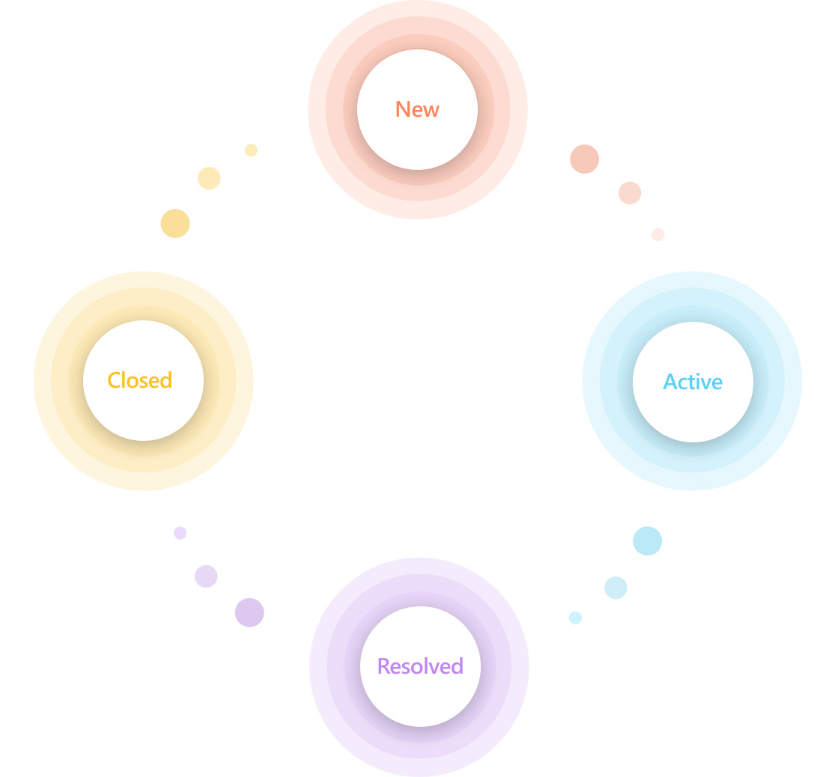
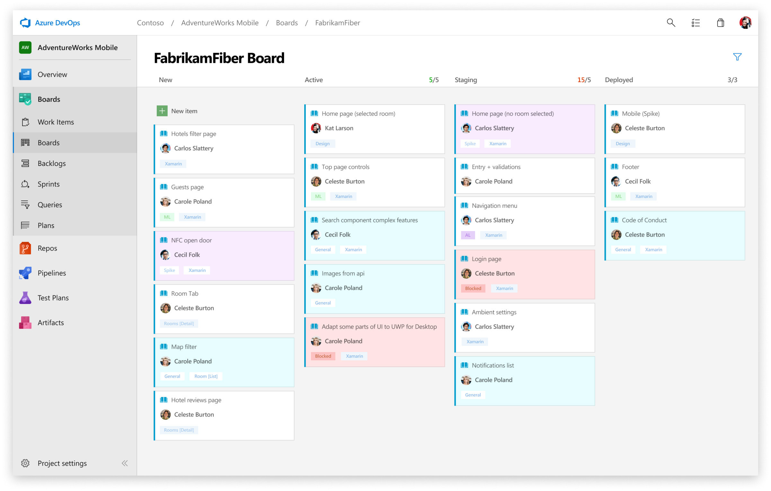
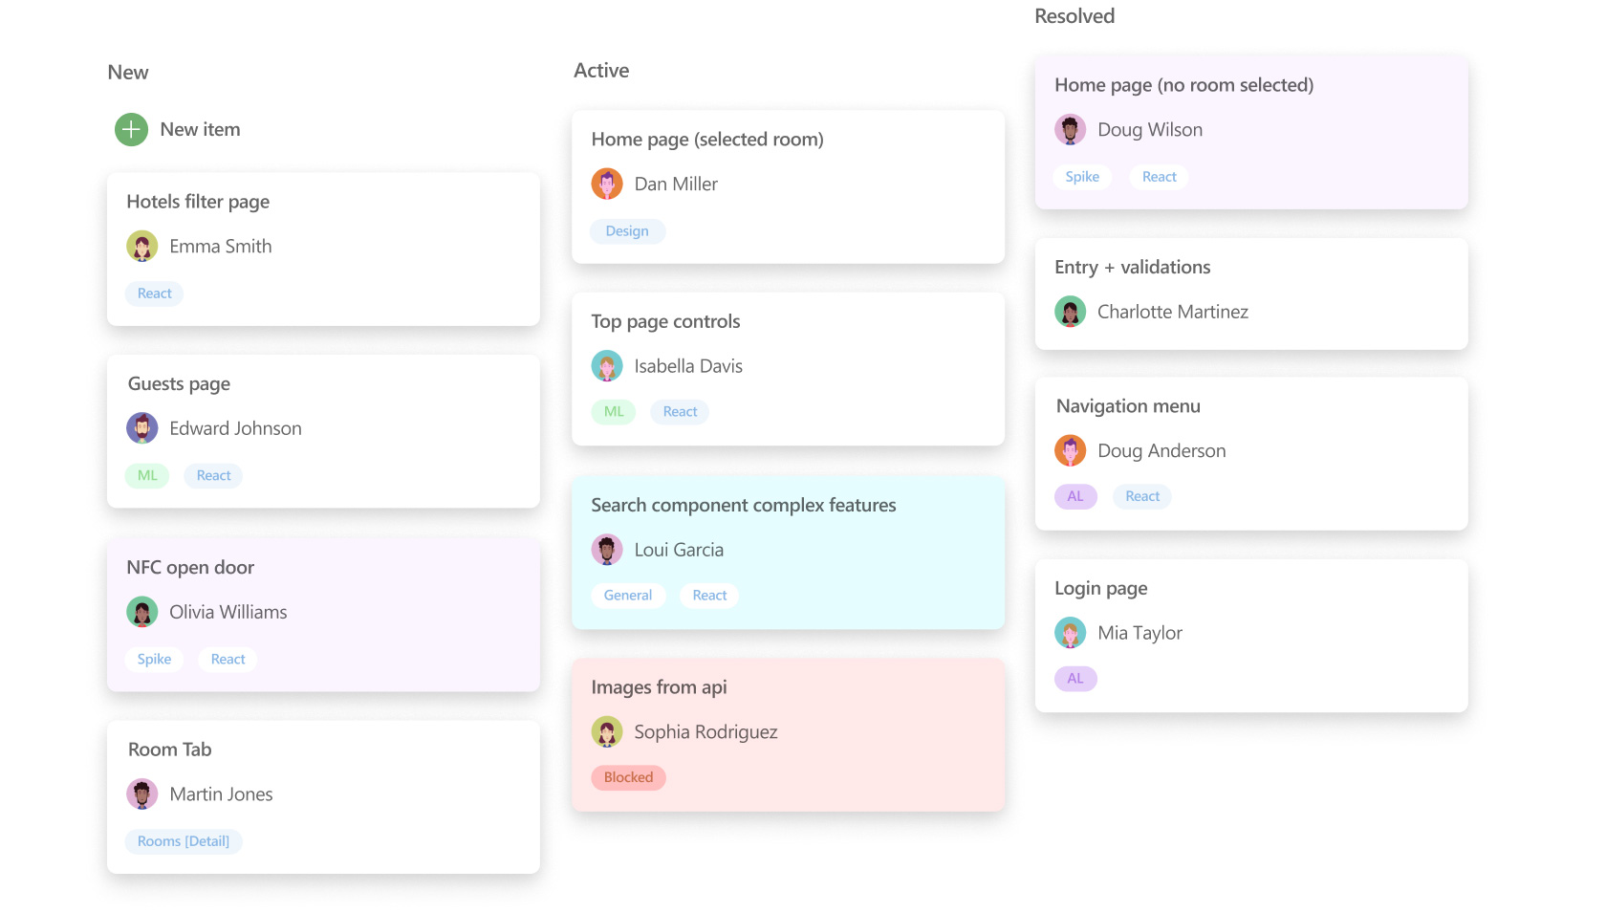
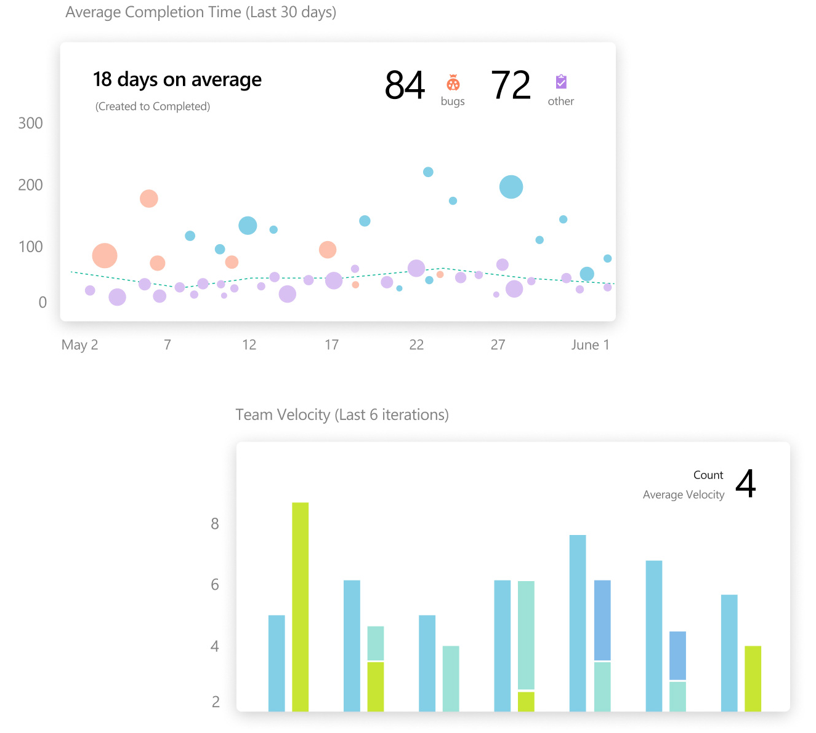
Azure Boards
Notes:
Track work with Kanban boards, backlogs, team dashboards, and custom reporting
Use proven productivity tools
Get your work done with simple and modern agile tools like Kanban boards, backlogs, dashboards, and scrum boards. Adapt the tools to fit your team’s needs and scale up easily.
Customize your dashboards
Build tailored views of the data you need, configure the layout that makes sense for your team, and easily monitor progress throughout the lifecycle of your project.
Choose your workflow
Start with a simple, out-of-the-box workflow. Use the powerful and flexible customization engine to create the workflow that fits your team’s needs.

Slide 20
Azure Pipelines
Build, test, and deploy with CI/CD that works with any language, platform, and cloud.
Any language/platform
Containers & Kubernetes
Extensible
Deploy to any cloud
Open source
Advanced features
Notes:
Any language/platform
Build, test, and deploy Node.js, Python, Java, PHP, Ruby, C/C++, .NET, Android, and iOS apps. Run in parallel on Linux, macOS, and Windows
Containers & Kubernetes
Easily build and push images to container registries like Docker Hub and Azure Container Registry. Deploy containers to individual hosts or Kubernetes
Extensible
Explore and implement a wide range of community-built build, test, and deployment tasks, along with hundreds of extensions from Slack to SonarCloud
Deploy to any cloud
Implement continuous delivery (CD) of your software to any cloud, including Azure, AWS, and GCP. Visualize deployment to any number of interdependent stages
Open source
Ensure fast continuous integration/continuous delivery (CI/CD) pipelines for every open source project. Get 10 free parallel jobs with unlimited build minutes for all open source projects
Advanced features
Take advantage of easy build chaining and multi-phased builds. Support for YAML, test integration, release gates, reporting—and more

Slide 21
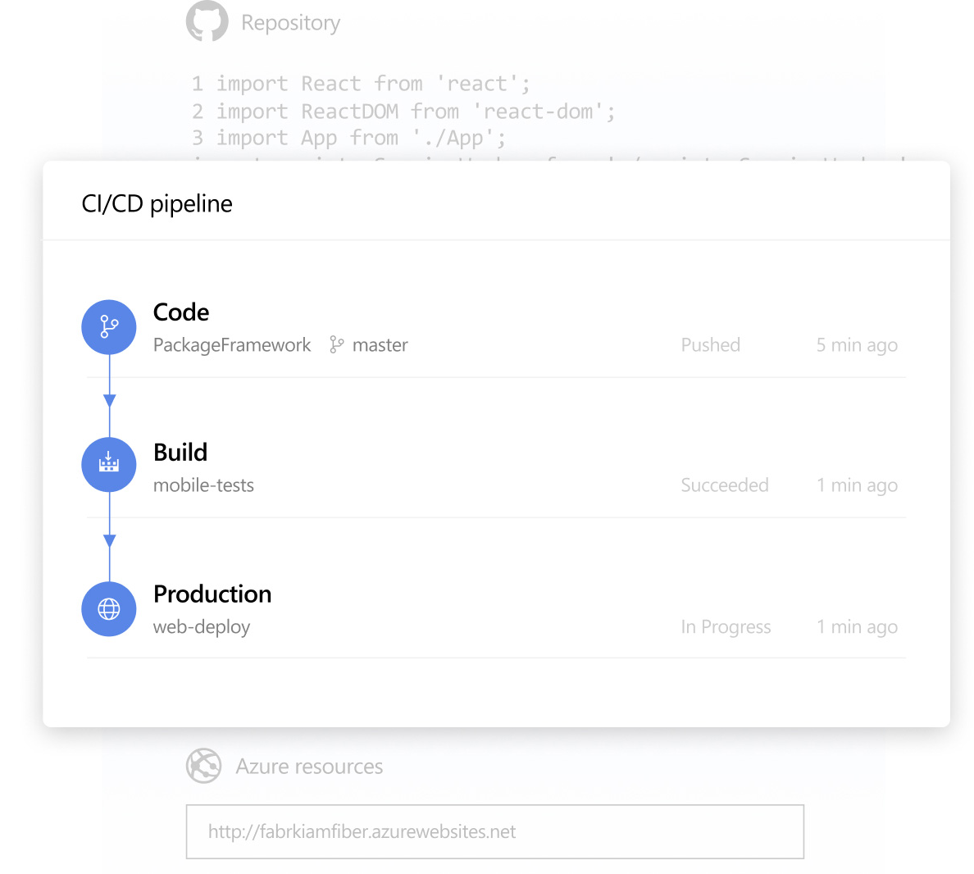
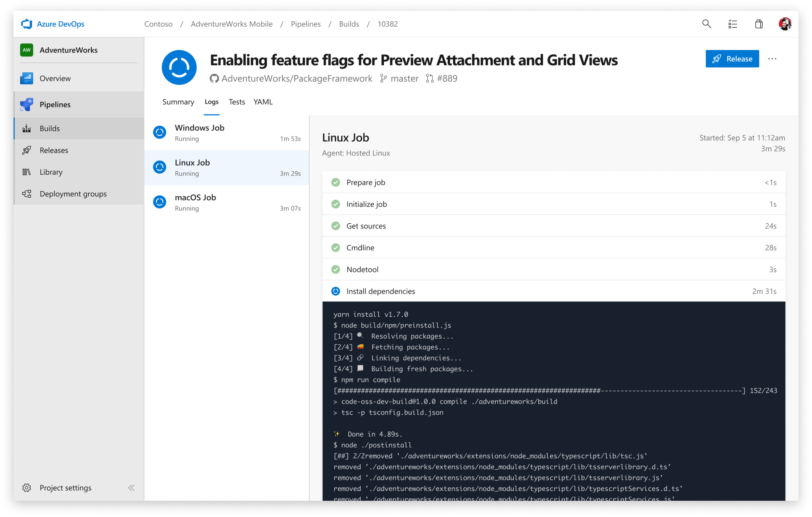
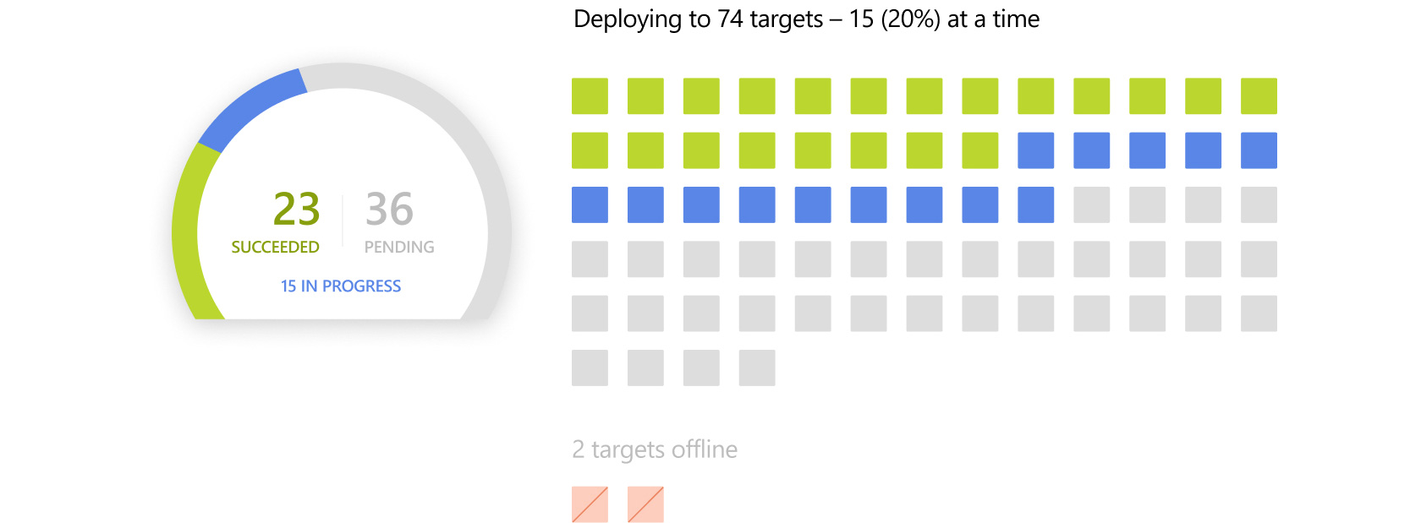
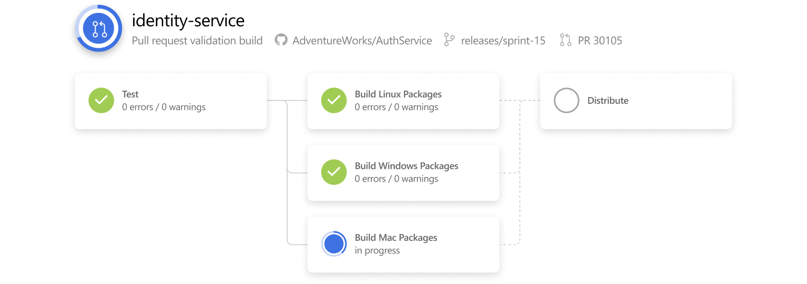
Azure Pipelines
Notes:
Get cloud-hosted pipelines for Linux, macOS, and Windows with unlimited minutes and 10 free parallel jobs for open source
Powerful workflows with native container support
Get lightning fast builds with parallel jobs and test execution. Use container jobs to create consistent and reliable builds with the exact tools you need. Create new containers with ease and push them to any registry.
Linux, macOS, and Windows agents—hosted by Microsoft
Simplify managing hardware and VMs by using Microsoft cloud-hosted agents. Get full CI/CD pipeline support for every major platform and tool.
Flexible deployments to Kubernetes, serverless, or VMs
Deploy to Kubernetes, VMs, Azure Functions, Azure Web Apps, or any cloud. Use stages, gates, and approvals to create a deployment strategy that’s right for you and ensures quality at every step. Even deploy from other CI systems, like Jenkins.

Slide 22
Azure Repos
Unlimited, cloud-hosted, private Git repos with pull requests and advanced file management
Support for any Git client
Web hooks and API integration
Semantic code search
Notes:
Support for any Git client
Securely connect with and push code into Git repos from any IDE, editor, or Git client
Web hooks and API integration
Add validations and extensions from the marketplace or build your own using web hooks and REST APIs
Semantic code search
Quickly find what you’re looking for with code-aware search that understands classes and variables

Slide 23
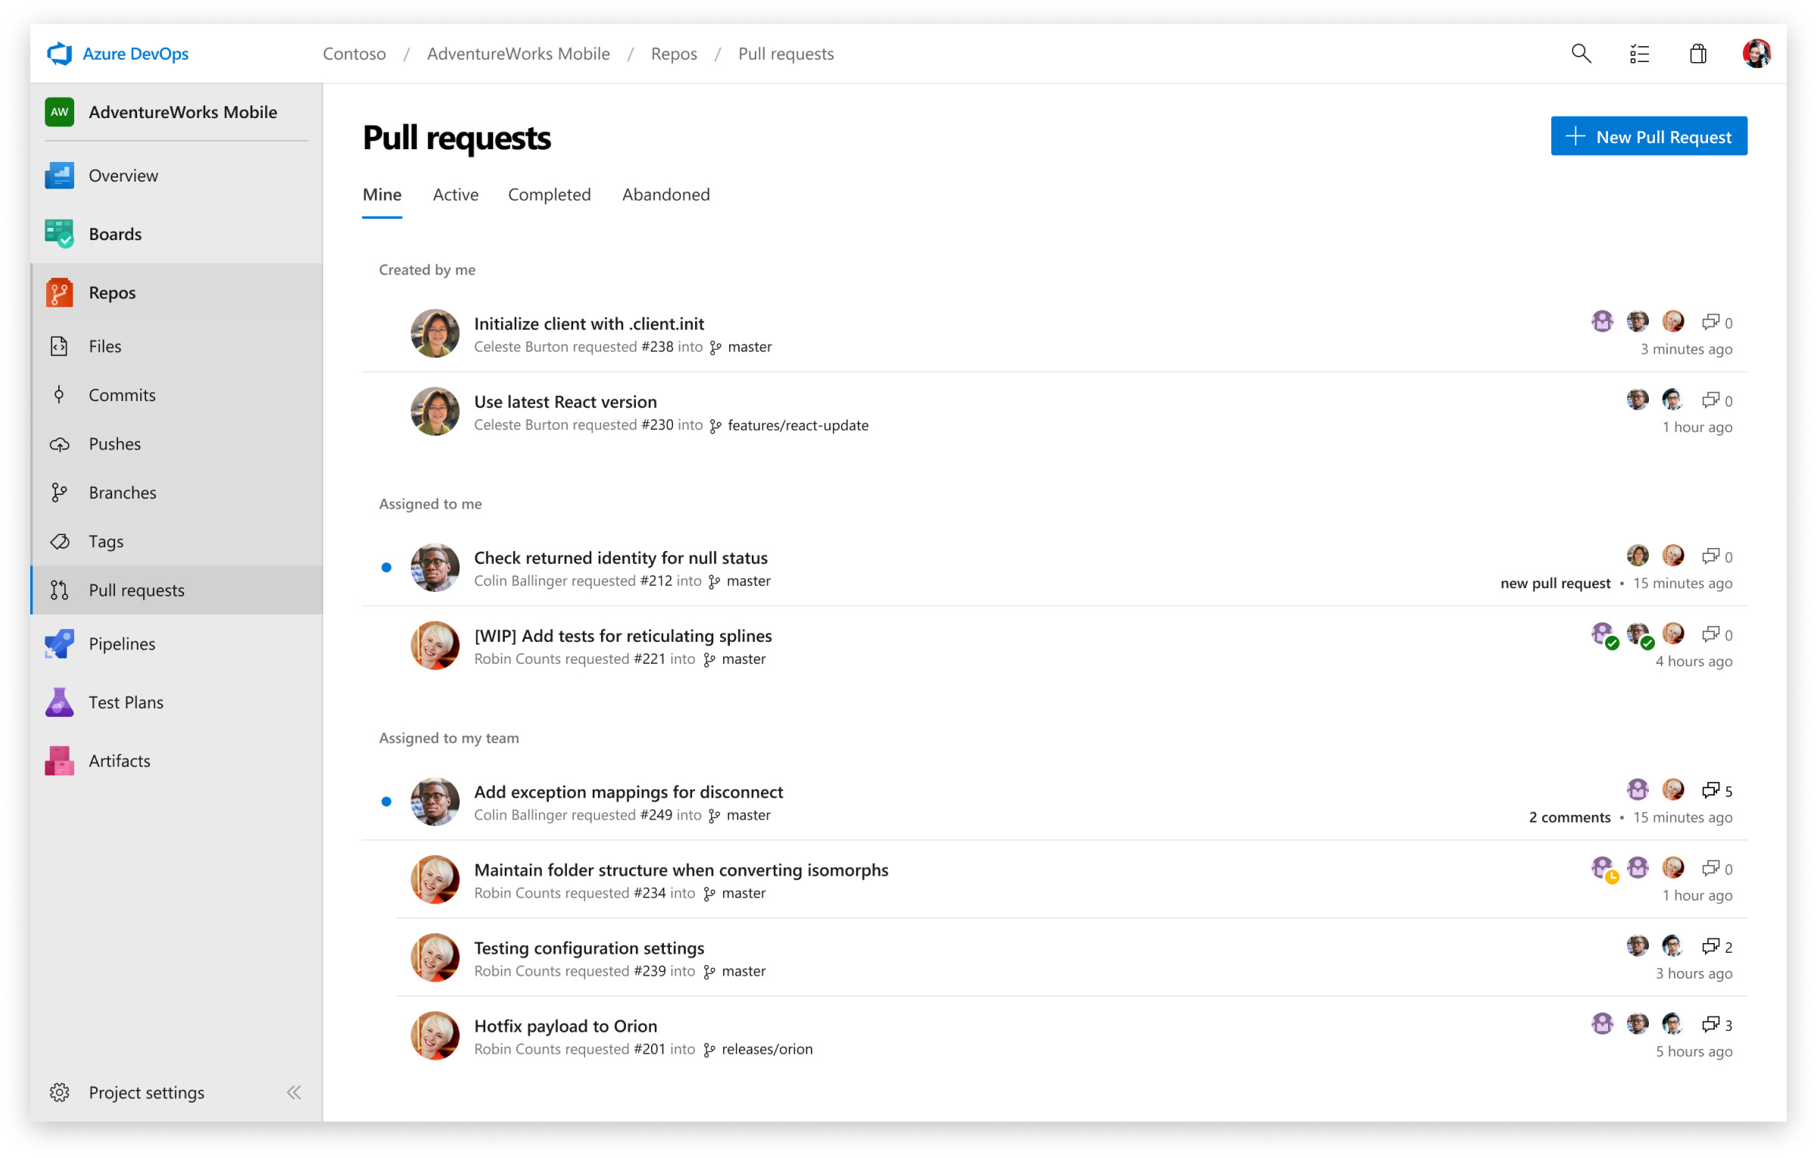
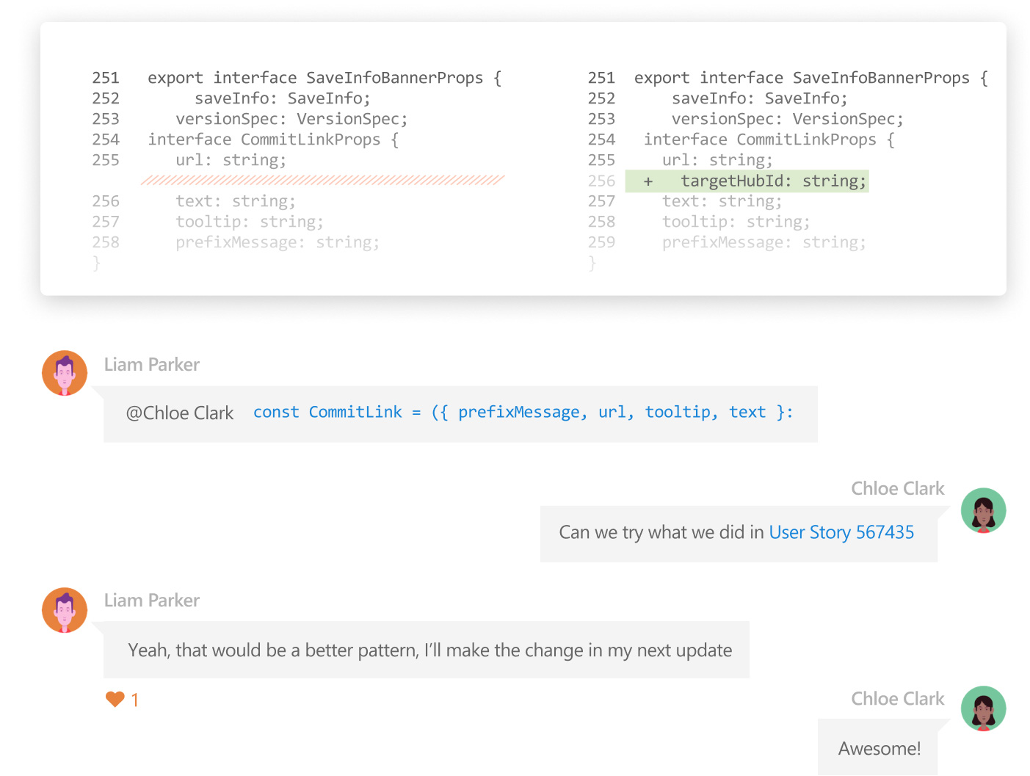
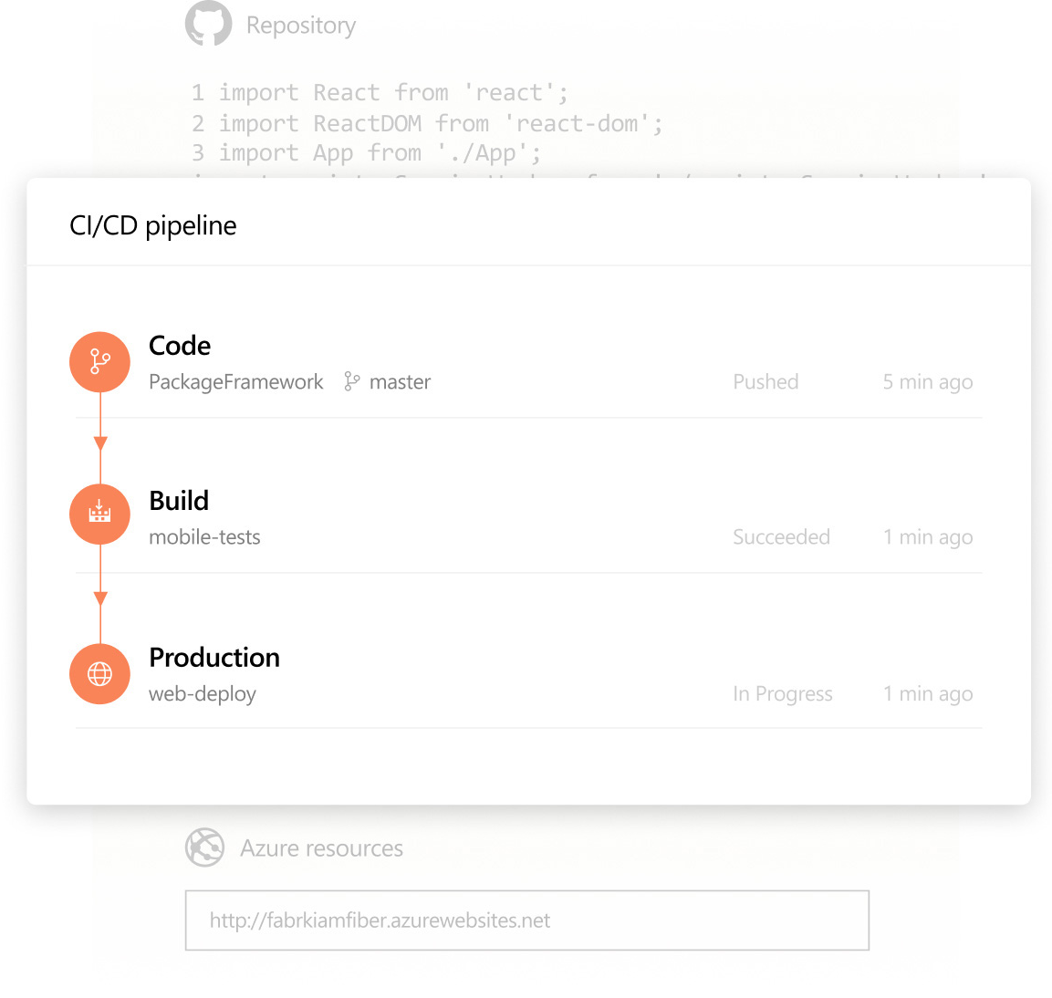
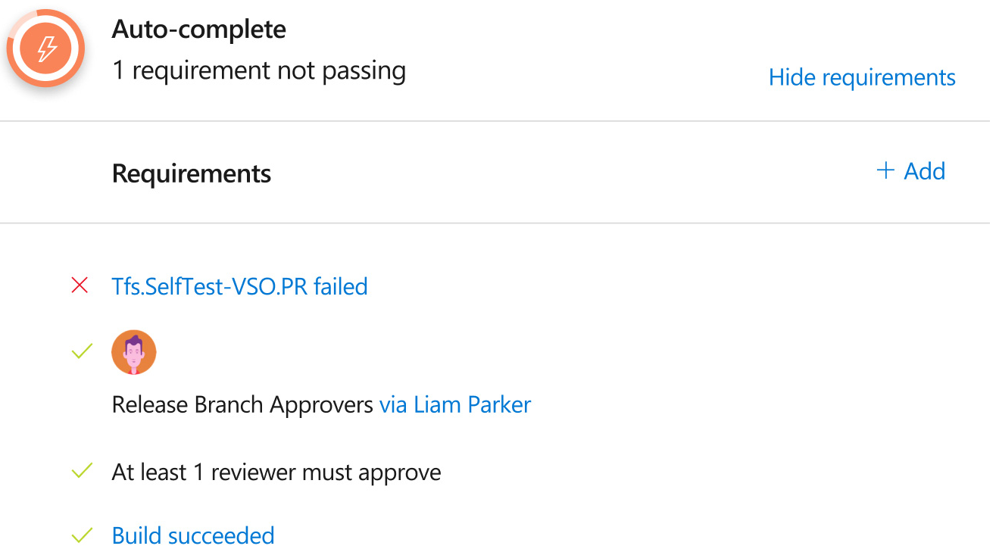
Azure Repos
Notes:
Collaborate to build better code
Perform more effective Git code reviews with threaded discussion and continuous integration for each change. Use forks to promote collaboration with inner source workflows.
Automate with built-in CI/CD
Set up continuous integration/continuous delivery (CI/CD) to automatically trigger builds, tests, and deployments with every completed pull request using Azure Pipelines or your tools.
Protect your code quality with branch policies
Keep code quality high by requiring code reviewer signoff, successful builds, and passing tests before pull requests can be merged. Customize your branch policies to maintain your team’s high standards.

Slide 24
Azure Test Plans
Test and ship with confidence using manual and exploratory testing tools
Capture
Capture rich data
Test
Test across web and desktop
Trace
Get end-to-end traceability
Notes:
Capture
Capture rich data
Capture rich scenario data as you execute tests to make discovered defects actionable
Test
Test across web and desktop
Test your application by executing tests across desktop or web apps
Trace
Get end-to-end traceability
Take advantage of end-to-end traceability and quality for your stories and features

Slide 25
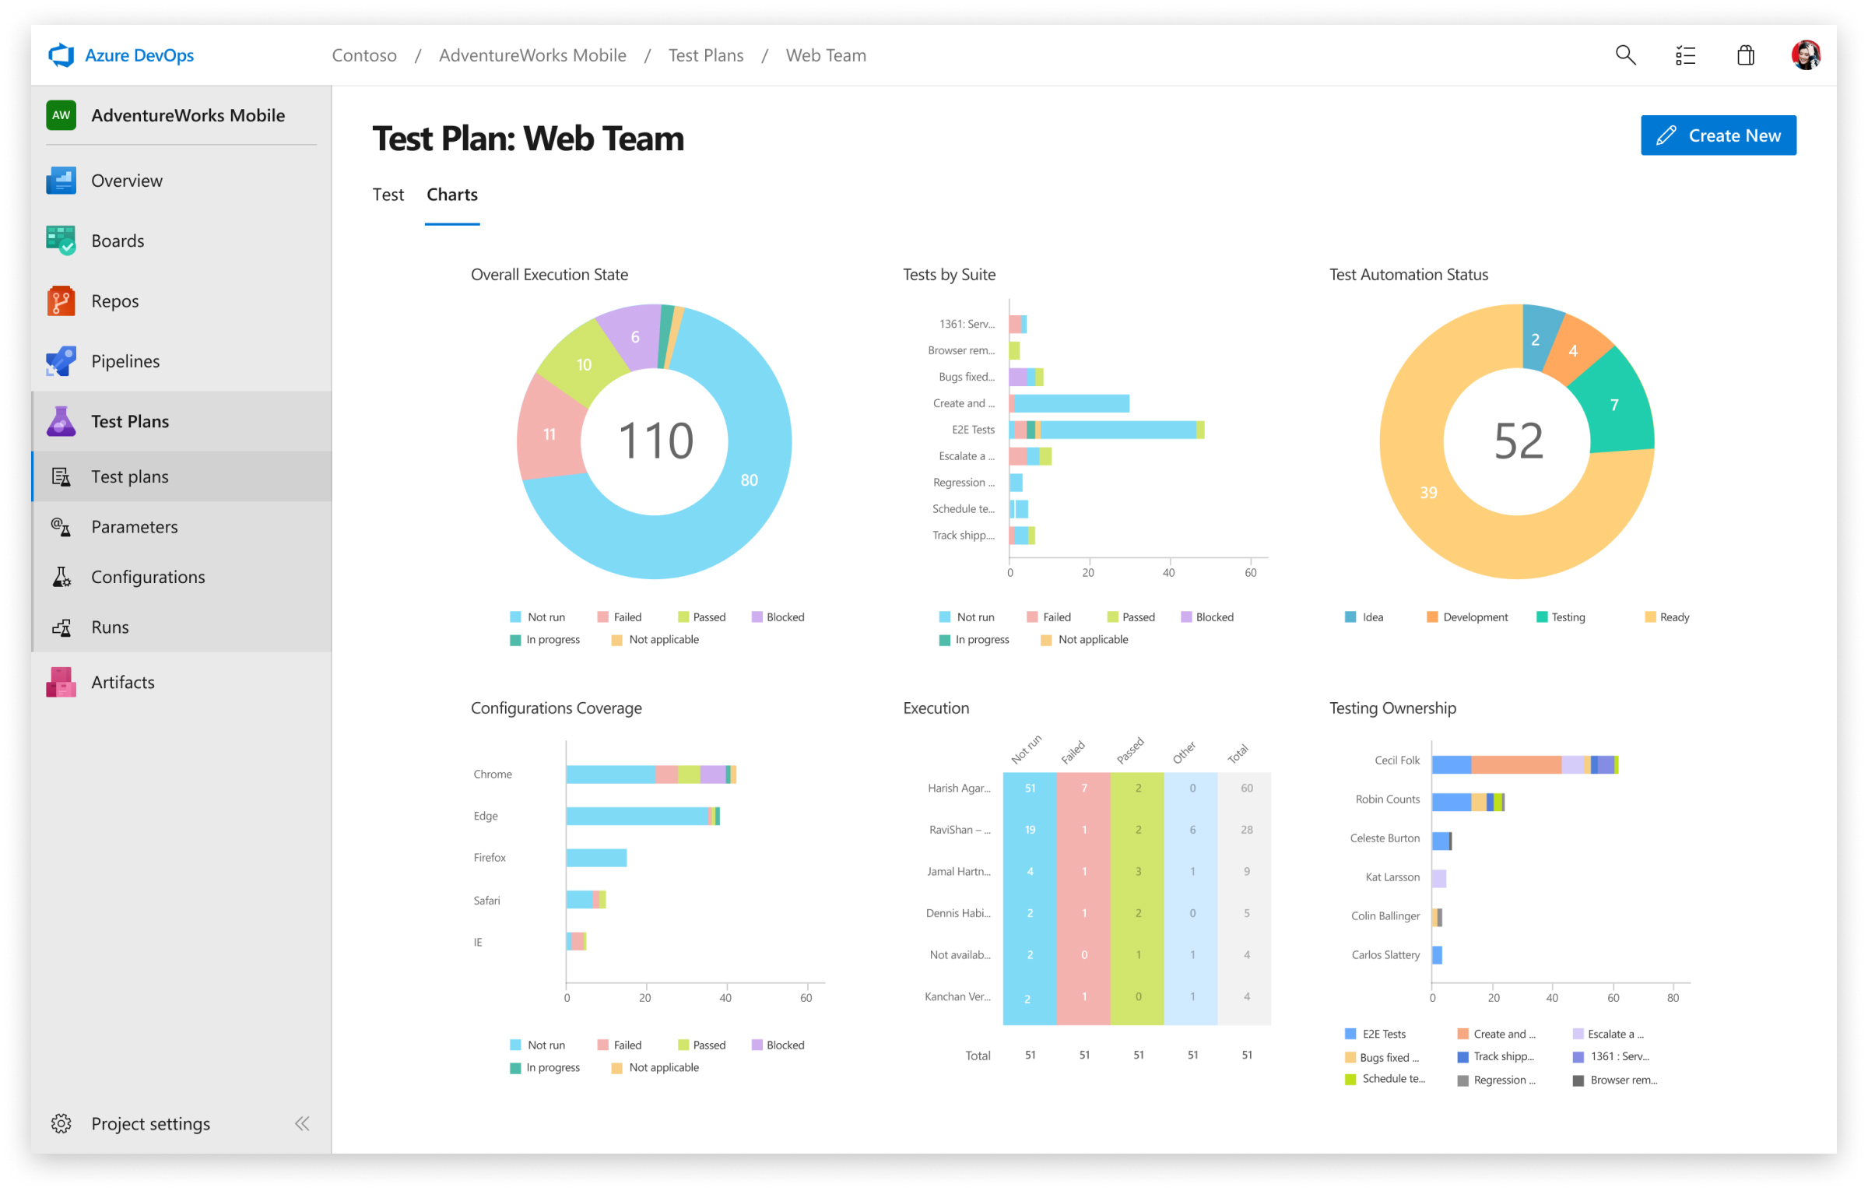
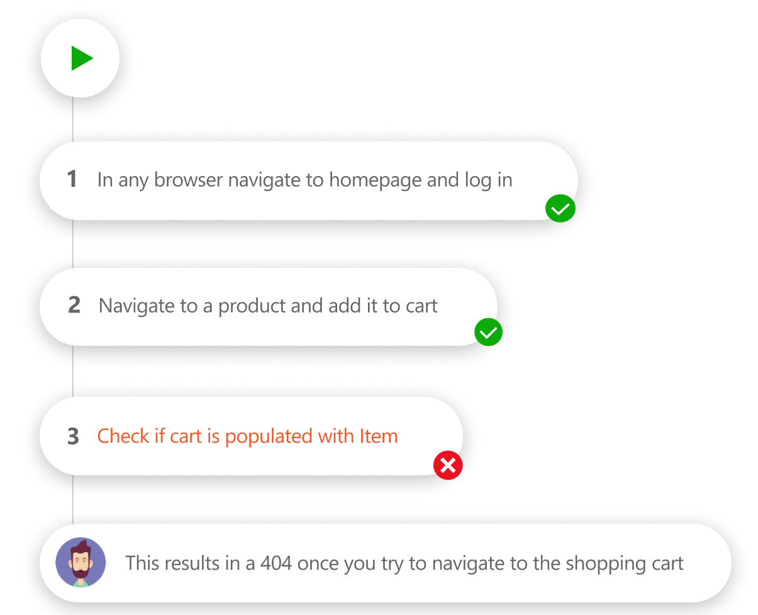
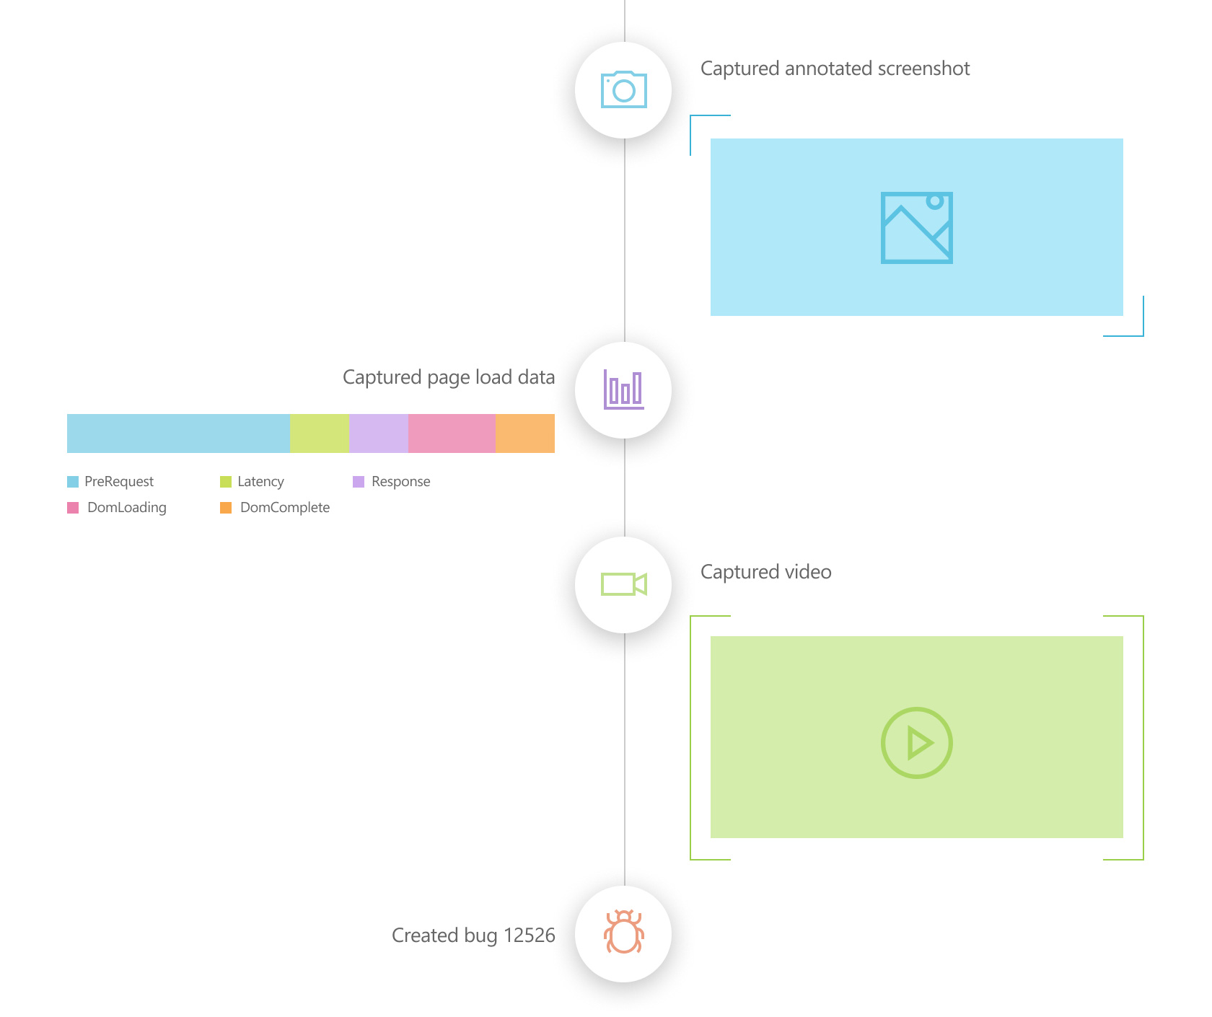
Azure Test Plans
Notes:
Planned manual testing
Plan, execute, and track scripted tests with actionable defects and end-to-end traceability. Assess quality throughout the development lifecycle by testing your desktop or web applications.
Exploratory testing
Design and execute tests simultaneously to maximize quality in modern software development processes using exploratory test sessions.

Slide 26
Azure Artifacts
Create, host, and share packages with your team, and add artifacts to your CI/CD pipelines with a single click
Share
Share code efficiently
Easily share code across small teams and large enterprises
Manage
Manage all package types
Get universal artifact management for Maven, npm, NuGet, and Python
Add
Add packages to pipeline
Share packages, and use built-in CI/CD, versioning, and testing

Slide 27
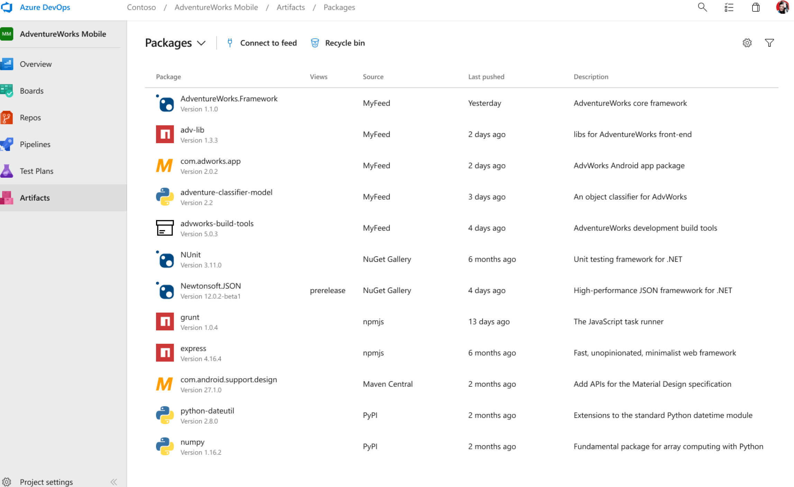
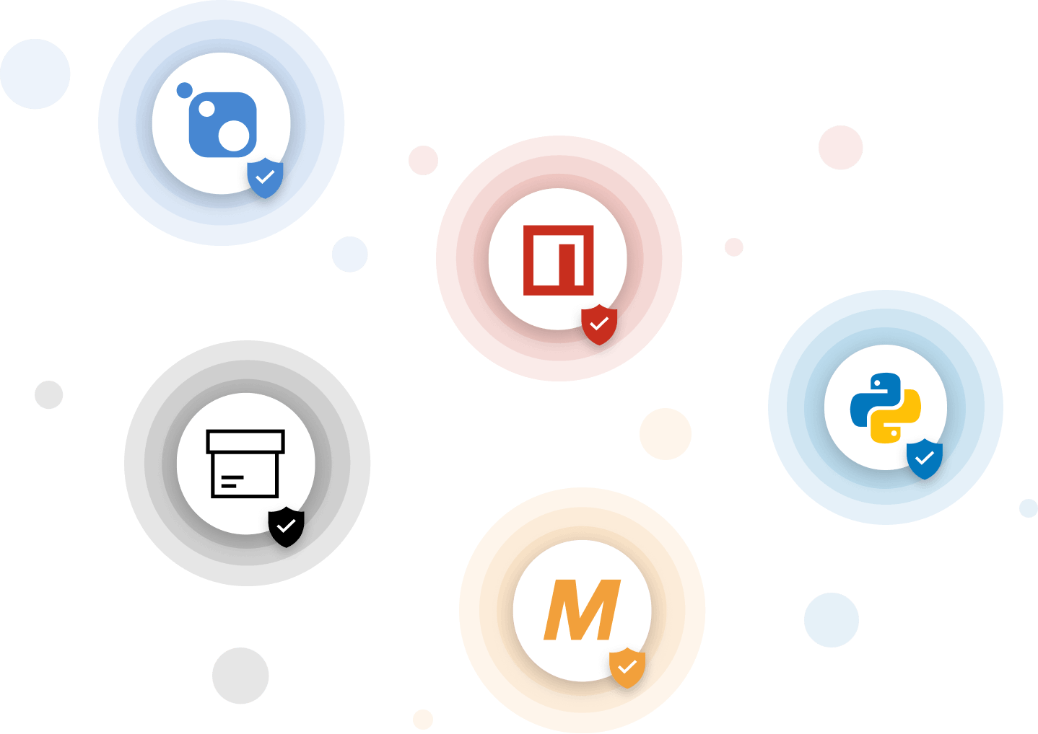
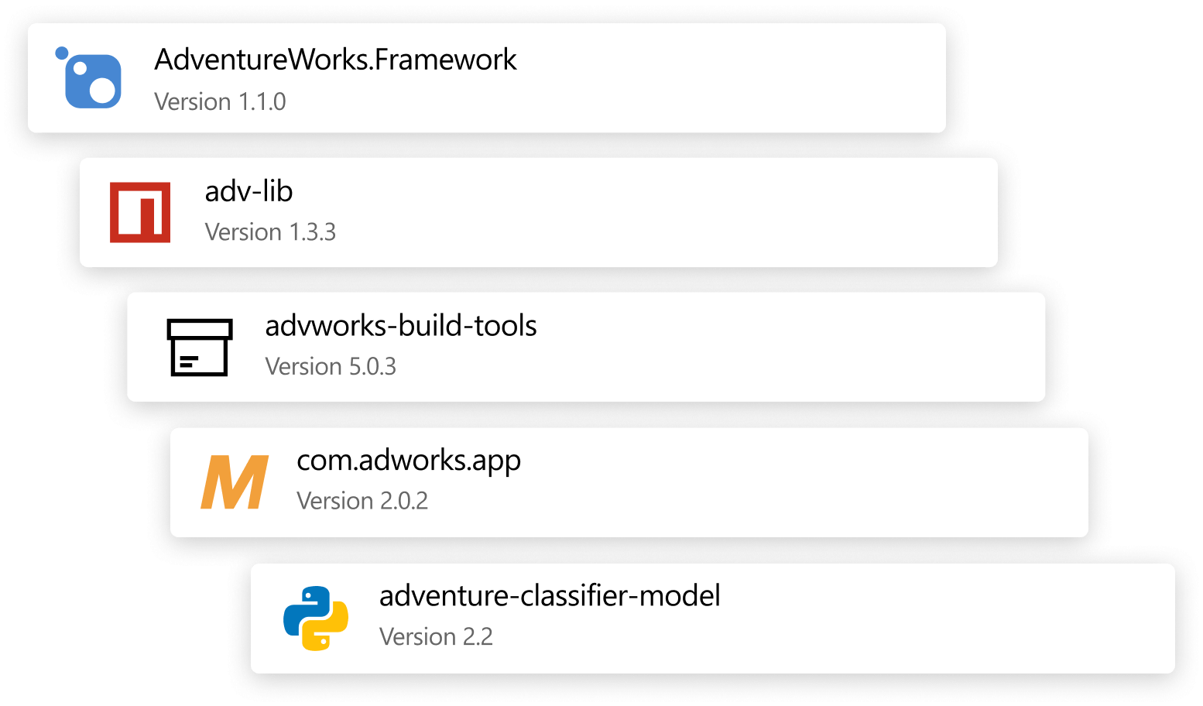
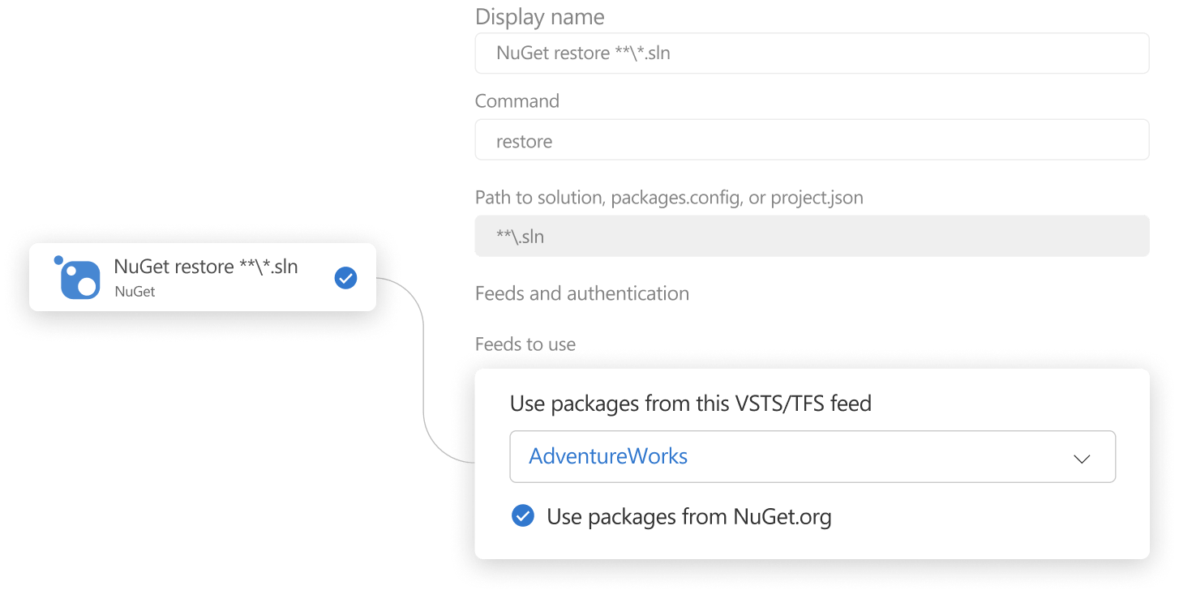
Azure Artifacts
Notes:
Keep your artifacts organized
Share code effortlessly by storing Maven, npm, NuGet, and Python packages together. And there’s no need to store binaries in Git—simply store them using Universal Packages.
Protect your packages
Keep every public source package you use—including packages from npmjs and nuget.org—safe in your feed where only you can delete it, and where it’s backed by the enterprise-grade Azure SLA.
Integrate seamless package handling into your CI/CD pipeline
Easily access all your artifacts in builds and releases—Artifacts integrates natively with the Azure Pipelines CI/CD tool.

Slide 28
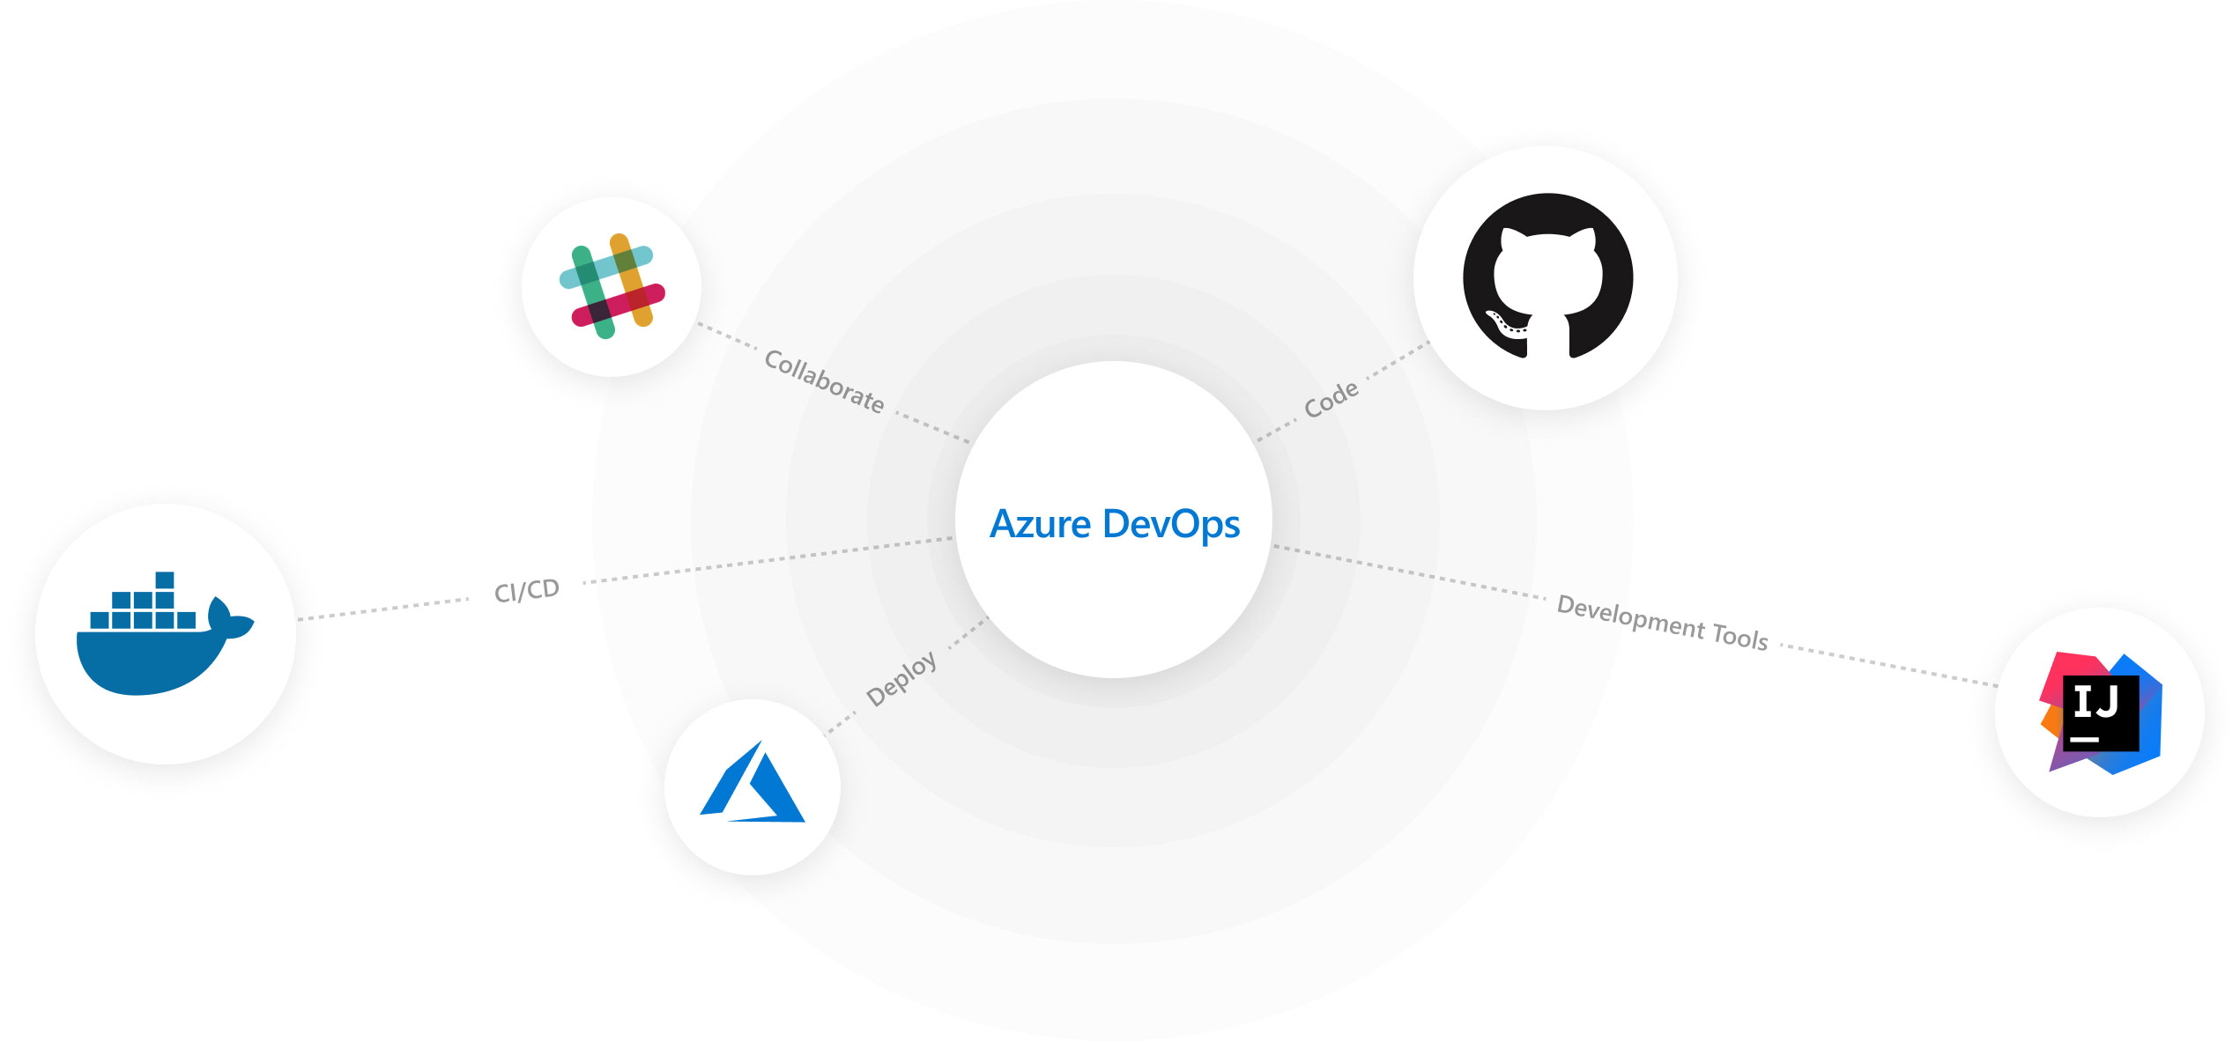
Integration Opportunities
Notes:
Discover flexible integrations
Mix and match the modular Azure DevOps tools to best fit your needs. Complement them with your existing tools and IDEs, and hundreds of integrations in the Marketplace.

Slide 29
Enterprise Ready
Azure DevOps
Enterprise-Grade Reliability
99.9 percent SLA and 24×7 support
New features every three weeks
On-Premises
Manage your own on-premises environment with Team Foundation Server
Source code management, automated builds, requirements management, reporting, and more
Notes:
What is Azure DevOps Server?
Collaborative software development tools for the entire team
Previously known as Team Foundation Server (TFS), Azure DevOps Server is a set of collaborative software development tools, hosted on-premises. Azure DevOps Server integrates with your existing IDE or editor, enabling your cross-functional team to work effectively on projects of all sizes.
Integration
Open and extensible
Integrate your custom tool or third-party service with Azure DevOps Server using open standards like REST APIs and OAuth 2.0. Integrate your favorite tools and services from our marketplace of extensions.
Azure DevOps Server Express
Free version for individuals and small teams
Use Azure DevOps Server Express as individual developers or teams of five or fewer, at no cost. Easily install on your personal desktop or laptop without needing a dedicated server. Upgrade to Azure DevOps Server when your team has grown beyond five team members and take your full history with you.

Slide 30

Which is right for me?
Deciding between Automation and DevOps

Slide 31

Azure
Automation
Infrastructure Perspective
Incorporate in ARM Templates
Add Users to AD
Connecting to other systems
Azure Resource Management
Deploy On-Prem Resources
Manage SQL
Start and Stop of Dev Machines
Processing Alerts

Slide 32
Azure
DevOps
Code Perspective
Project Tracking
Code Storage/Repository
CI/CD Pipeline Development
Test Plans
Store Project Artifacts
Software Development Lifecycle

Slide 33

Azure Automation
Infrastructure Perspective
Incorporate in ARM Templates
Add Users to AD
Connecting to other systems
Azure Resource Management
Deploy On-Prem Resources
Manage SQL
Start and Stop of Dev Machines
Processing Alerts
Code Perspective
Project Tracking
Code Storage/Repository
CI/CD Pipeline Development
Test Plans
Store Project Artifacts
Software Development Lifecycle
Manage resources in SDLC workflows
Manage Infrastructure as Code
Manage Projects with any code/scripts/etc.
Centralize Dashboards and Alerts
Azure DevOps

Slide 34

Next Steps: Azure Scaffold
Step 1: Governance
Step 2: Hierarchy Definition
Step 3: Naming Standards
Step 4: Policy and Initiatives
Step 5: Identity and Access
Step 6: Security
Step 7: Monitor and Alerts
Step 8: Cost Management
Step 9: Automation and DevOps
Step 10: Core Network
Notes:
Before we end, I’d like to cover an offering Pragmatic Works has that takes all we covered into account and much more
We call this offering the Azure scaffold, a Microsoft term that sets the framework for Azure architecture, but also can help validate your architecture
Automation and DevOps, as shown in the highlighted section (step 9) is one of many topics we cover in this initiative.
Other topics shown are customized and go into company-specific details on each specific area including:
Step 1: Governance – Building a foundation
Step 2: Hierarchy Definition – Organizing your Azure environment
Step 3: Naming Standards – Making your Azure environment consistent
Step 4: Policy and Initiatives – Managing your risk and enforcing rules
Step 5: Identity and Access – Controlling Access to the Azure environment
Step 6: Security – Protecting your Azure Resources
Step 7: Monitor and Alerts – Collecting, Analyzing, and Sending telemetry data
Step 8: Cost Management – Optimize and right-size your environment
*Step 9: Automation and DevOps – Save time and limit mistakes making items reusable
Step 10: Core Network - Ensure effective and secure data transfer

Slide 35
Thanks for Joining!
Have Any Questions?
Notes:
Thank you for joining todays session!
Hopefully, you were able to take something away from today’s session that will help you better manage your Azure environment.
I’d be glad to answer some questions with the time we have left if there are any in the queue

