Slide 1

IAM in Azure
Finding your Identity
May 21, 2019

Slide 2



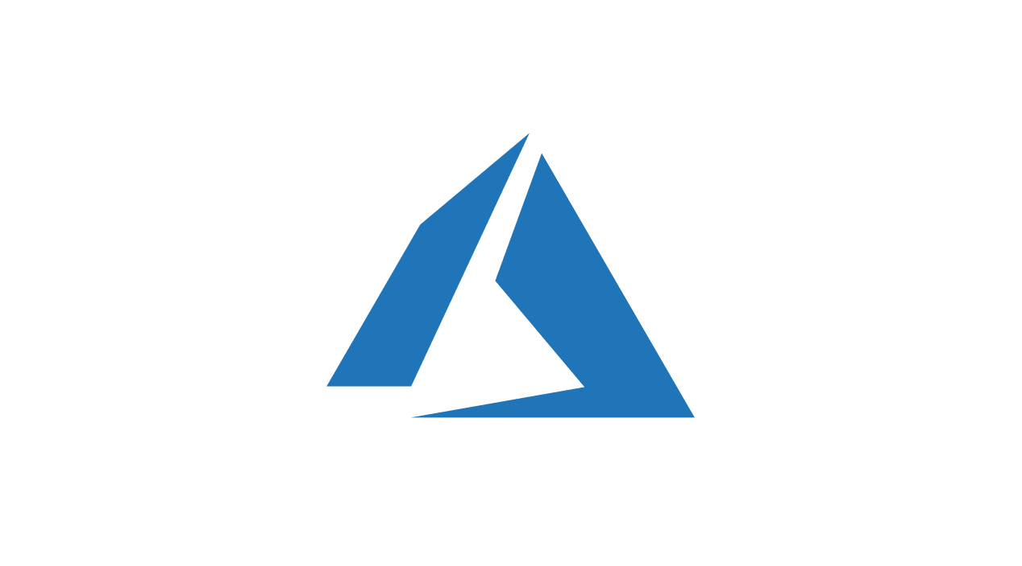




About Me
Joshua Gural
Senior Consultant at Pragmatic Works
Azure, IT Infrastructure, Office 365
Located near Pittsburgh, PA
Exercise, Outdoors, Time with Fiancée and Dog
Notes:
To get started, I wanted to introduce myself as the presenter
My name is Joshua Gural and I am a Sr. Consultant with Pragmatic works. I’m new to Pragmatic Works joining this year but come from a strong Cloud Computing (Azure focused), IT Infrastructure, and Office 365 background.
Even though Pragmatic Works is headquartered in FL, I am personally located just south of Pittsburgh, PA
In my free time, I enjoy exercising, being outdoors either hunting, fishing, or hiking, and spending time with my fiancée and dog (Dexter) who you can see in the upper right above my head with one of his many toys

Slide 3

Agenda
What is IAM in Azure?
Breaking it down – AAD
  Identity Sync Options
  AD Connect
  Organizational and Customer Relationships
  Role Based Access Control (RBAC)
  Security
Azure Scaffold

Slide 4

What is IAM in Azure?
An Overview of the Service

Slide 5
Identity and Access Management (IAM)
Secure access to your resources
Protect applications, devices, and data
Defend against malicious login attempts
Safeguard credentials

Slide 6
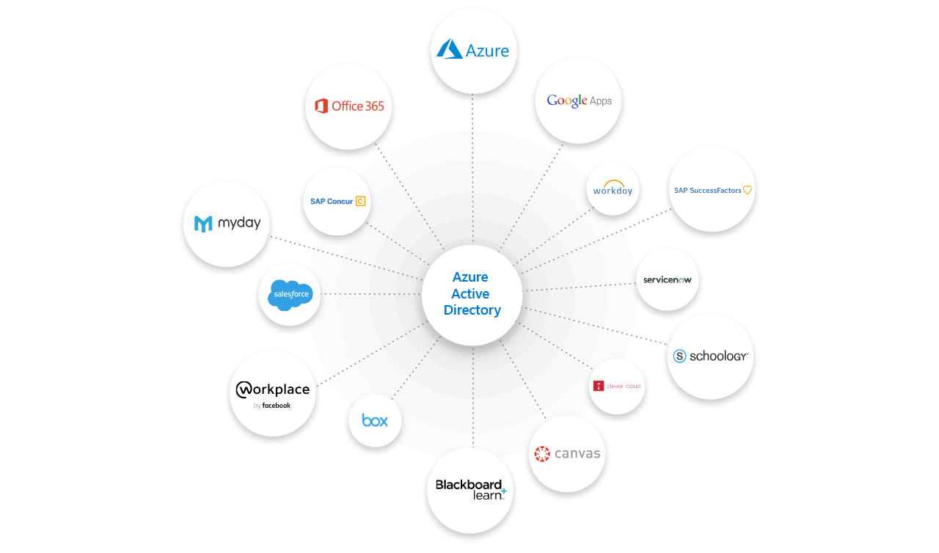

Slide 7
Azure Active Directory
Seamless, highly secure access
Comprehensive identity protection
Efficient management and compliance at scale
Customer and partner identities (B2B and B2C)
Identity platform for developers
Identity for IaaS
Notes:
Connect users with apps across cloud and on-premises environments
Protect and secure with conditional access and threat detection
Automation, self-service, & policy enforcement
Collaborate with customers and partners easily and more securely
Accelerate app dev and improve experience with authentication, SSO, etc.
Join Azure VMs to a domain without a physical DC or VPN

Slide 8
Secure
Access
Connect users, apps, data, and devices
Centralize identity
Password-less authentication

Slide 9
Identity Protection
Security based on user, location, device, data, and/or app context
Machine learning and intelligent security signals give insight to identity policies

Slide 10
Management & Compliance
Automate workflows for user provisioning and lifecycle management
Deploy policies and monitor access rights
Self-service account management

Slide 11
Customer and Partner Identities
Connect and collaborate with customers and partners
Azure AD B2B and B2C
Identity provider integration

Slide 12
Identity platform for developers
Integrate your app with AAD
Incorporate AAD authentication and advanced security features

Slide 13
Identity for IaaS (infrastructure as a service)
Join Azure VMs to a domain, without having to deploy DCs or use a VPN
Migrate legacy apps from on-premises to Azure with Azure Active Directory Domain Services
Notes:
Azure AD Domain Services provides managed domain services such as domain join, group policy, LDAP, Kerberos/NTLM authentication that are fully compatible with Windows Server Active Directory. You can consume these domain services without the need for you to deploy, manage, and patch domain controllers in the cloud. Azure AD Domain Services integrates with your existing Azure AD tenant, thus making it possible for users to log in using their corporate credentials. Additionally, you can use existing groups and user accounts to secure access to resources, thus ensuring a smoother 'lift-and-shift' of on-premises resources to Azure Infrastructure Services.
Azure AD Domain Services functionality works seamlessly regardless of whether your Azure AD tenant is cloud-only or synced with your on-premises Active Directory.

Slide 14

Identity Sync Options
What is the best way to sync your identities?

Slide 15
Hybrid Identity
Password hash synchronization (PHS)
Pass-through authentication (PTA)
Federation (AD FS)
Notes:
Password hash synchronization - Synchronizes a hash of a users on-premises AD password with Azure AD.
Pass-through authentication - Allows users to use the same password on-premises and in the cloud but doesn't require the additional infrastructure of a federated environment.
Federation integration - Can be used to configure a hybrid environment using an on-premises AD FS infrastructure. It also provides AD FS management capabilities such as certificate renewal and additional AD FS server deployments.

Slide 16
Hybrid Identity
I need to | PHS & SSO | PTA & SSO | AD FS
Sync user, contact, and groups created in my on-premises AD to the cloud automatically | ✓ | ✓ | ✓
Set up tenant for Office 365 hybrid scenarios | ✓ | ✓ | ✓
Sign in and access cloud services using on-premises password | ✓ | ✓ | ✓
SSO using corporate credentials | ✓ | ✓ | ✓
Cloud-based MFA solutions | ✓ | ✓ | ✓
No password hashes are stored in the cloud |  | ✓ | ✓
On-premises MFA solutions |  |  | ✓
Smartcard authentication |  |  | ✓
Password expiration notifications in the Office Portal and Windows 10 desktop |  |  | ✓

Slide 17
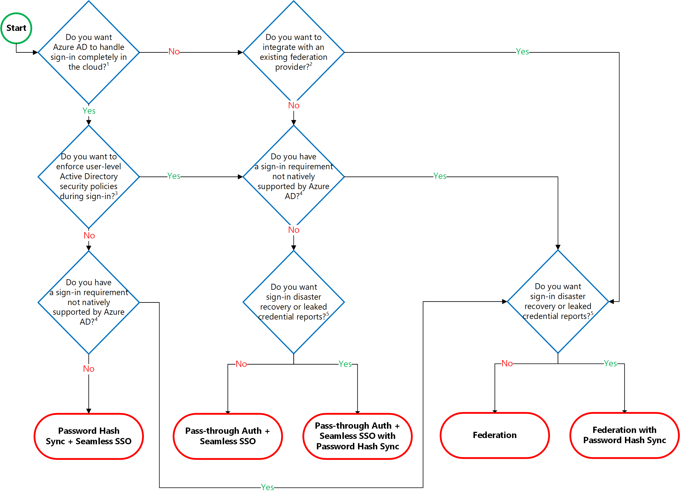
Hybrid Identity
Decision
Tree
Notes:
Details on decision questions:
Azure AD can handle sign-in for users without relying on on-premises components to verify passwords.
Azure AD can hand off user sign-in to a trusted authentication provider such as Microsoft’s AD FS.
If you need to apply user-level Active Directory security policies such as account expired, disabled account, password expired, account locked out, and sign-in hours on each user sign-in, Azure AD requires some on-premises components.
Sign-in features not natively supported by Azure AD:
Sign-in using smartcards or certificates.
Sign-in using on-premises MFA Server.
Sign-in using 3rd party authentication solution.
Multi-site on-premises authentication solution.
Azure AD Identity Protection requires Password Hash Sync regardless of which sign-in method you choose, to provide the Users with leaked credentials report. Organizations can failover to Password Hash Sync if their primary sign-in method fails and it was configured before the failure event.
Note
Azure AD Identity Protection require Azure AD Premium P2 licenses.
https://docs.microsoft.com/en-us/azure/security/azure-ad-choose-authn

Slide 18

AD Connect
Connecting on-premises and cloud presence

Slide 19
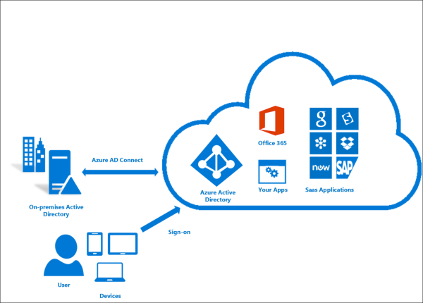

Slide 20
Why use Azure AD Connect?
Single identity to access on-premises and cloud services
Single tool to provide an easy deployment for sync and sign-in
Replaces older identity integration tools (DirSync / Azure AD Sync)
Automation options
IDFix

Slide 21
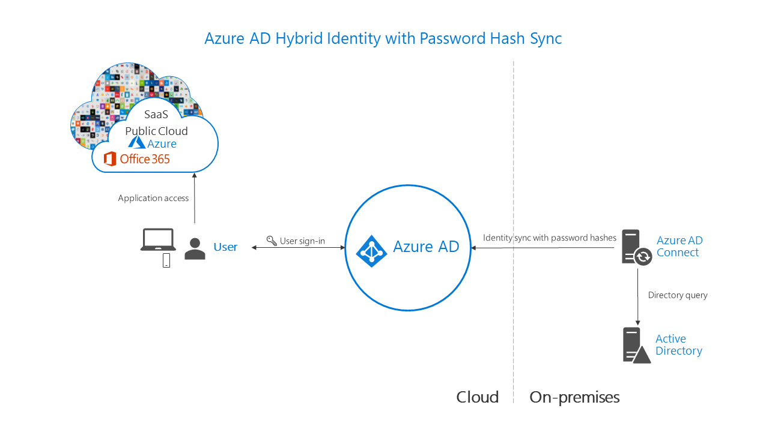

Slide 22
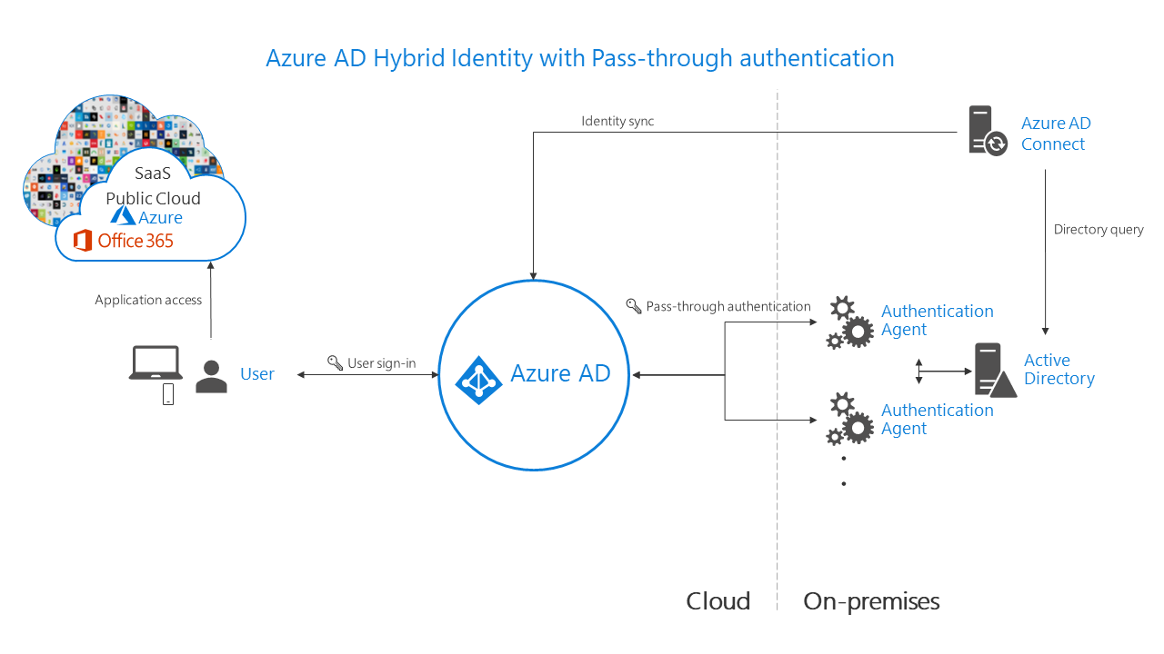

Slide 23
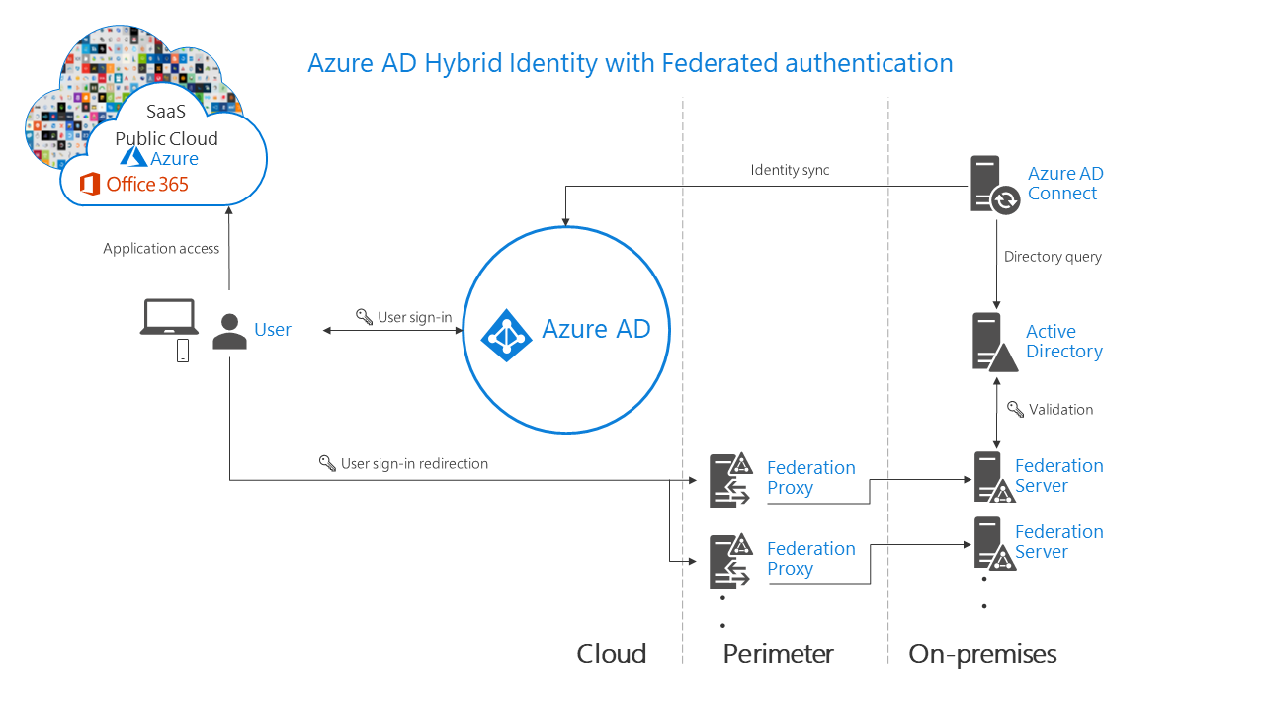

Slide 24

Company Relationships
Interact with business partners and clients

Slide 25
B2B and B2C
Azure AD B2B securely share with external users so they can collaborate
Azure AD B2C for businesses and developers that create customer-facing apps
Notes:
Both Azure Active Directory (Azure AD) B2B collaboration and Azure AD B2C allow you to work with external users in Azure AD. But how do they compare?
Azure AD B2B is for businesses that want to securely share files and resources with external users so they can collaborate. An Azure admin sets up B2B in the Azure portal, and Azure AD takes care of federation between your business and your external partner. Users sign in to the shared resources using a simple invitation and redemption process with their work or school account, or any email account.
Azure AD B2C is primarily for businesses and developers that create customer-facing apps. With Azure AD B2C, developers can use Azure AD as the full-featured identity system for their application, while letting customers sign in with an identity they already have established (like Facebook or Gmail).

Slide 26
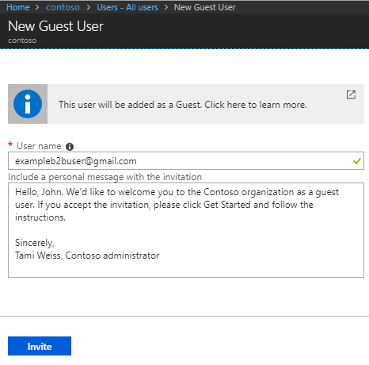
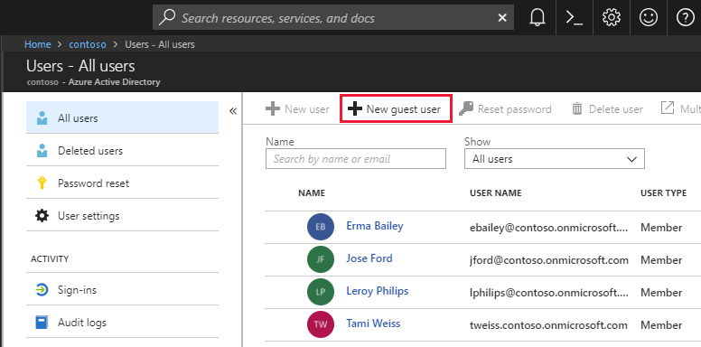
Notes:
Easily add guest users in the Azure AD portal
As an administrator, you can easily add guest users to your organization in the Azure portal.
Create a new guest user in Azure AD, similar to how you'd add a new user.
The guest user immediately receives a customizable invitation that lets them sign in to their Access Panel.
Guest users in the directory can be assigned to apps or groups.
https://docs.microsoft.com/en-us/azure/active-directory/b2b/what-is-b2b
https://docs.microsoft.com/bs-latn-ba/azure/active-directory/b2b/add-users-administrator

Slide 27

RBAC
Role-based Access Control

Slide 28
Important Questions
Who needs access? (Security Principal)
User, group, service principal, or managed identity
What permissions do they need?
Grouped into built-in or custom roles
Where do they need access? (Scope)
Management group, subscription, resource group, or a single resource
Notes:
To be the most effective with the Access control (IAM) blade, it helps if you can answer the following three questions when you are trying to manage access:

Slide 29
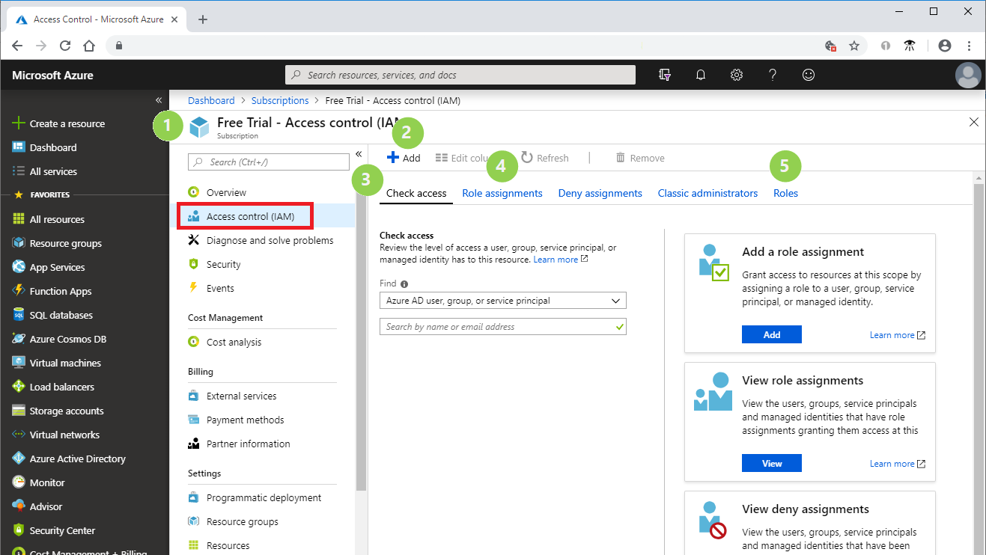
Notes:
# Element What you use it for
1 Resource where IAM is opened Identify scope (subscription in this example)
2 Add button Add role assignments
3 Check access tab View the role assignments for a single user
4 Role assignments tab View the role assignments at the current scope
5 Roles tab View all roles and permissions

Slide 30
Application administrator | Can create and manage all aspects of app registrations and enterprise apps.
Application developer | Can create application registrations independent of the 'Users can register applications' setting.
Authentication administrator | Has access to view, set, and reset authentication method information for any non-admin user.
B2C IEF Keyset administrator | Can manage secrets for federation and encryption in the Identity Experience Framework.
B2C IEF Policy administrator | Can create and manage trust framework policies in the Identity Experience Framework.
B2C user flow administrator | Can create and manage all aspects of user flows.
B2C user flow attribute administrator | Can create and manage the attribute schema available to all user flows.
Billing administrator | Can perform common billing related tasks like updating payment information.
Cloud application administrator | Can create and manage all aspects of app registrations and enterprise apps except App Proxy.
Cloud device administrator | Full access to manage devices in Azure AD.
Compliance administrator | Can read and manage compliance configuration and reports in Azure AD and Office 365.
Conditional Access administrator | Can manage conditional access capabilities.
Customer LockBox access approver | Can approve Microsoft support requests to access customer organizational data.
Desktop Analytics administrator | Can access and manage Desktop management tools and services.
Dynamics 365 administrator | Can manage all aspects of the Dynamics 365 product.
Exchange administrator | Can manage all aspects of the Exchange product.
External Identity Provider administrator | Can configure identity providers for use in direct federation.
Global administrator | Can manage all aspects of Azure AD and Microsoft services that use Azure AD identities.
Guest inviter | Can invite guest users independent of the ‘members can invite guests’ setting.

Slide 31
Helpdesk (Password) administrator | Can reset passwords for non-administrators and Helpdesk (Password) Administrators.
Information Protection administrator | Can manage all aspects of the Azure Information Protection product.
Intune administrator | Can manage all aspects of the Intune product.
License administrator | Ability to assign, remove and update license assignments.
Message center reader | Can read messages and updates for their organization in Office 365 Message Center only.
Power BI administrator | Can manage all aspects of the Power BI product.
Privileged authentication administrator | Allowed to view, set and reset authentication method information for any user (admin or non-admin).
Privileged role administrator | Can manage role assignments in Azure AD, and all aspects of Privileged Identity Management.
Reports reader | Can read sign-in and audit reports.
Security administrator | Can read security information and reports, and manage configuration in Azure AD and Office 365.
Security reader | Can read security information and reports in Azure AD and Office 365.
Service administrator | Can read service health information and manage support tickets.
SharePoint administrator | Can manage all aspects of the SharePoint service.
Skype for Business administrator | Can manage all aspects of the Skype for Business product.
Teams Communications Administrator | Can manage calling and meetings features within the Microsoft Teams service.
Teams Communications Support Engineer | Can troubleshoot communications issues within Teams using advanced tools.
Teams Communications Support Specialist | Can troubleshoot communications issues within Teams using basic tools.
Teams Service Administrator | Can manage the Microsoft Teams service.
User administrator | Can manage all aspects of users and groups, including resetting passwords for limited admins.

Slide 32

Security
How can IAM affect your company's security?

Slide 33
Security Overview
Device and App Management
Conditional Access
Identity Protection
Reports and Monitoring

Slide 34

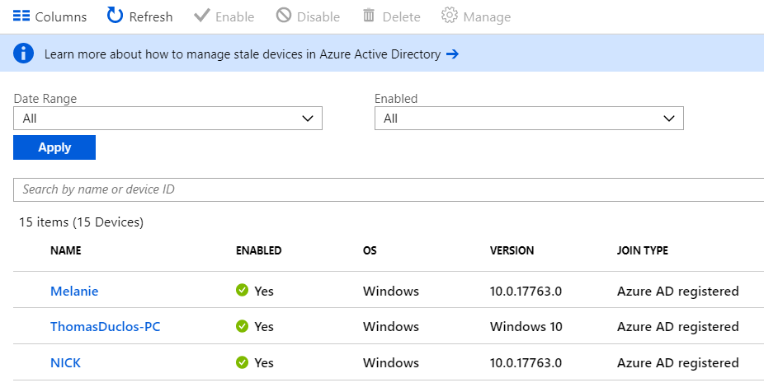
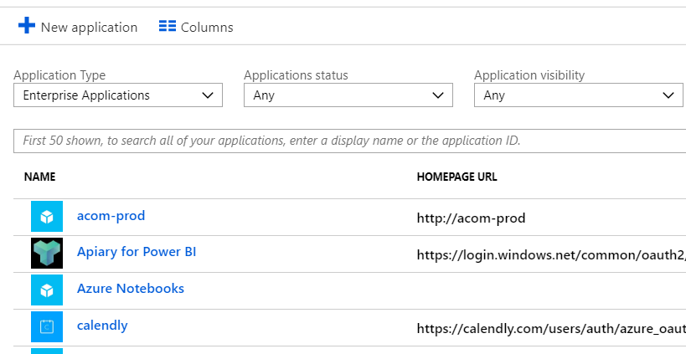
Device & App Management
Working anywhere on any device
Protect corporate assets
Foundation for device-based conditional access
Notes:
With device-based conditional access, you can ensure that access to resources in your environment is only possible with managed devices.

Slide 35

Conditional Access
Implement automated access control decisions for accessing your cloud apps
Conditional access policies are enforced after the first-factor authentication has been completed
Notes:
Location Based
Device Based

Slide 36
Azure AD Identity Protection
Detecting vulnerabilities and risky accounts
Providing custom recommendations to improve security
Calculating user risk levels
Investigating risk events
Sending notifications for risk events
Investigating risk events using contextual information
Providing workflows to track investigations
Providing easy access to remediation actions
Risk-based conditional access policies
Policy to block sign-ins or requiring MFA
Policy to block or secure risky user accounts
Policy to require users to register for MFA
Calculating sign-in risk levels
Notes:
Risky sign-ins - A risky sign-in is an indicator for a sign-in attempt that might have been performed by someone who is not the legitimate owner of a user account.
Users flagged for risk - A risky user is an indicator for a user account that might have been compromised.
Azure Active Directory Identity Protection is a feature of the Azure AD Premium P2 edition that enables you to:
Detect potential vulnerabilities affecting your organization’s identities
Configure automated responses to detected suspicious actions that are related to your organization’s identities
Investigate suspicious incidents and take appropriate action to resolve them

Slide 37
AAD Reports
Comprehensive activity view
Determine how apps and services are utilized
Detect risks affecting the health of your environment
Troubleshoot issues
Two main pillars
Security reports
Activity reports
Notes:
https://docs.microsoft.com/en-us/azure/active-directory/identity-protection/overview

Slide 38
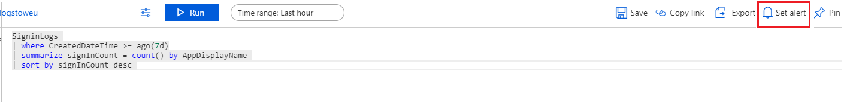
AAD Monitoring
Route your activity logs to different endpoints for retention or integration
  Azure storage account
  Azure event hub to integrate with Splunk and Sumologic
  Azure Log Analytics workspace
Notes:
https://docs.microsoft.com/en-us/azure/active-directory/reports-monitoring/overview-monitoring

Slide 39

Next Steps: Azure Scaffold
Step 1: Governance
Step 2: Hierarchy Definition
Step 3: Naming Standards
Step 4: Policy and Initiatives
Step 5: Identity and Access
Step 6: Security
Step 7: Monitor and Alerts
Step 8: Cost Management
Step 9: Automation and DevOps
Step 10: Core Network
Notes:
Before we end, I’d like to cover an offering Pragmatic Works has that takes all we covered into account and much more
We call this offering the Azure scaffold, a Microsoft term that sets the framework for Azure architecture, but also can help validate your architecture
IAM, as shown in the highlighted section (step 5) is one of many topics we cover in this initiative.
Other topics shown are customized and go into company-specific details on each specific area including:
Step 1: Governance – Building a foundation
Step 2: Hierarchy Definition – Organizing your Azure environment
Step 3: Naming Standards – Making your Azure environment consistent
Step 4: Policy and Initiatives – Managing your risk and enforcing rules
*Step 5: Identity and Access – Controlling Access to the Azure environment
Step 6: Security – Protecting your Azure Resources
Step 7: Monitor and Alerts – Collecting, Analyzing, and Sending telemetry data
Step 8: Cost Management – Optimize and right-size your environment
Step 9: Automation and DevOps – Save time and limit mistakes making items reusable
Step 10: Core Network - Ensure effective and secure data transfer

Slide 40
Thanks for Joining!
Have Any Questions?
Notes:
Thank you for joining todays session!
Hopefully, you were able to take something away from today’s session that will help you better manage your Azure environment.
I’d be glad to answer some questions with the time we have left if there are any in the queue

