Slide 1
Intro to Data Governance in Azure SQL DB
Webinar
Jon Bloom, Principle
01/08/2019
Notes:
1

Slide 2
Agenda
About Me
Intro to Azure Data Governance
Demos
Summary
Notes:
2

Slide 3

About Me
Principle Consultant Pragmatic Works
Worked with data since 1996
Consulting 6 years
Reside in Tampa Bay, Fl
Notes:
3

Slide 4
Brief Description
Data Governance has slowly crept into the limelight, for good reason. With upcoming mandates on Data Privacy, having a Data Governance framework in place will support and fortify your efforts to becoming a Data Driven organization. See how easy you can apply Row Level Security and Data Masking to your Azure SQL Database.
Notes:
4

Slide 5
Enterprise Data Governance
Create an organized, consistent and proper handling of an organization's data to ensure accuracy trusted by the enterprise. Comprised of 3 things:
  People – assign Data Steward who the data within an org
  Processes – centralized steps to ensure data Stored, Processed, Archived and Protected
  Information Technology – applications and tools to govern content and metadata
Notes:
5

Slide 6
Why Data Governance?
  Best Practices
  Consistency
  Transparency
  Organization
  Security
  Point of Ownership / Responsibility
  Data Driven Org
Notes:
6

Slide 7
Data Steward
  Responsible for data quality within orgs
  Data Stewards are responsible for what is stored in a data field
    Accuracy
    Completeness
    Consistency
Notes:
6

Slide 8
Data Steward Responsibilities
Has clear and unambiguous data element definition
Does not conflict with other data elements in the metadata registry (removes duplicates, overlap etc.)
Has clear enumerated value definitions if it is of type Code
Is still being used (remove unused data elements)
Is being used consistently in various computer systems
Is being used, fit for purpose = Data Fitness
Has adequate documentation on appropriate usage and notes
Documents the origin and sources of authority on each metadata element
Is protected against unauthorized access or change
Notes:
7

Slide 9
Data Custodian
  Responsible for the safe custody, transport, storage of the data and implementation of business rules
  Common job titles for data custodians are Database Administrator (DBA), Data Modeler, and ETL Developer
Notes:
8

Slide 10
Data Custodian Responsibilities
Access to the data is authorized and controlled
Data stewards are identified for each data set
Technical processes sustain data integrity
Processes exist for data quality issue resolution in partnership with Data Stewards
Technical controls safeguard data
Data added to data sets are consistent with the common data model
Versions of Master Data are maintained along with the history of changes
Change management practices are applied in maintenance of the database
Data content and changes can be audited
Notes:
9

Slide 11
Chief Data Officer (CDO)
New Role Mid to Large Orgs
Reports to CEO or CFO or CIO
Aligns Data Strategy
Consolidate Software / Vendors / Developer Skills
  Cost Savings
  Build In-house / 3rd Party Software
Leverage Domain Knowledge
  Leverage Internal Staff as needed
Notes:
11

Slide 12
Master Data Management (MDM)
Method used to define and manage the critical data of an organization to provide, with data integration, a single point of reference
Streamlines data sharing among personnel and departments
Notes:
11

Slide 13
Master Data Management Tools
Removing duplicates
Standardizing data
Incorporating rules to eliminate incorrect data
Create an authoritative source of master data
Notes:
12

Slide 14
Transmission of Master Data
Data consolidation – The process of capturing master data from multiple sources and integrating into a single hub (operational data store) for replication to other destination systems.
Data federation – The process of providing a single virtual view of master data from one or more sources to one or more destination systems.
Data propagation – The process of copying master data from one system to another, typically through point-to-point interfaces in legacy systems.
Notes:
13

Slide 15
Data Catalogs
Contain List of all Data Sources
  Tables
  Fields
  Field Types
  Description
Automated using AI
  Scans DBs for Changes
Notes:
14

Slide 16
Regulatory Compliance
New & Existing Rules
  Constantly Changing
  Penalties for Non-Compliance
  Design Ecosystem with Data 1st
Notes:
14

Slide 17
Regulatory Compliance HIPPA
HIPPA Health Insurance Portability and Accountability Act
  Law (1996) stipulate how Personally Identifiable Information maintained by the healthcare and healthcare insurance industries should be protected from fraud and theft, and address limitations on healthcare insurance coverage
Notes:
14

Slide 18
Regulatory Compliance PCI
PCI Payment Card Industry Data Security Standard
  An information security standard for organizations that handle branded credit cards from the major card schemes
Notes:
15

Slide 19
Regulatory Compliance GDPR
GDPR General Data Protection Regulation
  Aims primarily to give control to individuals over their personal data and to simplify the regulatory environment
Notes:
16

Slide 20
Regulatory Compliance PII
PII Personally Identifiable Information
  information that can be used on its own or with other information to identify, contact, or locate a single person, or to identify an individual in context
Notes:
17

Slide 21
Regulatory Compliance US DPL
United States data protection law
  United States privacy legislation tends to be adopted on an ad hoc basis, at both National and State level, not uniform in definitions or adoption
  Need to ensure that their current processes comply with GDPR requirements, or face strict, and potentially costly, sanctions
  Any retailer who requests information from a customer for a specific purpose, can only use the information for that purpose, and must delete the information from its records afterwards
  If a retailer profiles a customer, using methods such as online purchase history, they may need to obtain individual consent to do so, according to GDP
Notes:
18

Slide 22
Regulatory Compliance US DPL
Internally Sensitive Data
  Salary
  Sales Quotas
  Financial Data
  Customer Data
Notes:
19

Slide 23
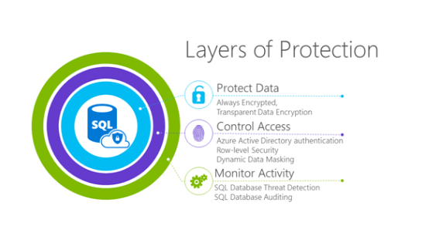
Azure Security
3 Levels of Security in Azure
Notes:
20

Slide 24
Security 1: Protect the Data
Transparent Data Encryption using Certificate or Key
Always Encrypted | Encrypted at all times
  In transit
  In memory
  On disk
  During query processing
Notes:
21

Slide 25
Security 2: Control Access
Azure Active Directory (Azure AD) authentication
Row Level Security
  SSMS
  Database & Schema Bound to Table
  Create Security Policy = filter predicate, as an inline table-valued function
  Users & Groups assigned to Roles
  Predicates store Users & Assigned Permissions
Notes:
22

Slide 26
Security 2: Control Access
Dynamic Data Masking
  Applied in Azure
  Table or Column level | Configuration Tab | T-SQL
  Masked In real time
    Email Address
    Social Security Number
    Phone Number
    Text, PCI, HIPPA, GDPR, Sensitive Data
Notes:
23

Slide 27
Security 3: Monitor Activity
SQL Database Threat Detection
SQL Database Auditing
  Track and Log Server Activity (default setting)
  Track and Log Database Activity (specific databases)
Notes:
24

Slide 28
Security: Other
Firewall
  Server level rules that allow a range of IPs access in Azure Portal
  Database level rules using Azure Portal, T-SQL or PowerShell
Manage User Permission
Encrypted Connections
  Encrypted connection between a client application and SQL Database
  Reduces the risk of man-in-the-middle attacks
Notes:
25

Slide 29
Demo
Row Level Security in Azure SQL DB
Dynamic Data Masking in Azure SQL DB
Notes:
26

Slide 30
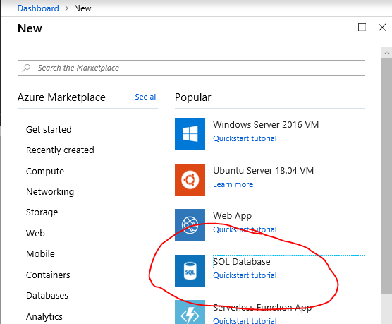
Azure SQL Database

Slide 31
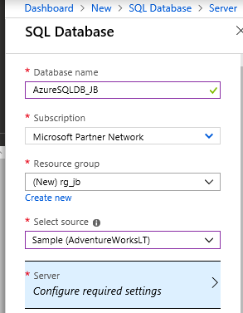
Azure SQL Database

Slide 32
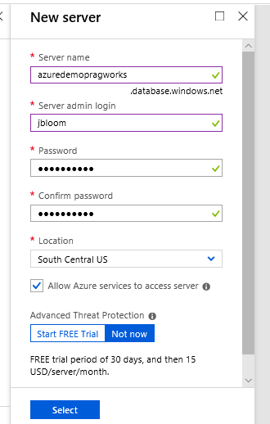
Azure SQL Database

Slide 33
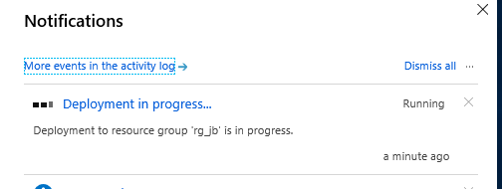
Azure SQL Database

Slide 34
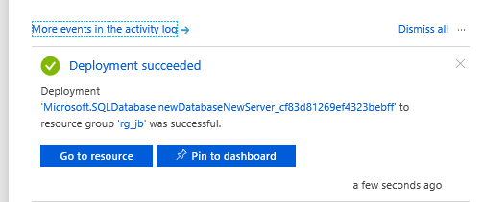
Azure SQL Database

Slide 35
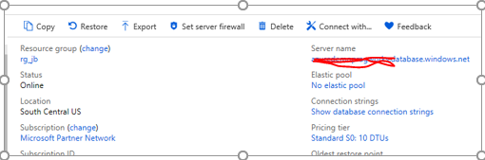
Azure SQL Database

Slide 36
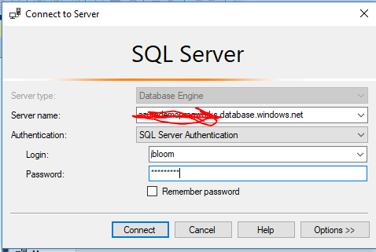
Azure SQL Database

Slide 37
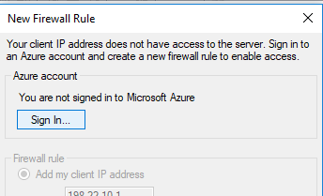
Azure SQL Database

Slide 38
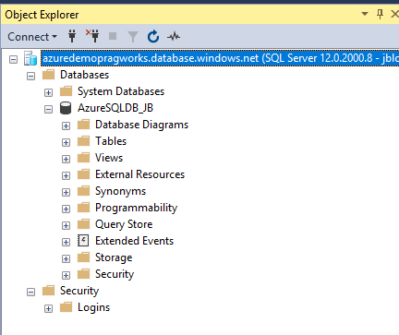
Azure SQL Database

Slide 39
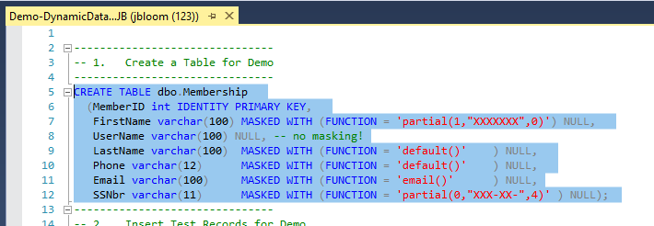
Azure SQL Database

Slide 40
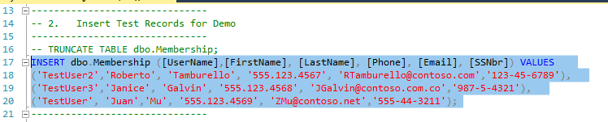
Azure SQL Database

Slide 41

Azure SQL Database

Slide 42
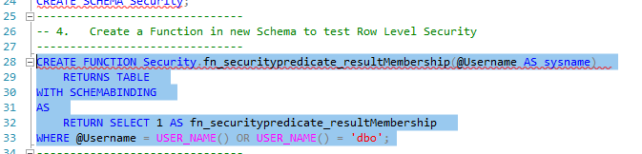
Azure SQL Database

Slide 43
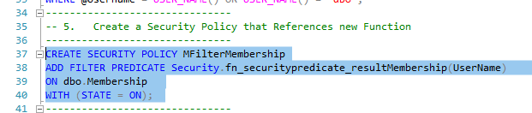
Azure SQL Database

Slide 44
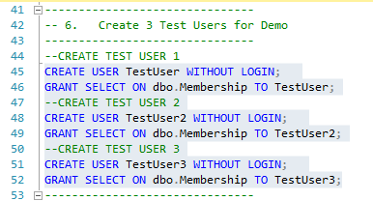
Azure SQL Database

Slide 45
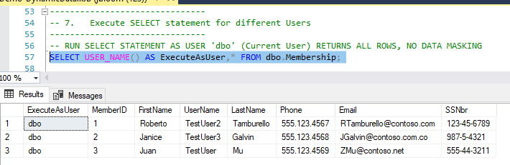
Azure SQL Database

Slide 46
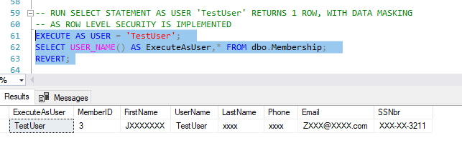
Azure SQL Database

Slide 47
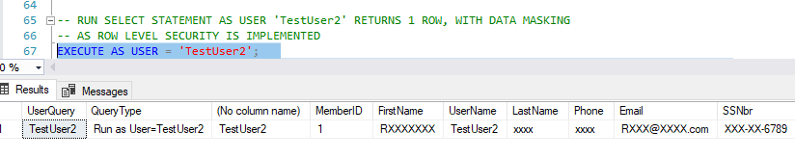
Azure SQL Database

Slide 48
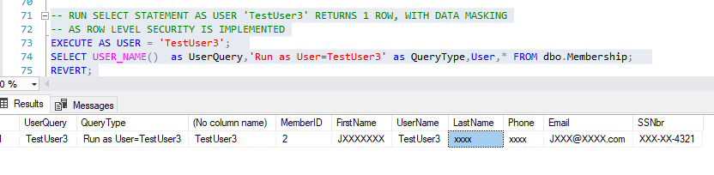
Azure SQL Database

Slide 49
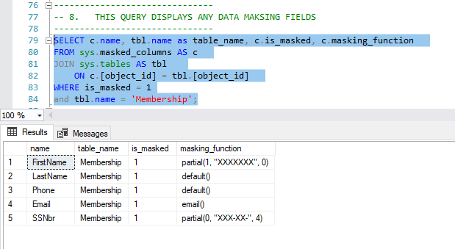
Azure SQL Database

Slide 50
Summary
Data Governance
Azure SQL DB Security
Azure SQL Data Masking
Azure SQL Row Level Security
Notes:
26

Slide 51
Jon Bloom
jbloom@pragmaticworks.com
https://pragmaticworks.com/

