Slide 1

Preparing for DA-100
Steven Wise
Consultant, Pragmatic Works
August 25, 2020

Slide 2

About the Presenter
Steven Wise
Consultant @ Pragmatic Works
Power BI user for 5 years
Came into data from the excel pathway
swise@pragmaticworks.com
Certifications:
MCSA: BI Reporting
DA-100: Data Analysis with Power BI
Notes:
Previous experience was all Excel-based (starting in 2012) – self taught (thanks Youtube).
Speak about journey from non-data person to data consultant (maybe some audience members are looking to make the same leap).
When did I take each test (February for 70-778 and July for DA-100)

Slide 3

Outline
What is DA-100
Should you take DA-100?
How much preparation will you need?
What material is covered?
What study materials are available?
What is the examination format?
Practice Questions
Next Steps

Slide 4
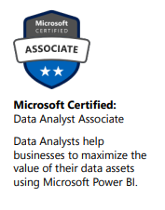
What is DA-100?
“Analyzing Data with Microsoft Power BI”
Role-Based Certification/exam offered by Microsoft
Specific to using Microsoft Power BI in the capacity
of a data analyst.
Next generation exam for
70-778: Analyzing & Visualizing Data in Power BI (retiring Jan 2021)
‘Equivalent Certification’ for MCBA: BI Reporting (Excel + Power BI) also retiring Jan 2021
Considered the main certification pathway for individuals wanting to demonstrate proficiency with Power BI.
Notes:
Exam and certification are one in the same.
It’s an exam – a badge – and at most a qualification that you are appropriately proficient in your understanding of Power BI

Slide 5
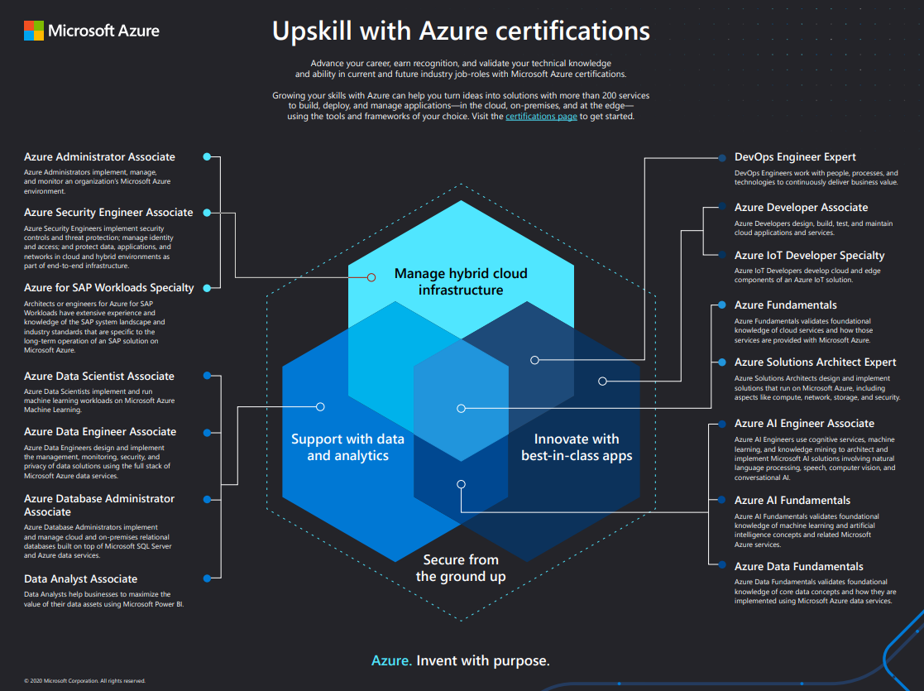
What is DA-100?
Part of the landscape of Azure based certifications
It is not a prerequisite or part of another large certification pathway.
https://query.prod.cms.rt.microsoft.com/cms/api/am/binary/RE4wyqh
Notes:
Take a moment to review where this certification sits in the larger landscape of azure products.

Slide 6
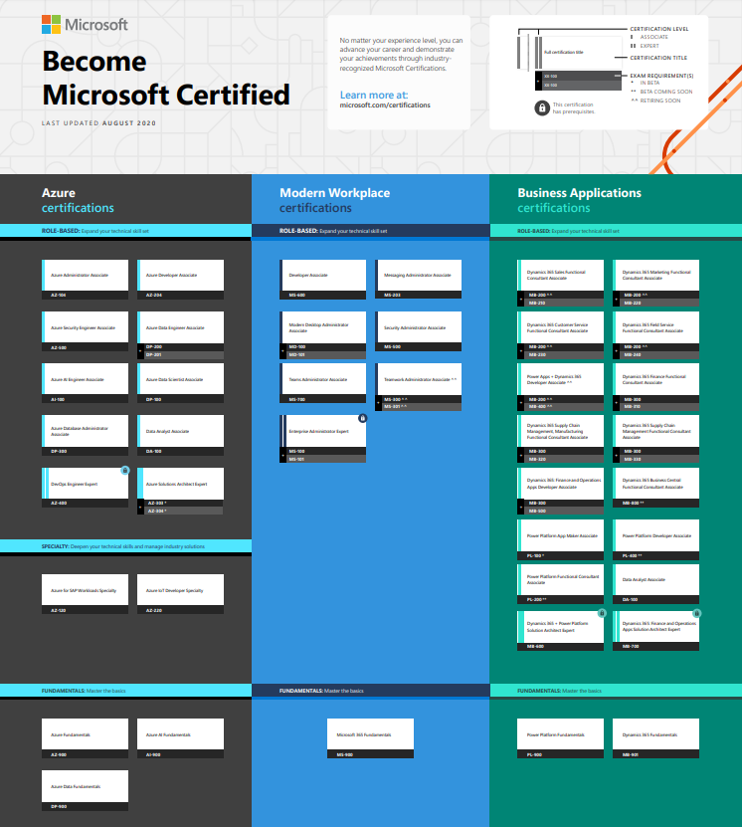
What is DA-100?
Stand-alone role-based certification
  1 Exam
Falls in the Power Platform family of skills
  Power BI
  Power Automate
  Power Apps
http://aka.ms/TrainCertPoster
Notes:
Sits under both Azure and Business Applications categories.
Some certifications require two exams (as the previous MCSA BI Reporting once did).
A partial prerequisite could be Power Platform fundamentals -

Slide 7
Should you take DA-100?
Associate Level Exam - which assumes some Power BI experience
It is not a ‘requirement’ for most Power BI jobs – although certifications ‘can’ help you stand out
Must be renewed every 2 years
Cost $165
Notes:
Earning this certification doesn’t suddenly thrust open the doors of companies hiring for Power BI developers.
Paper-smart should be paired with experience – there’s an expectation that if you take that job – you know what you’re doing

Slide 8
Should you take DA-100?
Are you currently using Power BI?
Are you interested in validating your Power BI knowledge?
Are there incentives at your job for earning certifications?
Are you trying to transition to a Power BI specific job?
Do you have an expiring MCSA: BI Reporting certification?
Yes
Yes
Yes
Yes
Yes
Notes:
The path to certification is unique for each person. In some circumstances – it may not make sense to take the test at this moment.
You must come to an understanding of your purpose with this exam – so here are some common scenarios where taking the test may be prudent

Slide 9



How much preparation will you need?
Better get practicing
Time studying / Reviewing
Just go take it!
Time developing solutions with Power BI
Notes:
This seems pretty-straight forward.
Exams are not built to be easily passed if you have limited experience with the program.

Slide 10
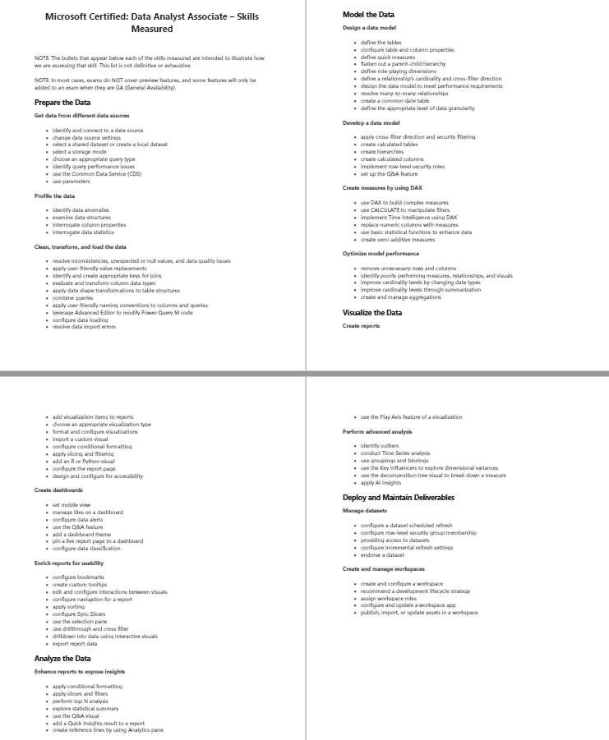
How much preparation will you need?
There are no ‘official’ released exams to use as a ‘pre-test’
Review the skills card provided by Microsoft: https://query.prod.cms.rt.microsoft.com/cms/api/am/binary/RE43KLw
Highlight skills that you may not have at mastery – this will help get started.

Slide 11
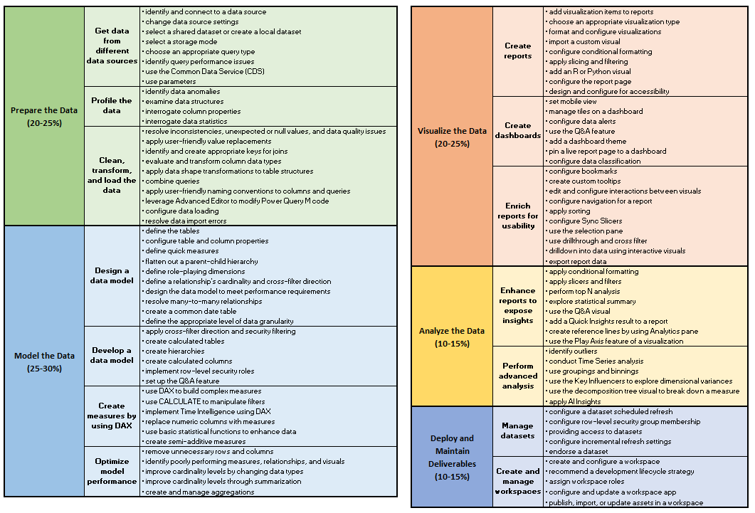
What material is covered?
Notes:
Pause to reflect on this list of topics – and their general weight to the whole exam.

Slide 12
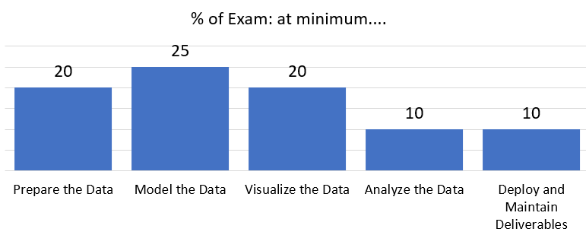
What material is covered?
List of topics is not definitive or exhaustive
Preview features will NOT be covered (added after GA)
Exam questions are representative of the full suite of Power BI capabilities.
Notes:
At minimum – this should help direct your preparation – some areas have more weight on content than others.

Slide 13
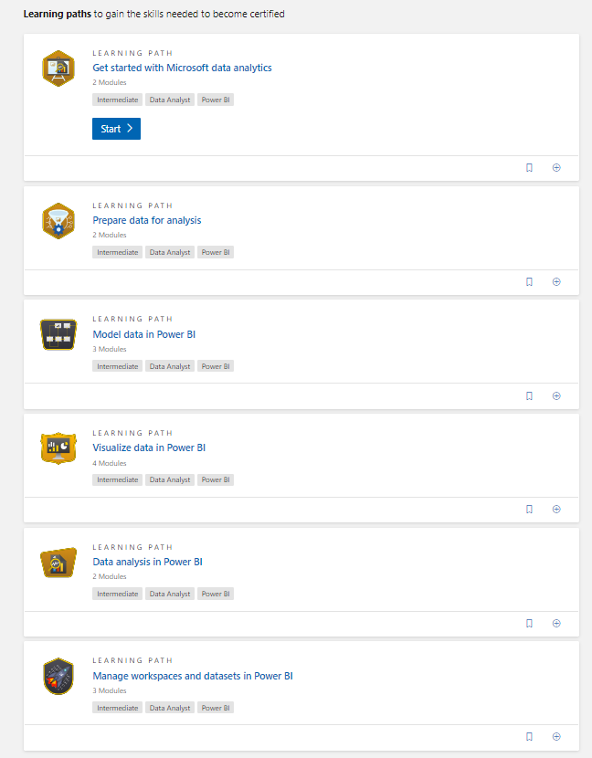
What study materials are available?
Microsoft offers
  Online Free Learning Path →
  Instructor Led ($$) class by learning partners
DA-100 Prep Courses
  BIElite, Udemy, Coursera, etc
“Released” exams questions
Avoid ‘question dumps’
Notes:
Microsoft makes the exam – created the study material – and created the product (Power BI). Staying close to the source will likely have to best overall impact.

Slide 14
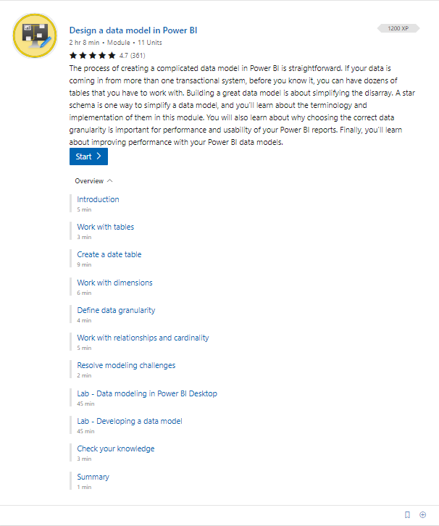
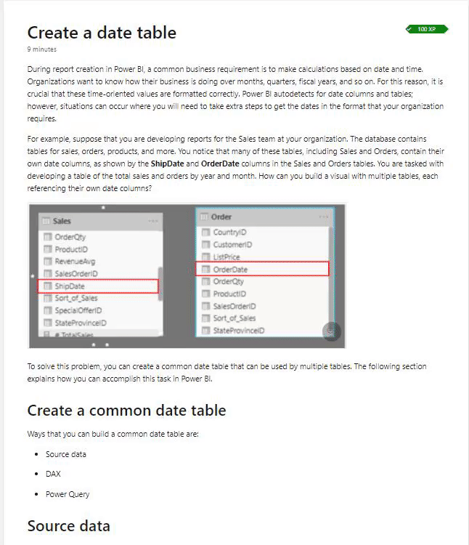
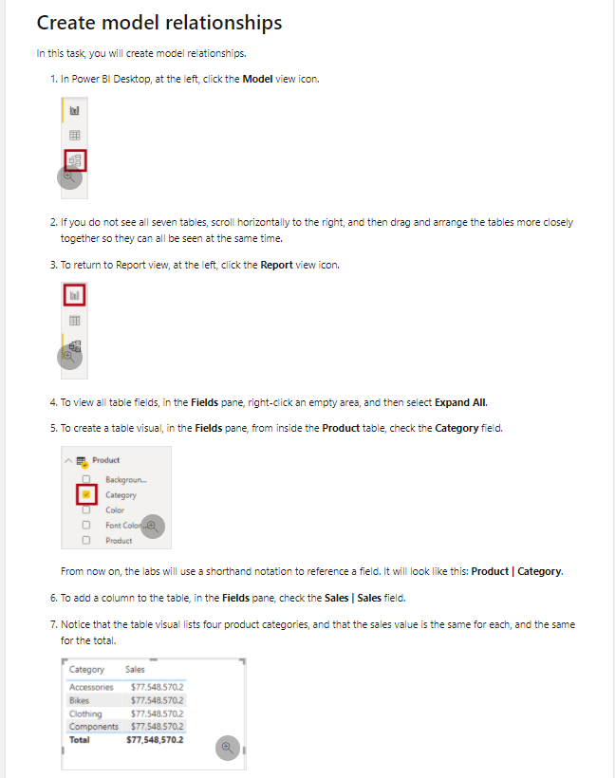
What study materials are available?
Learning Path:
Step by step labs

Slide 15
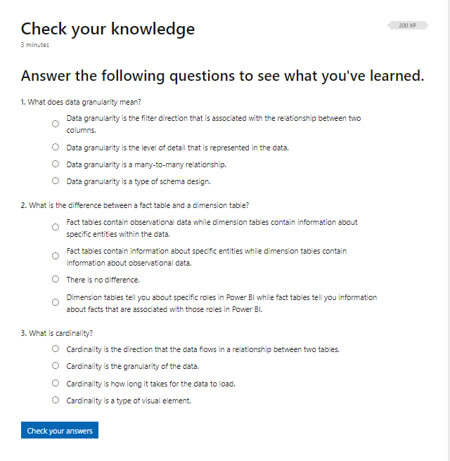
What study materials are available?
Learning Path:
Not representative of
actual exam questions

Slide 16
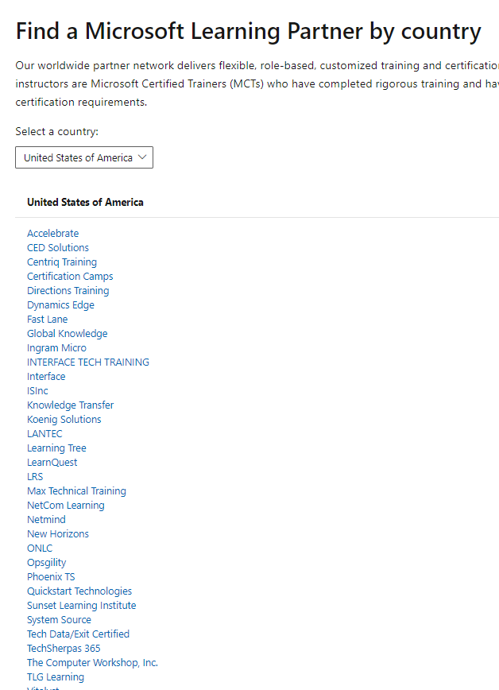
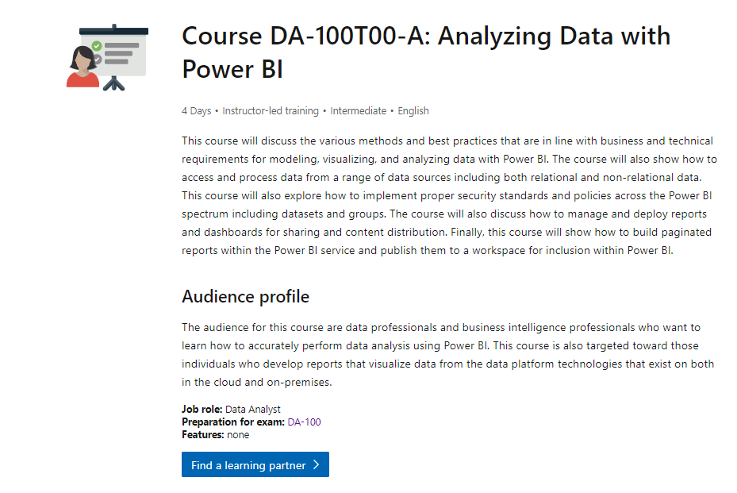
What study materials are available?
Instructor Led:
$1600!!!
Notes:
This is very expensive!
Some people prefer to learn in a ‘classroom’ setting. (Perhaps your organization is willing to cover the cost of training).

Slide 17
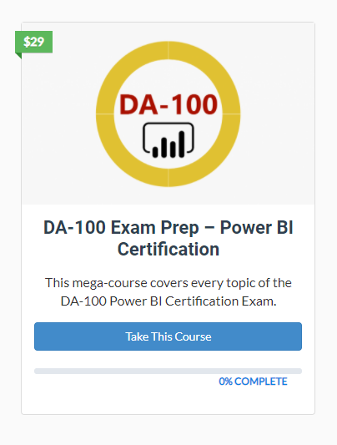
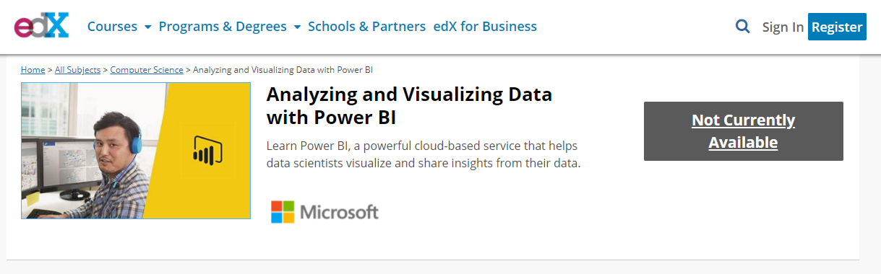
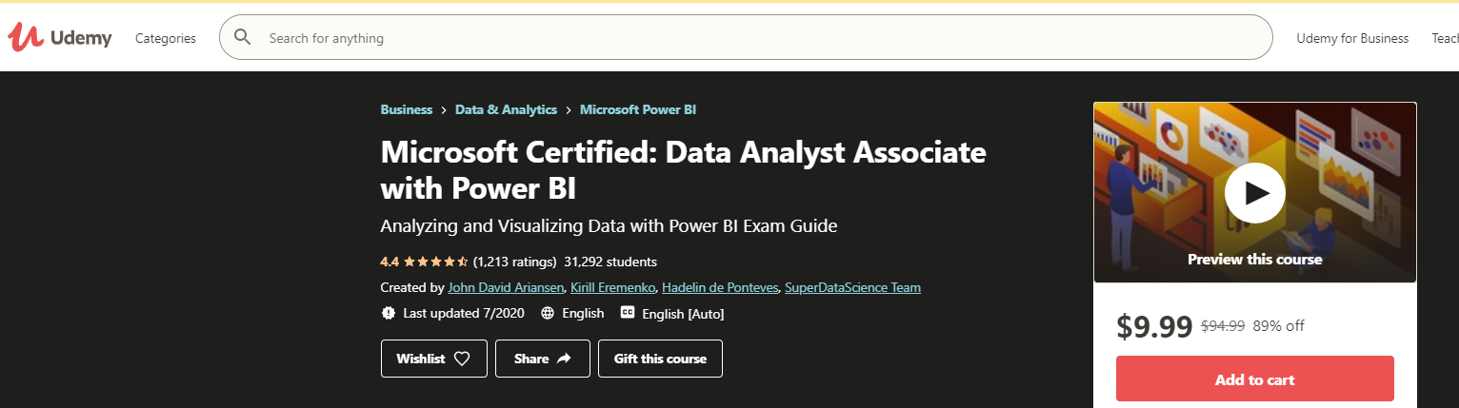
What study materials are available?
DA-100 Prep Courses – built specifically for this exam
https://training.bielite.com/
Notes:
Make sure to check the reviews if you go through a program like Udemy – some are very poorly rated – and were created more as a cash grab – then genuine support.
Parker Stevens with BI Elite is well-known in the industry and has curated plenty of content – specific to preparing for this exam.

Slide 18

What is the examination format?
~58 Questions
180 minutes (3 hours)
Computer-based (Test @ home OR at a testing center)
Passing score is 700
Will receive results immediately upon completion
  Includes a category breakdown
Notes:
Briefly talk about experience with at-home testing/proctoring

Slide 19
What is the examination format?
Question Types
Case Studies
  These are multiple questions based on a detailed business scenario with stated requirements and described data. You must make a recommendation based on the known information. (Lots of back-and-forth - no computation)
Drag & Drop
  Put in Order (how to do certain actions in PBI)
  Fill in the Blank (Basic DAX, m-query, time intelligence)
Multiple Choice
Multi-Select
  More than 1 correct answer (maybe)

Slide 20
What is the examination format?
Scoring
  You are awarded points for every correct answer – and part correct ‘parts’ in questions that have multiple components.
Question Delivery
  Started with 2 Case Studies: (each with ~4 or 5 questions)
  Everything else
  Unable to return to case studies once complete
You do not actually use Power BI in the exam (practicum)
Score Report

Slide 21
*Practice Questions*
Sorry!
Be wary of sites claiming to have exam questions from this test, especially if they are requiring you to ‘pay’ for it.
Generally – no one in the Power BI community is putting these things out there. (NDA)
Comments about 70-778 vs DA-100
Notes:
Compare experience taking 70-778 versus DA-100
70-778 was more theory driven - way more DAX in previous assessment

Slide 22
Next Steps
Start with the Learning Pathway
Create solutions within your domain of influence
Practice and grow
So now what?
Novice / Beginning with Power BI
Evaluate yourself on the skill checklist
Review and fill in missing areas
If desired – take the exam
Intermediate with Power BI
You will likely pass without any prep
Pro

Slide 23
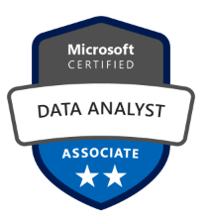
After Earning your…

Slide 24
Have Any Questions?

