Slide 1


Your First Notebook on Azure
Steve Hughes
Director of Consulting, West
August 4, 2020

Slide 2






About Steve
Director of Consulting, West Region
20+ Years with SQL Server, Microsoft BI, and Azure
https://www.linkedin.com/in/dataonwheels/
shughes@pragmaticworks.com
Blog: www.dataonwheels.com

Slide 3




Vision
Accelerate innovation by unifying data
science, engineering and business
Solution
Fast, easy, and collaborative Apache Spark based analytics platform optimized for Azure
Original creators of:
Who we are
3,500+ global companies use our platform
across big data and machine learning lifecycle
Notes:
Andreessen Horowitz
Our company’s goal from its inception almost 5 years ago was to truly help companies Accelerate their innovation cycles by bringing together and unifying DS, DE and business for the outcomes they want…
Our charter from the beginning is not only to Demystify the challenges that surround those areas, but to also Democratize the Data and the Science to allow customers… and not just the 1% companies (Uber/ FB, Netflix and others) to use this platform for a distinct business advantage.
We deliver our unified platform as a managed service in the cloud
We are the foremost experts in doing this…notably our founders are the six guys who created the Spark engine….which was the first unified engine for processing both Big Data and ML….and has become the de-facto OS standard in the industry. Databricks has industrialized spark exponentially and built an entire Secure Enterprise Platform that meets the needs of the modern enterprise.
mention customers, what we do etc. right now it is just a list of projects.

Slide 4
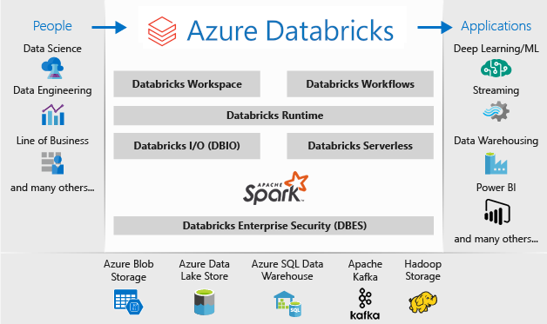
Source: https://docs.microsoft.com/en-us/azure/databricks/scenarios/what-is-azure-databricks

Slide 5
Today’s Plan
What you need: Pay-as-you-go Subscription
  You cannot create a Databricks service in a free account (exceeds core limit)
  You can use your Visual Studio Subscription Azure Credits
Plan for the day
  Add Azure Databricks to Your Subscription
  Review the Workspace
  Set up the cluster
  Manipulate some data
  Create visualizations if we have time
Magic Commands
%python – use Python
%r – use R
%scala – use Scala
%sql – use SQL statements
%sh – use BASH
%fs – Databricks Filesystem
%md – markdown
%run – run different notebook

Slide 6
Have Any Questions?
The notebook will be available with my blog post later this week.
https://www.dataonwheels.com

