Slide 1
Creating Custom Visuals in Power BI
With Tom Ward
App Development Consultant at Pragmatic Works

Slide 2
Custom Visuals in Power BI
Create custom data visualizations from scratch using TypeScript
Test / Debug your visuals online using live reports
Package / Deploy Deploy your visual to a production report
Learn more at: https://powerbi.microsoft.com/en-us/developers/custom-visualization/

Slide 3
Creating a New Custom Visual
Ensure you have node installed on your machine
Run commands: npm i –g powerbi-visual-tools pbiviz new demoproject pbiviz start
To debug go to app.powerbi.com, create a new report and add the developer visual to the report

Slide 4
Developing Custom Visuals using React
Within project folder run:
npm install react react-dom
import * as React from ‘react’;
import * as ReactDOM from ‘react-dom’;
Create a reactRoot element in the visual.ts
private reactRoot: React.ComponentElement<any, any>;
Create the DOM element
this.wrapper = document.createElement("div");
Create the element
this.reactRoot = React.createElement(ComponentName, {props});
Add the element to the DOM
ReactDOM.render(this.reactRoot, this.wrapper);

Slide 5
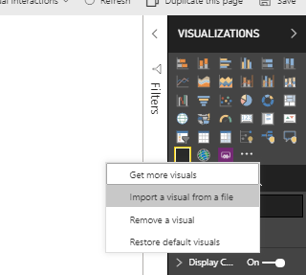
Package & Deploy
Set your project / author details in the pbiviz.json file
Run pbiviz package
Import custom visual into Power BI via the .pbiviz file
Select the visual & add data / configure settins

Slide 6
Modifying Existing Visuals
Modifying an existing custom visual allows you to leverage an existing project so there’s no need to start from scratch
Microsoft’s team makes their custom visual source code publicly available on GitHub
Custom Visuals provided by Microsoft can be found at https://github.com/Microsoft/

Slide 7
Thanks for joining me!

